Slide 1
We can do it together!
Interview to:
Mr. Angelo Ogbonna.

Slide 2
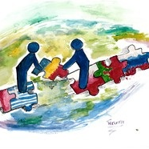

Slide 3
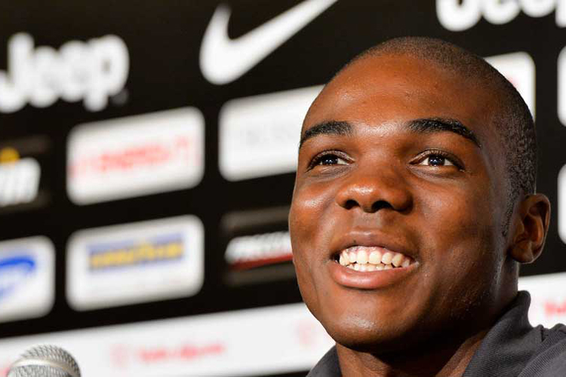
Students: “Goodmorning Angelo, we’re five students of Liceo Classico G. Carducci of Cassino. We’d like to ask you some questions about your life and about the change which it underwent for your dream.”
Mr. Ogbonna:
“Hello students, I’m plased to answer your questions.”

Slide 4
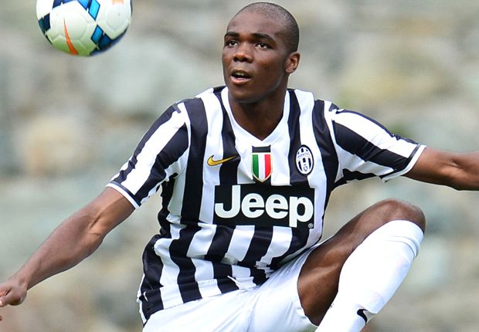
Students: “Let’s go! What does football mean for you? Is it important?”
Mr. Ogbonna:
“Football is my passion, my dream came true, my life! Since I was a child, I loved playing football, now it’s my job!”

Slide 5
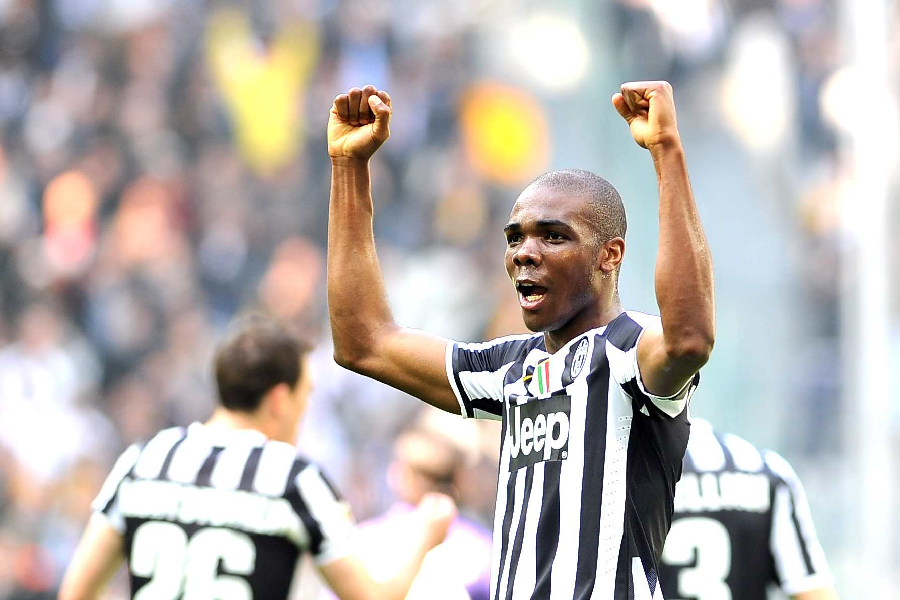
Students: “How did you become so famous? Was it difficult?”
Mr. Ogbonna:
“Well, I worked a lot, it was hard but I arrived here and I became famous thanks to my parents help too!”

Slide 6
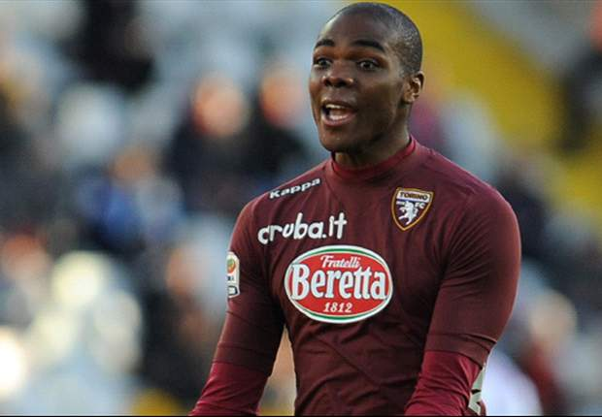
Students: “What did your parents do for you?”
Mr. Ogbonna:
“My parents helped me, we faced every problem together.”

Slide 7
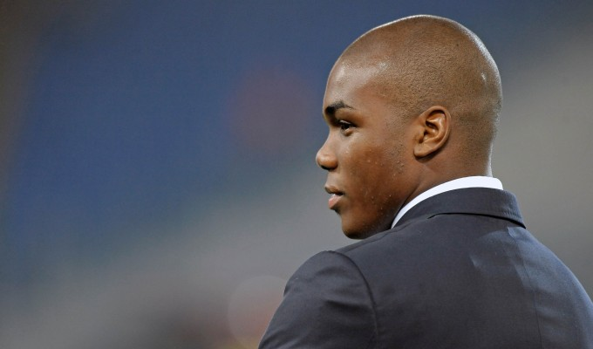
Students: “When did you start playing?”
Mr. Ogbonna:
“My mother took me to a football school wen I was six, because I was a very lively child. When I was thirteen I left Cassino to follow my dream and I went to Turin.”

Slide 8
Students: “Do you think culture is important also for football?”
Mr. Ogbonna:
“Sure! My job gave me away much time, but anyway a continue to attend the university. I started studying in my city (Cassino), a spent my childhood there. I attended a private school St. Maria delle Grazie. I received a good education so I didn’t have any problems in my Media School Gaetano Di Biasio. Then I continued studying in Turin.

Slide 9
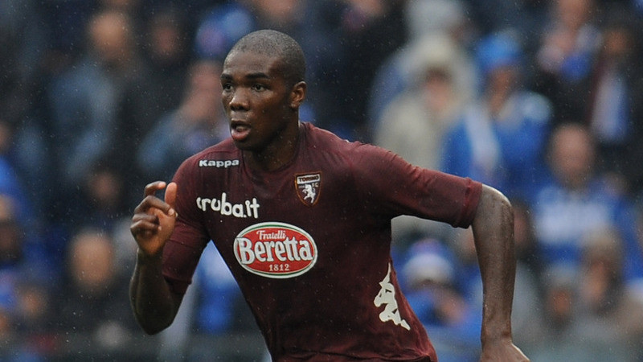
Students: “Did football help you with your problems ?”
Mr. Ogbonna:
“Football is like music: sometimes it makes you happy, sometimes it pulls you down. Sport helps every guy because it’s important for your education. It presents the same problems that life presents you every day.”

Slide 10
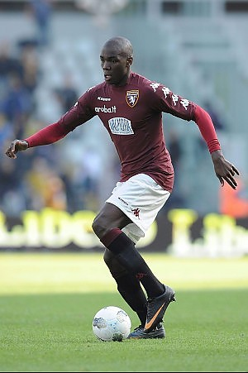
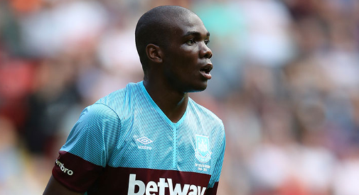
Students: “Are you satisfied?”
Mr. Ogbonna:
“No, I’m not. I’m happy to be famous for my job but I think I can do better, so I will continue to work a lot."

Slide 11
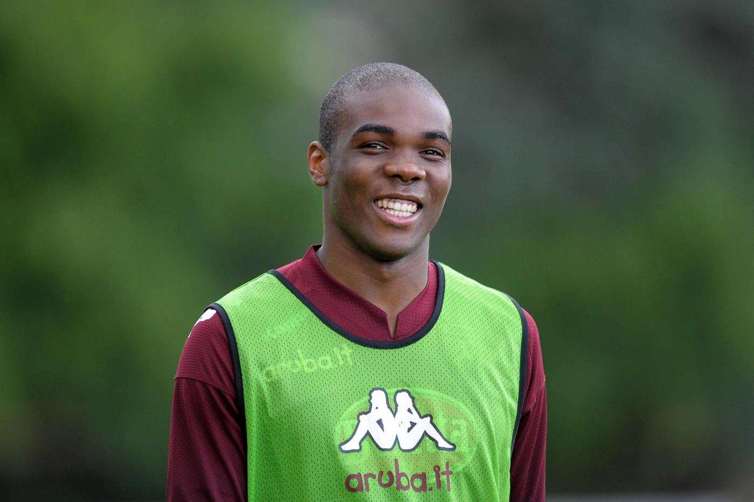
Students: “What do you tell us, today guys?”
Mr. Ogbonna:
“I tell you just one thing: follow your dreams!
Don’t listen to who tells you it’s impossible. This is your life…
SO WORK HARD!”

Slide 12
Work done by:
-Falco Alessandra IC
-Nardone Dorothea IC
-De Luca Marco Italo IE
-Angela Di Raddo IA
-Federico Macrì IA

