Slide 1
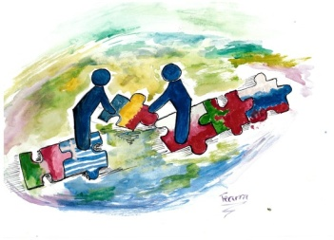
Polish National Day
May 3rd

Slide 2
Kacper Jaszczuk

Slide 3
3rd May National Holidayis a Polish national and public holiday that takes place on 3rd May. The holiday celebrates the declaration of the Constitution of May 3, 1791.

Slide 4
May 3rd Constitution, by Matejko

Slide 5
The Constitution of May 3, 1791 is considered one of the most important achievements in the history of Poland, despite being in effect for only a year, until the Russo-Polish War of 1792. Historian Norman Davies calls it "the first constitution of its type in Europe"; other scholars also refer to it as the world's second oldest constitution.

Slide 6
The May 3rd Constitution was designed to redress long-standing political defects of the Polish–Lithuanian Commonwealth. The Constitution sought to supplant the existing anarchy fostered by some of the country's magnates with a more democratic constitutional monarchy.

Slide 7
Celebrations
May 3 was first declared a holiday on May 5, 1791, and celebrated a year later, on May 3, 1792.
Banned during the partitions of Poland it was celebrated in the Duchy of Warsaw in 1807.
It was again made an official Polish holiday in April 1919.
The May 3 holiday was banned once more during World War II by Nazi and Soviet occupiers

Slide 8
May 3 was restored as an official Polish holiday in April 1990, after the fall of communism.
In 2007, May 3 was also declared a Lithuanian national holiday; the first joint celebration by the Polish Sejm and the Lithuanian Seimas took place on May 3, 2007.

Slide 9
In modern Poland, this day, free from work, sees many parades, exhibitions, concerts and public figure speeches.

Slide 10
May 3 parade in Łódź, Poland, 2010

Slide 11
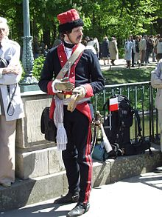
Polish cavalryman in traditional dress uniform during the celebrations of May 3, 2007

Slide 12
3rd May 2016, Lublin

Slide 13
Most important Polish politicians participate in those festivities; for example in 2011 President of Poland, Bronisław Komorowski, Prime Minister of Poland, Donald Tusk, and Marshal of the Sejm, Grzegorz Schetyna, Marshal of the Senate, Bogdan Borusewicz, and Minister of National Defence, Bogdan Klich, took part in the festivities in Warsaw.

Slide 14
The official festivities in Warsaw or in other Polish cities in the presence of the President and important dignitaries would include flag flying, cannon salvos, reading of the constitution preamble, and singing a patriotic song from the November Uprising, Witaj, majowa jutrzenko (Welcome, May Dawn) plus drill shows and the annual military parade.

Slide 15
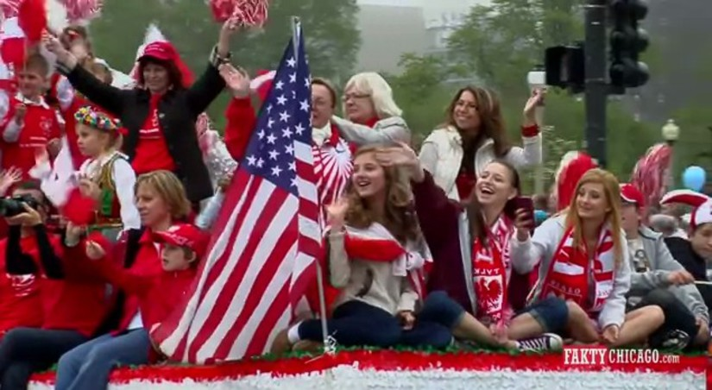
The holiday has been a focal point of ethnic celebrations of Polish-American pride in the Chicago area, where it is known as Polish Constitution Day, since 1892.

