Slide 1
Gisela João
AGRUPAMENTO DE ESCOLAS DO FUNDÃO
Rita Almeida nº20
Sara Salvado nº21
9ºB

Slide 2
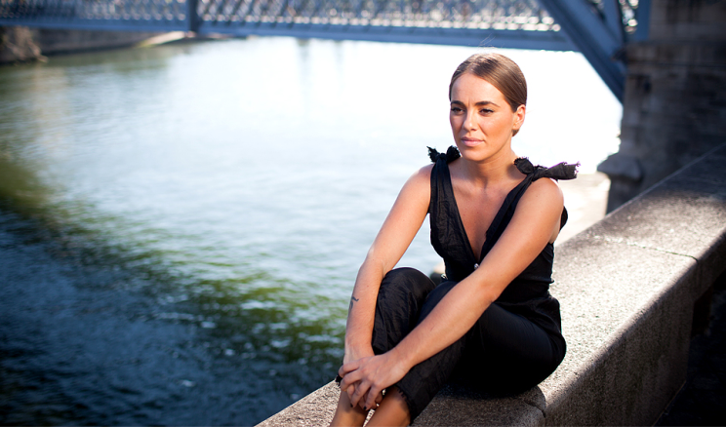
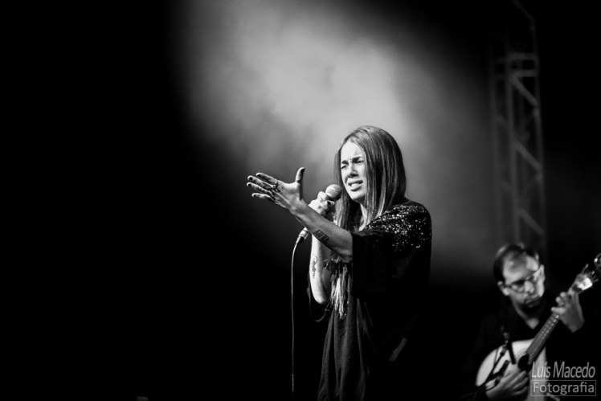
Gisela João
Gisela João is a younger and renowned portuguese singer, she was born in Barcelos, in 1983. She lived for many years in Porto, but in 2000 her passion for music made her move to Lisbon.

Slide 3
Gisela João
In 2009, Gisela participated on Fernando Alvim’s disco “Fados e as Canções do Alvim”. In 2012 she was considered one of the greatest female revelations on portuguese fado, of the latest years.

Slide 4
Her work
In 2013, Gisela produced her first album which was considered the best nacional album of the year and that made her win te prize Revelação Amália.

Slide 5
Her achievements
In May, 2014, she won a Golden Globe in the category of Best Individual Interpert, in SIC Caras’ ceremony. She was also awarded the prize José Afonso 2014, in which the jury considered that Gisela is “the best voice that has appeared after Amália”, the most important voice of portuguese fado.

Slide 6
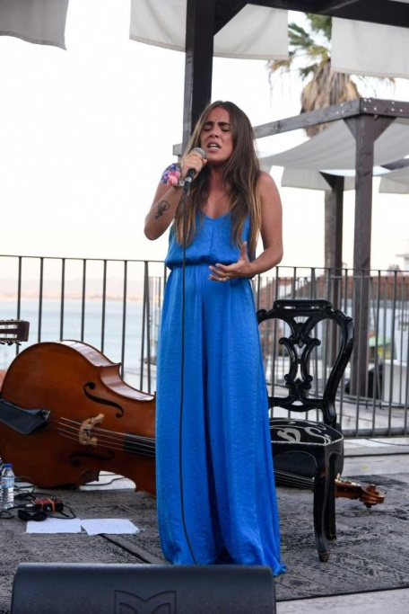
Her work
In July 2015, Gisela was invited to participate in the tribute album of Amália Rodrigues, “Amália: as Vozes do Fado”, with the participation of some of the most iconic artists of portuguese music .

Slide 7
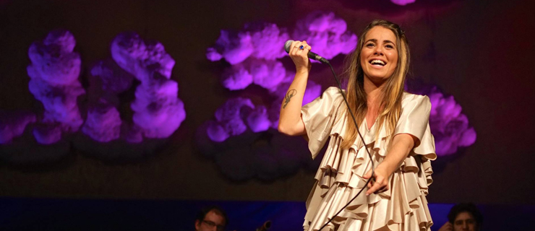
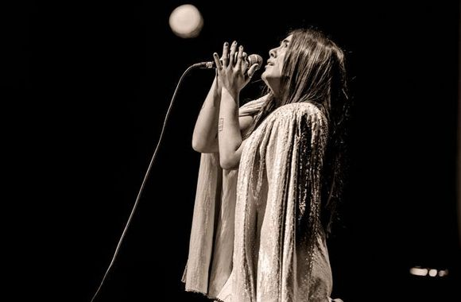
Her work
Last year, Gisela acted on stages in France, USA, England, Belgium, Spain, Switzerland, Slovenia and Germany.

Slide 8
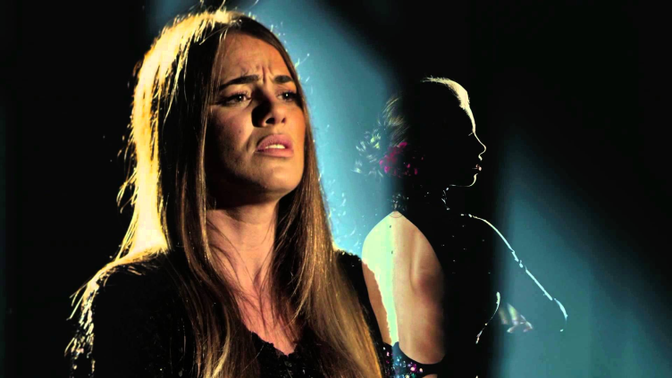
a
Gisela continues to sing and charm Portugal and the world.
Some of her songs are already part of soundtracks of portuguese films and soap operas. Some examples are:
Coração d’Ouro
Casa de Mariquinhas
Meu amigo está Longe
Madrugada sem Sono

