Slide 1
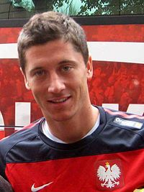
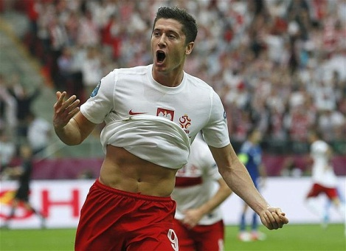
Robert Lewandowski

Slide 2
The Great Polish striker

Slide 3
The striker of Bayern Munich

Slide 4
Early Career
Lewandowski started his career at Varsovia, where as a teen he played for seven years.
The following year he moved to Delta Warsaw where he finally managed to play in the first team, scoring four goals.
In 2006–07, Lewandowski was the Polish third division's top goal scorer with 15 goals, helping Znicz Pruszków win promotion

Slide 6
Lech Poznań
In June 2008, Lech Poznań signed Lewandowski from Znicz for 1.5 million złotys
. He made his debut for Lech in July 2008 as a substitute in a first round UEFA Cup qualifier versus Khazar Lenkoran from Azerbaijan. In that match, he scored the only goal of the match.

Slide 7
2010-11 Season
Following press speculation that Lewandowski might move to one of a number of clubs he joined Bundesliga club Borussia Dortmund in June 2010, signing a four-year contract with the German club for a fee reported to be worth around €4.5 million.
On 19 September, he scored his first goal in the Bundesliga to make it 3–0 in the Revierderby against Schalke 04; the game ended 3–1.

Slide 8
2011-12 Season
Lewandowski finished the year as the third top goal scorer with 22 goals, none from the penalty spot, and six assists.
In the final game of the season for Dortmund, he scored a hat-trick in the DFB-Pokal Final, a 5–2 win over Bayern Munich, to earn the club its first league and cup double. Lewandowski finished as the DFB-Pokal's top goalscorer, with seven goals from six games

Slide 9
Robert celebrating his 2011-12 season

Slide 10
2012-13 Season
He finished season with 24 league goals, one goal short of the Bundesliga's topscorer, Bayer Leverkusen's Stefan Kießling.
On 24 April 2013, Lewandowski became the first player to score four goals in a Champions League semi-final as Borussia Dortmund defeated Spanish champions Real Madrid 4–1 in the first leg at BVB's Westfalenstadion. On 25 May, he played in the 2013 UEFA Champions League Final in which Borussia were defeated 2–1 by Bayern Munich.

Slide 12
2013–14 season
Lewandowski ended the 2013–14 season as the top goalscorer in the Bundesliga with 20 goals.
He also scored six goals in the Champions League, as Borussia reached the quarter-finals
Lewandowski played his final match for Dortmund in the 2014 DFB-Pokal Final against Bayern Munich on 17 May. Manager Jürgen Klopp had excused him from some training ahead of the final due to injury concerns; although Lewandowski played all 120 minutes of the final, Dortmund lost 2–0

Slide 13
2014-15 Season
In November 2013, Lewandowski confirmed he would sign a pre-contractual agreement for Borussia Dortmund's rivals Bayern Munich which officially happened on 3 January 2014; signing a five-year contract, joining the team at the start of the 2014–15 season.
With 17 goals in 31 games, Lewandowski was joint-second top scorer of the Bundesliga season alongside teammate Arjen Robben, behind Eintracht Frankfurt's Alexander Meier.

Slide 15
2015-16 Season
Lewandowski's second season began with the 2015 DFL-Supercup on 1 August, with Bayern losing in a penalty shootout away to VfL Wolfsburg
On 22 September 2015, Lewandowski set a Bundesliga record by coming on as a substitute with Bayern trailing 0–1 to Wolfsburg and scoring five goals in 8 minutes and 59 seconds, the fastest by any player in Bundesliga history, to take a 5–1 lead. He also set Bundesliga records for the fastest hat-trick (three goals in four minutes), and most goals scored by a substitute (five). Lewandowski's five goals in nine minutes was also the fastest in any major European football league since Opta began keeping records, and it ended Wolfsburg's 14-match unbeaten run. He was awarded four certificates by Guinness World Records for this feat.

Slide 16
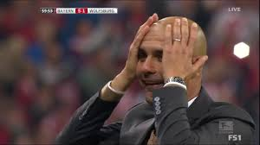

Slide 17
The end Prepared by Kacper Jaszczuk IIb

