Slide 1
Andrzej Sapkowski probably the most famous Polish fantasy author

Slide 2
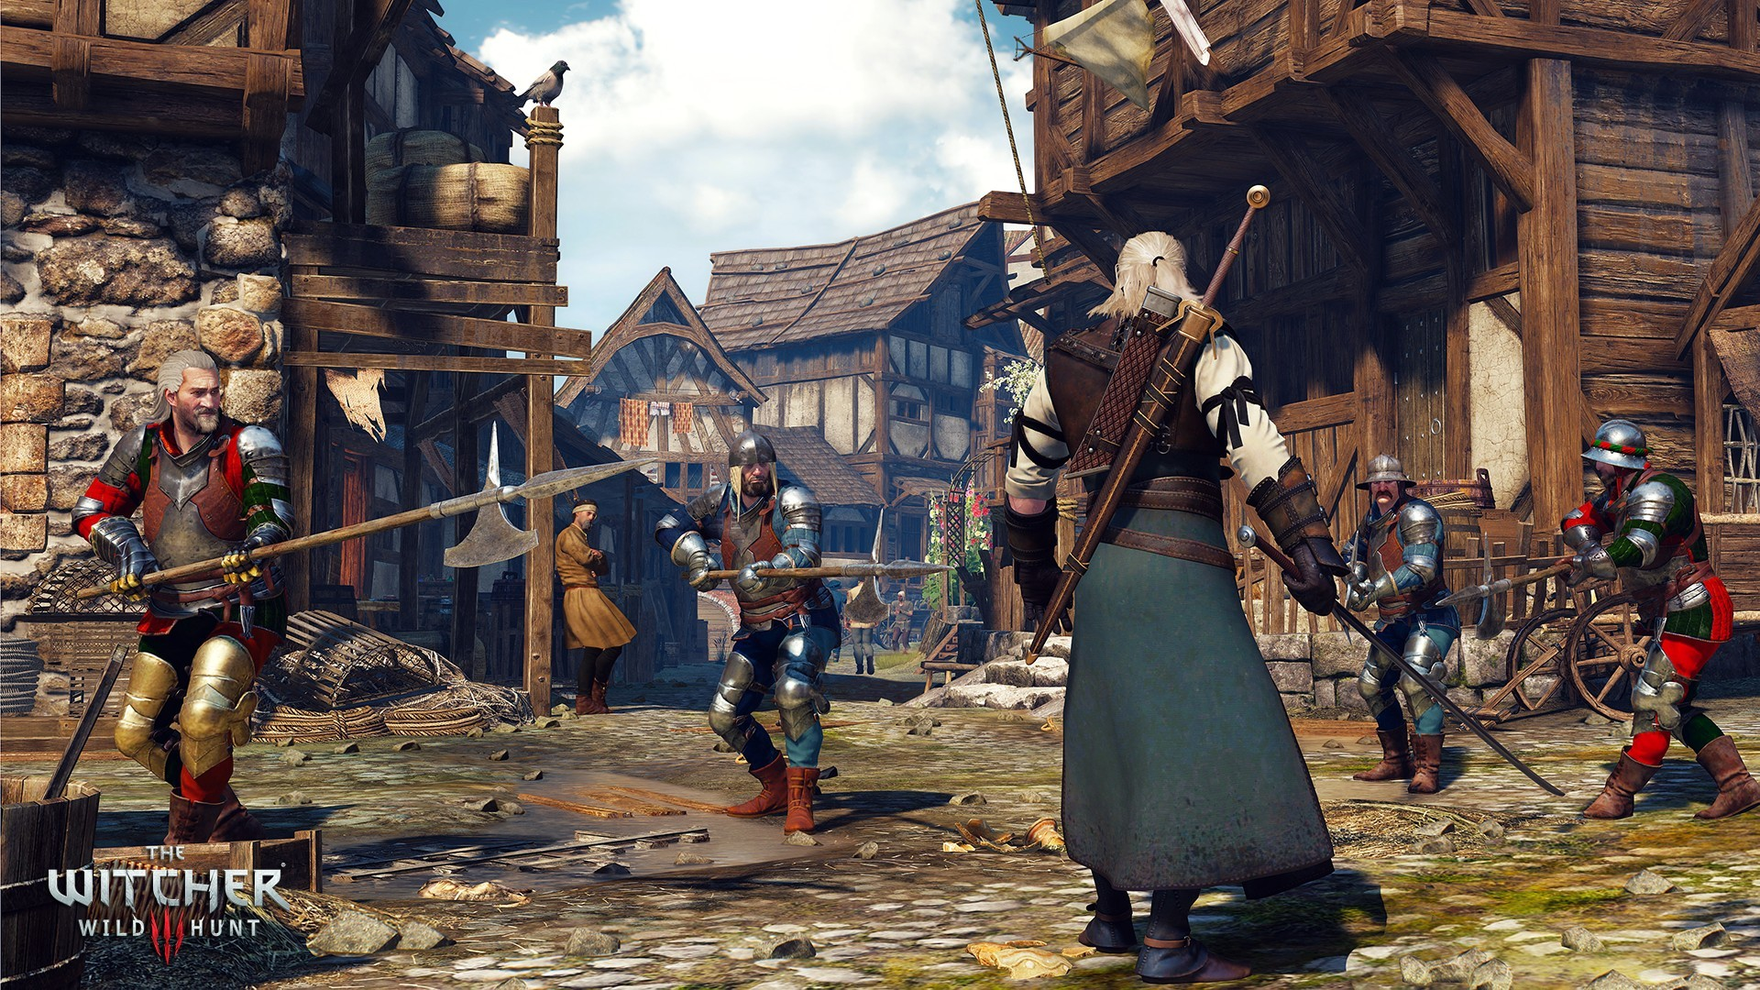

Slide 3
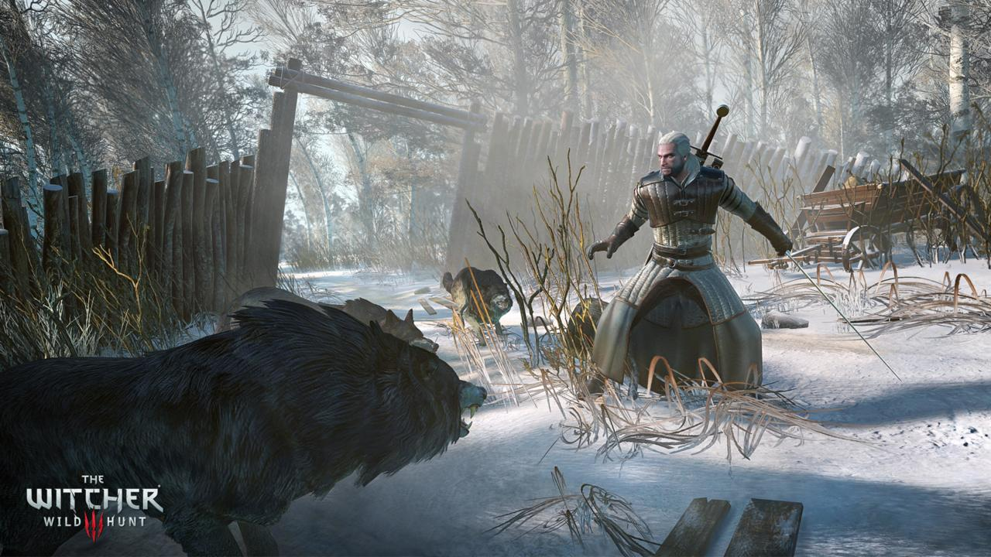

Slide 4
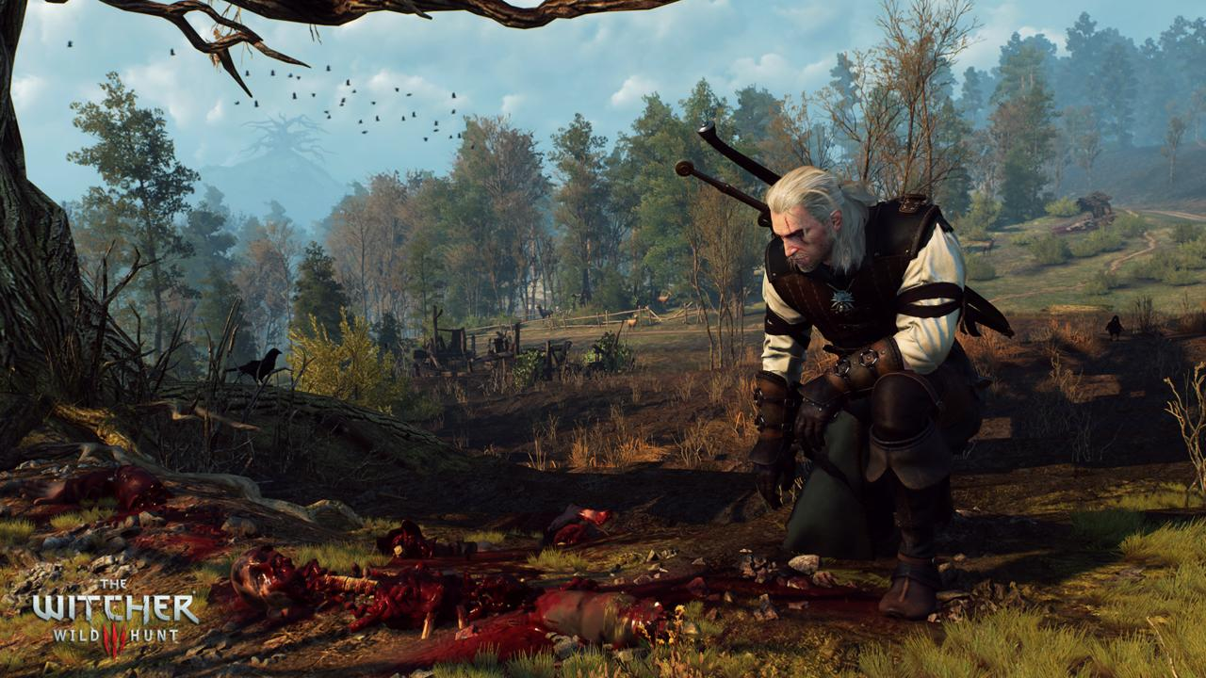

Slide 5
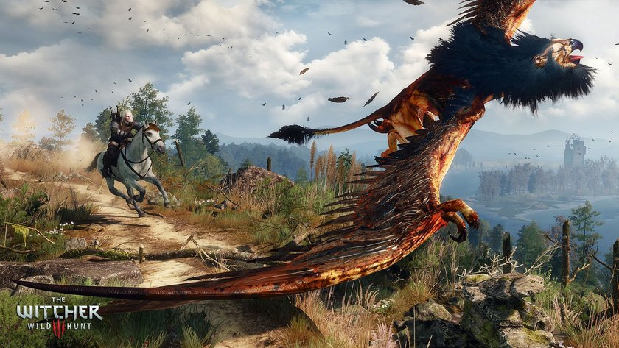

Slide 6
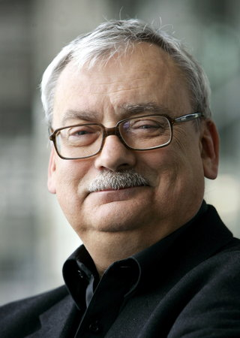
The Witcher - Creator
Do you know, what is it? It’s Witcher- the most famous Polish game in the Europe.The author of the world, the characters and monsters, which appear in this great game is Andrzej Sapkowski .

Slide 7
The Witcher - Books
Sapkowski has won five Zajdel Awards, including three for short stories "Mniejsze zło" ("Lesser Evil") (1990), "Miecz przeznaczenia" ("Sword of Destiny") (1992) and "W leju po bombie" ("In a Bomb Crater") (1993), and two for the novels, Krew elfów (Blood of Elves) (1994) and Narrenturm (2002). He also won the Spanish Ignotus Award, best anthology, for The Last Wish in 2003, and for Muzykanci (The Musicians), best foreign short story, same year.

Slide 8
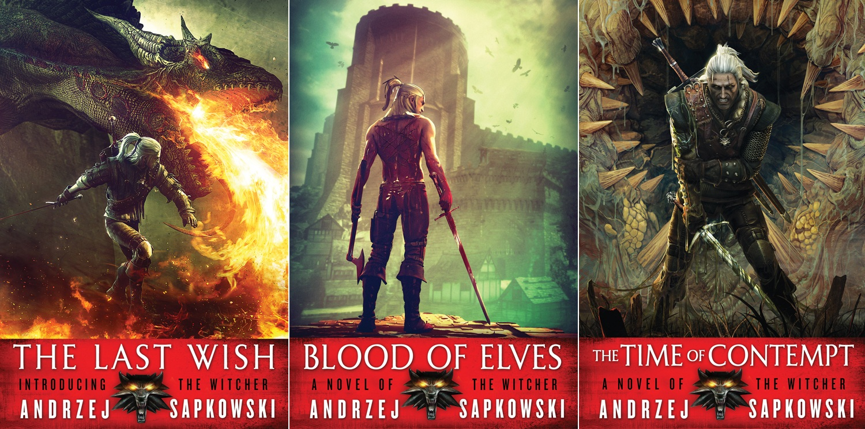
The Witcher - Books

Slide 9
The Witcher - Books
Sapkowski's books have been translated into Czech, Hungarian, Russian, Lithuanian, German, Spanish, French, Ukrainian, Portuguese, Finnish, Slovak, Bulgarian, Serbian, English, Italian, Dutch, Estonian and Swedish. An English translation of The Last Wish short story collection was published by Gollancz in 2007.From 2008, the Witcher saga is published by Gollancz. The English translation of Sapkowski's novel Blood of Elves won the David Gemmell Legend Award in 2009.

Slide 10
The Witcher - Games
The Polish game developer, CD Projekt RED, created a role-playing game series based on The Witcher universe. The first game, titled simply The Witcher, was first released in October 2007. The sequel, The Witcher 2: Assassins of Kings was released in 2011. The third and final game in the trilogy, The Witcher 3: Wild Hunt, was released in May 2015.

Slide 11
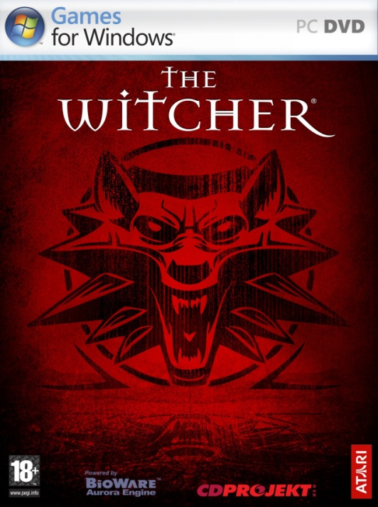
The Witcher - Games

Slide 12
The Witcher - Comic
There have been two series of comic books based on Andrzej Sapkowski's The Witcher series. The original series in 1993-1995 and a new one in 2011. A 6-issue series of The Witcher comic books based on Andrzej Sapkowski's witcher short stories was published in Poland in the years 1993-1995, written by Maciej Parowski and illustrated by Bogusław Polch. The next series is published by the American publishing house Dark Horse.

Slide 13
The Witcher - Comic

Slide 14
The Witcher - Movie
Wiedźmin (The Witcher in English) is a 2001 fantasy film by director Marek Brodzki, starring Michał Żebrowski as main character Geralt of Rivia. The story is based on the books and stories of The Witcher written by Polish author Andrzej Sapkowski.

Slide 15
The Witcher - Movie
The new movie adaptation of The Witcher will be spearheaded by producer Sean Daniel, who will work alongside Poland’s own Platige Films. Tomek Baginski, a Polish filmmaker best known for his Oscar-nominated animated short The Cathedral, will make his feature debut with The Witcher. Thania St. John, whose credits include episodes of Grimm, Eureka, and Roswell is writing the screenplay

Slide 16
Thank you for waching it! (Prepared by Julia Krzywicka)

