Slide 1
National Day Third of May

Slide 2
Polish national day celebrated 3rd of May to commemorate the enactment Constitution 3rd of May the Republic of Two Nations

Slide 3
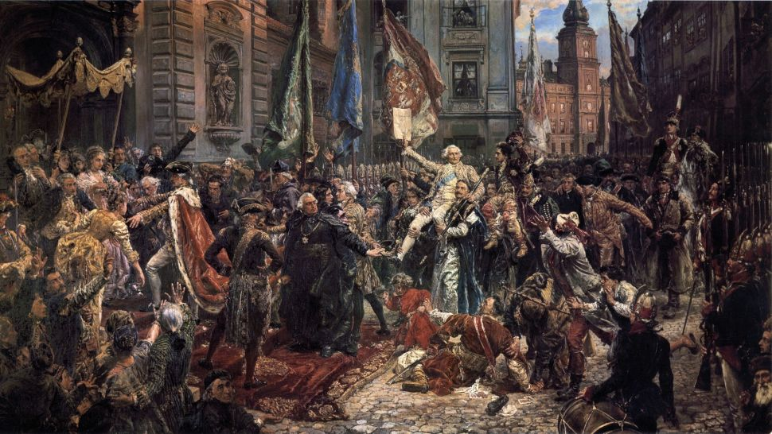
3rd May 1791 passed the first modern constitution in Europe and second in the world after the American. The Constitution was enacted by the Parliament of Great, which was convened in October 1788

Slide 4
During the celebration of the first anniversary of the Constitution 3rd of May 1792 in Warsaw focused around many military units, which were missing at the time of the Russian attack

Slide 5
After Poland regained its independence in 1918, anniversary of the Constitution 3rd of May was recognized as a national day

Slide 6
In 1946, the communist authorities banned the handling of this feast, and attempts demonstrations were suppressed by militias

Slide 7
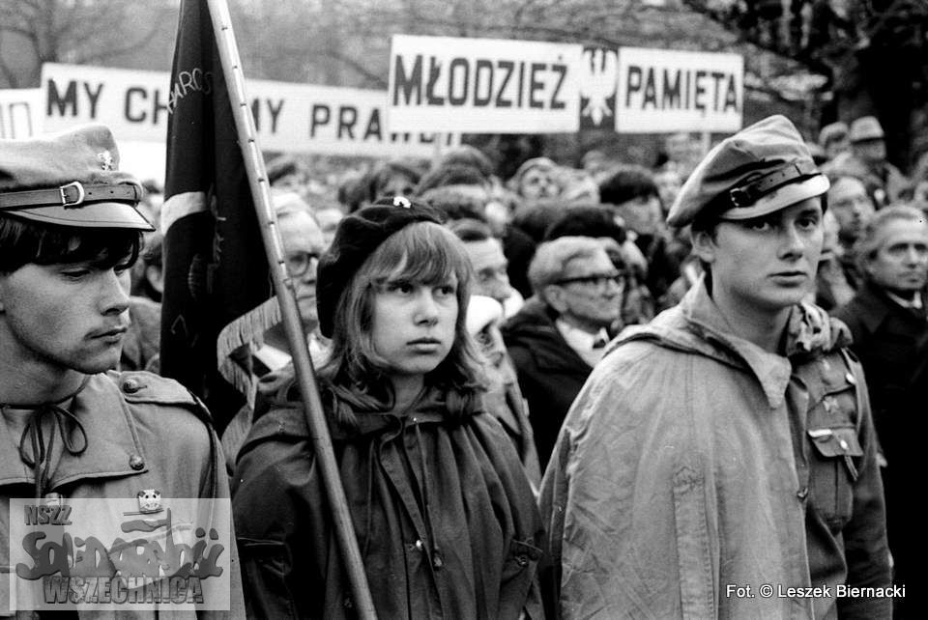
It was only in 1981 it was again recognized as the feast

Slide 8
Currently anniversary of the Constitution 3rd of May is celebrated through numerous academies, Mass in the church are also organized parades

Slide 9
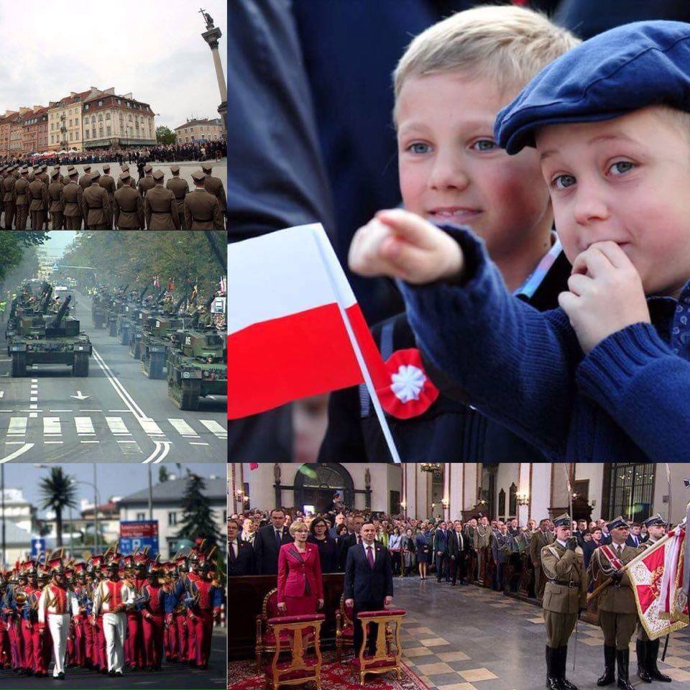

Slide 10
Thank you for your attention
Zuzanna Posturzyńska
☺

