Slide 1
Sport – my hobby

Slide 2
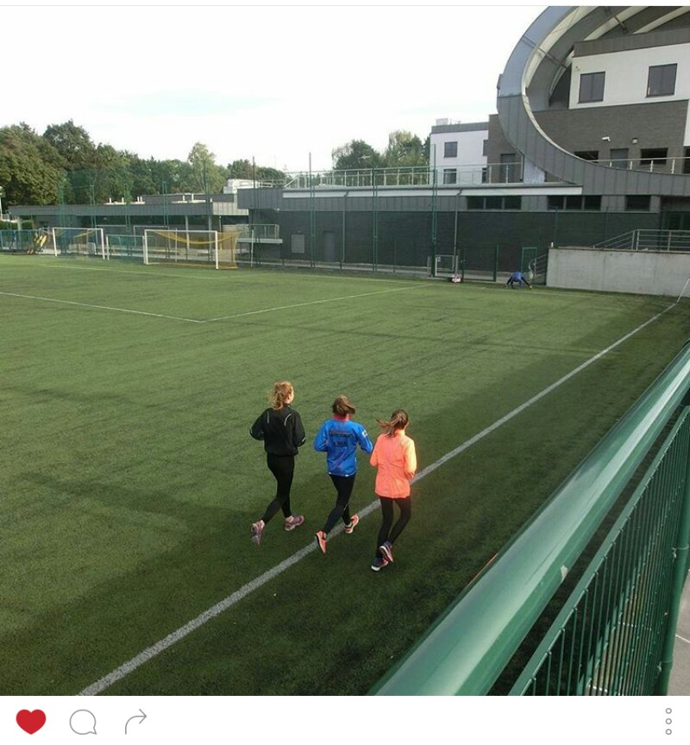
I train 3 times a week

Slide 3
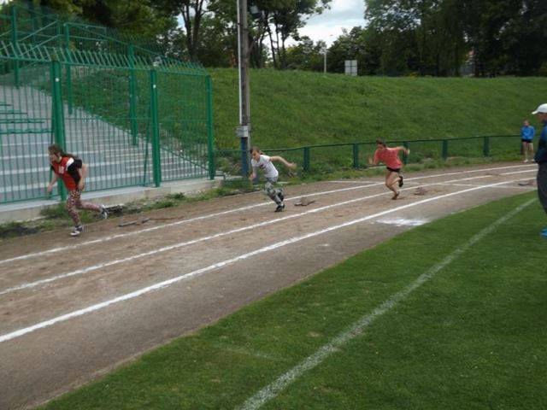
I participate in many athletic competitions

Slide 4
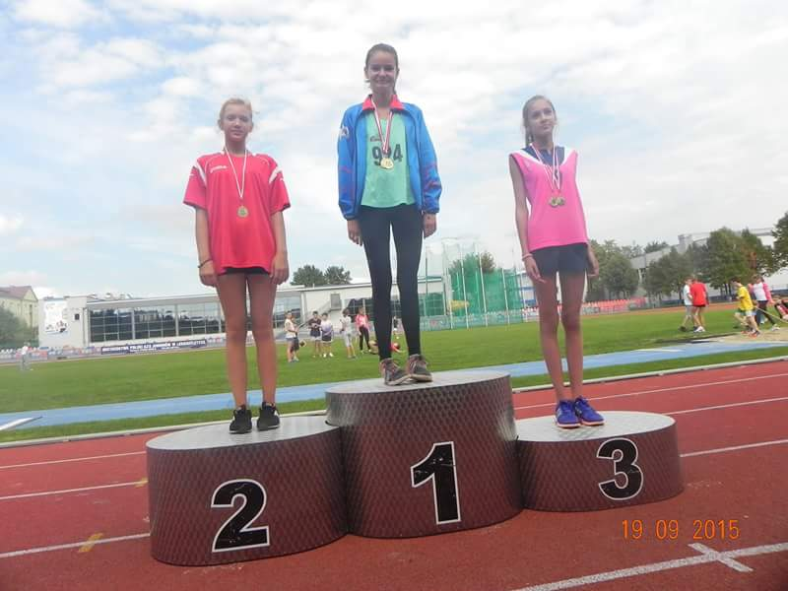
Thanks to the hard training I often manage to win

Slide 5
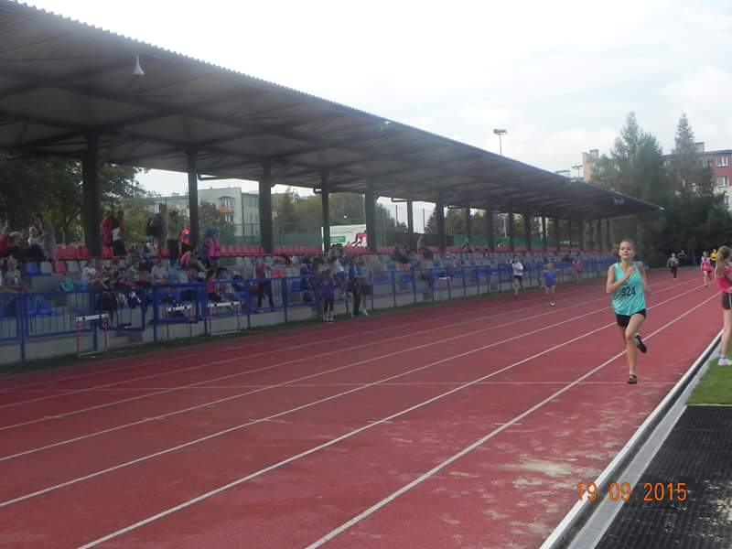
My favorite distance is 300 m

Slide 6
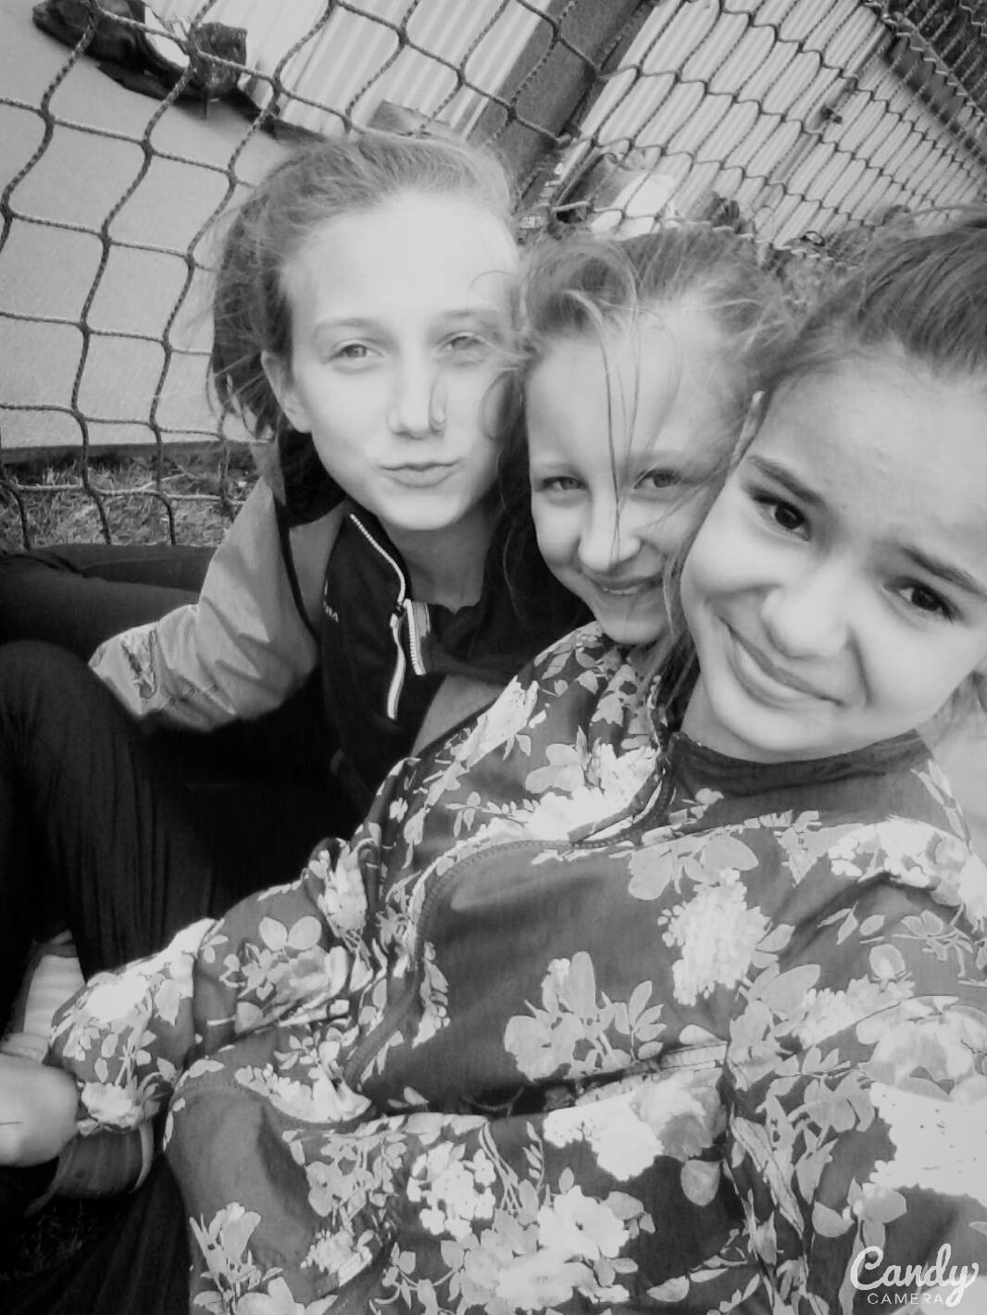
During the competitions I have met many interesting people

Slide 7
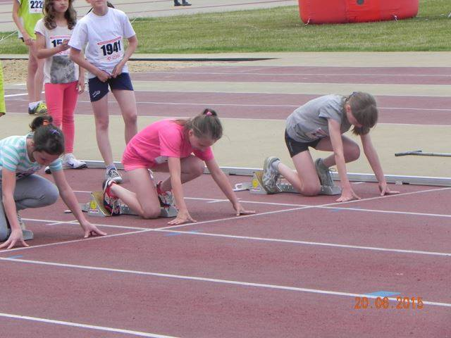
Here are some photos from my competitions

Slide 8
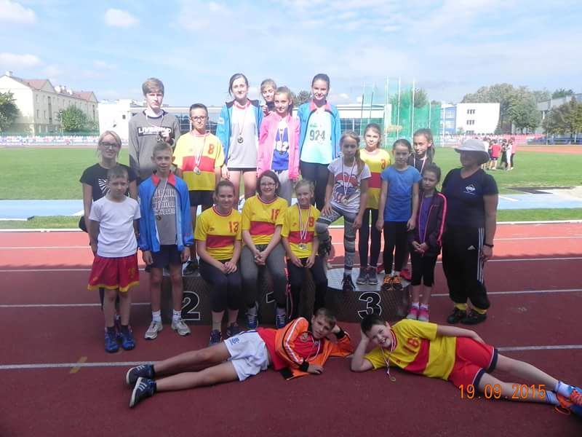

Slide 9
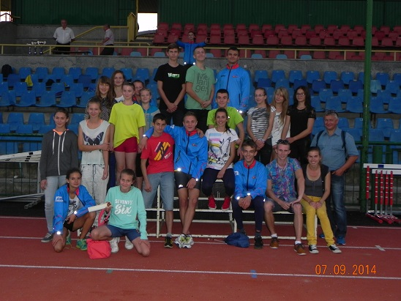

Slide 10
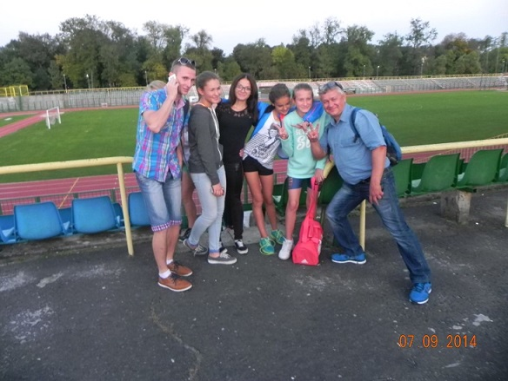

Slide 11
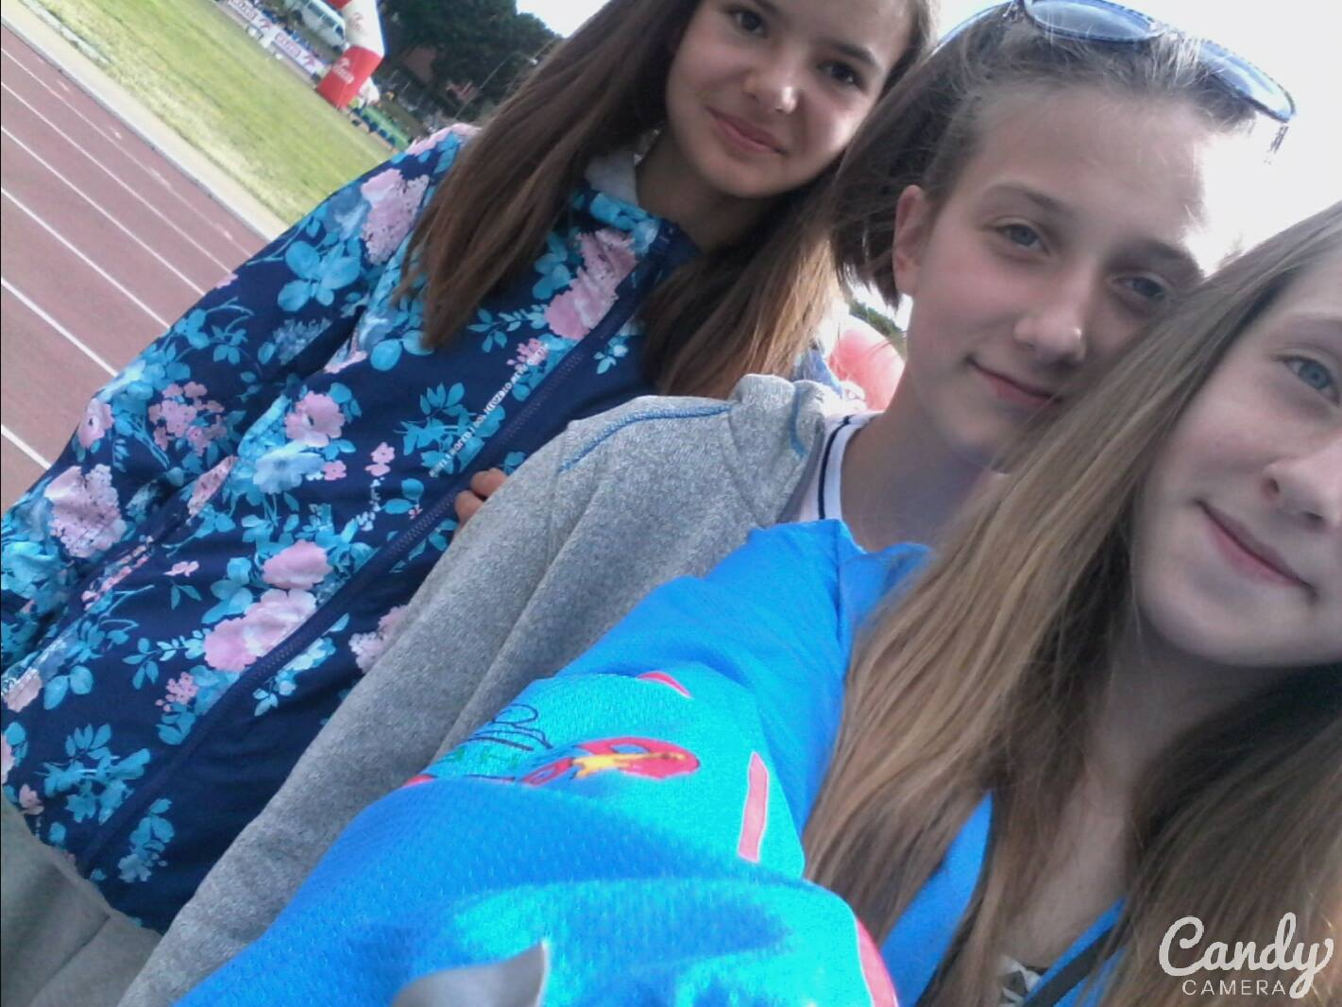

Slide 12
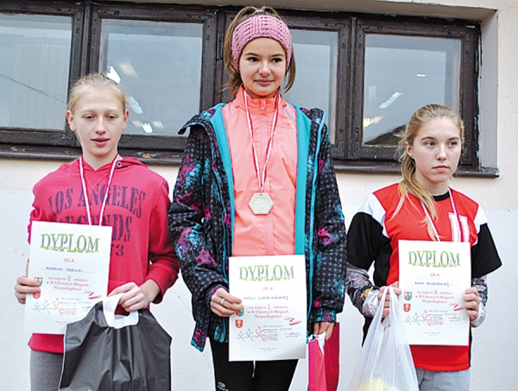

Slide 13
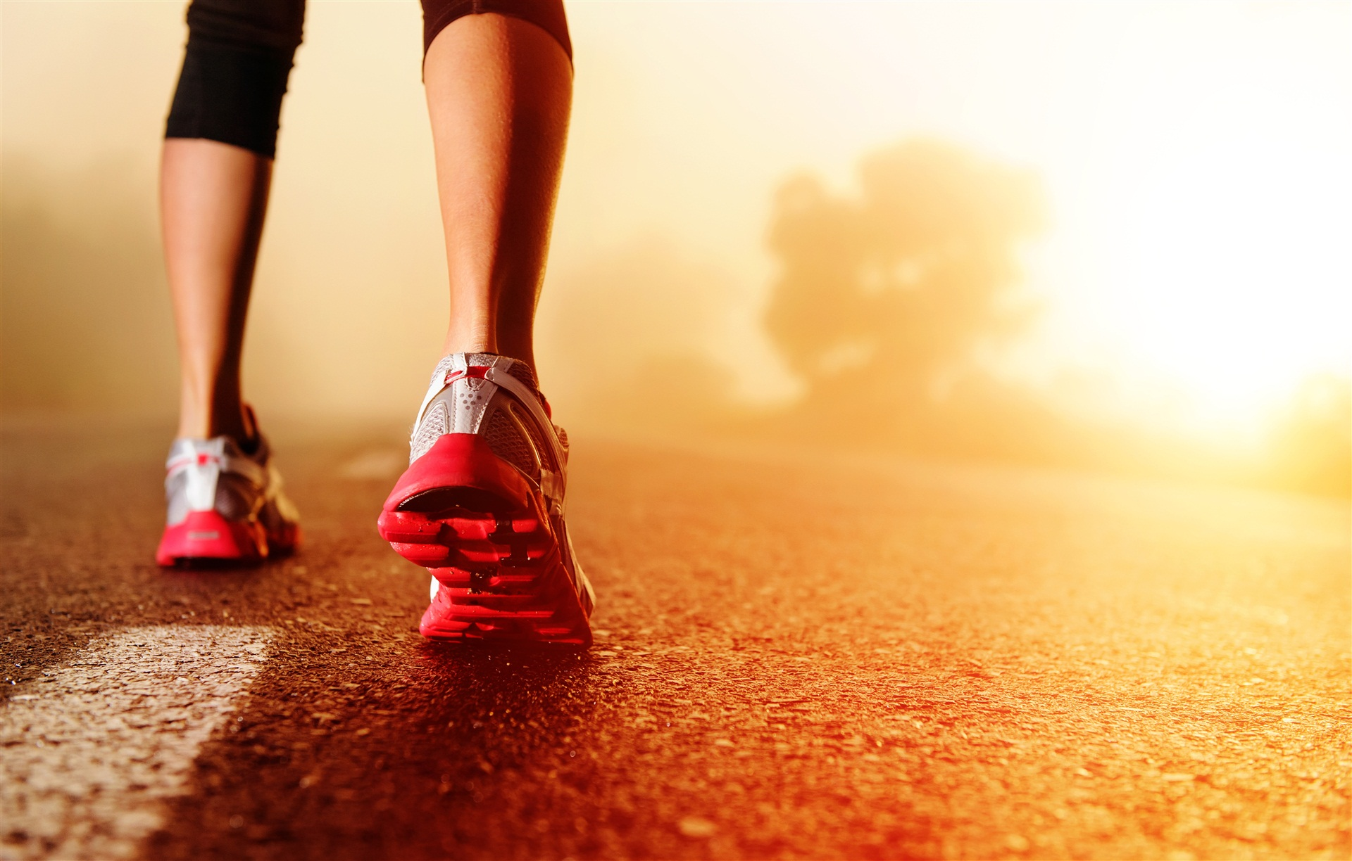

Slide 14
Presenation by
Amelia Oleszczyńska
Class VI b

