Slide 1
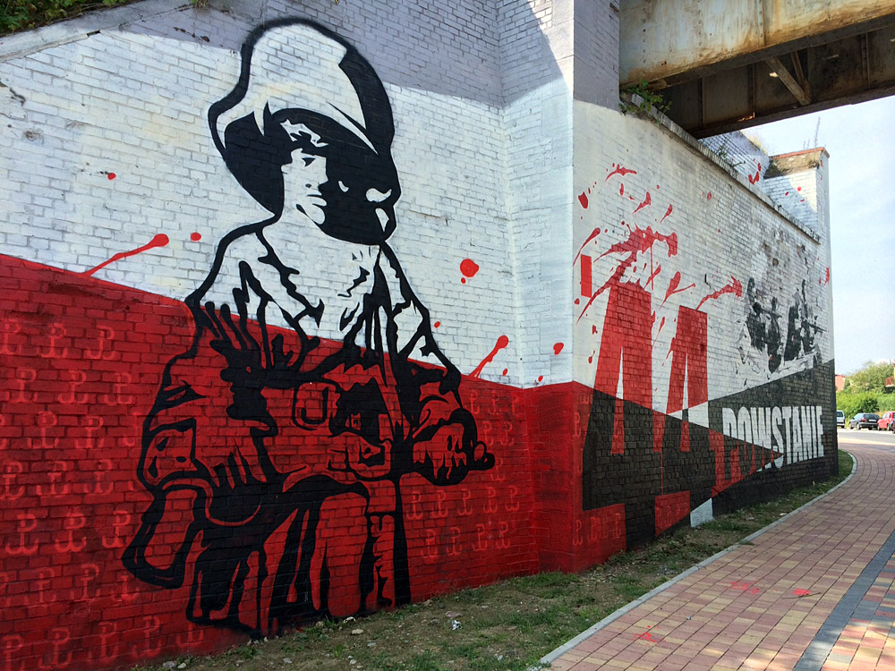
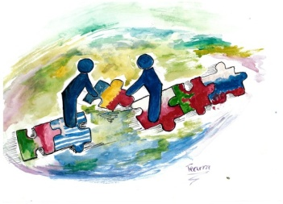
Warsaw Uprising Memorial Day
1st August

Slide 2
Warsaw Uprising Memorial Day is a new national holiday, that is observed in Poland since 2010. This day commemorates the heroes of the Warsaw Uprising, that began on August 1, 1944.

Slide 4
As the Red Army approached Warsaw (July 29–30, 1944), Soviet authorities, promising aid, encouraged the Polish underground there to stage an uprising against the Germans. However, the Polish underground, known as the Home Army, was anxious because the Soviet Union had already assumed direct control of eastern Poland.

Slide 5
Hoping to gain control of Warsaw before the Red Army could “liberate” it, the Home Army followed the Soviet suggestion to revolt.
Commanded by General Tadeusz Bór-Komorowski, the Warsaw corps of 50,000 troops attacked the relatively weak German force on August 1 and within three days gained control of most of the city.

Slide 7
The Germans sent in reinforcements, however, and forced the Poles into a defensive position, bombarding them with air and artillery attacks for the next 63 days.

Slide 9
Meanwhile, the Red Army, which had been detained during the first days of the insurrection by a German assault, occupied a position at Praga, a suburb across the Vistula River from Warsaw, and remained idle. In addition, the Soviet government refused to allow the western Allies to use Soviet air bases to airlift supplies to the beleaguered Poles.

Slide 11
Without Allied support, the Home Army split into small, disconnected units.
By the end of September, the Home Army was short of all supplies – food, fresh water ammunition etc and the city was being systematically destroyed. The Polish Red Cross negotiated and on October 2nd a ceasefire was announced.

Slide 13
Bór-Komorowski and his forces were taken prisoner, and the Germans then systematically deported the remainder of the city’s population and destroyed the city itself - after anything of value was taken to Berlin.
No-one is quite sure of casualties but Polish historians believe that 150,000 Poles died in the uprising. It is claimed that 26,000 Germans were killed in the two months of the fighting.

Slide 15
By allowing the Germans to suppress the Warsaw Uprising, the Soviet authorities also allowed them to eliminate the main body of the military organization that supported the Polish government-in-exile in London.
Consequently, when the Soviet army occupied all of Poland, there was little effective organized resistance to its establishing Soviet political domination over the country and imposing the communist-led Provisional Government of Poland (Jan. 1, 1945).

Slide 17
The Warsaw Uprising is a national symbol of courage and determination. In 2009 then-President of Poland Lech Kaczyński initiated establishment of Warsaw Uprising Memorial Day. His initiative was supported by the Senate of Poland. The first observation of this memorial day took place on August 1, 2010.

Slide 19
Once a year the city commemorates those heroes, and on 1st of August at 5 pm, an alarm will interrupt the activities in the city, all the people in Warsaw (but really all the people) will stop for 1 minute their activities, if you are going in the bus for example, the bus will stop completely in the middle of the street for 1 minute; the same if you are walking somewhere in Warsaw, you will see that Polish people will stop when hearing the alarms of the memorial of the Warsaw Uprising.

Slide 21
Sources:
https://anydayguide.com/calendar/1497
https://www.britannica.com/event/Warsaw-Uprising
http://www.historylearningsite.co.uk/world-war-two/world-war-two-and-eastern-europe/the-warsaw-uprising-of-1944/
http://www.chido-fajny.com/2016/07/warsaw-uprising-memorial-day.html

Slide 22
Thank you for your attention ☺
Mikołaj Krzywicki V b

