Slide 1
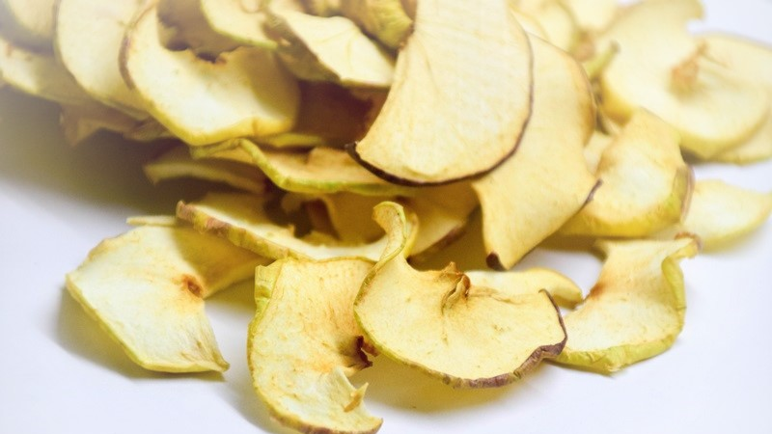
Apple Chips
Mia Periškić, 8.a

Slide 2
You will need:
-one whole apple
-half a tablespoon of apple cider vinegar
-2 tablespoons of cristal sugar
-ground cinnamon
-4 tablespoons of water

Slide 3
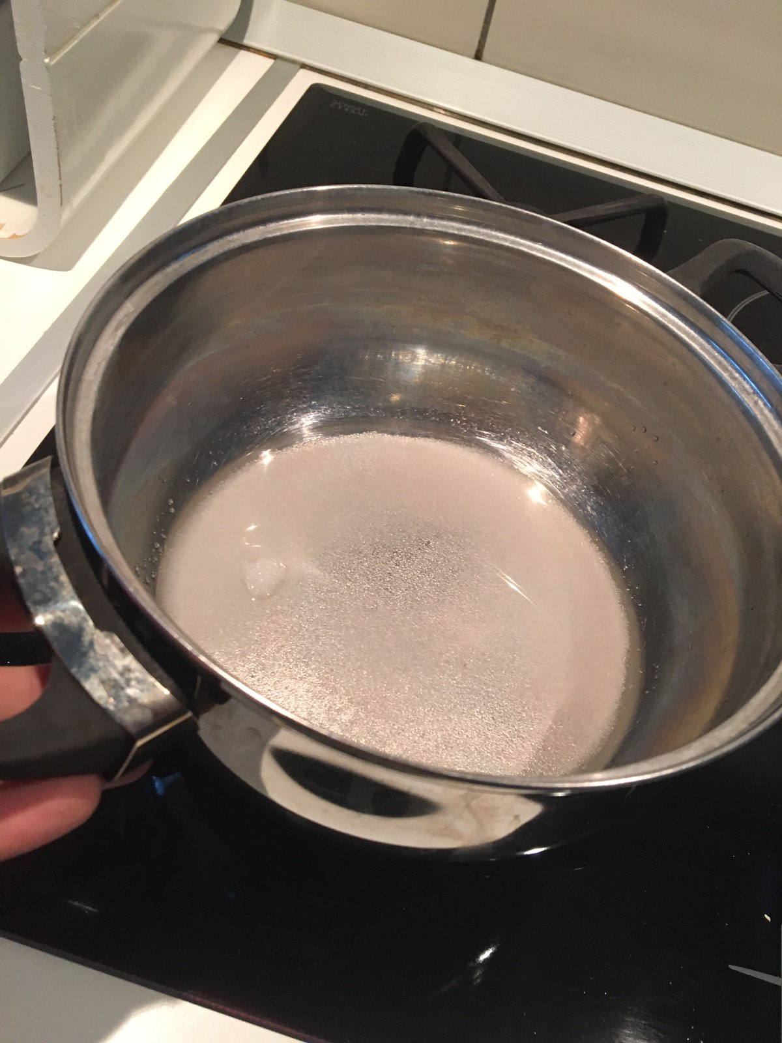
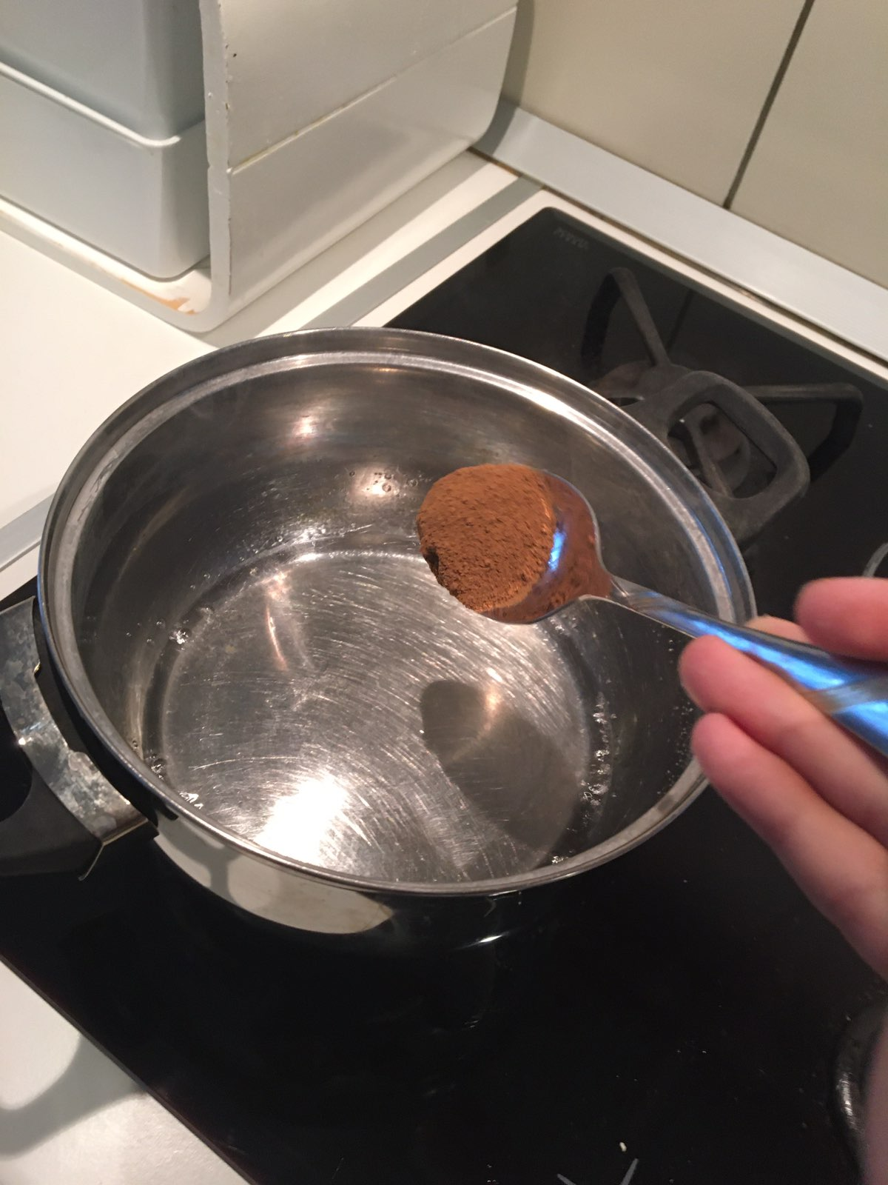
Preparation
First, gently heat up two tablespoons of sugar and four tablespoons of water.
When the sugar is melted, add half a spoon oh apple cidar vinegar, add some cinnamon and take off the stove.

Slide 4
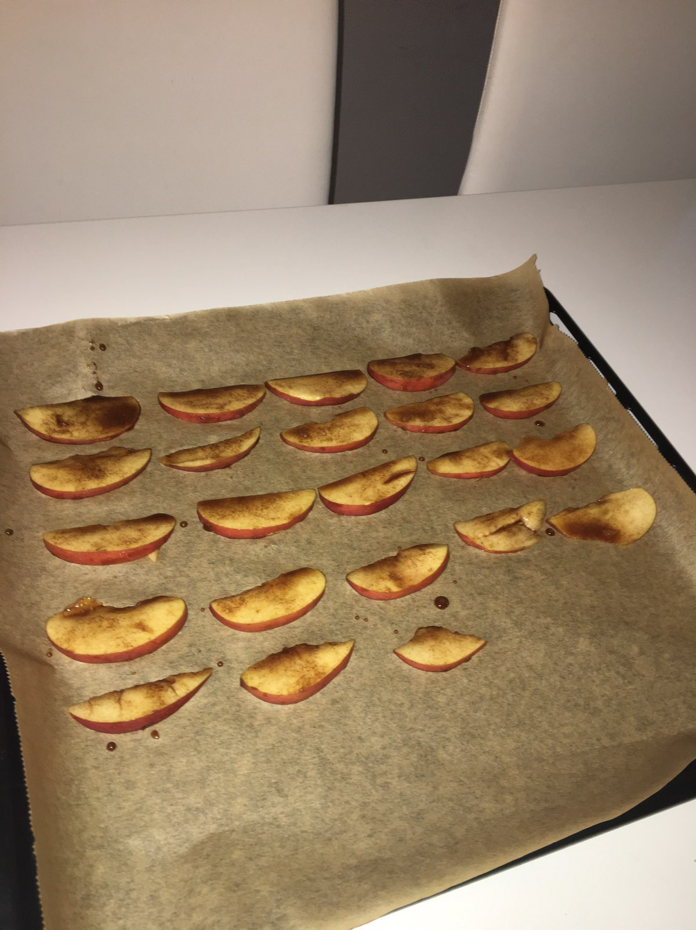
One big apple cut on half, remove seeds and cut into thin slices.
One side of each slice dip in the mixture of sugar and put on a baking pan so the soaked side of the slice faces up.

Slide 5
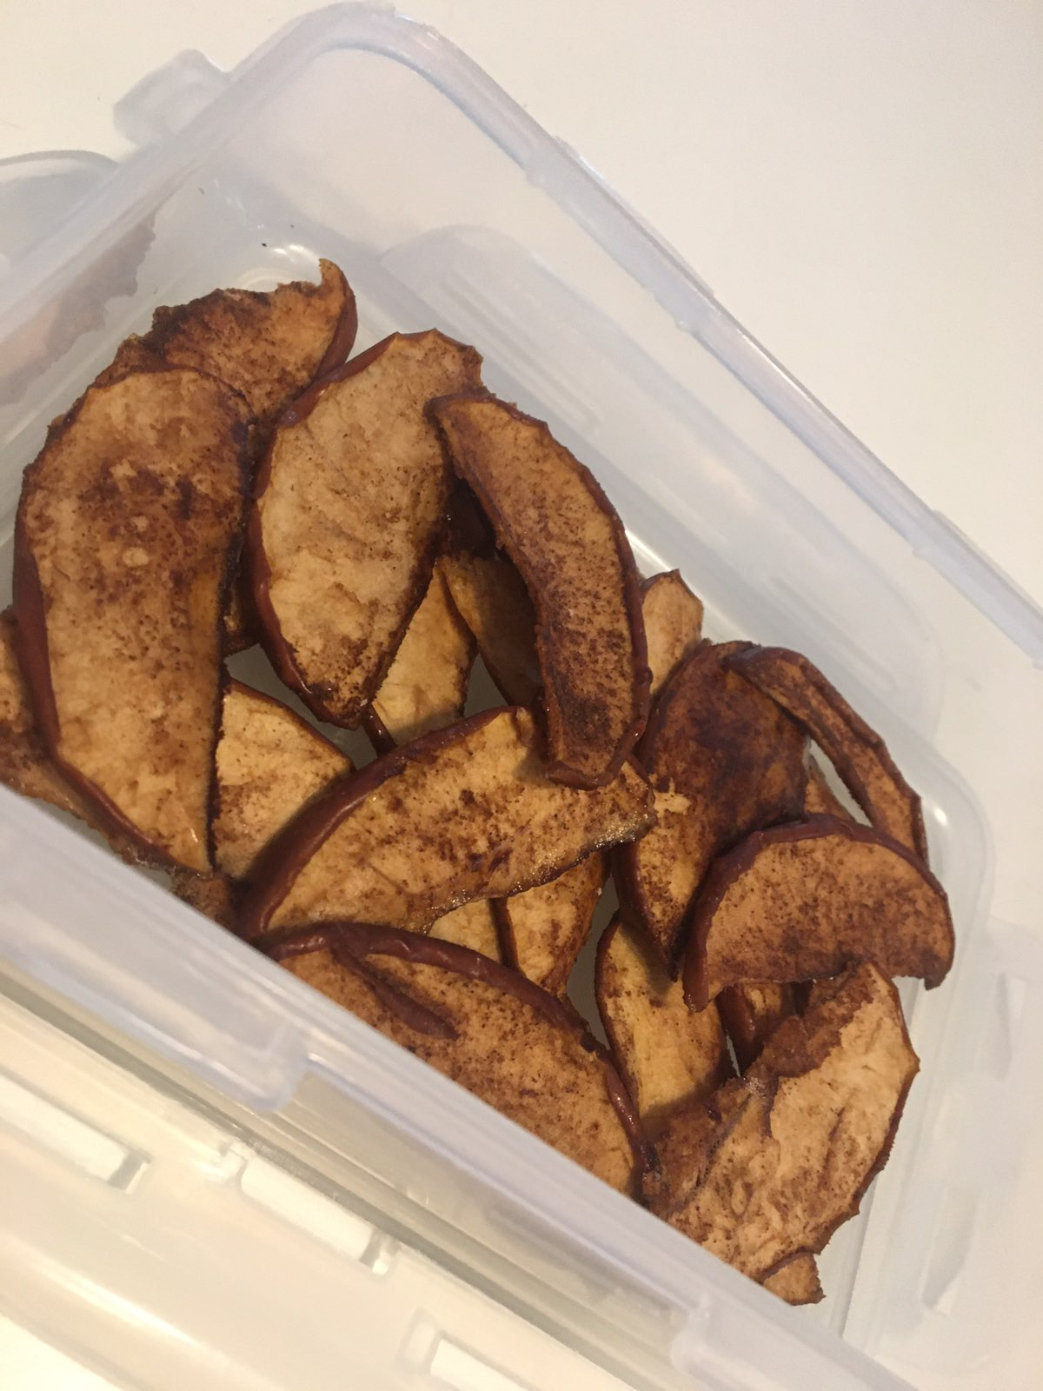
Bake in the oven until crispy, minimal 1 hour at 100˚C.
When it’s done, it should look like this. Enjoy!

Slide 6
Made by: Mia periškuć, 8.a

