Slide 1
VEGETABLE SOUP
EMA FABIJANOVIĆ
7.A

Slide 2
INGRIDIENTS:
HALF TABLESPOON OF PORK FAT
1 SMALL RED ONION
ONE BAG OF FROZEN MIXED VEGETABLES (CAULIFLOWER, BROCCOLI AND CARROT)
WATER (TO COVER THE VEGETABLES, AND LATER AS DESIRED)
SALT (AS DESIRED)
PEPPER (AS DESIRED)
THYME (AS DESIRED)
VEGETA (AS DESIRED)
SOUR CREAM (AS DESIRED)

Slide 3
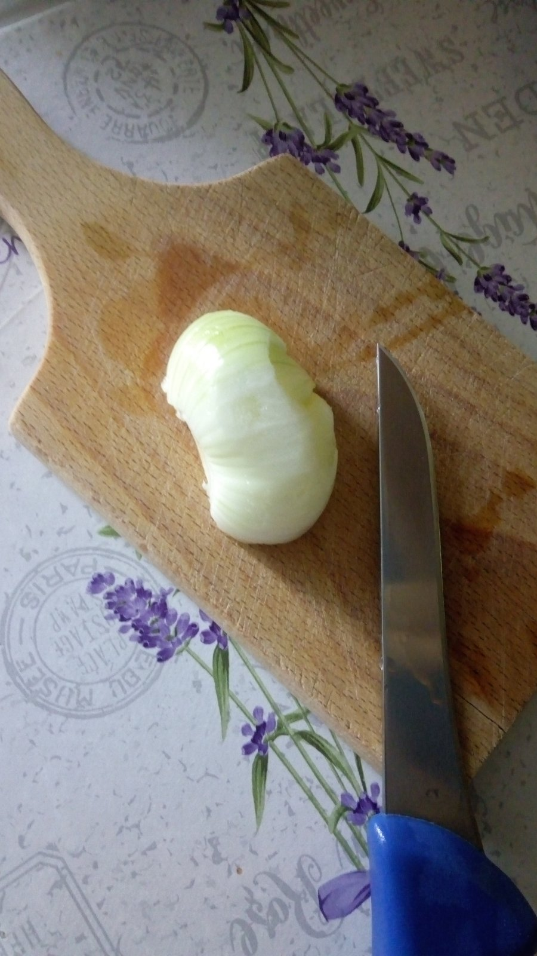
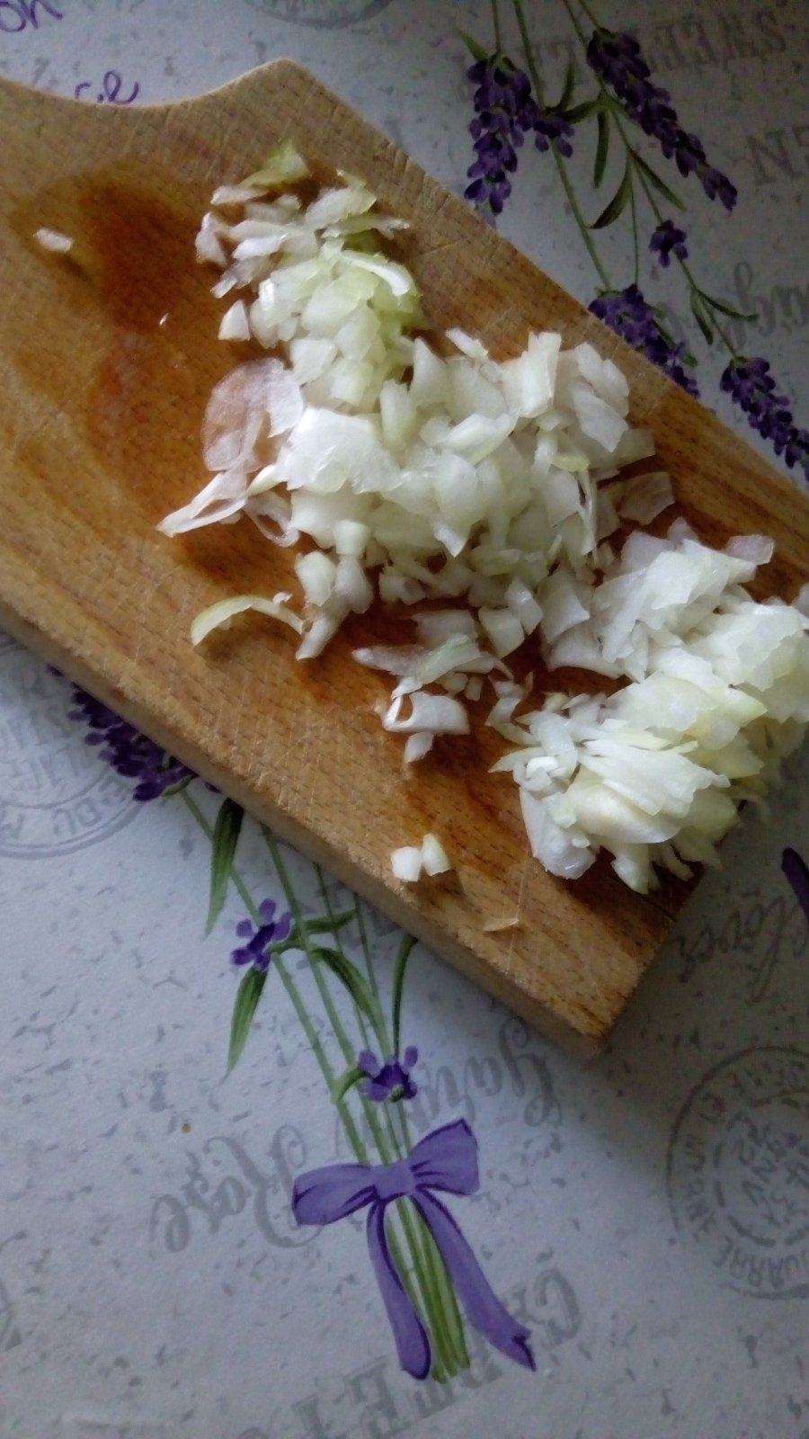
1.STEP:
CHOP 1 SMALL RED ONION

Slide 4
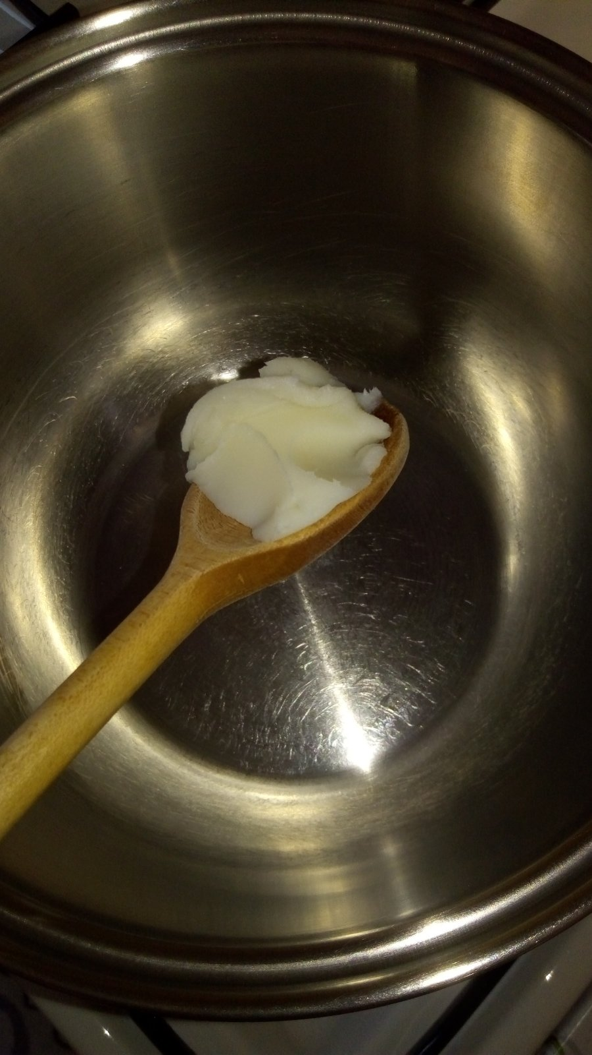
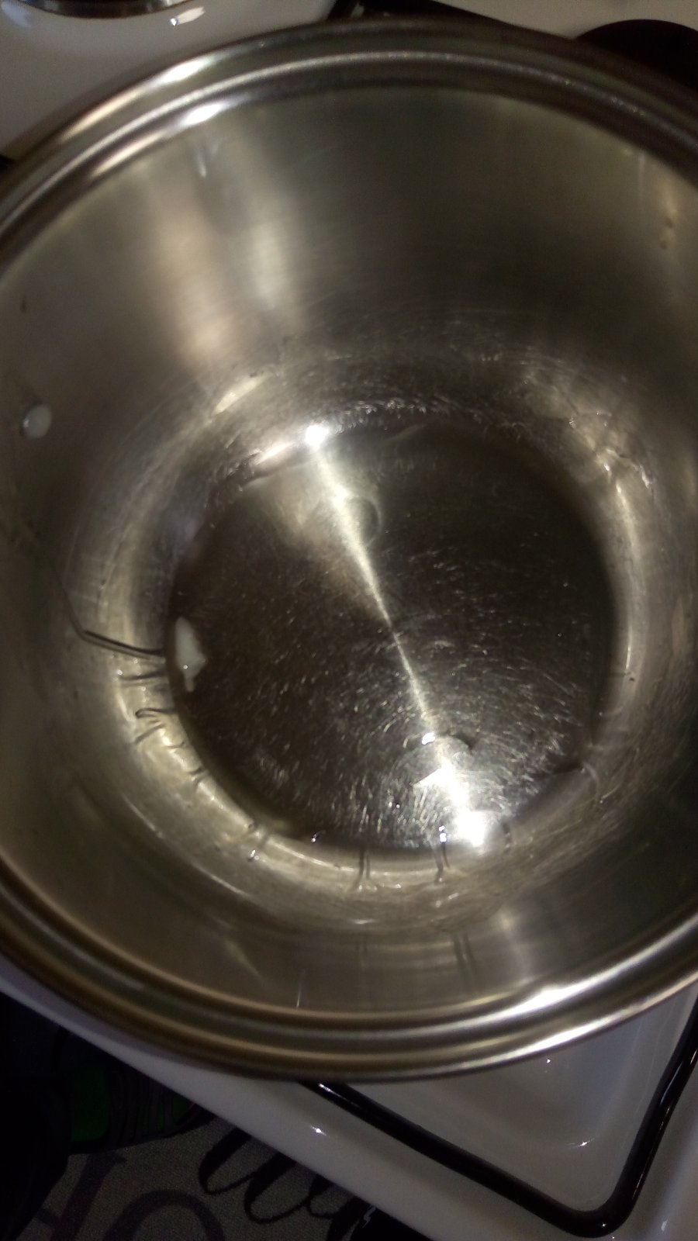
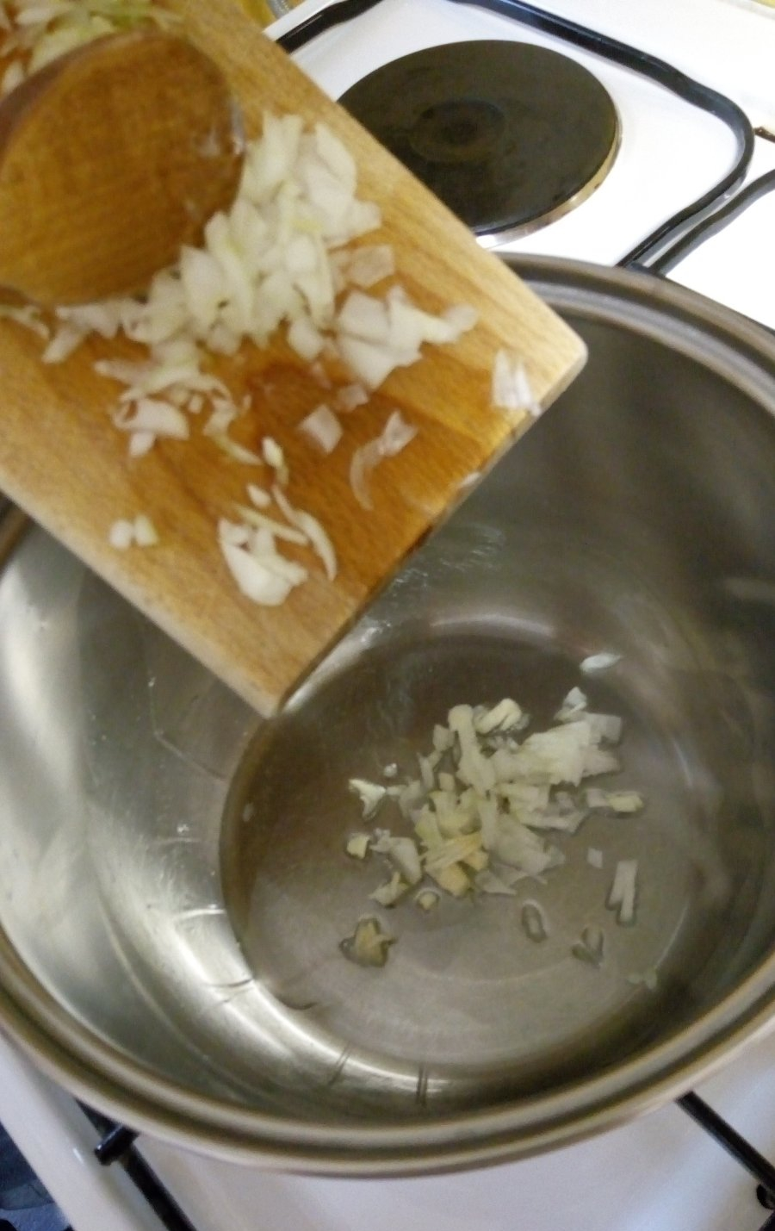
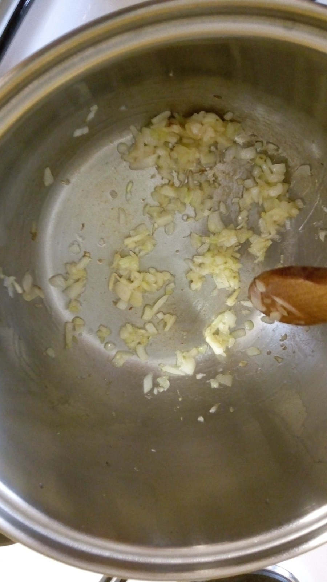
2.STEP:
DISSOLVE HALF A TABLESPOON OF PORK FAT AND ADD CHOPPED ONION

Slide 5
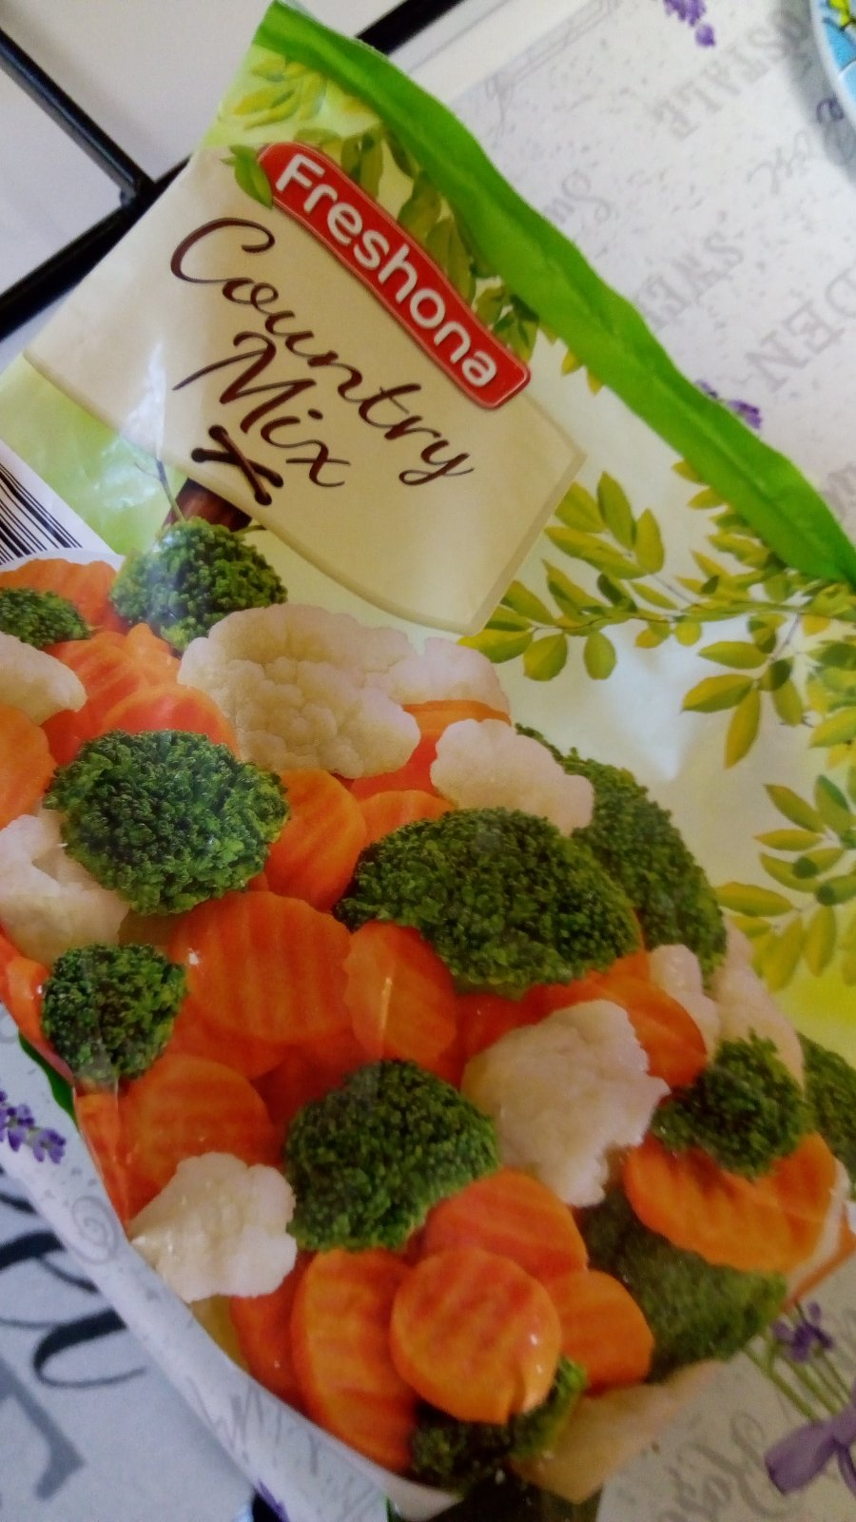
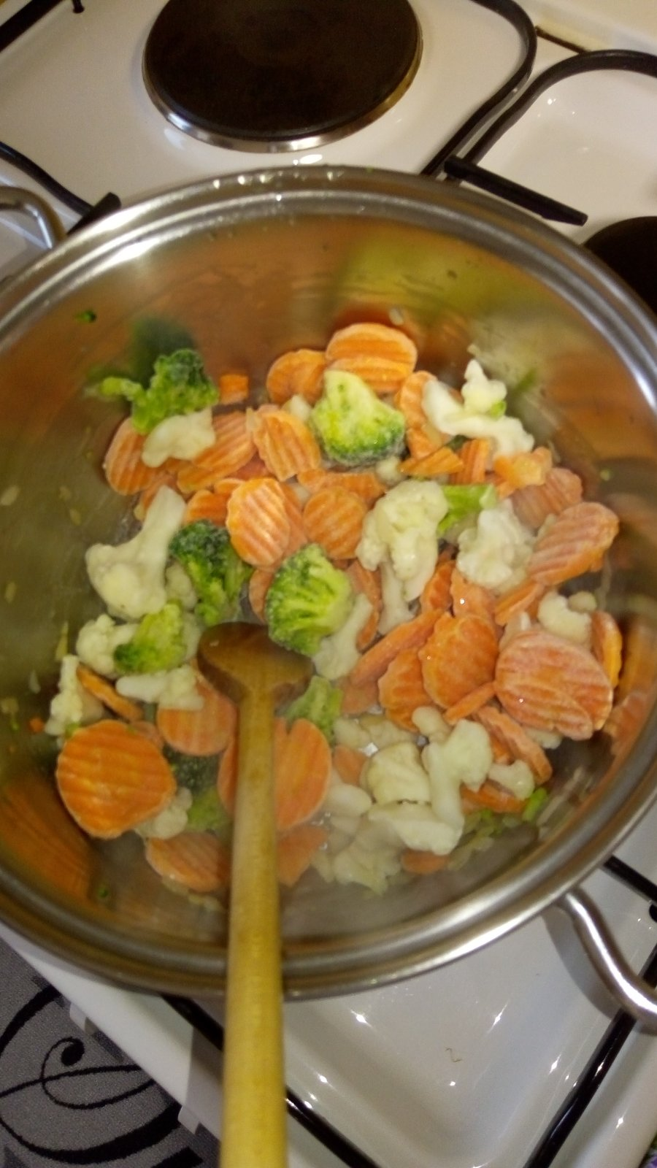
3.STEP:
WHEN THE ONION TURNS „GOLDEN”, ADD THE VEGETABLES AND WATER (THAT MUCH THAT COVER THE VEGETABLES)
ALLOW TO BOIL, THEN REDUCE THE FLAME AND COOK UNTIL THE VEGETABLES SOFTEN

Slide 6
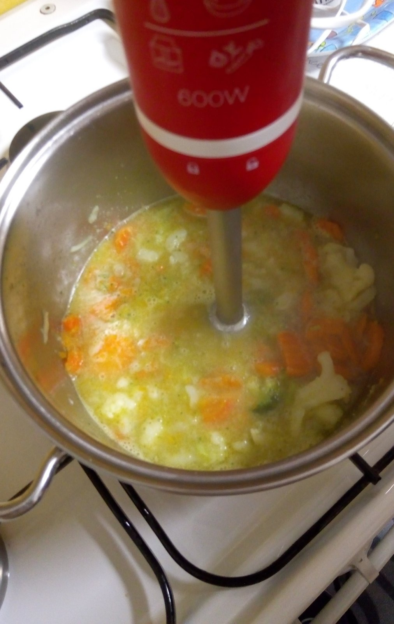
4.STEP:
CHOP IT WITH A STICK MIXER

Slide 7
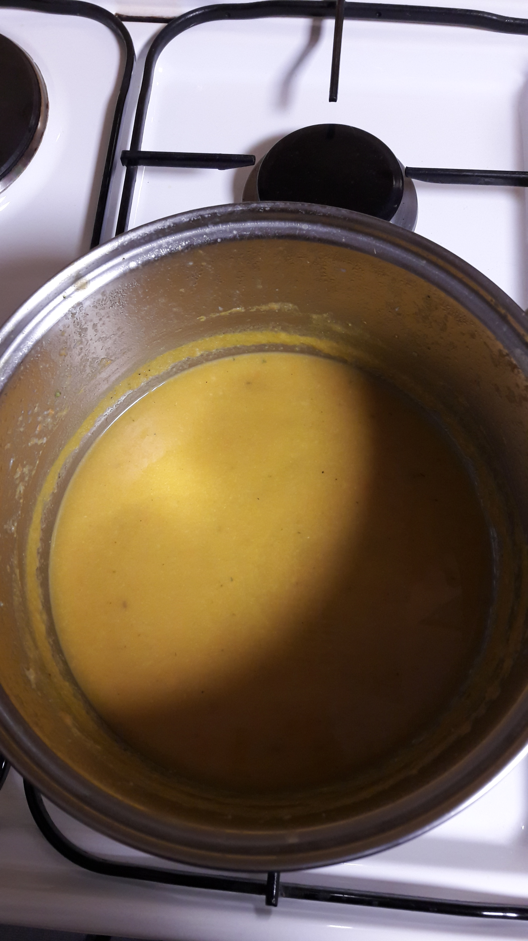
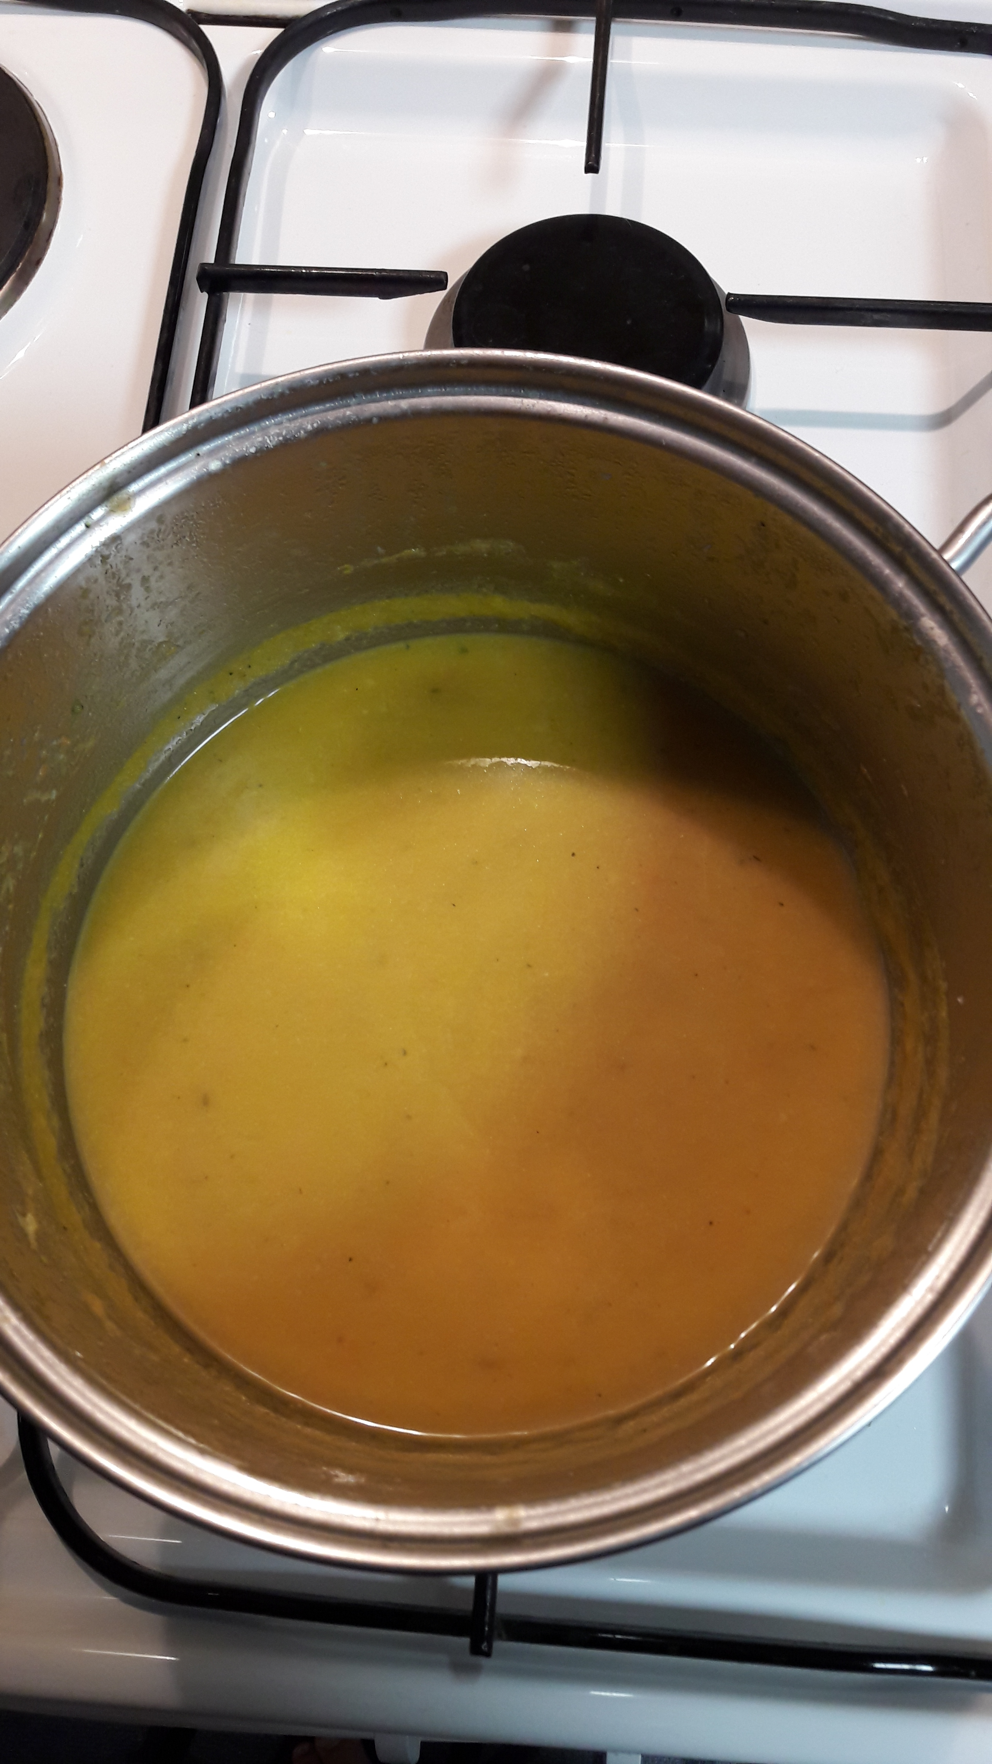
5.STEP:
AS DESIRED ADD SALT, PEPPER, THYME, VEGETA AND WATER
LET IT BOIL OVER

Slide 8
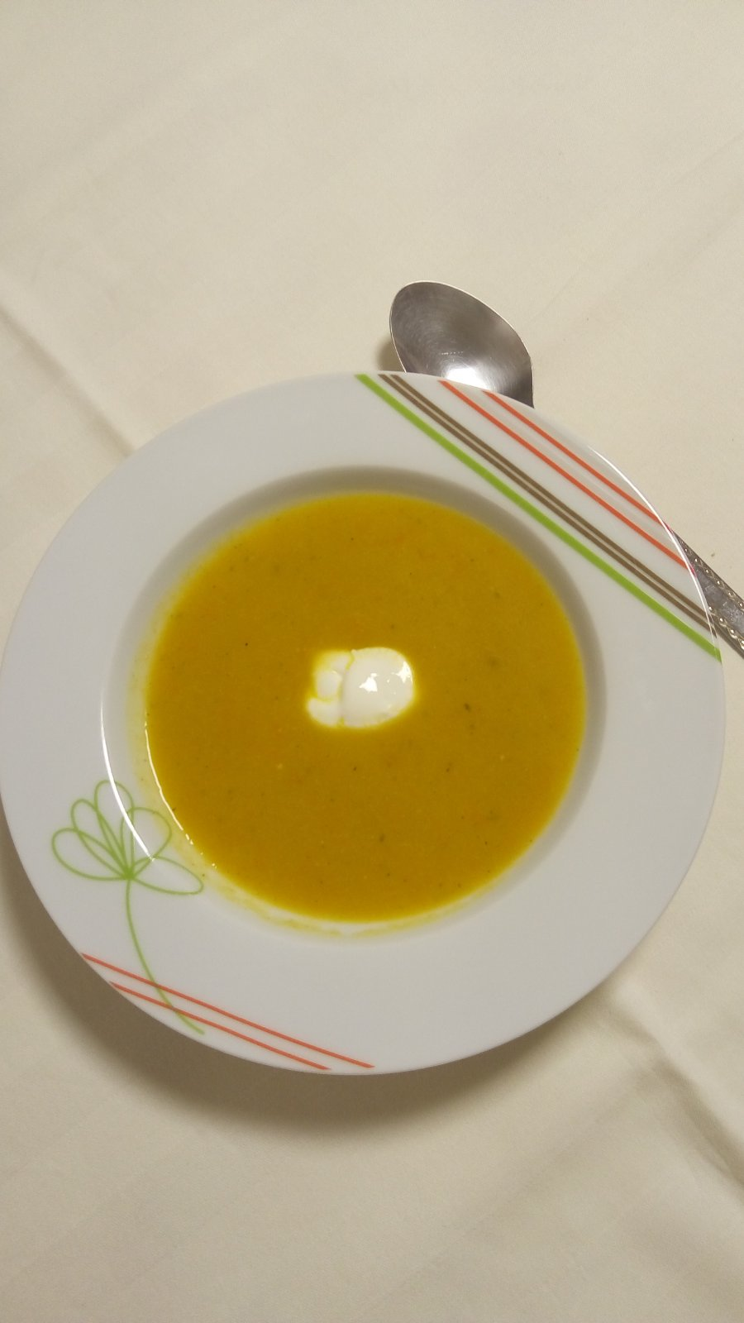
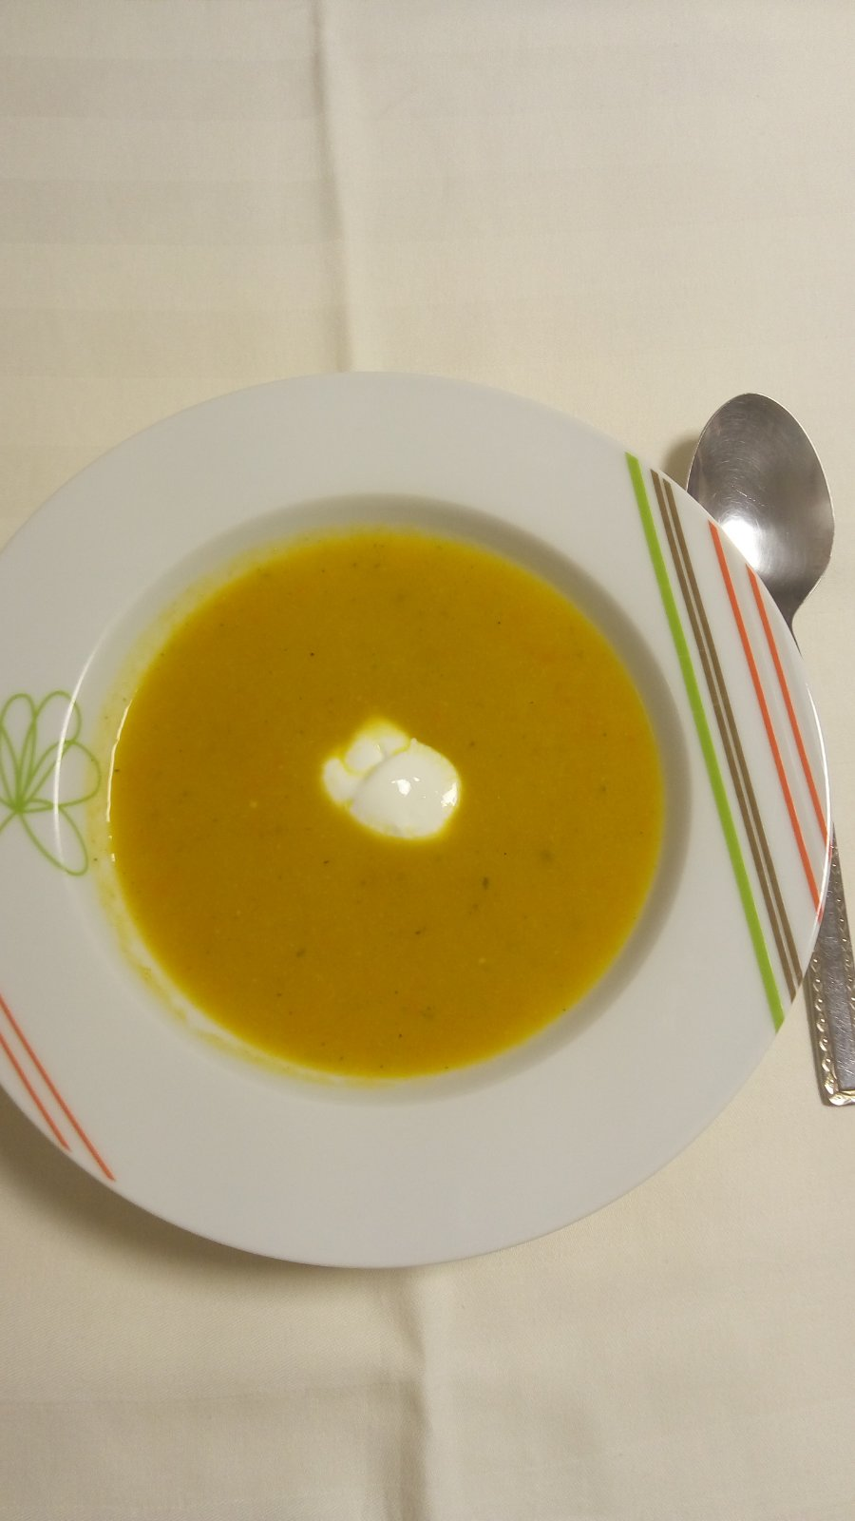
6.STEP:
WHEN YOU ARE SERVING IT, IF YOU WANT YOU CAN PUT SOUR CREAM IN IT

