Slide 1
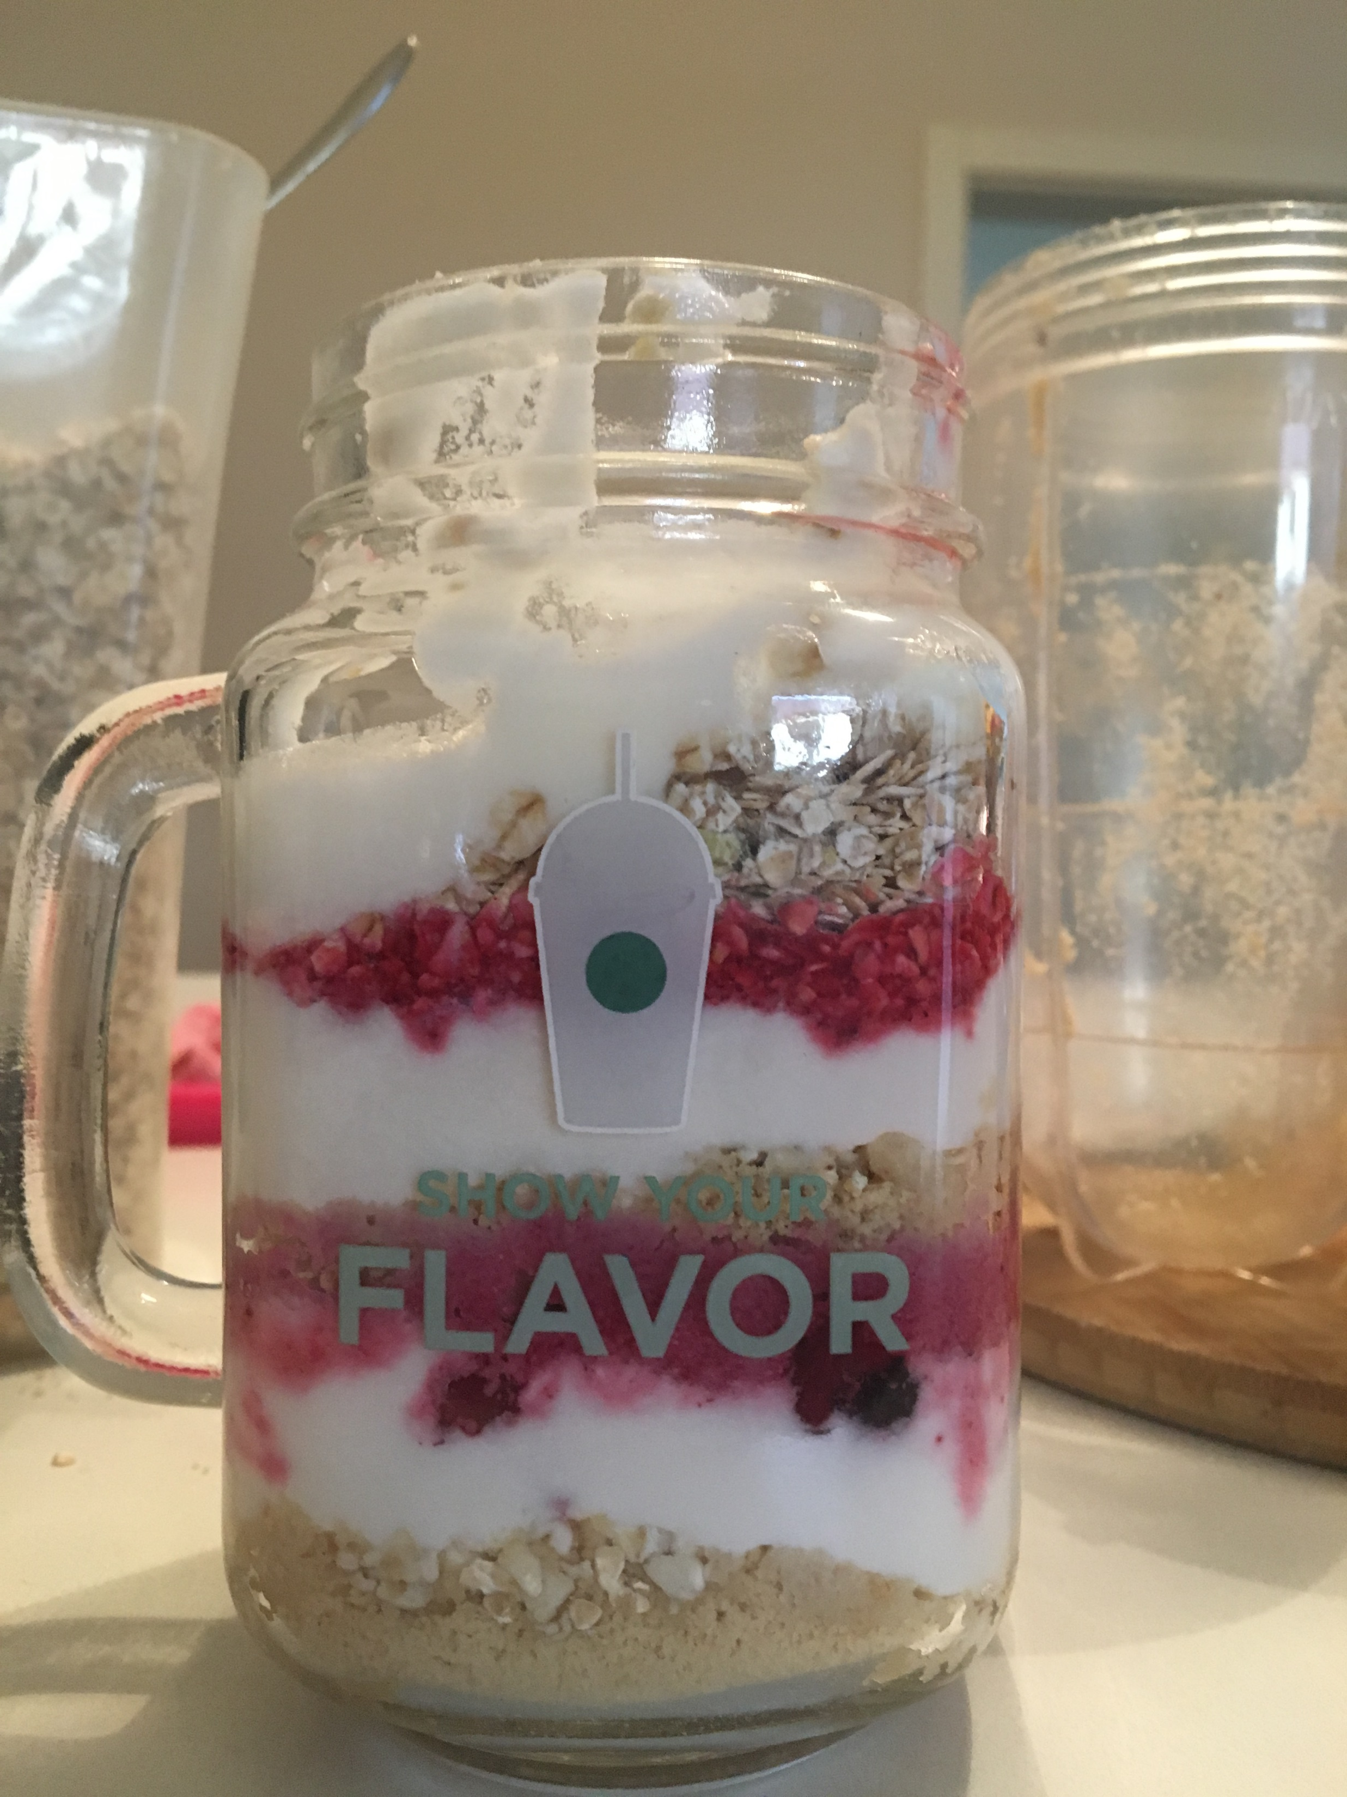
VITAMIN FANTASY
ANA SRPAK 7.A

Slide 2
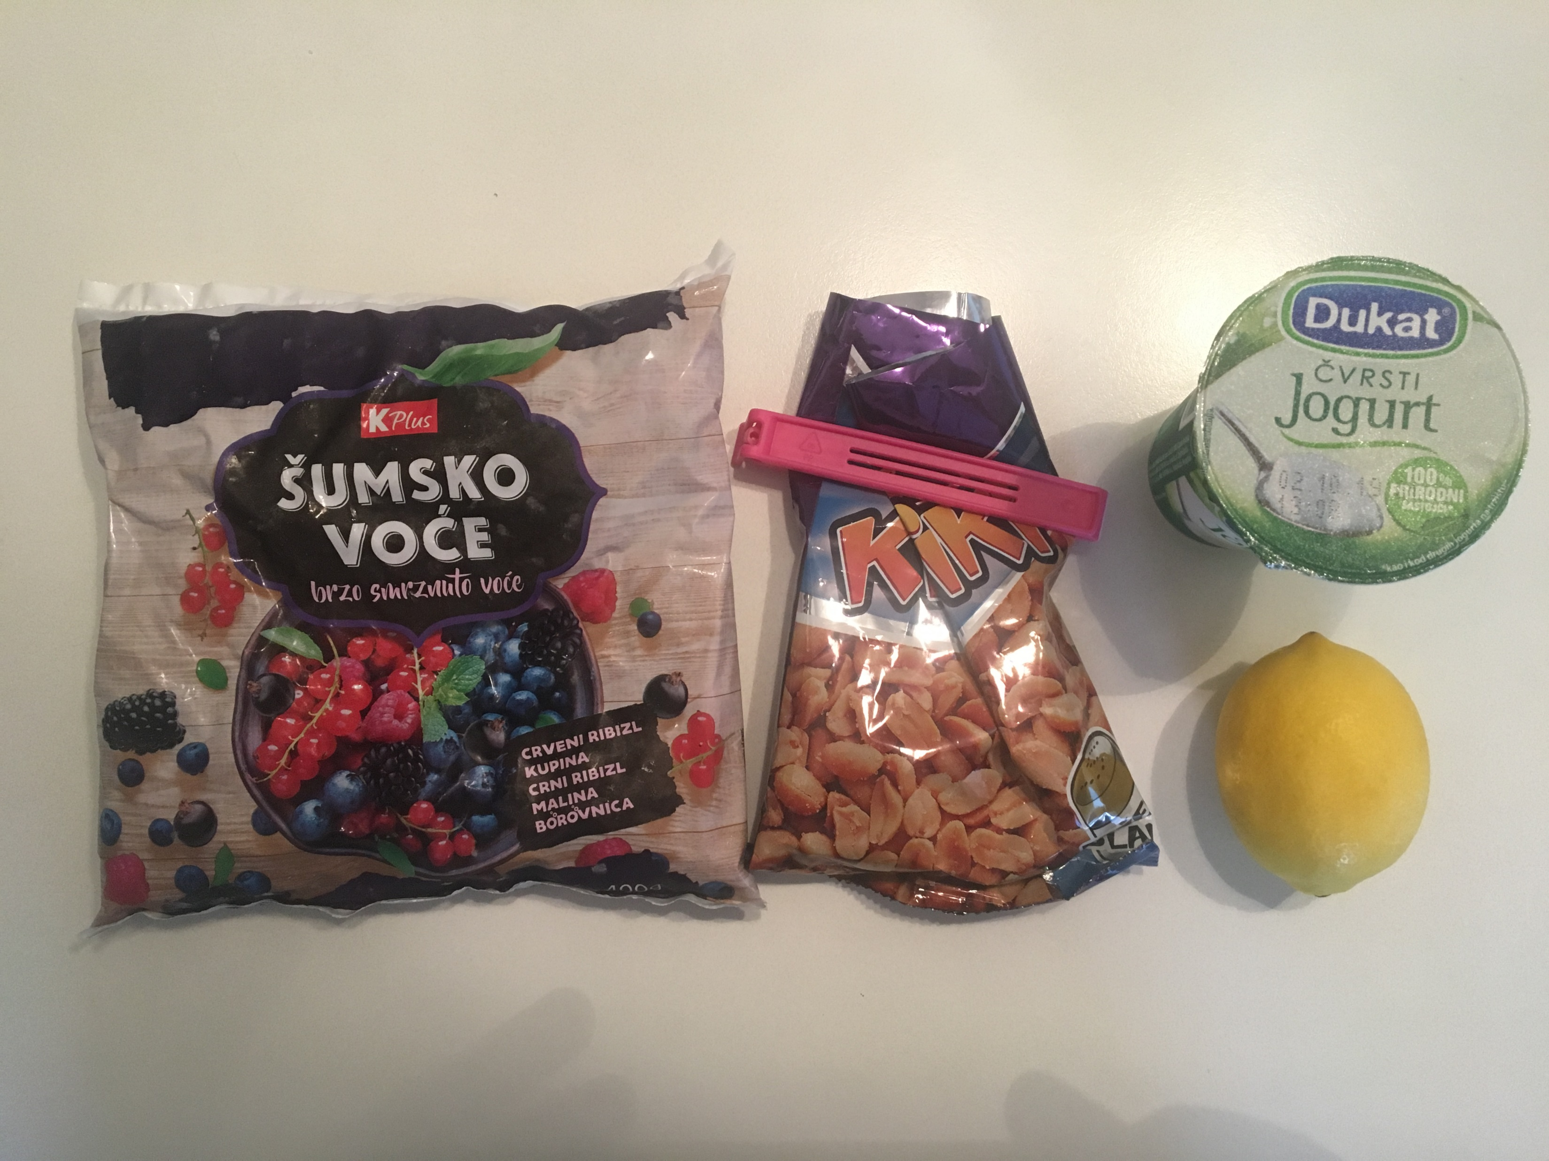
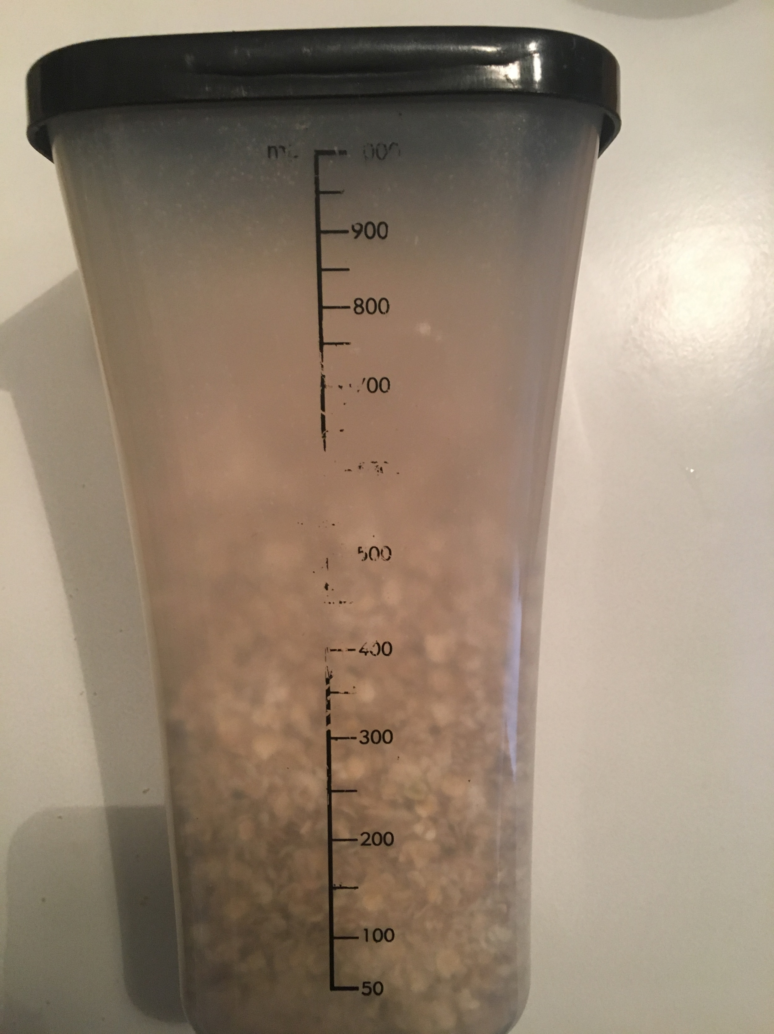
Ingridiens
You will need:
Frozen fruit
Plain yogurt
Peanuts
One lemon
Muesli

Slide 3
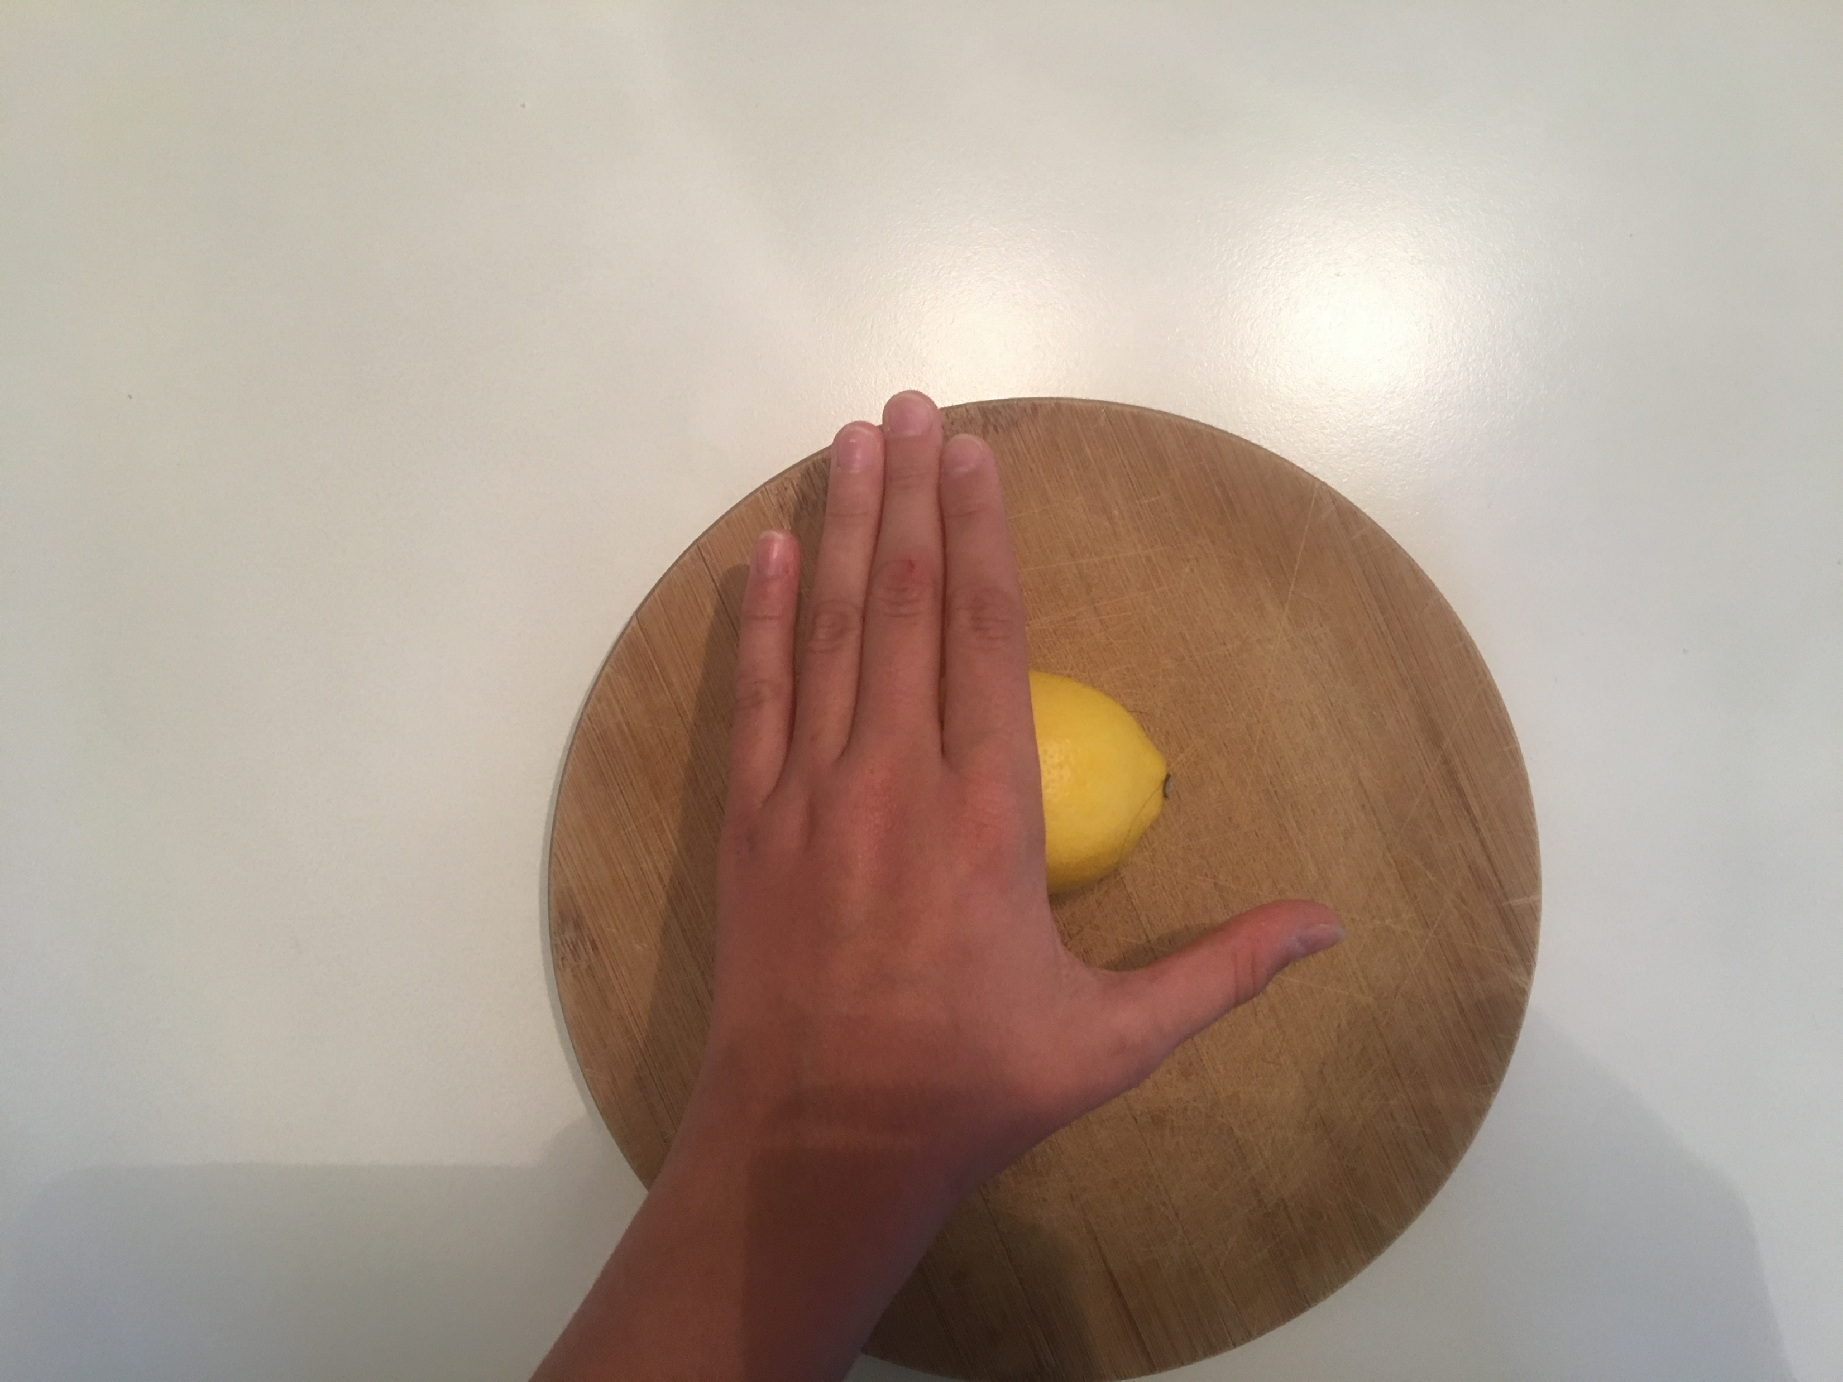
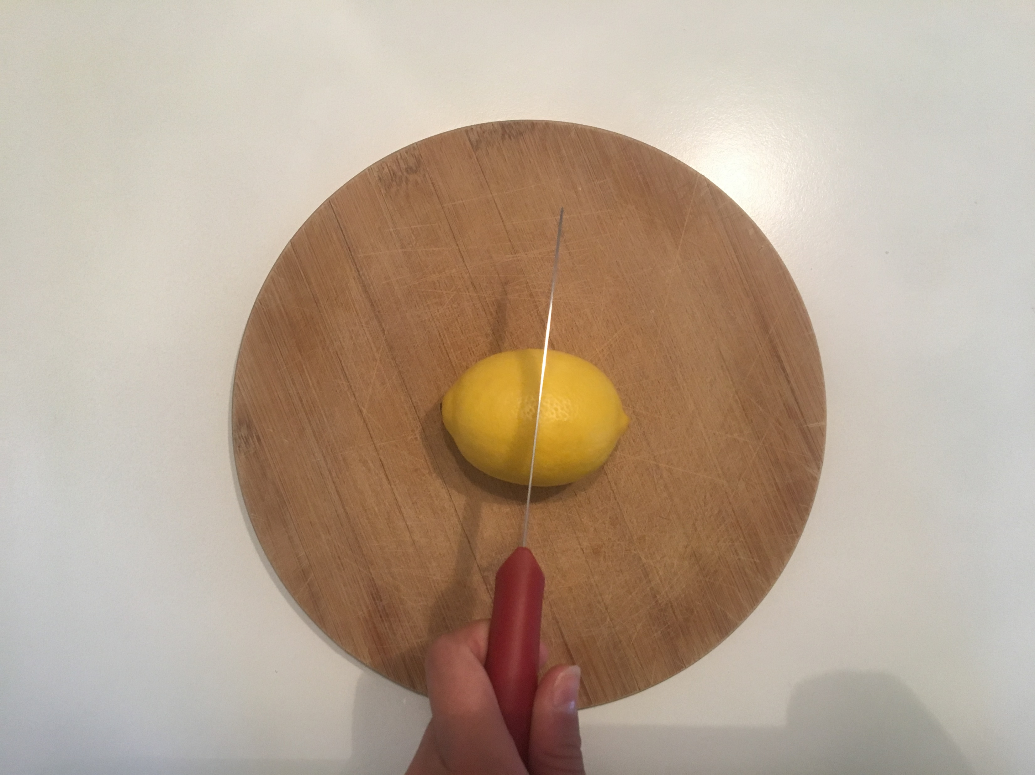
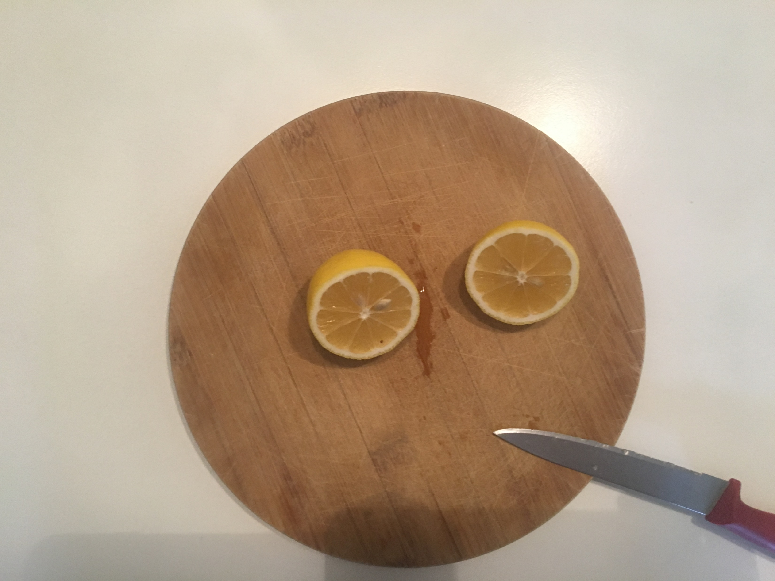
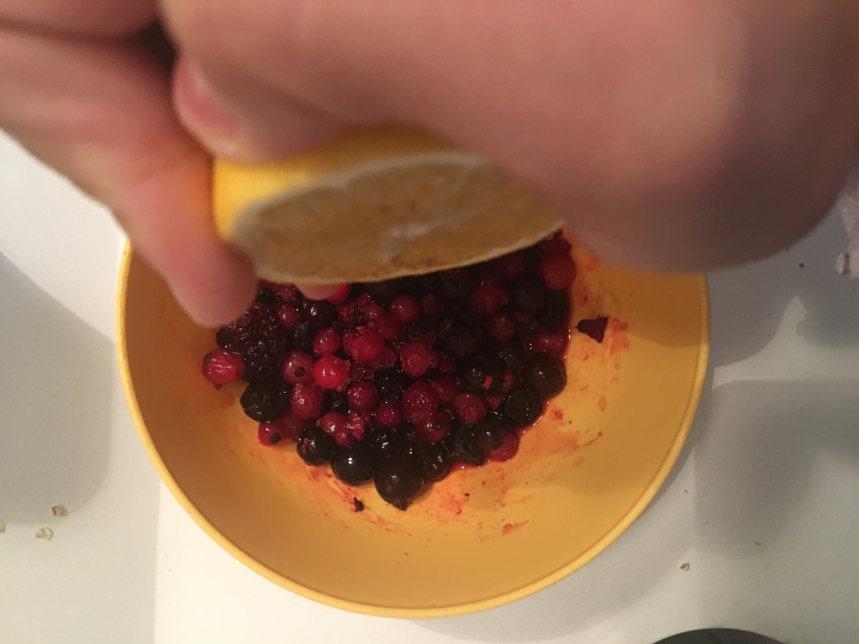
First step
First you will need to put frozen fruit in dish and wait until is not frozen anymore
By that time you will need to make lemon juice
To make lemon juice you will first need to masage lemon like on picture and than cut it and squese it in fruit when is not frozen

Slide 4
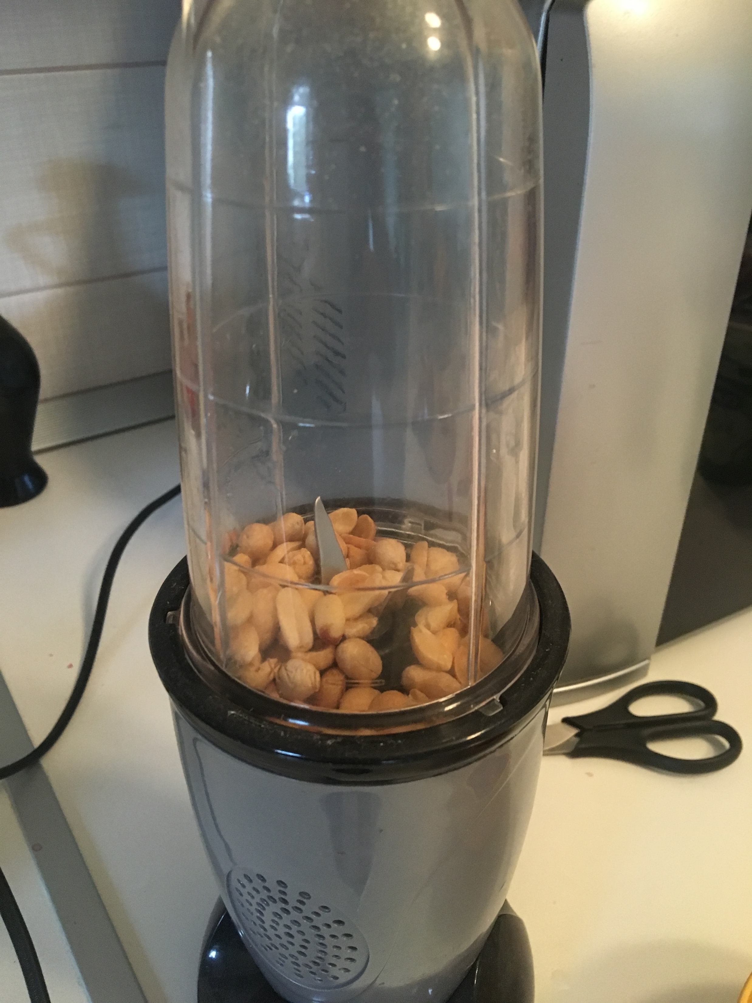
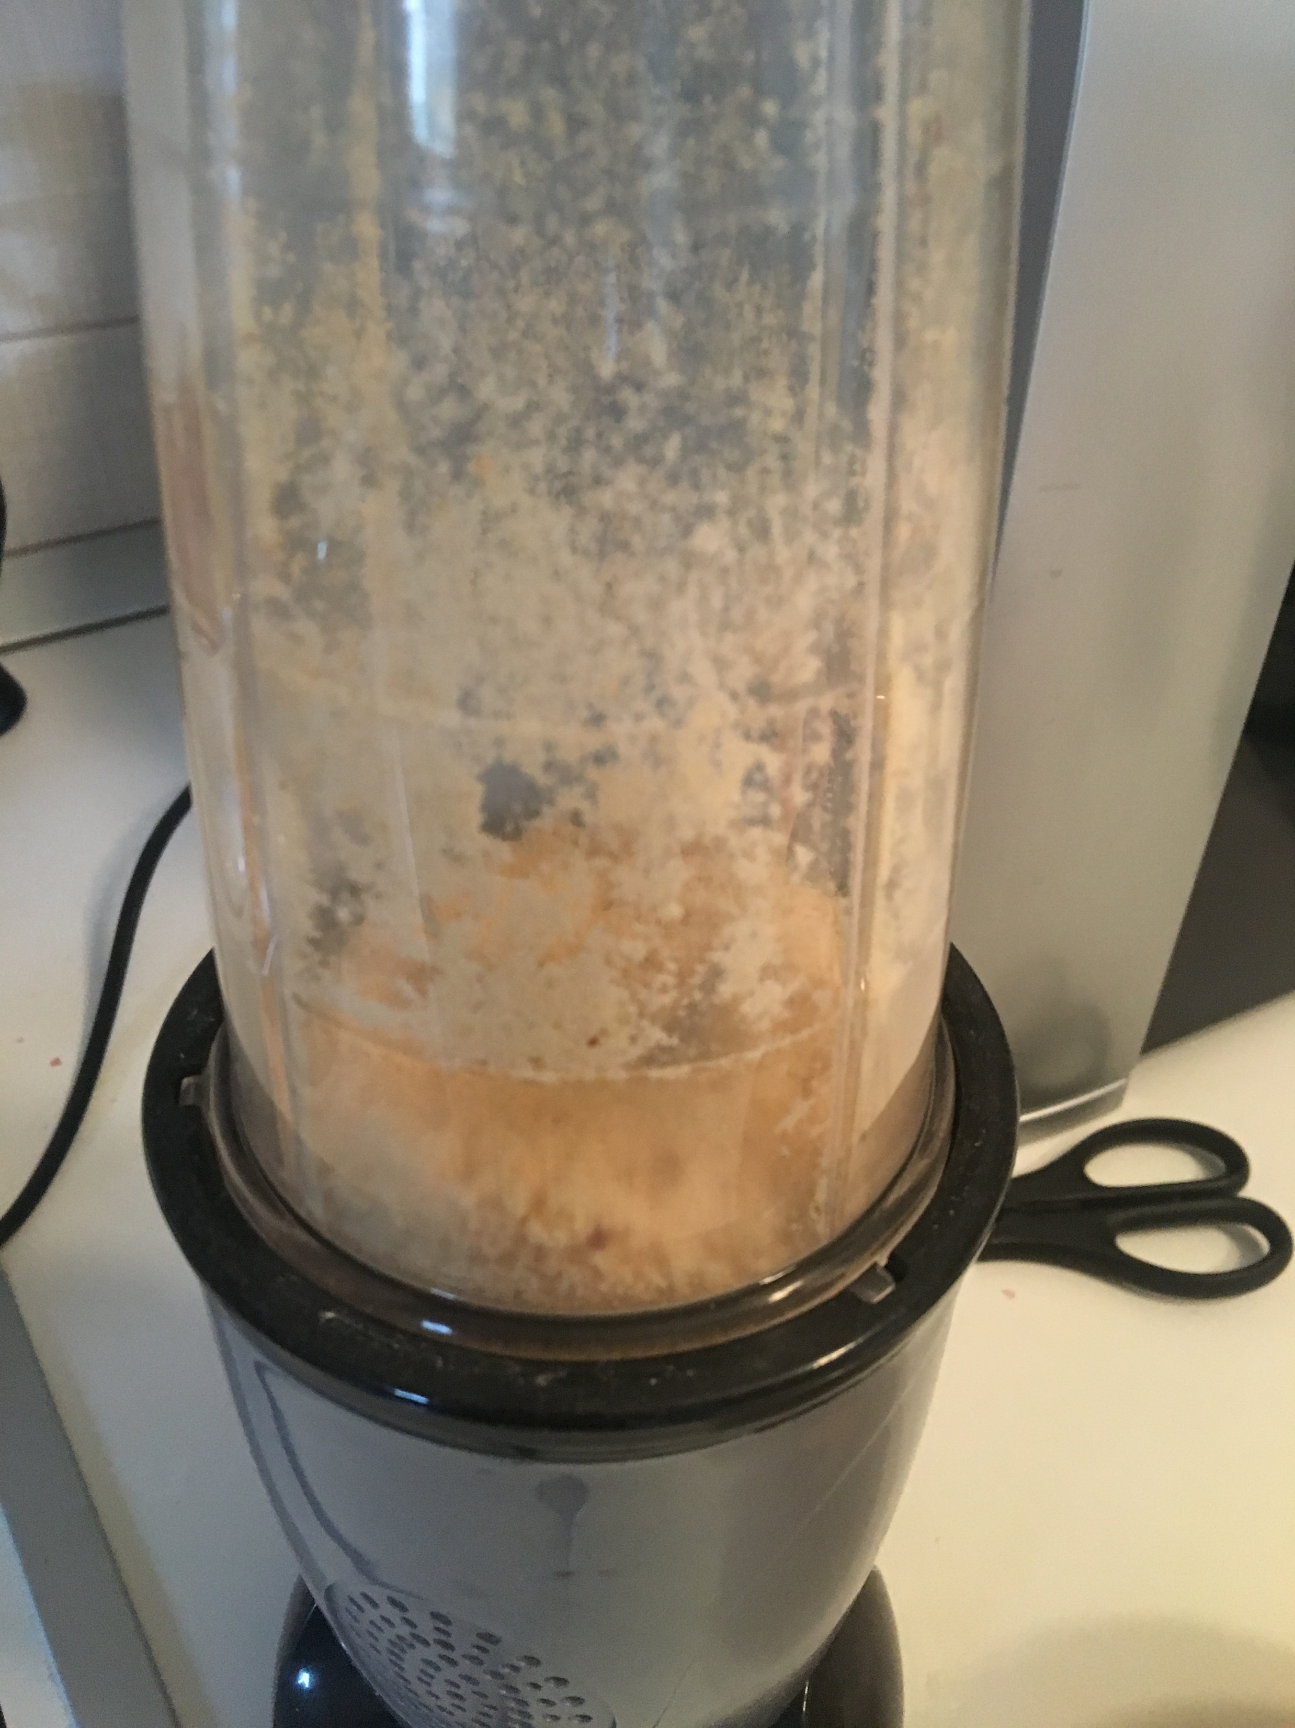
Second step
Second, you will need to crush penuts like on picture

Slide 5
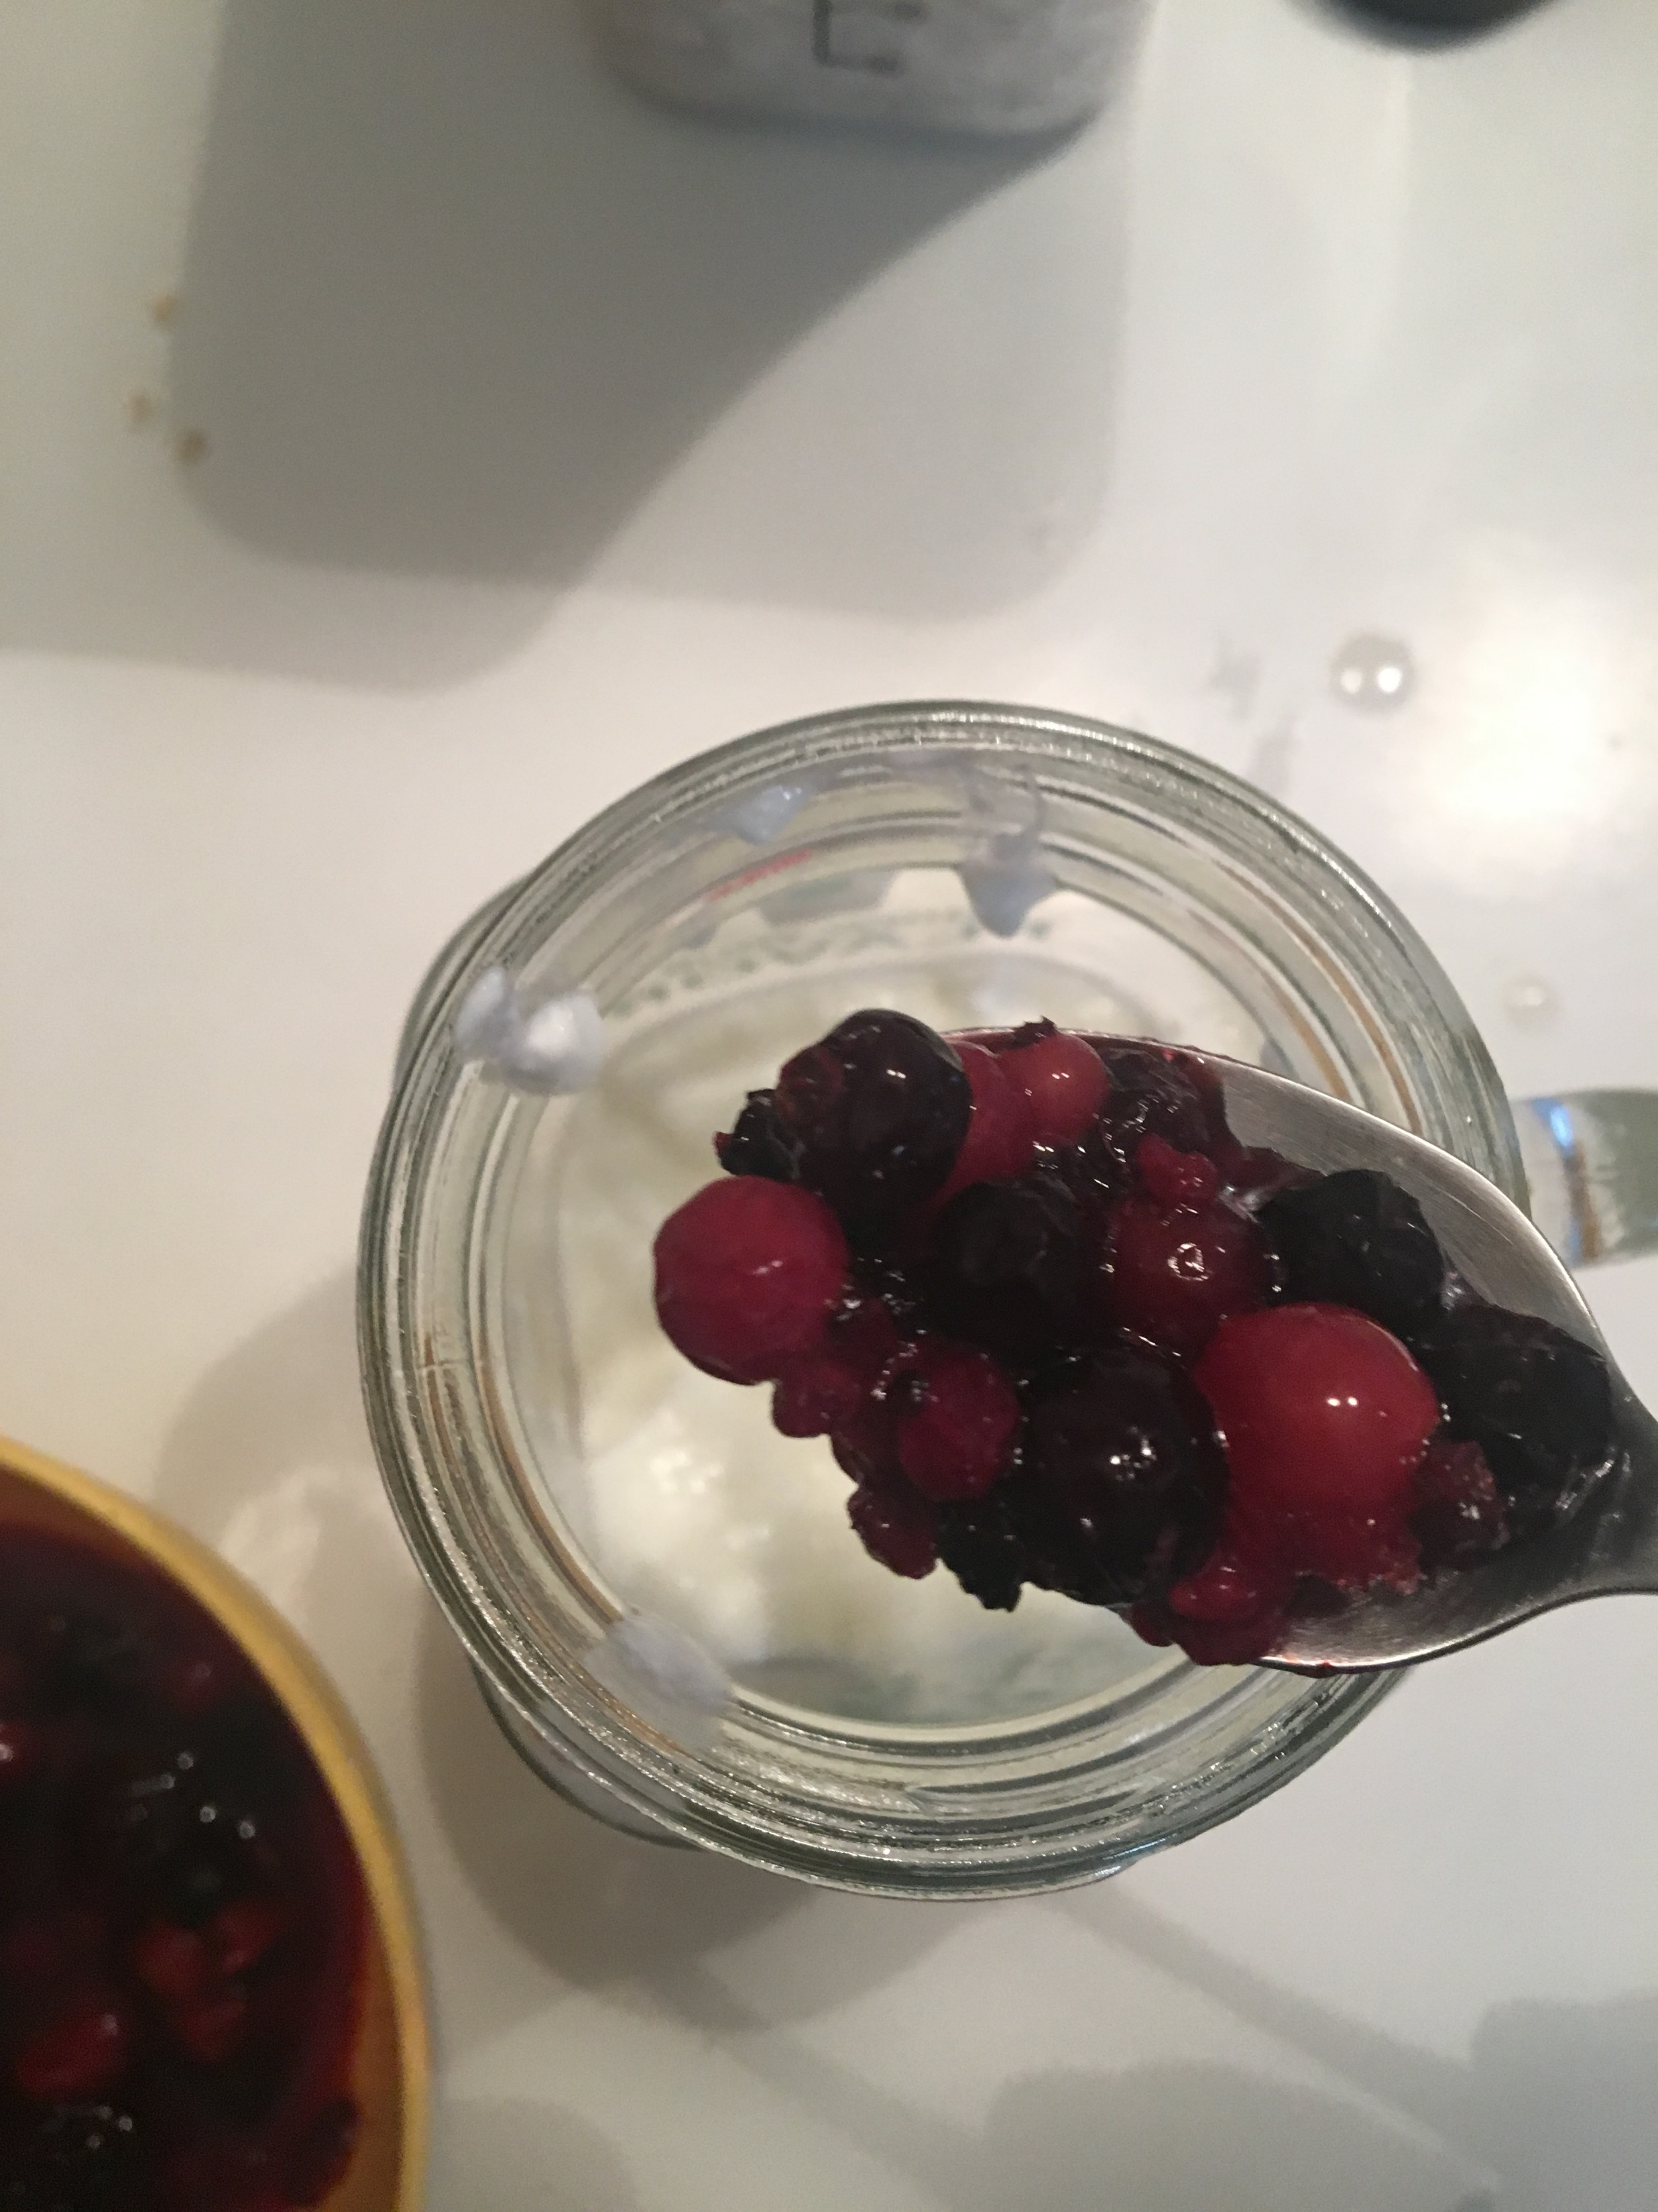
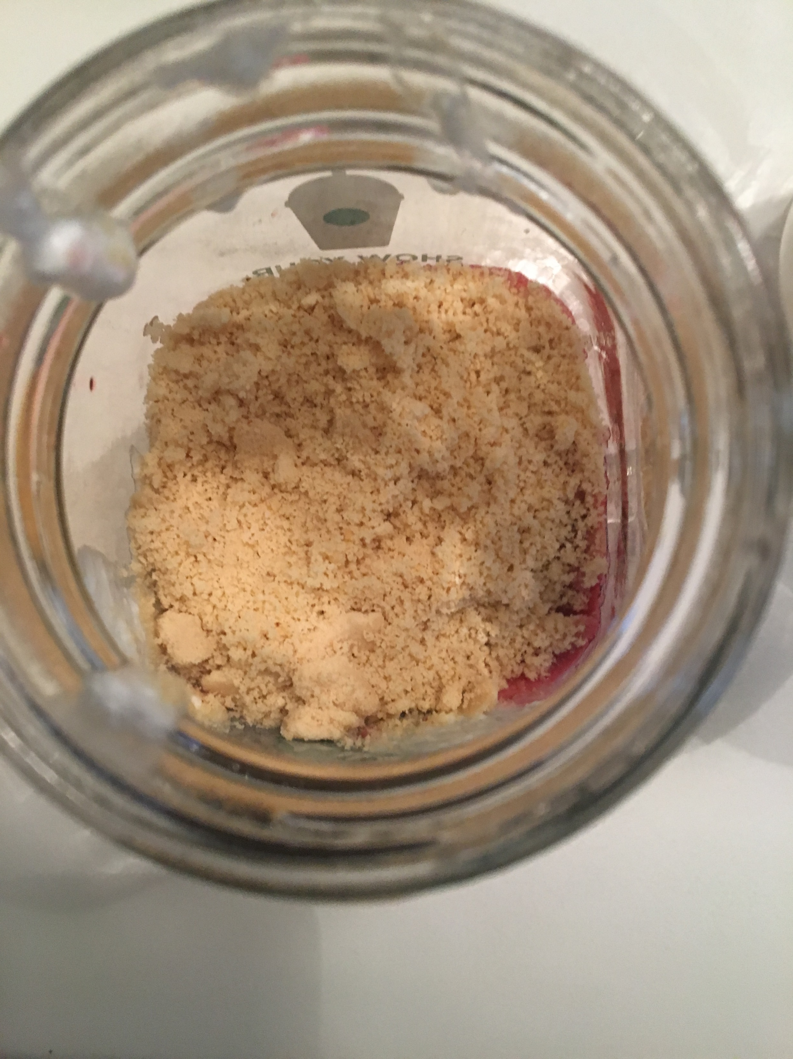
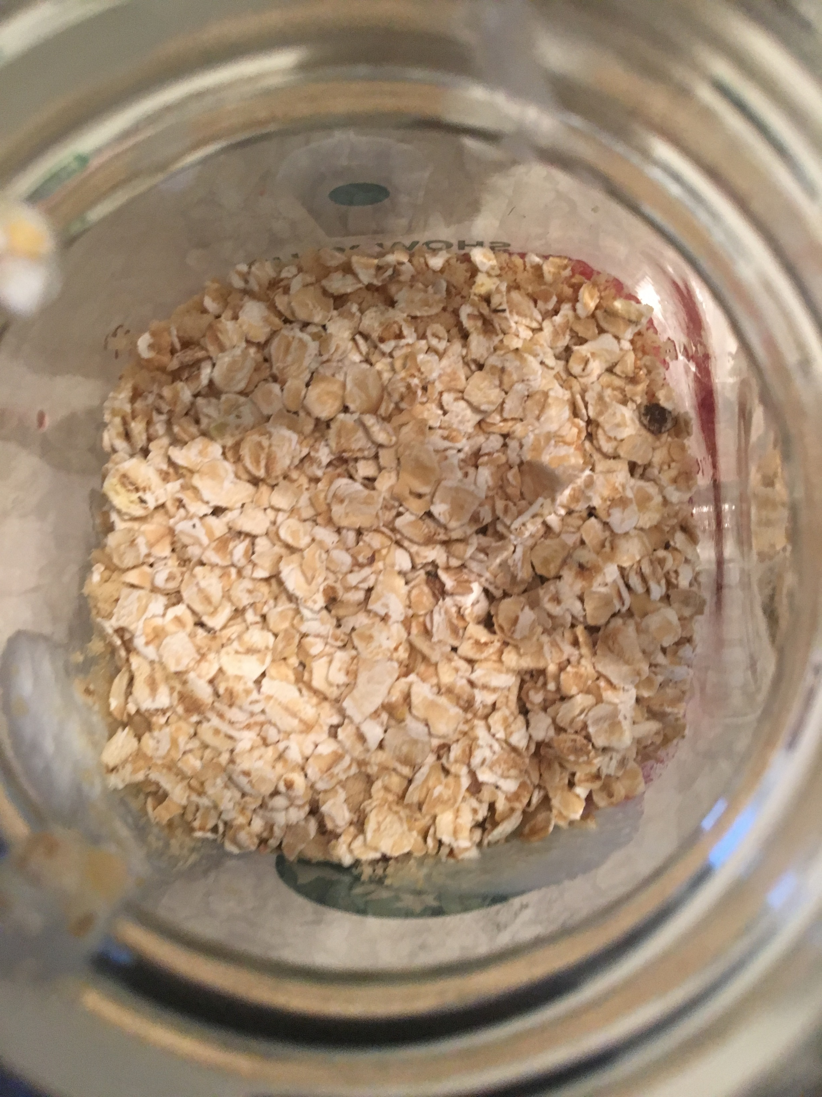
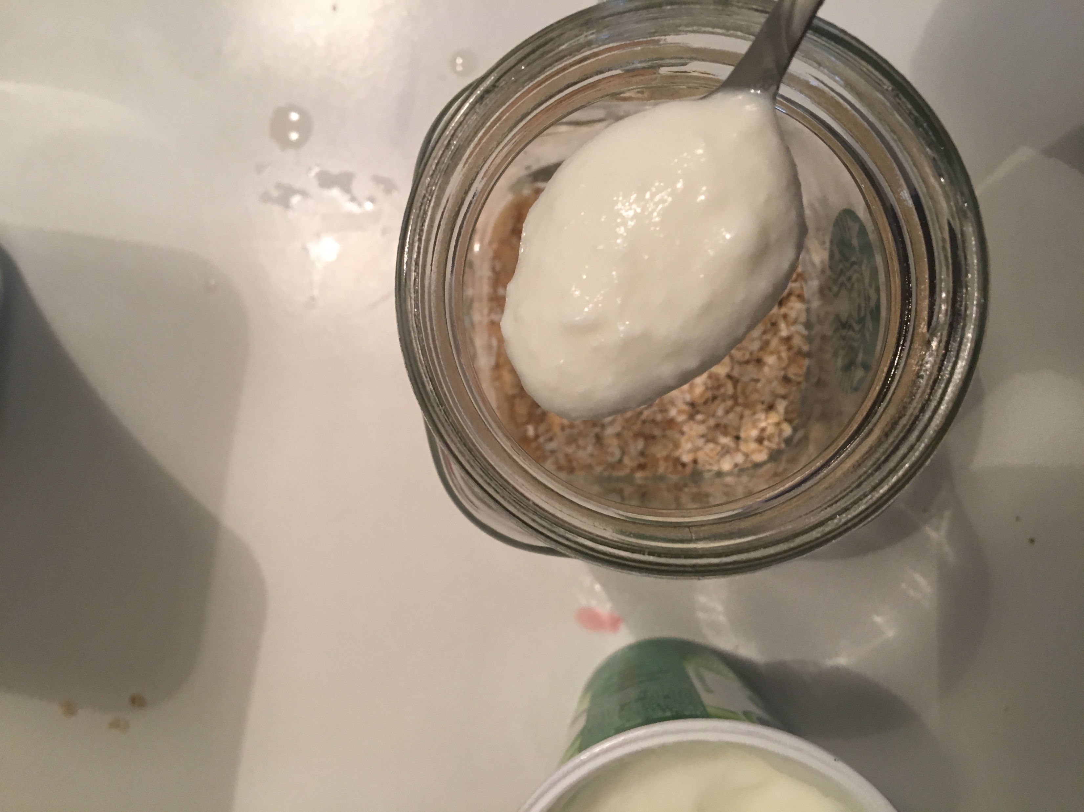
Third step
Now you will need a glass from witch you will eat
You will first need to put one layer of peanuts
On that layer you will pu layer of muesli, than layer of yougurt and on top, layer of fruit

Slide 6
Reasult
This is what it shoud looks like
Good apetite!

