Slide 1
MUFFINS WITH APPLE

Slide 2
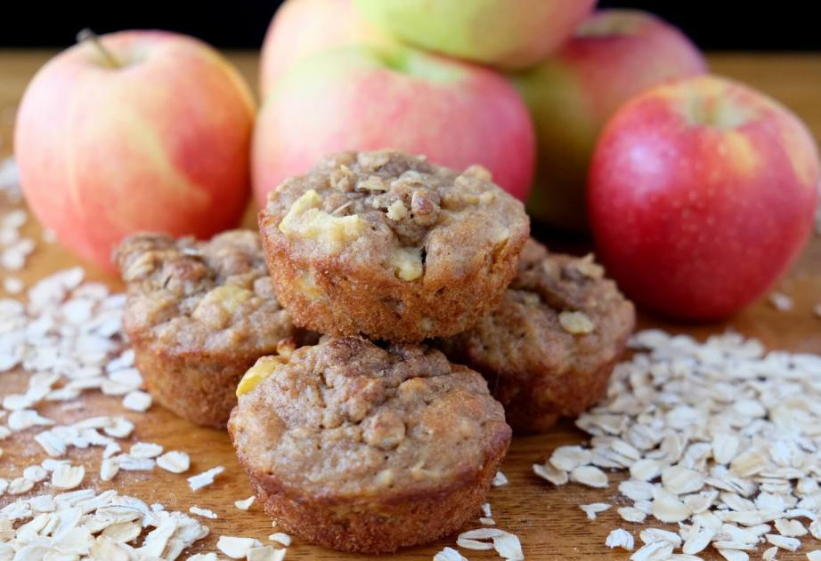
MUFFINS
Muffins with apples is simple recipe.
It doesn't work long and it's really good.

Slide 3
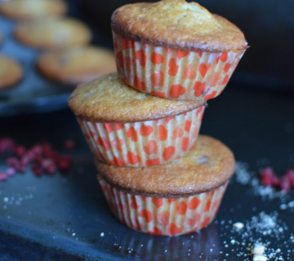
INGREDIENTS:
1 egg
100 g of sugar
60 g of sunflower oil
120 ml of milk
250g flour
1 baking powder
a pinch of salt
200 g of apples
2 teaspoons Vegeta cinnamon minced

Slide 4
Preparation
1.Mix eggs and sugar, add oil, milk, flour, baking powder and salt.
2.Stir well to obtain a smooth mixture and finally mix grated apple and cinnamon.
3.Place the arrangement in the muffin molds in which you previously placed the paper baskets.
4.Bake at 170 ° C for 30 minutes.

Slide 5
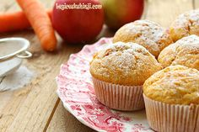
Serving: Sprinkle the cooled muffins with powdered sugar
Tip: Optionally, instead of apples and cinnamon, you can add chocolate, cherries or blueberries to the dough.

Slide 6
THE END

