Slide 1
Where’s Reunion located ?
Reunion is here. It’s really small !
Reunion is situated in the Indian Ocean, next to Madagascar on the East coast of Africa.

Slide 2
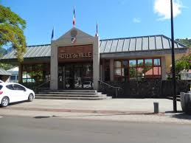
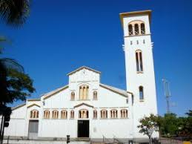
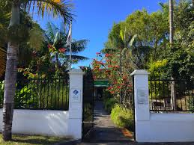
The village of Entre Deux
The village of Entre-Deux is one of the most beautiful villages in Reunion,
In Entre-Deux , there are a lot of things to do.
Entre Deux has a swimming pool, a soccer field, tennis courts, a dojo, etc.
You can also go shopping and then eat local food or ice-cream and crêpes
We have nice restaurants!
The name "Entre-Deux" was given because this city is between two
branches of the River Saint-Etienne.
In Entre-Deux, there are about 6000 inhabitants.

Slide 3
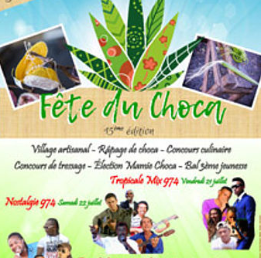
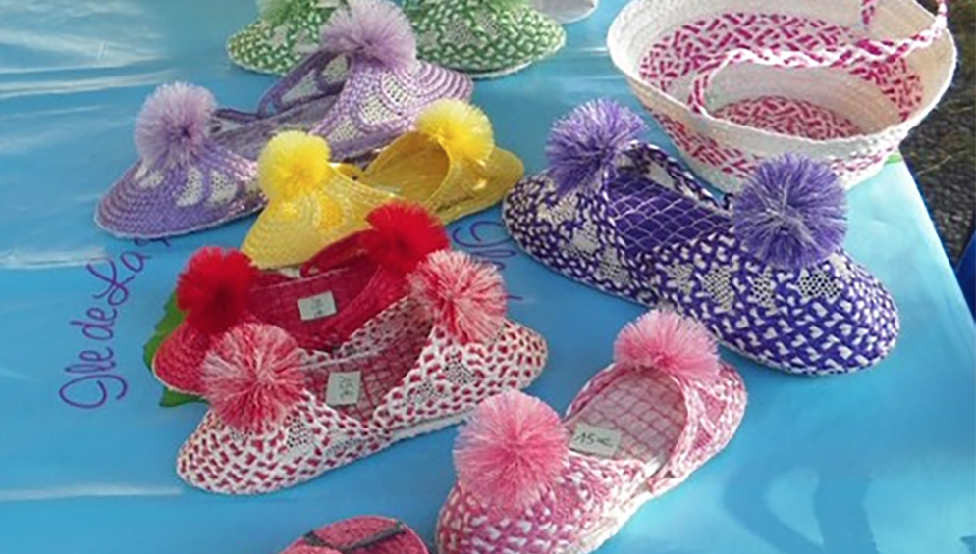
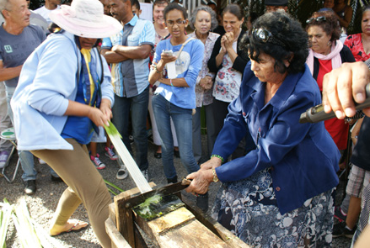
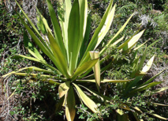
The village organizes festivities like ‘La fête du Choca’, a cultural festival around this local plant.
The choca is a plant which is transformed to make everyday objects like slippers,hats or baskets.
Choca weaving is an old craft.

Slide 4
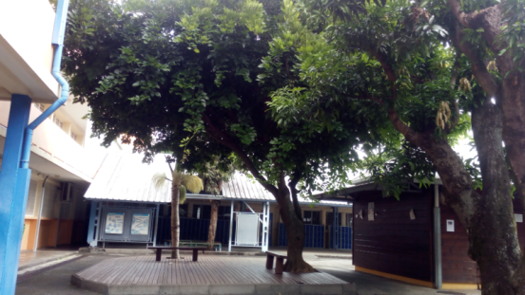
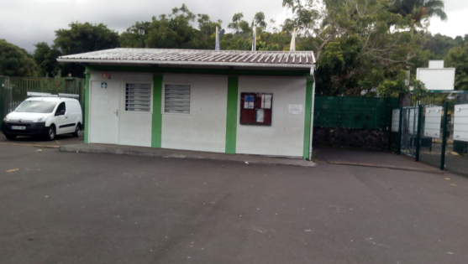
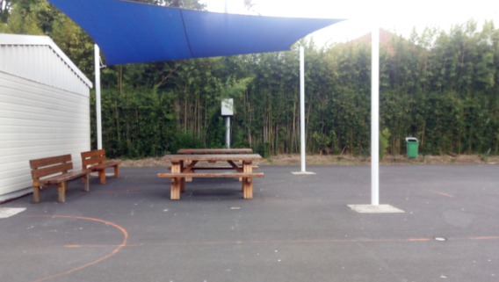
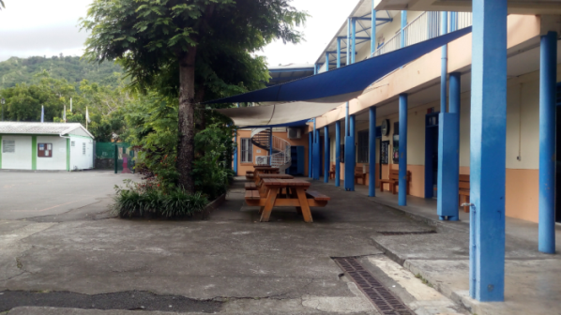
Le Dimitile High School
There are about 400 pupils in our school. There are 16 classes from 1st to 4th year.
We are in 2nd year.
The headteacher is called Mr Strintz.

Slide 5
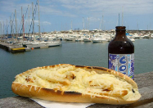
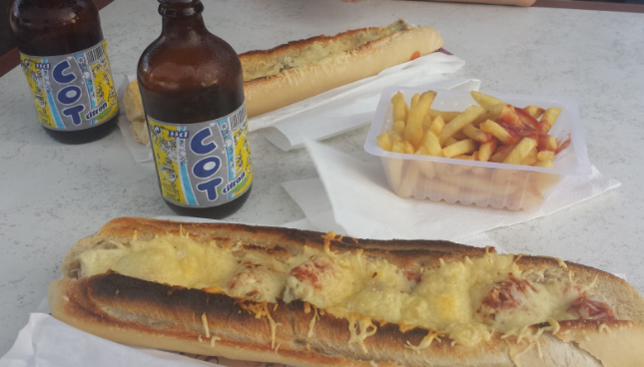
FOOD AND DRINKS

Slide 6
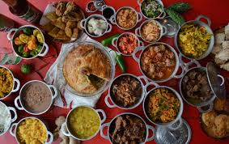
Reunionese cuisine or Creole cuisine from the Indian Ocean is the result of a mixture of Malagasy, French, Indian, African and Chinese influences brought to the island by successive immigrants. It is spicy and tasty , yum!

Slide 7
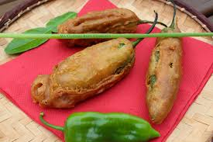
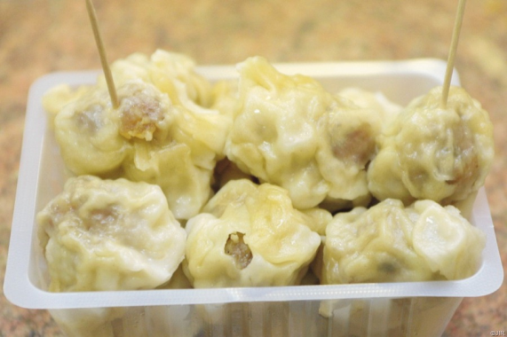
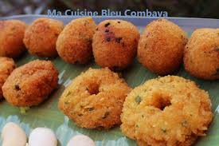
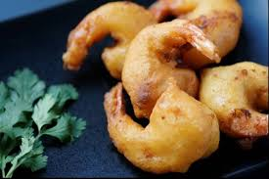
Appetizers or snacks
The most traditional are
SAMOSAS
BIG STUFFED PEPPERS
BOUCHONS
CHILI SWEETS
SHRIMP FRITTERS

Slide 8
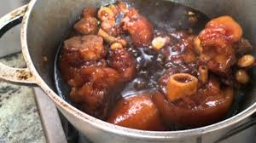
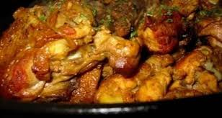
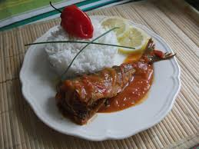
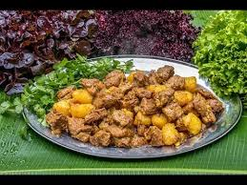
MAIN DISHES
ROUGAIL SAUSSAGE
These dishes are usually served with rice, beans and also a hot and spicy side called ‘rougail’.
PIG’S LEG
CHICKEN CARRY
PORK CARRY
FISH CARRY

Slide 9
No carry without
ROUGAIL!!!

Slide 10
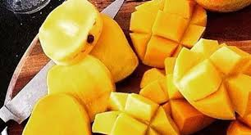
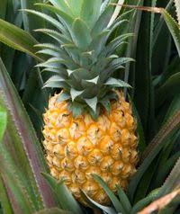
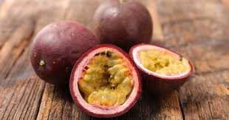
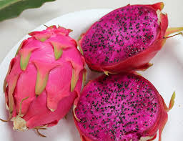
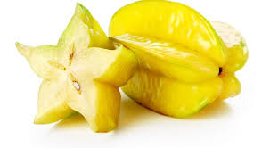
THE FRUITS
MANGOES
LYCHEES
PINEAPPLES
PASSION FRUIT
DRAGON FRUITS
STAR FRUITS

Slide 11
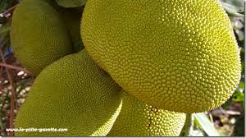
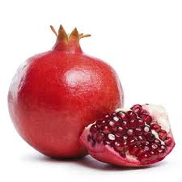
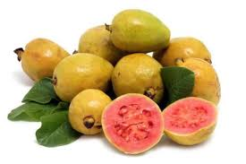
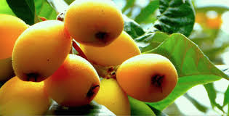
TI’JACQUE OR JACK FRUIT
POMEGRANATE
GUAVAS
TAMARIND
LOQUAT FRUITS

Slide 12
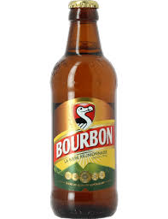
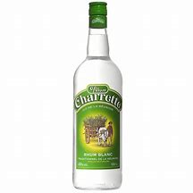
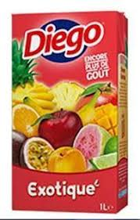
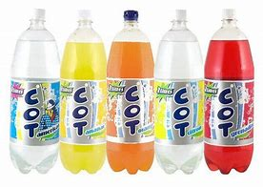
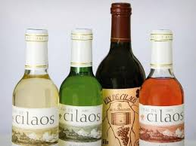
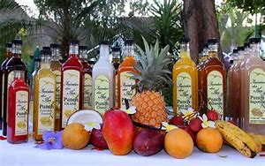
THE DRINKS
JUICES AND SOFT DRINKS
ALCOHOLS
DODO, THE LOCAL BEER
RHUM
CILAOS WINE
PUNCH

Slide 13
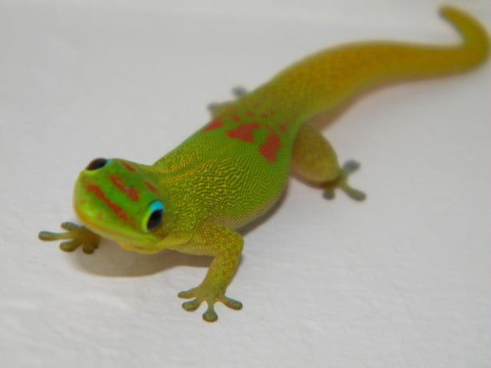
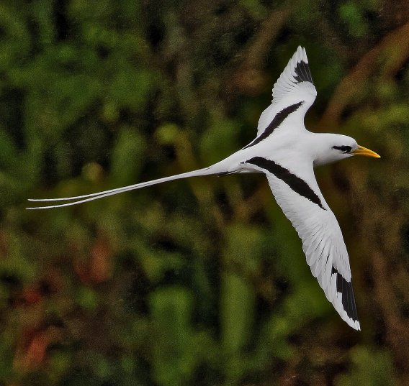
The endemic animals from Reunion

Slide 14
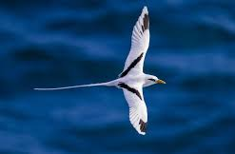
The Paille en queue
The Tropic bird is an emblematic bird of Reunion Island.
It partly feeds on fish and nests on the cliff.

Slide 15
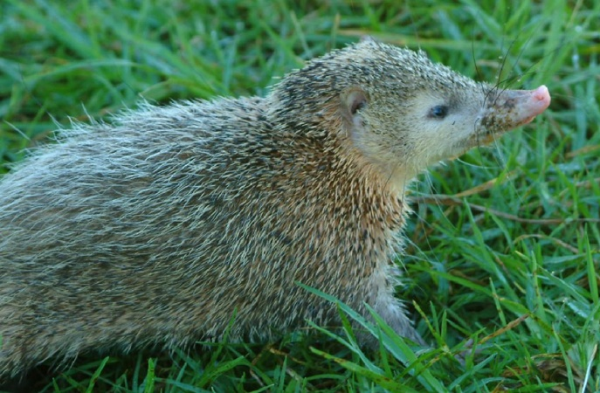
The Tangue
This little mammal looks a lot like a hedgehog.
It sleeps during the day and goes out at night to only feed on insects.

Slide 16
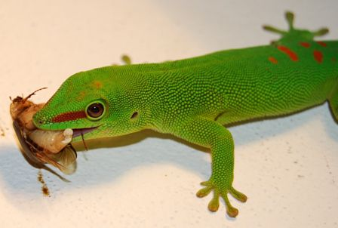
The Margouillat
It's a small lizard that lives inside the houses.
It feeds on midges, spiders and cockroaches.

Slide 17
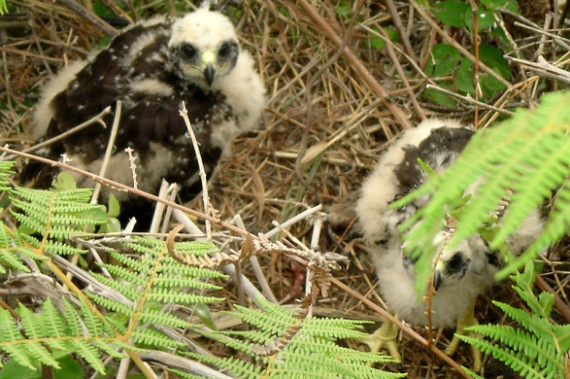
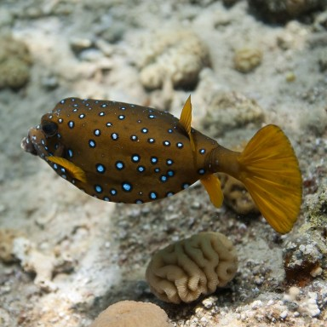
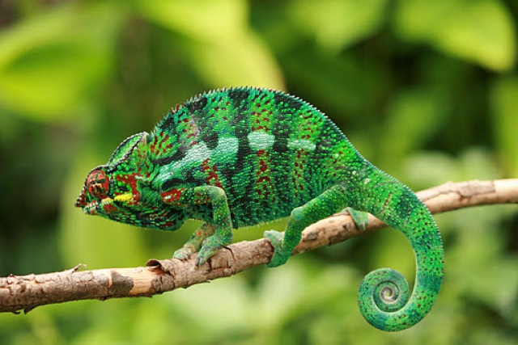
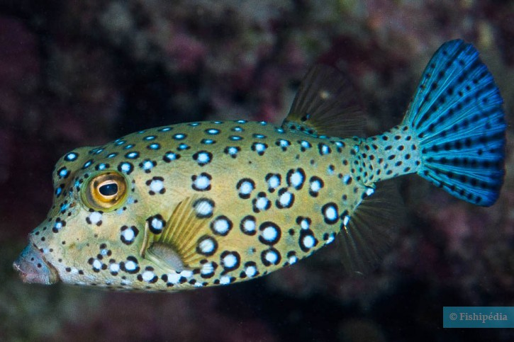
We can also see all sorts of animals ….

Slide 18
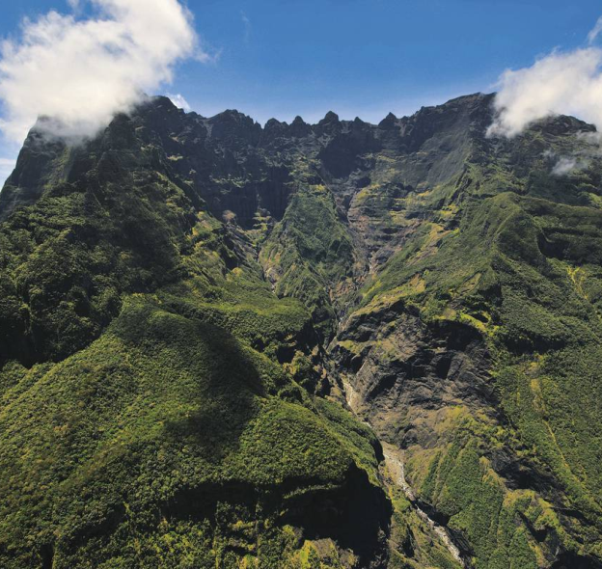
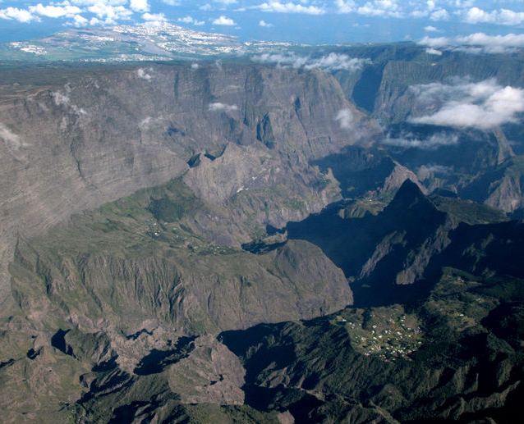
And its different reliefs

Slide 19
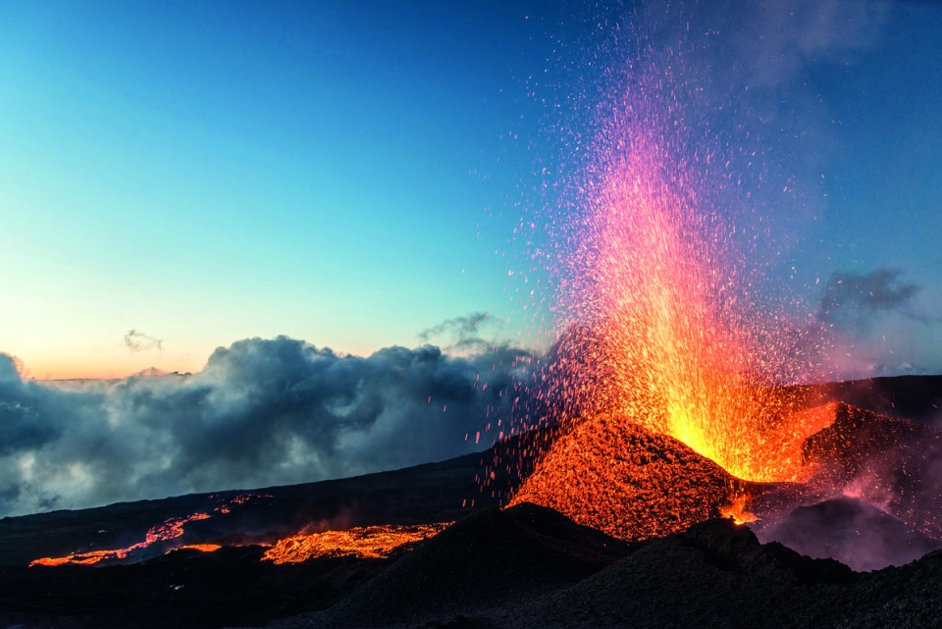
Piton de la Fournaise
It's one of the most active volcanoes in the world.
It’s 2632m above sea level.

Slide 20
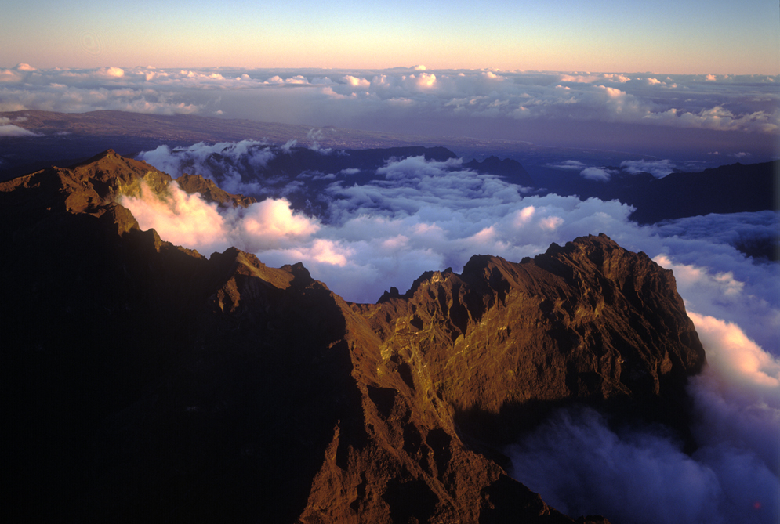
The Piton des Neiges
Piton des Neiges and the volcano are at the origin of the formation of Reunion Island.
It’s the highest point of the island at 3070m above sea level.

Slide 21
The Cirque de Mafate
Its formation is due to important collapses of “Piton des Neiges”.
It’s a great place for hiking.

