Slide 1
And now, Let’s think about plastic!

Slide 2
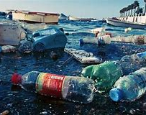
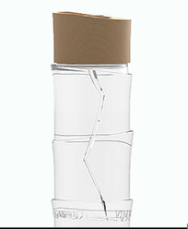
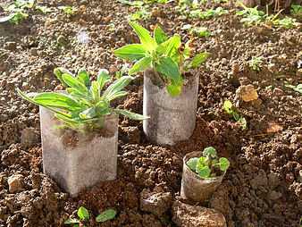
On a global level, there are many startups and organisations which work on solutions to reduce the use of plastic or to collect the tons of plastic waste that pollute the oceans.
For example, Lyspackaging makes bottles from sugar cane residue.
Over 2 million bottles are produced each year. They are 100% biodégradable, compostable and of course reusable !

Slide 3
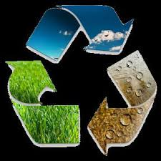
The associations and companies dealing with the environment
GTC :
GTC is in SAINT PIERRE in the south of the island. This company is specialized in non dangerous waste treatment and disposal.
Green Tropical Circle

Slide 4
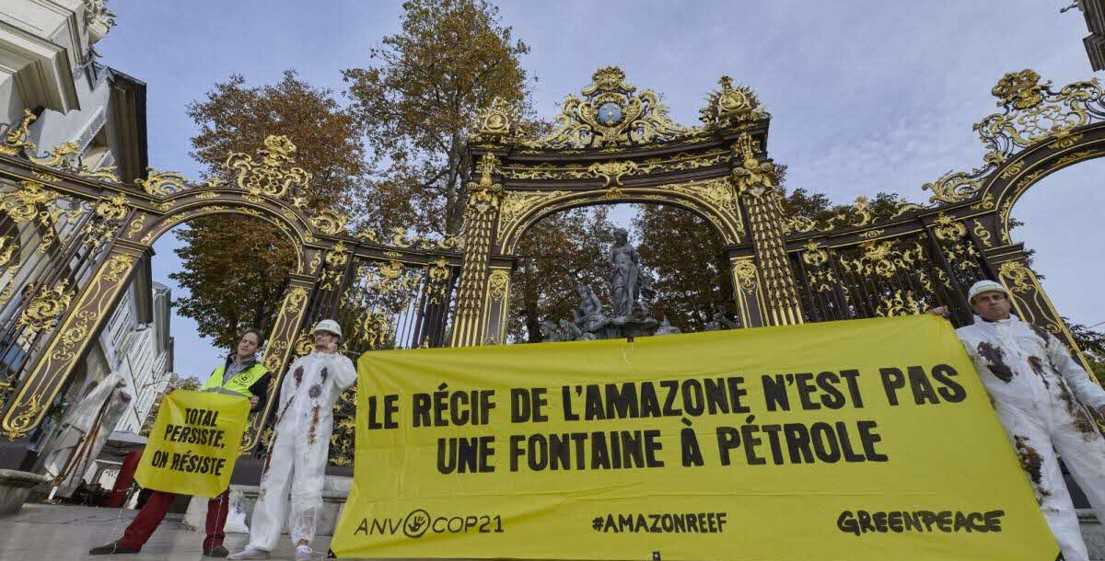
Greenpeace
It’s an association that acts peacefully to protect the environment and biodiversity.
It was created in Vancouver in 1971.
There is a local branch in Reunion, of course!

Slide 5
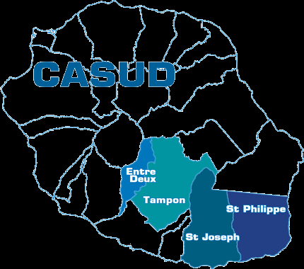
CASUD
CASUD stands for Southern Agglomeration Community.
This association was born in 1998.
Its goals :
Wastewater treatment
Protect the environment
Economic development
And MANY more.

Slide 6
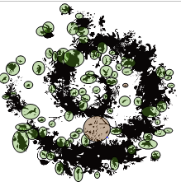
the National Park
In the National Parks logo, we can see a lot of plants and also a lot of animals. Some small animals are drawn like the big ones, why?
Because they are all as important as the others!
We can see many birds, mammals, insects (ants, butterflies, scorpions...) but also lezards, fishes, snails, spiders...
A lot of plants (trees, ferns, flowers, leaves...) are drawn too. Have you noticed that there are also animal footprints?
It's a beautiful logo!!
The logo of each National Park has a different colour and Reunion ‘s is dark green

Slide 7
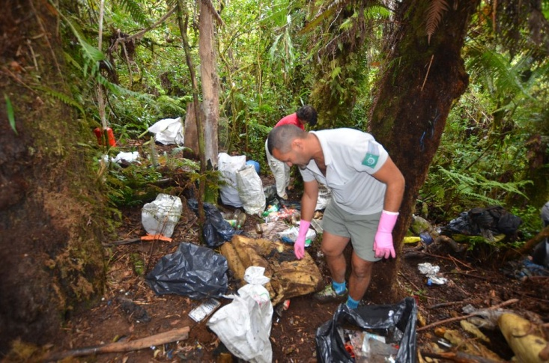
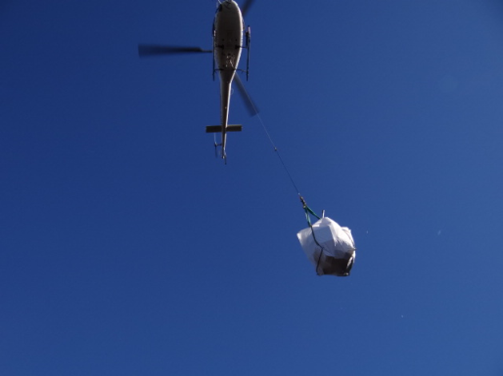
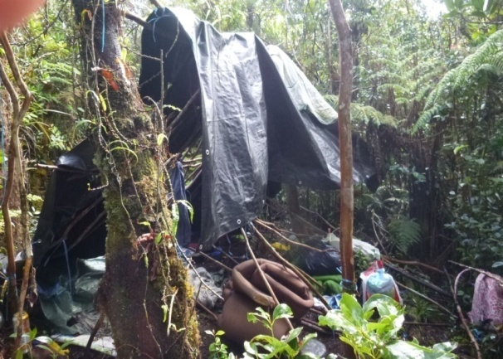
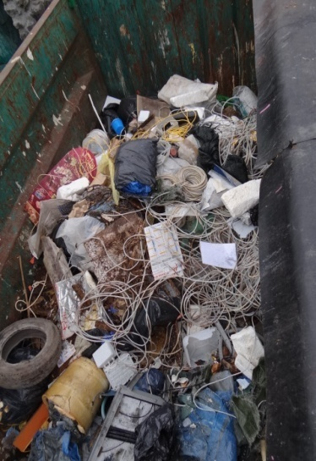
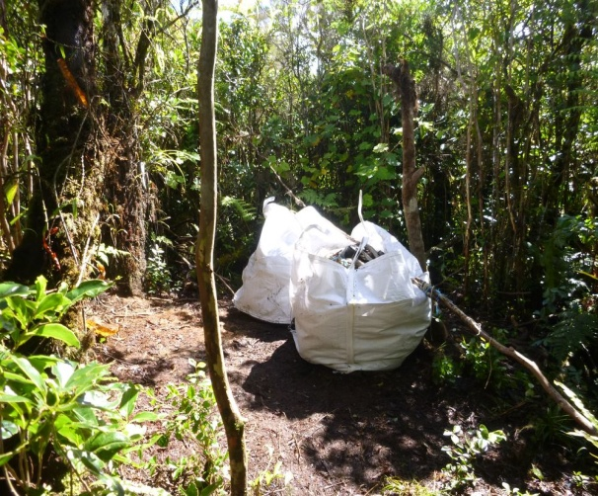
One of their mission is to clean up waste left by poachers and scientists.
They are often helped by volonteers.
Before
After
So much plastic is collected!

Slide 8
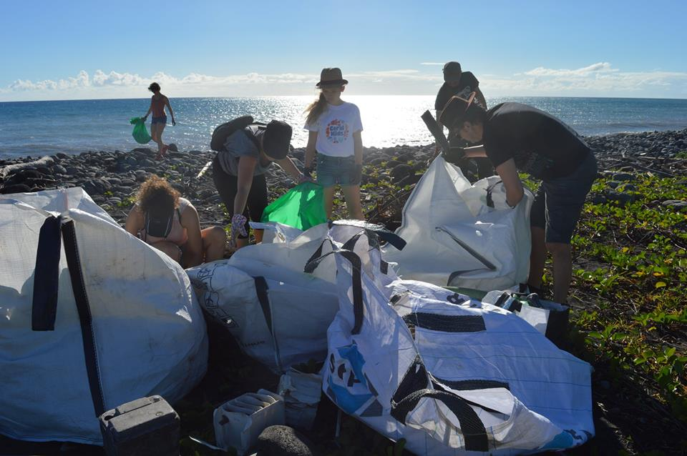
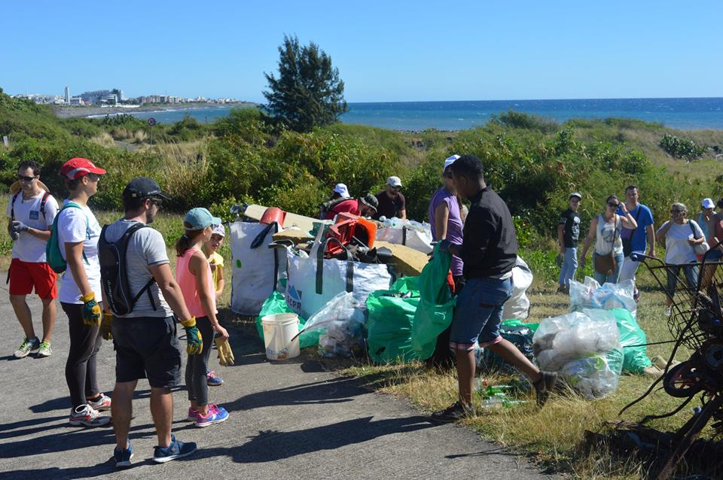
PROPREUNION
Propreunion is an association which organizes Redd up throughout the island. Here, in St-Benoit, in the east.
They ask for volunteers to get together and to collect and separate the waste .
They have a Propreunion Facebook page and a YouTube channel where you can see their videos and actions.

Slide 9
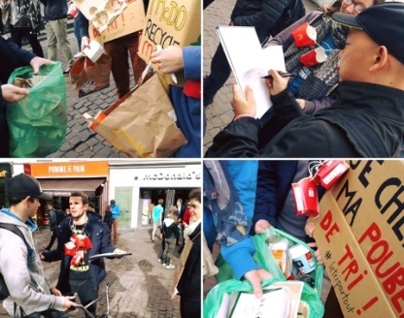
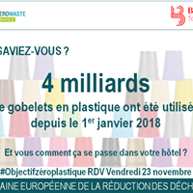
ZEROWASte . ZERO DECHET LA REUNION
Zerowaste is an association created in 1997 which tries to sensibilize a large public such as citizens, local businessmen and politicians
They want to make them reduce their waste.
Zéro déchet La Réunion is the local group of zéro waste France.
This is one of their campain !

Slide 10
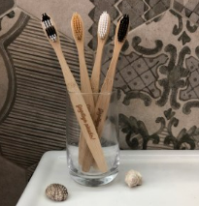
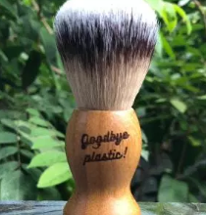
GOODBYE PLASTIC: Looking for alternative solutions to single use plastics IN REUNION!
Tristan Simille created GOODBYE PLASTIC ! with the objective to contribute to the reduction of waste in Reunion and elsewhere with products such as toothbrushes imagined in Reunion and made in wild bamboo.

Slide 11
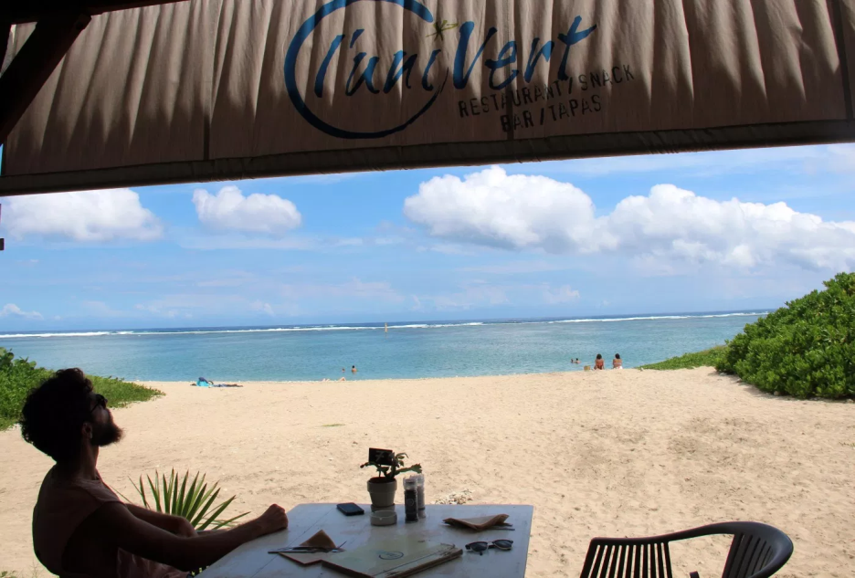
La Rondavelle l’Univert
But, what is a rondavel in Reunion? It’s a public place where you can eat or have a drink. Rondavels are usually near the beach
La Rondavelle Univert is in the west in a place called « La Saline ». They are specialized in vegetarian, vegan and gluten-free dishes.
They partly organize «The international day without plastic straw » in Reunion.

Slide 12
La Rondavelle l'Univert, Goodbye plastic and Zero dechet La Reunion organize for the second year:
The international day without plastic
Saturday 2nd February 2019, from 16:30 to 21:00
Beach cleaning
Cocktail party without straws.
Screening of the documentary « straws » and exchange of ideas with local actors.
It’s a big problem in Reunion too. There are about 100 000 straws used every day. Can you believe it?

Slide 13
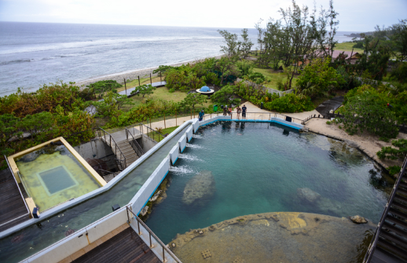
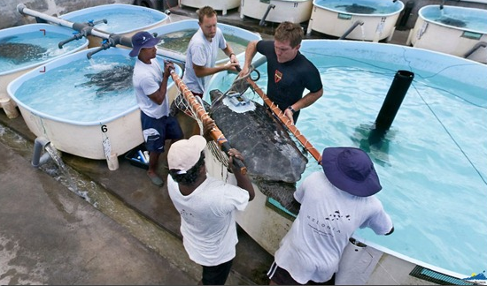
KELONIA
Kélonia is an aquarium, a museum and a research centre devoted to sea turtles. It is located near Saint-Leu , a small town on the west coast of the island.
When we went to Kelonia, we first visited the centre but after we did a workshop and discovered how harmful plastic is to sea turtles!!!

Slide 14
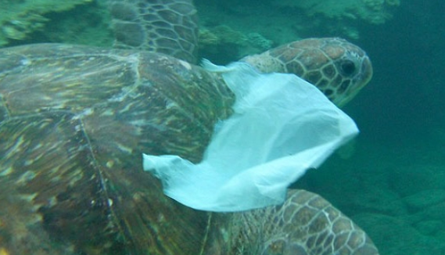
A lot of sea turtles die because they have eaten plastic!
They can also suffocate because of plastic bags!
That’s what we can find in turtles’droppings!!!! Hard plastic!

Slide 15
DEFI PLASTIK
Défi Plastik were 3 scientific and et pédagogic expeditions which departed from Reunion for a total of 10 000 km.
As a result, they helped us to discover how much plastic there was in the Indian ocean.
The aim was to sensibilize people, opinion leaders and political actors to this ecological disaster.

Slide 16
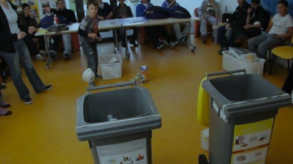
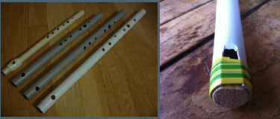
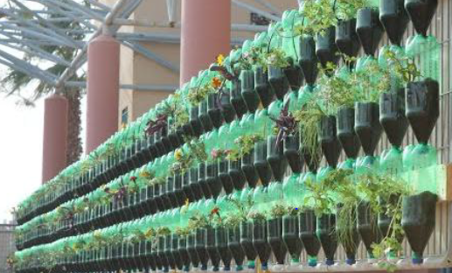
FABLAB CYBERUN
The association organizes different workshops with students to sensibilize them to plastic recycling.
Let’s try to throw plastic in the right bin!!!
Let’s make musical instruments with plastic!
Why don’t we makea green wall using plastic bottles?

Slide 17
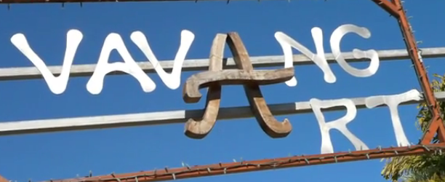
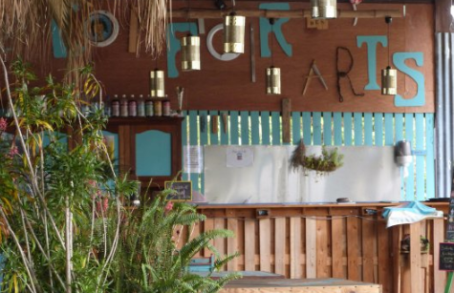
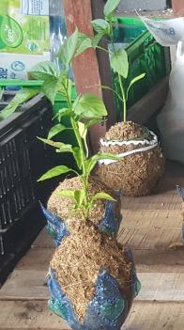
VAVANG’ART
Situated in Entre Deux, it’s an art centre which promotes the recycling of all kinds of objects.
They have banned single used plastic items and use for example bamboo straws!
We took part in a workshop there, making kokadame with plastic bottles!

Slide 18
What about us!! What do we do ( or try to do) to reduce our plastic use???
When I go to the beach, I pick up the waste ( mostly plastic) and I put them in the yellow bin. EMMA
At home, we use zero plastic. We make our own soap or washing powder!
ZIA
I buy yoghurt in big pots to avoid overpacking.
CHRISTINE
When I go to the shops, I never take or buy plastic bags.
ALBANE

Slide 19
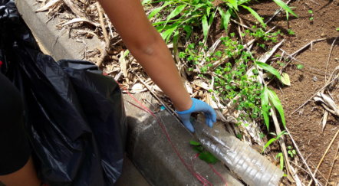
I recycle! That was my Christmas tree!
LYNZEE
I’m very careful not throw anything!
KILYANNE AND LORENZO
When I go walking with my family, I collect plastic bottles and put them in the recycling bin.
SUZANNE
I recycle plastic bottles to reuse them. I use paper bags rather than plastic bags
JADE

Slide 20
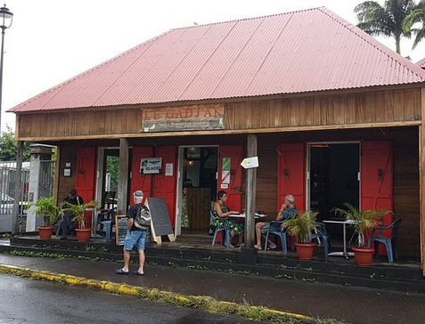
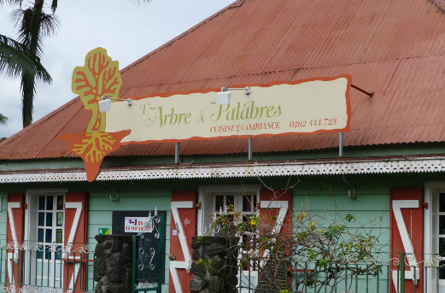
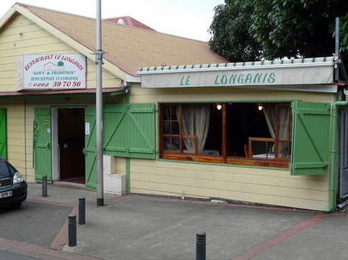
What’s happening in Entre Deux? Are the local actors ready to change their practice and use less plastic?
Here are the answers from the shopkeepers and the restaurant owners!

