Slide 1
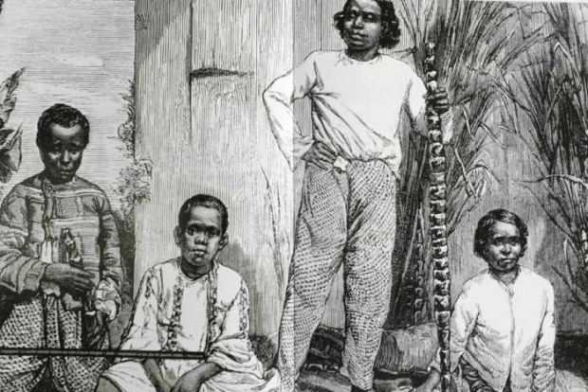
HISTORY of REUNION
Reunion was often visited but nobody lived there before 1642 when the French East India Company send its first ship there.
1665: 12 inhabitants
1671: 100 inhabitants
1704: 734 inhabitants
The first map of Reunion island. It was first called « ile Bourbon »
The first inhabitants of the island

Slide 2
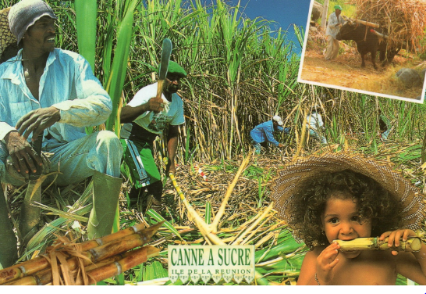
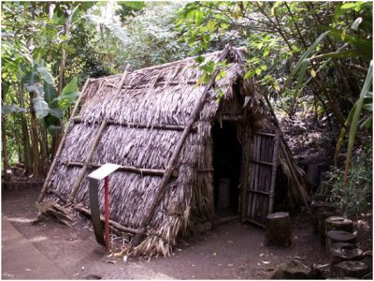
1715/1730: Coffee was introduced,
then sugar cane so
the economy changed a lot
and more and more slaves were needed!!
!1788: 47 195 inhabitants
( 37 984 black slaves)
Late 18th century: a lot of slaves escaped in the mountains and built villages but they had to wait 1948 to be free!
Did you know Reunion had been British for 5 years, from 1810 to 1815??

Slide 3
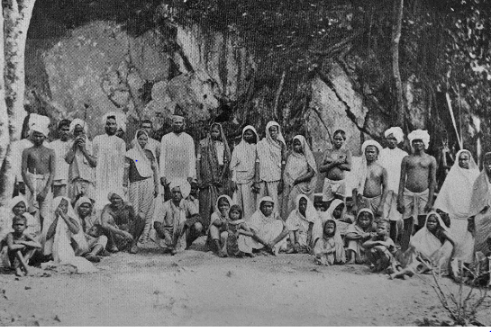
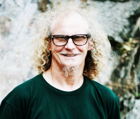
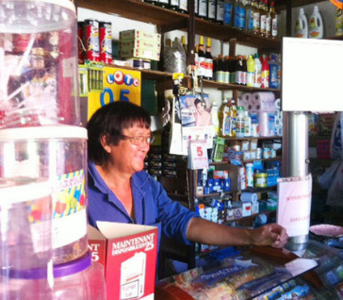
With the abolition of slavery, workers from different parts ofAsia and Africa came. A lot of white settlers went to live in the Highlands but they were very poor. They were called « Yab » At the turn of the century, Chinese and Muslim arrived to sell food and textile. That’s why Reunion is a land of diversity!!!

Slide 4
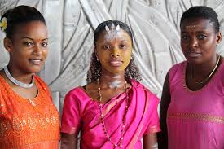
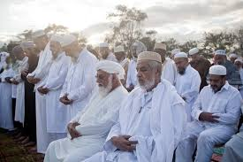
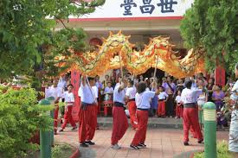
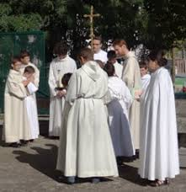
Religious diversity
In Reunion Island, we have a great religious diversity:
Hinduism,(Malbars) who pray in the temples.
Muslims (Zarabes) who pray in the mosques.
Buddhists (Chinese) who pray in the temples.
The Catholics (Christians) who pray in the churches.
The Jews (Jewish) who pray in the synagogues.
Even with a lot of religions, everyone respects the religion of the other.
It’s all these religions that make our genaration.
Malbars
Zarabes
Chinese
Christians

Slide 5
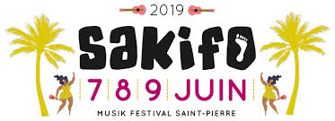
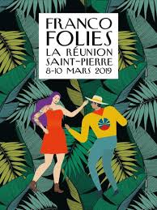
Musical Diversity
Maloya and séga
In Reunion island, we have two traditionnal dances:
-The maloya is a dance that comes from the slaves
-The séga comes from Mauritius
In these two dances, we wear the same outfits :
A long skirt and a short top . The whole is flowery and colorful . This outfit is called « Robe Maloya » .We also listen to all kinds of music
Every year, great musical evens take place: The « Sakifo » and the « Francofolies ».
They take place in southern Reunion. Sakifo and Francofolies last three days during which there are several concerts. Francofolies are in March and the Sakifo is in June.
sakifo
Francofolies

Slide 6
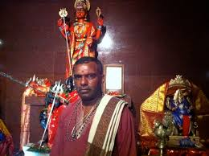
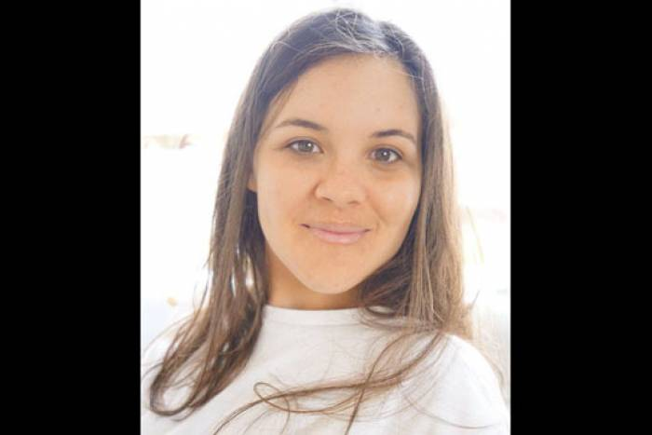
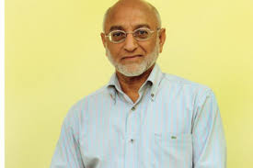
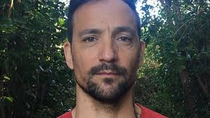
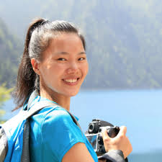
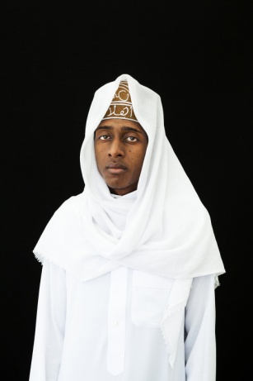
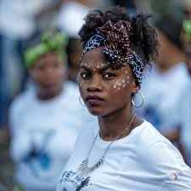
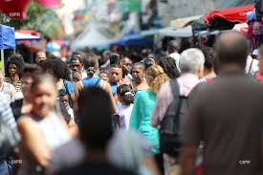
Linguistic diversity
-The Malbars speak Hindou and « Creol »
-The Yabs (The whites who live in the highlands) speak creol but with a singing accent
-The Zoreils (the metropolitans) who can also be called « Zoréoles » speak fluently French and try to talk Creol .
-The Zarabes speak Arab and Creol a little
-The Chinese speak Mandarin but more often Creol.
-The Comorians speak the « Shikomori » and Creol.
The official language in Réunion is French but the first spoken language is Creol.
In Réunion, all these languages make our beautiful culture

Slide 7
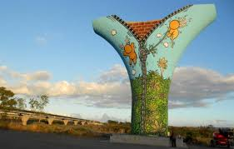
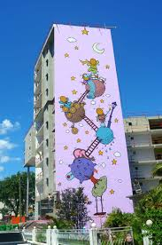
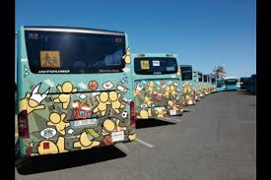
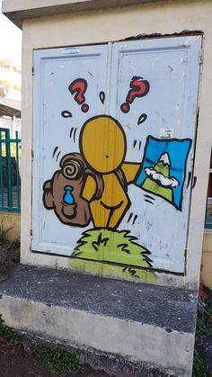
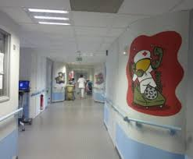
ART
In Reunion, we have a famous graffiti artist, JACE , who created the famous Gouzou: the little orange characters that we can see everywhere on the island:
on bridges, walls, in hospitals, and on buses. His creations went beyond the borders of Reunion because he exhibited in Paris and New York

Slide 8
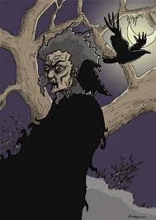
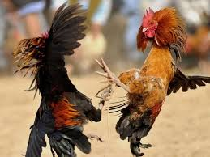
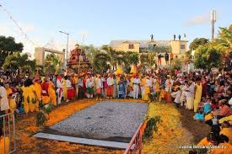
Culture, tradition & legends
Grand-Mère kalle
It’s a scary old woman who lives under the volcano, she tells misfortune and practices witchcraft.
To scare the children, they are told that she will pick them up and eat them
Cockfights
Probably imported from Asia, cockfights are a true Reunion tradition. Players bet money on a rooster. The roosters fight and the one which puts the crest of the other on the ground is the winner.
The Walking on fire
It takes place in the context of a religious vow in which the devotee walks on fire in exchange of a wish or a blessing granted by the goddess Draupadi. The walking on fire is very popular in Reunion

Slide 9
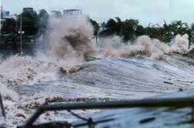
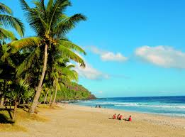
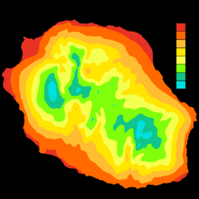
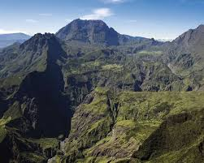
Reunion has a humid tropical climate.There are two seasons: a rainy season from January to March, during which most of the year's precipitation falls and a dry season from May to November. Rain can be important even in the dry season
It's very hot in summer and it's often hot in winter too. But, if you go to the volcano, it’s much colder. It can even be under zero!!!!
The biggest cyclone in Reunion was “ Hyacinth” in 1980.
On this picture, we can see temperatures in different towns
Climates in Reunion Island.

Slide 10
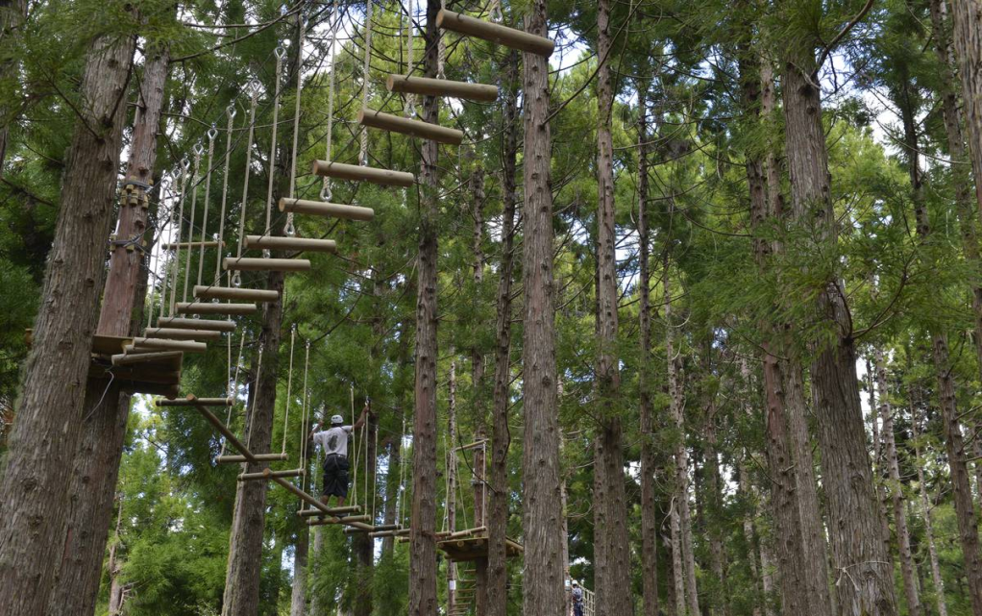
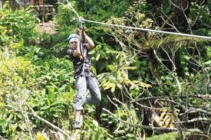
SPORTS AND ACTIVITIES IN Reunion
You can go tree climbing
It’s really cool!

Slide 11
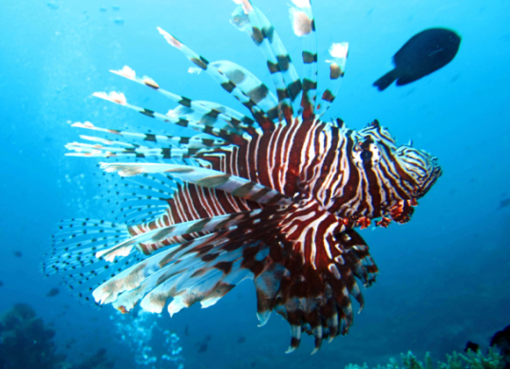
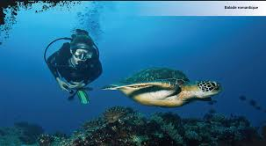
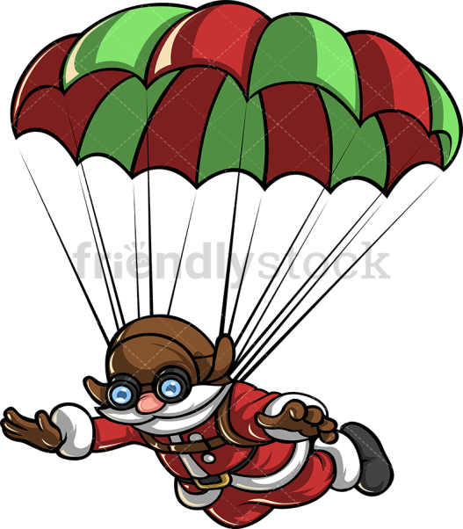
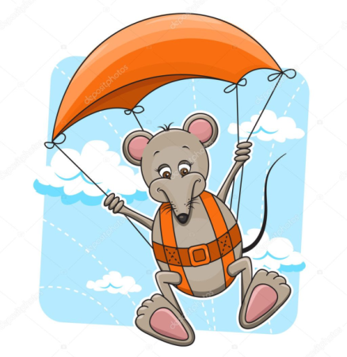
You can go diving
You can also go parachuting!!

Slide 12
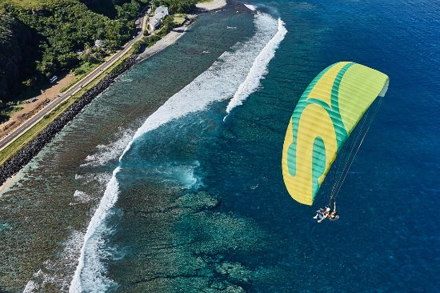
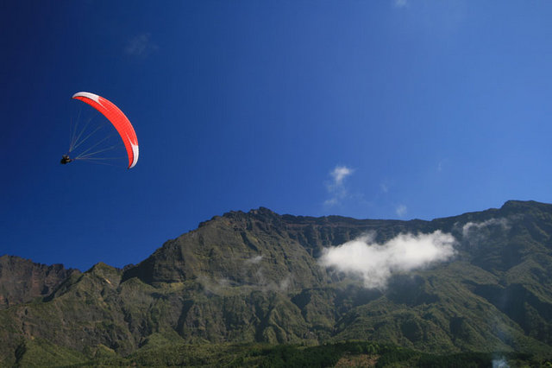
AND YOU CAN GO Paragliding OF COURSE! It’S VERY POPULAR!
In Reunion, we can also practice paragliding. In St-Leu, in the west of the island, there is the most famous site. But it is possible to practice in many different places.
When paragliding, you can see the lagoon or the mountains depending on where you are.

Slide 13
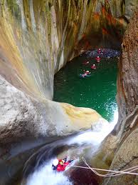
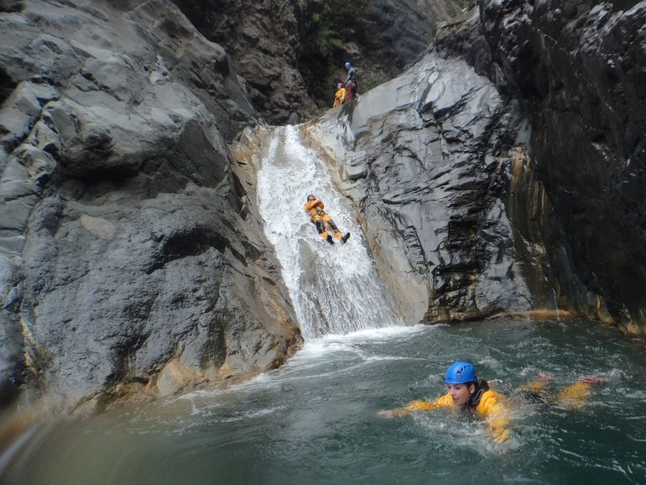
Let's go canyoning to the depths of the earth with a rope !

Slide 14
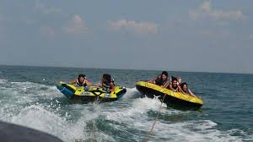
Let’s have fun on a banana boat with funki jet !!!!!!!!!!!!!!!!!!!!

Slide 15
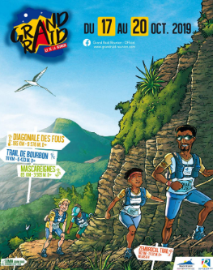
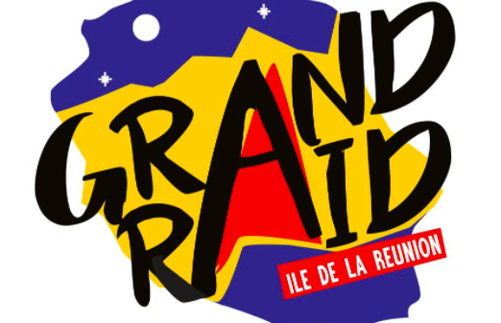
And of course, let’s go hiking or …..running in the mountains!
Have you ever heard of the very famous mountain race?
You must be totally crazy to run 165km in the mountains in less than 3 days! Less than 24 hours for the first ones!!!!!!

