Slide 1
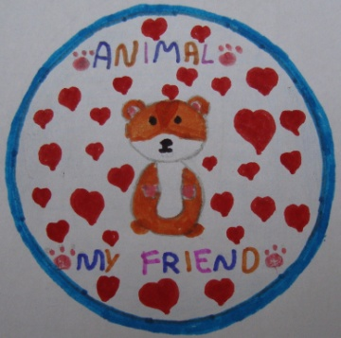
The “ARK” of Mytilene Goes To School
Pamfila Primary School
Mytilene, Lesvos
GREECE
25-2-2016

Slide 2
The animal welfare association for unprotected animals –THE ARK- visited our school and informed the pupils about the animal needs and our attitude towards them.

Slide 3
They also showed the children why we should be friendly towards stray animals. Next, the pupils asked questions and discussed them with the volunteers of the association.
https://www.youtube.com/watch?v=j_2vNAIaAPk
https://www.youtube.com/watch?v=3jQRMAEmDy8

Slide 4
Finally, the children expressed their concerns in Art, as well.
LOVE THE ANIMALS
Don’t let me Die!

Slide 5
I like the Sea!
Don’t pollute the SEA!

Slide 6
I want to give animals what they want. The animals are heroes!
The animals are my friends!

Slide 7
Don’t abandon animals!
They are happier when we help them!

