Slide 1
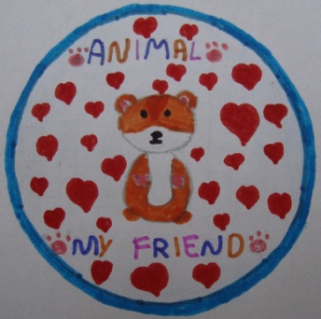
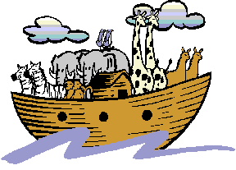
“NOAH’S ARK-” A BOARD GAME
An eTwinning project
“An Animal-My Friend”
By D’ Class
Pamfila Primary School
2016

Slide 2
By playing this game we can practise animal description using the Simple Present. First, we give one copy of the page for every 2 players. The pupils colour the Ark and the animals. Then, they cut them out and fold them along the dotted lines to stand up. You had better glue the Ark on carton and don’t forget to cut out the door.

Slide 3
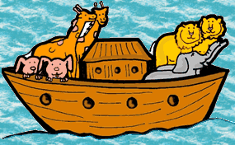
HOW TO PLAY THE GAME
When the Ark and animals are ready, each pair of pupils has one Ark and each pupil chooses 6 animals. Next, the teacher starts saying sentences, like the following:
“The animal that walks slowly goes into the Ark”
“The animal that is long and thin/makes a hiss sound goes into the Ark”
“The animal that eats bananas goes into the Ark”
“The animal that lays eggs goes into the Ark” “The animal that has sharp teeth/lives in rivers goes into the Ark”

Slide 4
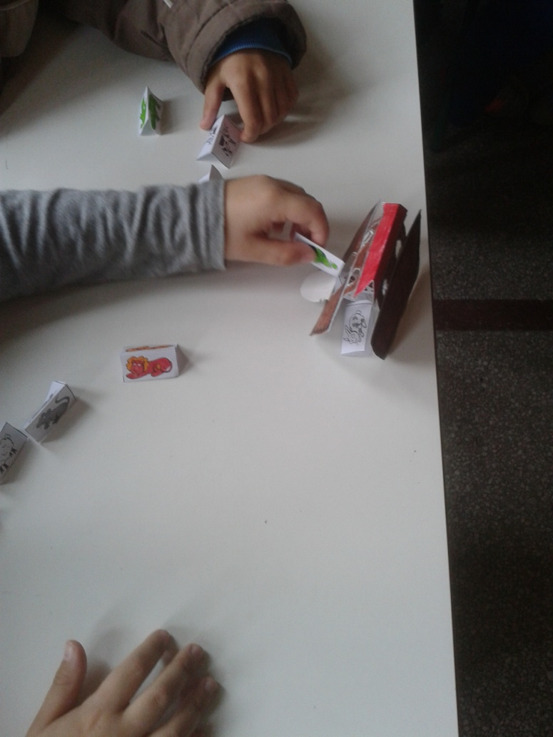
And The winner is…
Every time a pupil hears the description that matches his/her animals, he/she puts that animal into the Ark. And the winner is the one who puts all 6 animals into the Ark first. Of course, you can continue until you have ,a second place winner and a third and so on…
You may also like to learn the song
“THE ANIMALS WENT INTO THE ARK”
https://www.youtube.com/watch?v=Vuhy33admZI
https://www.youtube.com/watch?v=IuQjR2lsYl0
HOPE YOU HAVE FUN!

