Slide 1
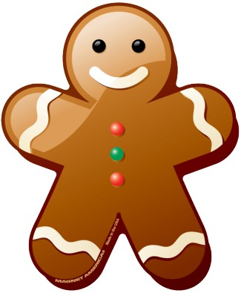
The Gingerbread Man

Slide 2
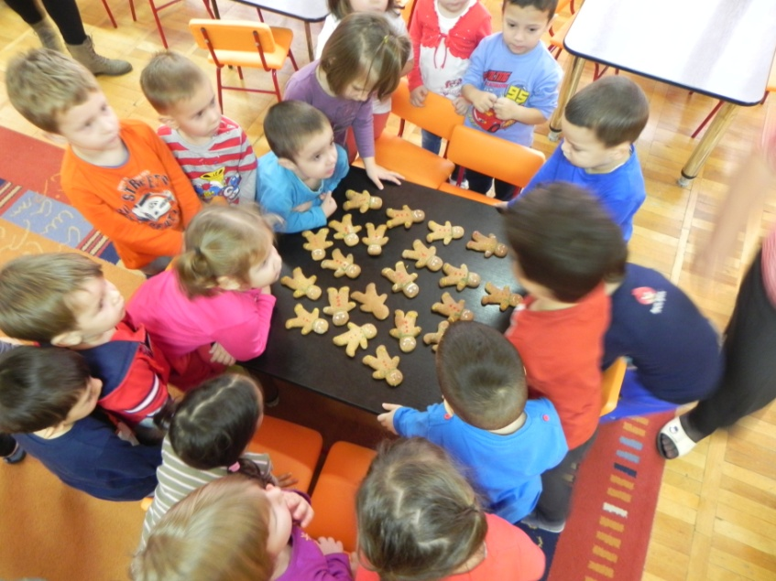
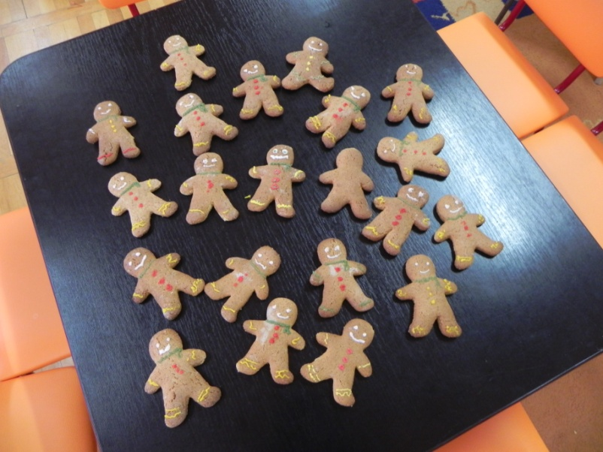
Gingerbread fun in Romania

Slide 3
The recipe
750 g Flour
370 g Sugar
6 Tbsp Honey
6 Eggs
Cinnamon after taste
1 tsp Baking powder or Baking soda
All the ingrediens are mixed together, and after about 1 hour, you can start making and cooking the gingerbread forms.

Slide 4
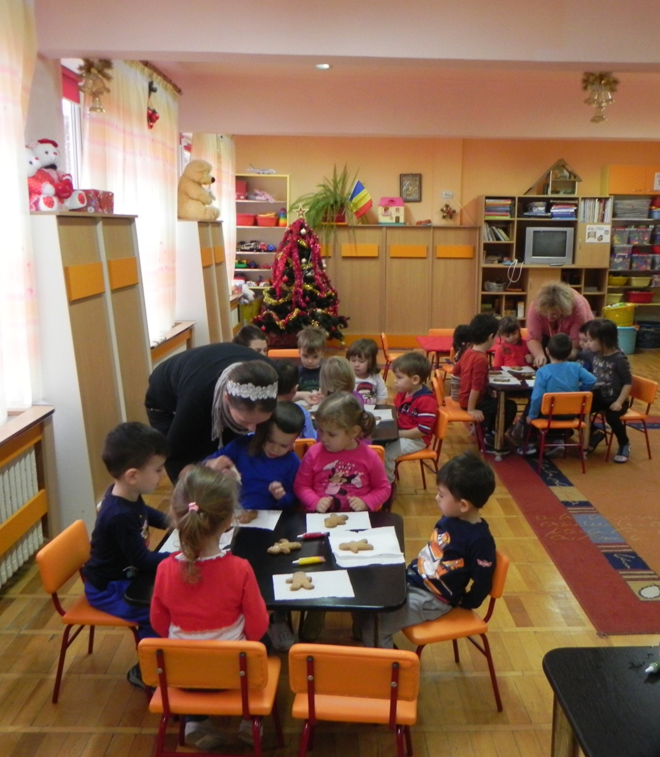

Slide 5
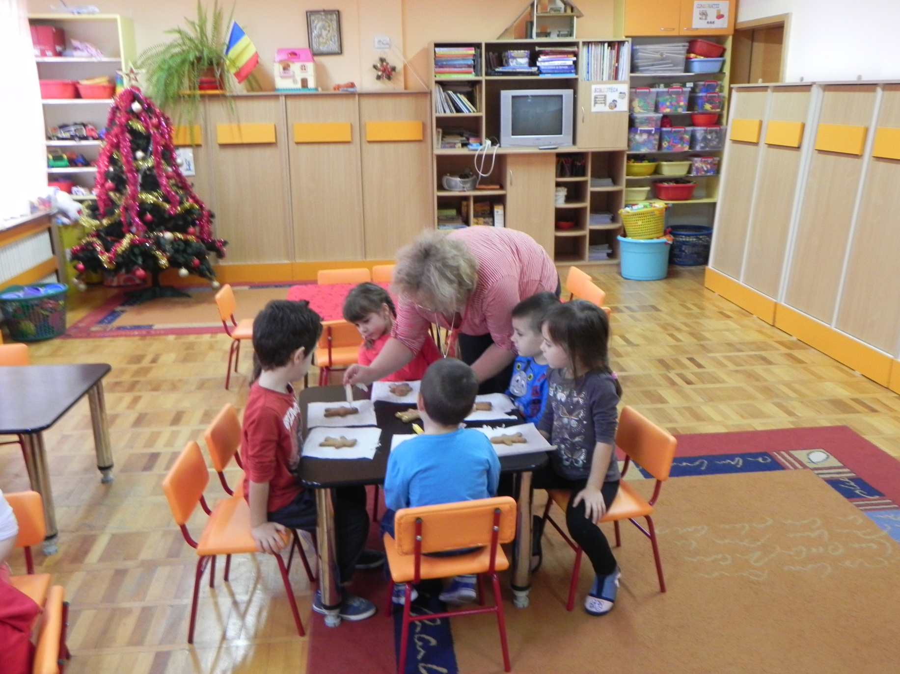

Slide 6
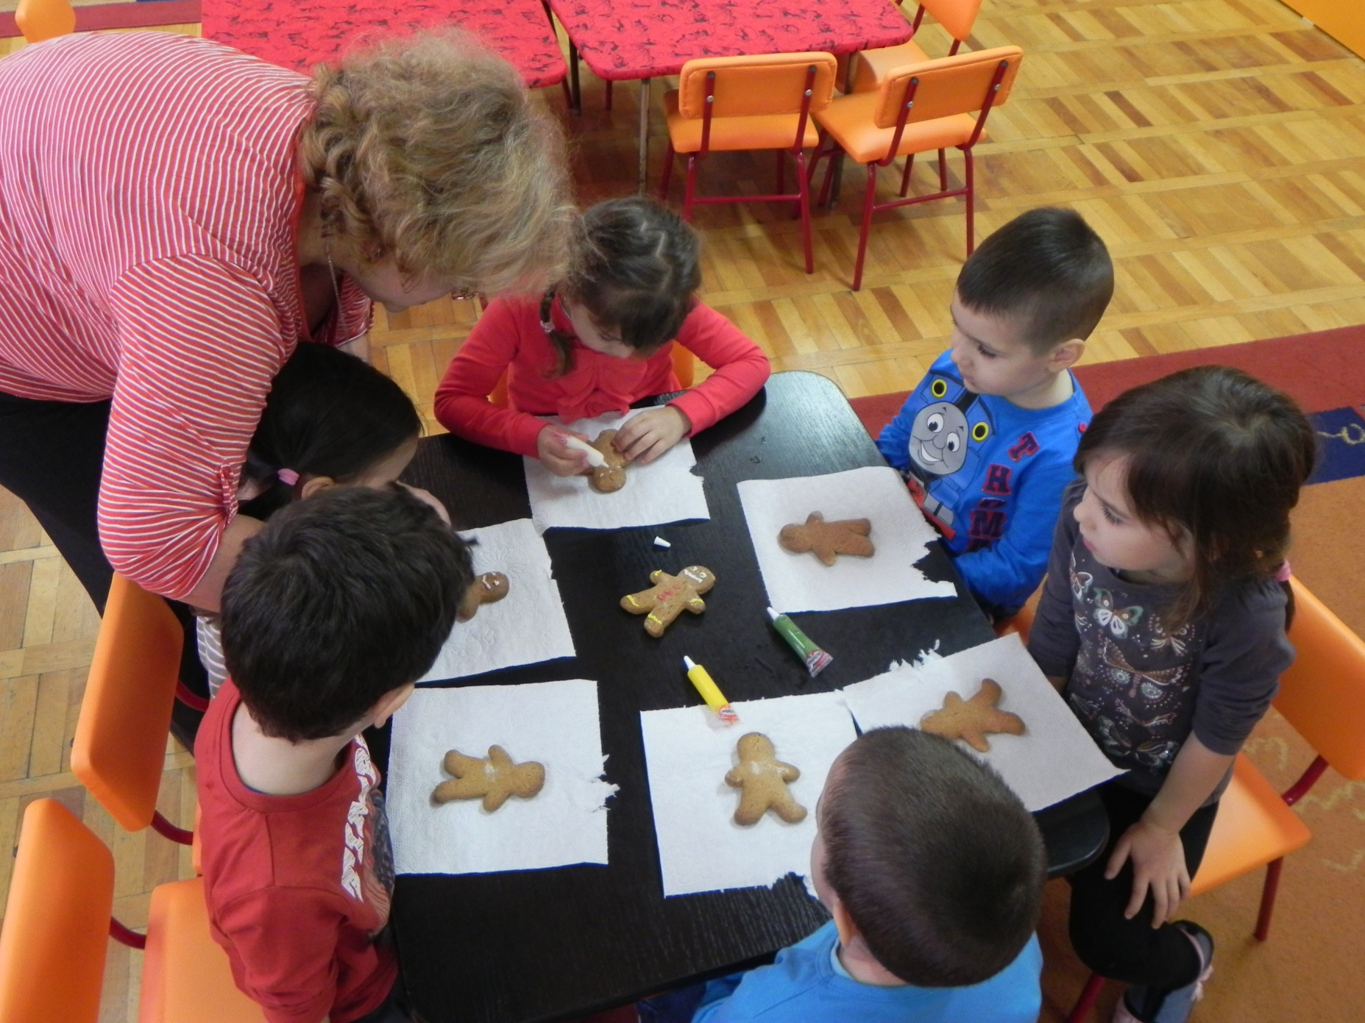

Slide 7
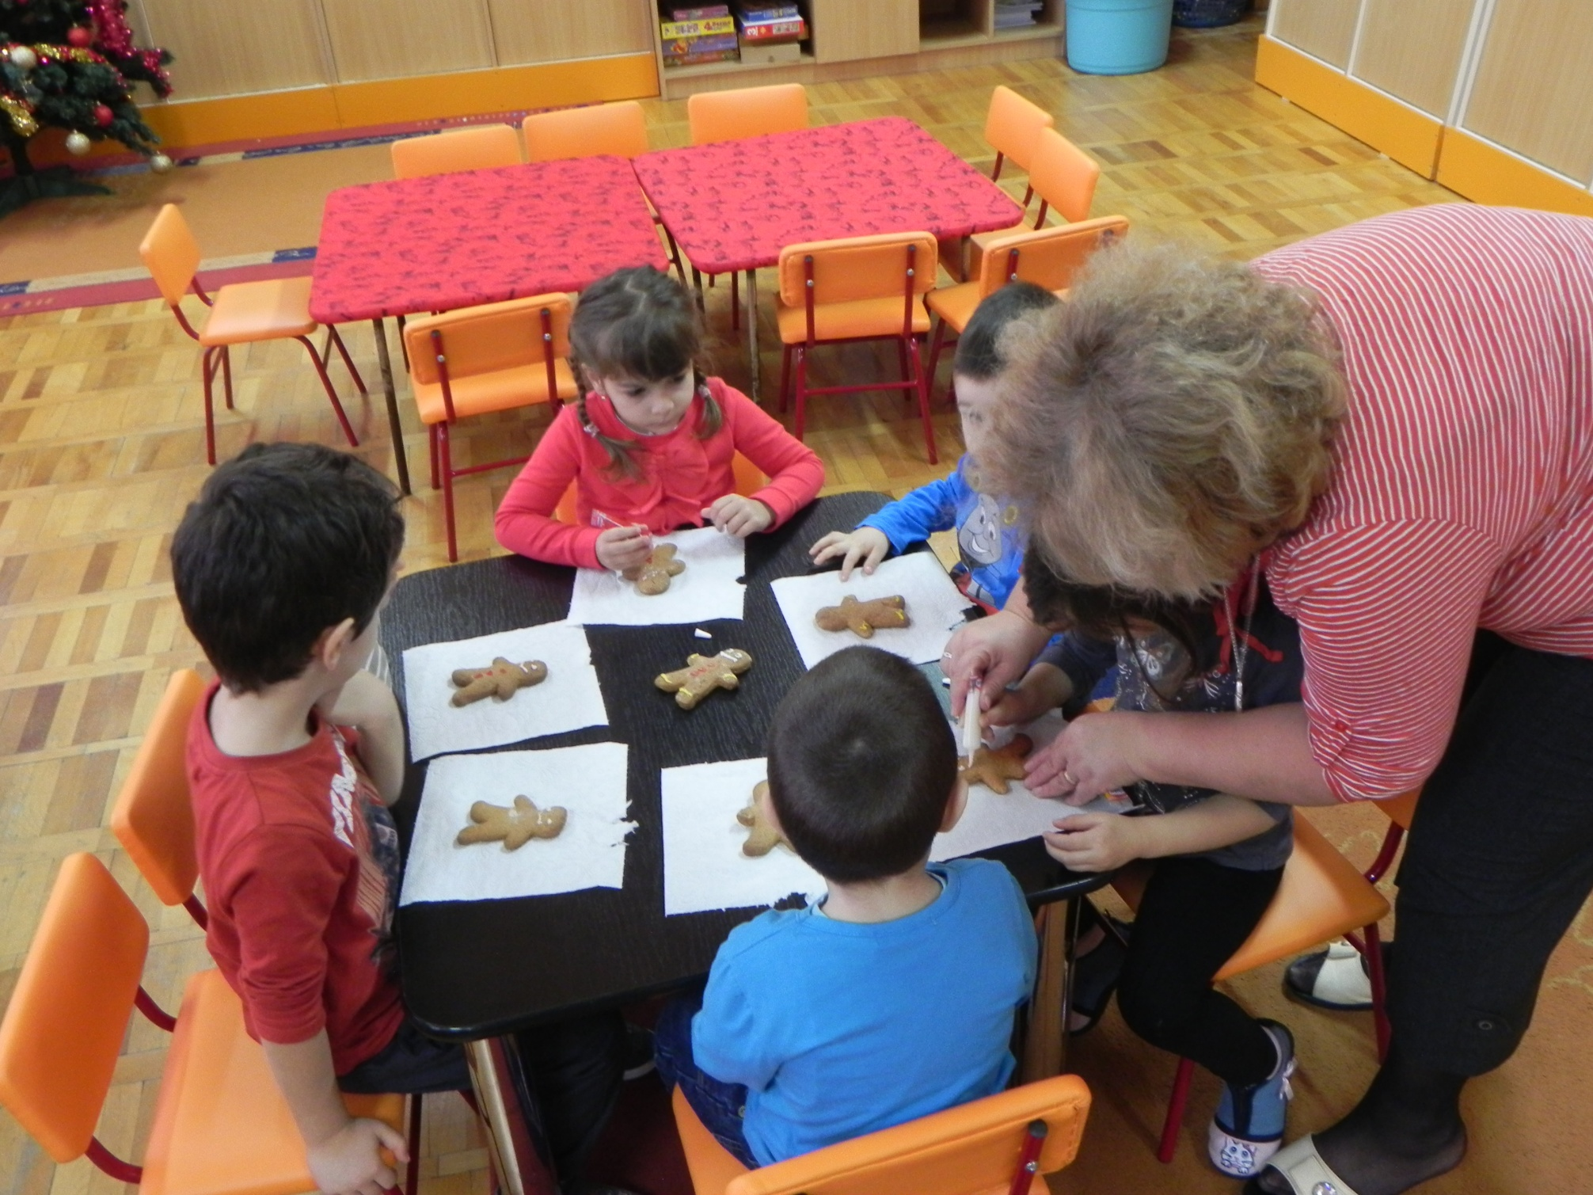

Slide 8
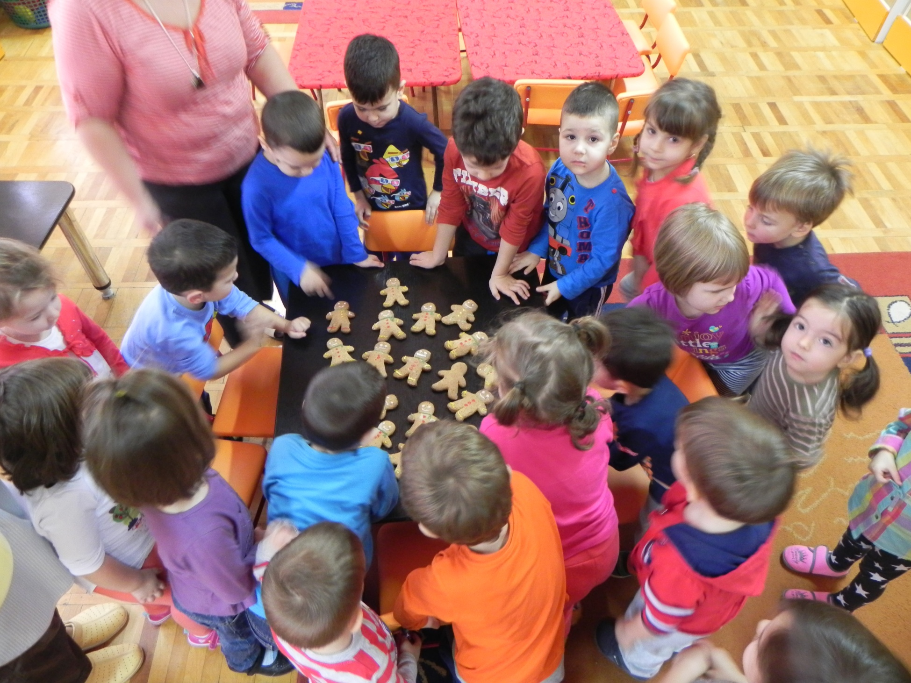

Slide 9
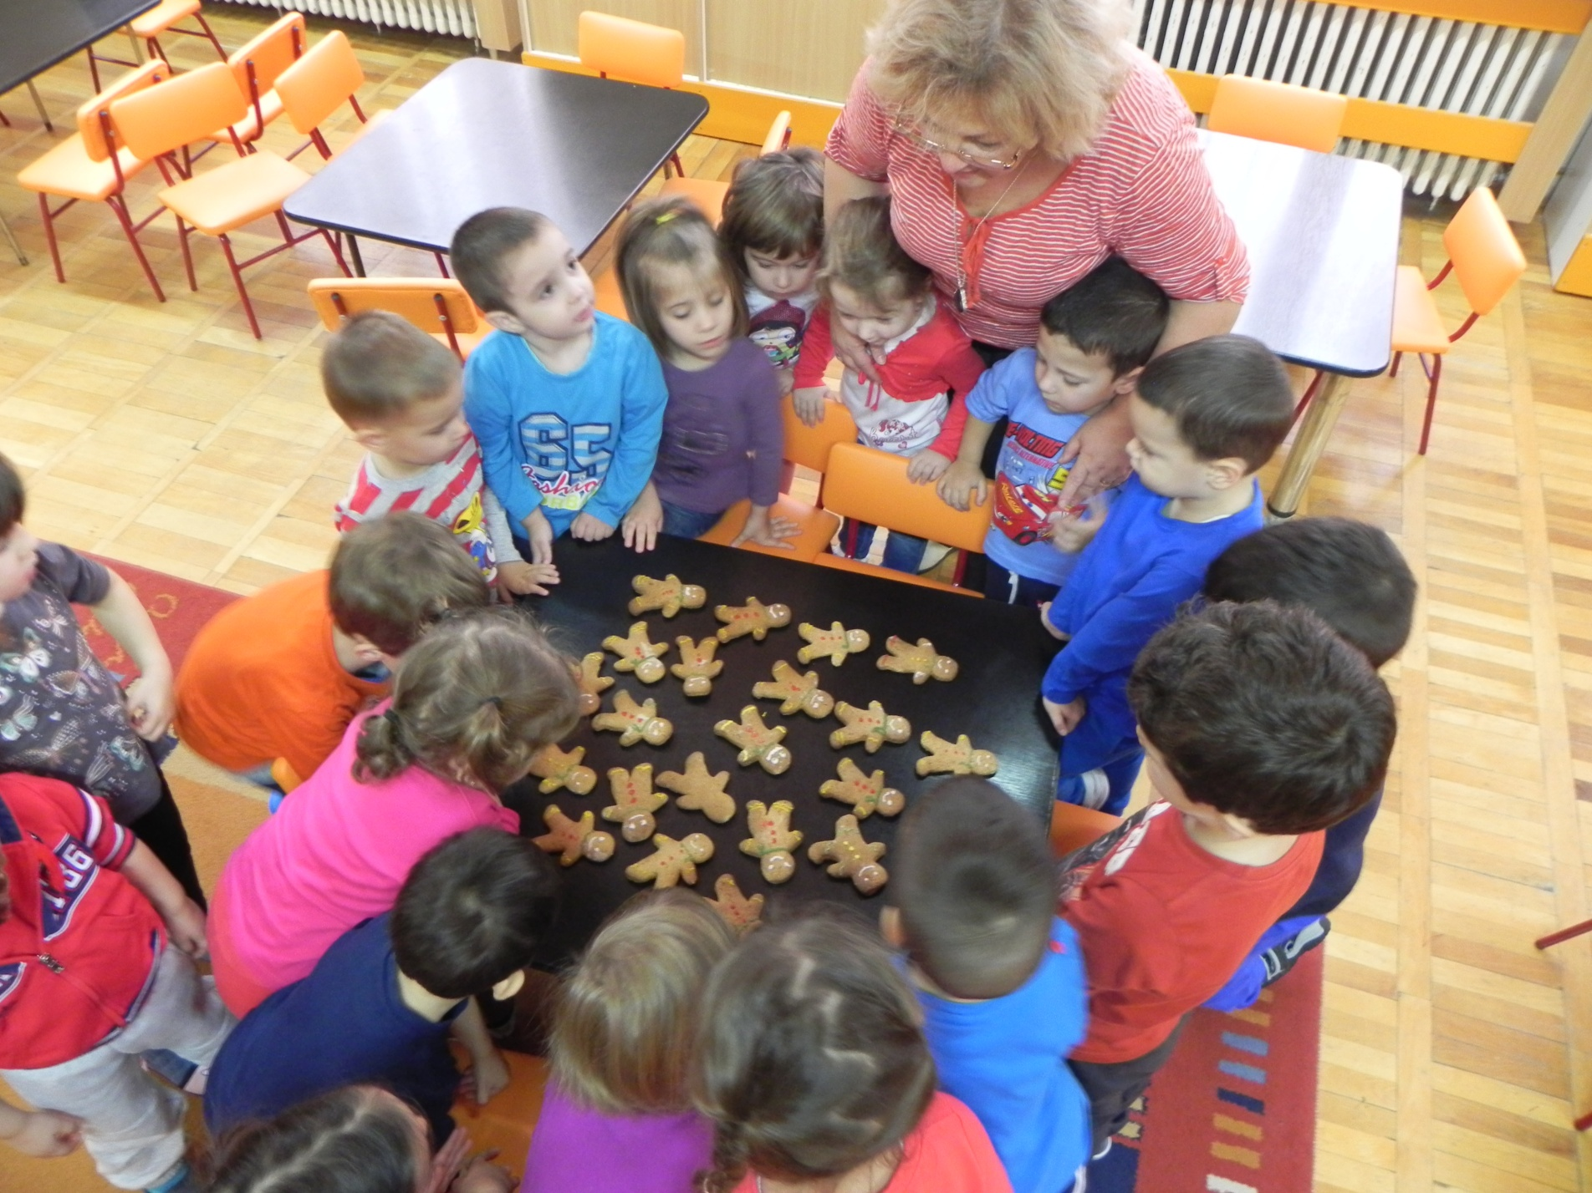

Slide 10
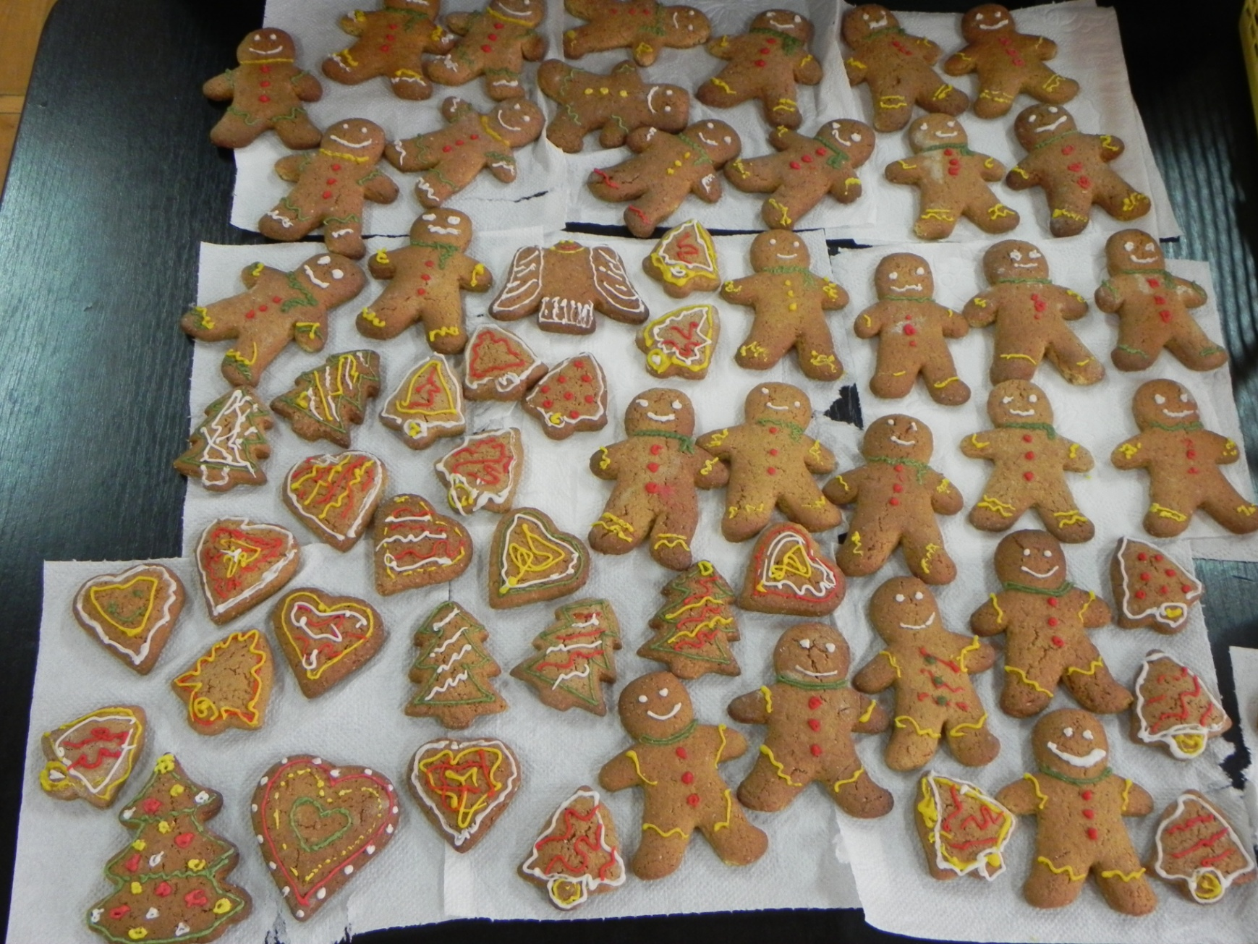
Because children had so much fun decorating gingerbread men, we also decorated other forms like bells, stars, christmas trees and hearts.

Slide 11
Merry Christmas
to everyone!
Children from Romania

