Slide 1
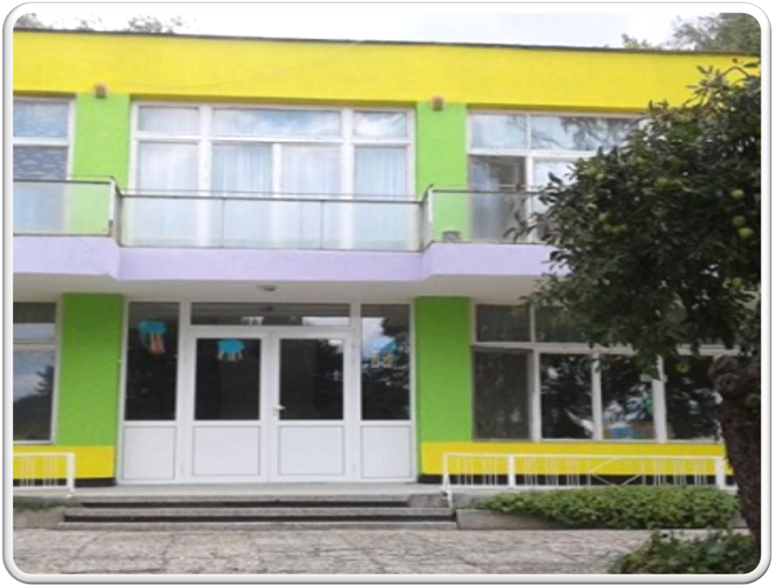
“ Firsт of june” kindergarten
Dobrich,Bulgaria

Slide 2
НАШИТЕ ГРУПИ
OUR GROUPS

Slide 3
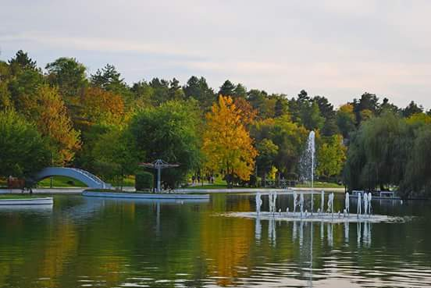
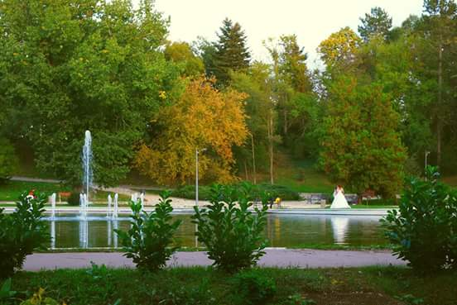
St.”Georgi”park in Dobrich

Slide 4
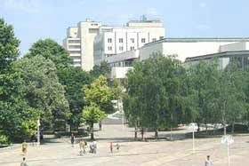
The town of Dobrich is situated almost in the center of the Dobrudzha plateau, 50km to the north of Varna. It occurred in the 15th century under the name of Hadjioglu Pazardjik. In 1882 it was called Dobrich after the name of Dobtotich, a former ruler in Dobrudzha in the past. Some of the sights in Dobrich are the museum of Yordan Yovkov, the ruins of a Middle Ages settlement, the ancient necropolis, and a big number of monuments. The town bore the name of the Soviet Marshal Tolbouhin for several decades during the Communist rule. The name Dobrich was restored with a decree of the President of 19.09.1990.
Now the town of Dobrich is the second largest economic center in Northeastern Bulgaria and one of the ten largest towns in Bulgaria - am important cultural, economic and administrative centre in the northeast economic region of the country.

