Slide 1
Spain

Slide 2
Fun facts about Spain;
1 The national anthem of Spain has not words.
2 The national animal is the bull .
3 The oldest restaurant in the world is in Madrid .
4 The tooth fairy ,in Spain,is a mouse.
5 Spain is the country with the longest roads in the world.

Slide 3
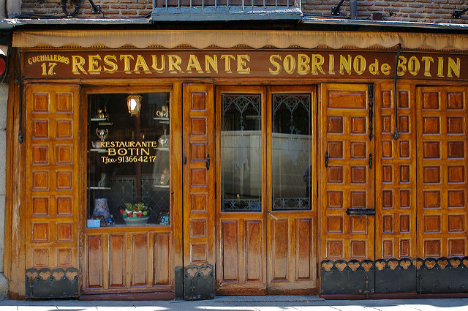
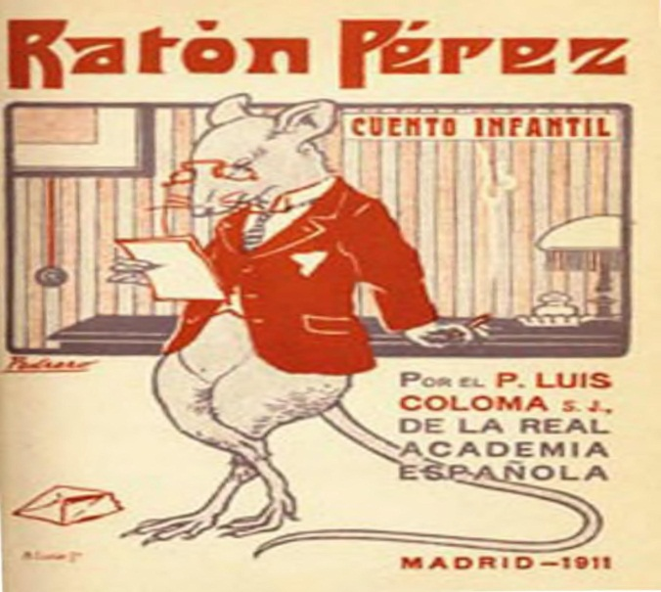
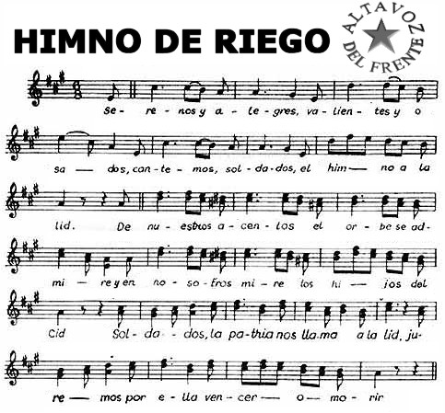
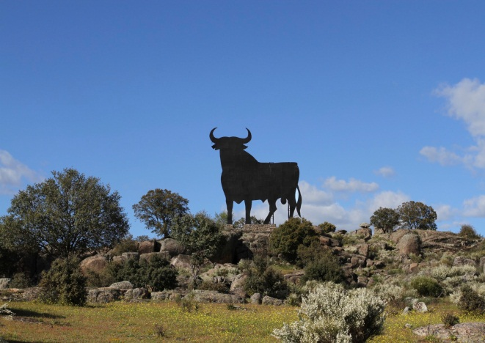
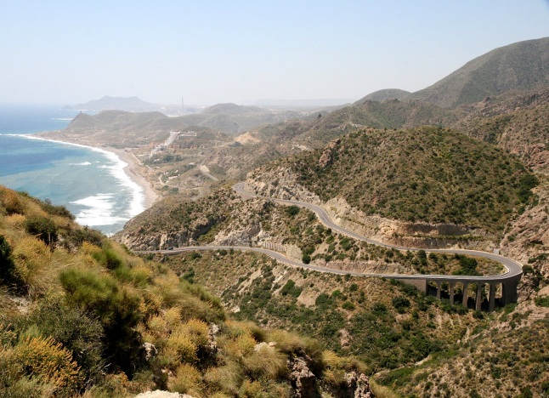
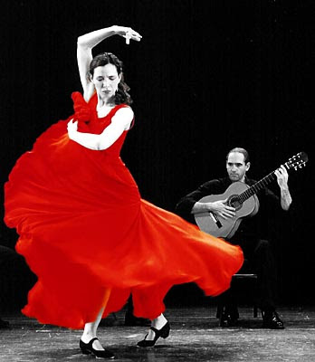

Slide 4
6 Out of school ,children are free.
7 The Spanish love to chill out.
8 One of the most dangerous hicking trails in the world , El Caminito Del Rey , is located in Spain.
9 The population of 49 million is the fifth largest in Europe.
10 Spain has Europe’s biggest wealth gap.

Slide 5
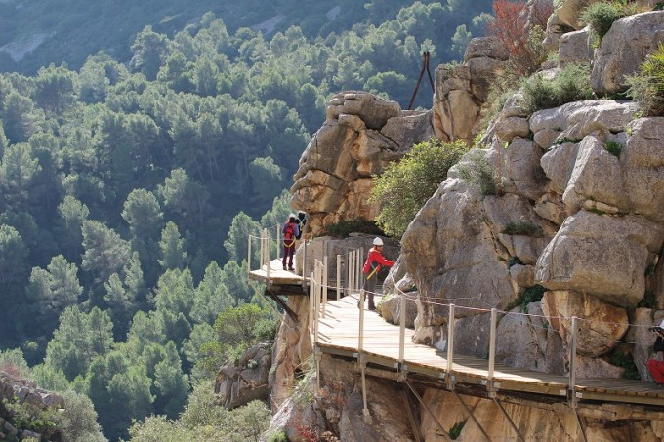
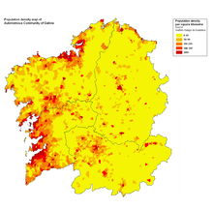
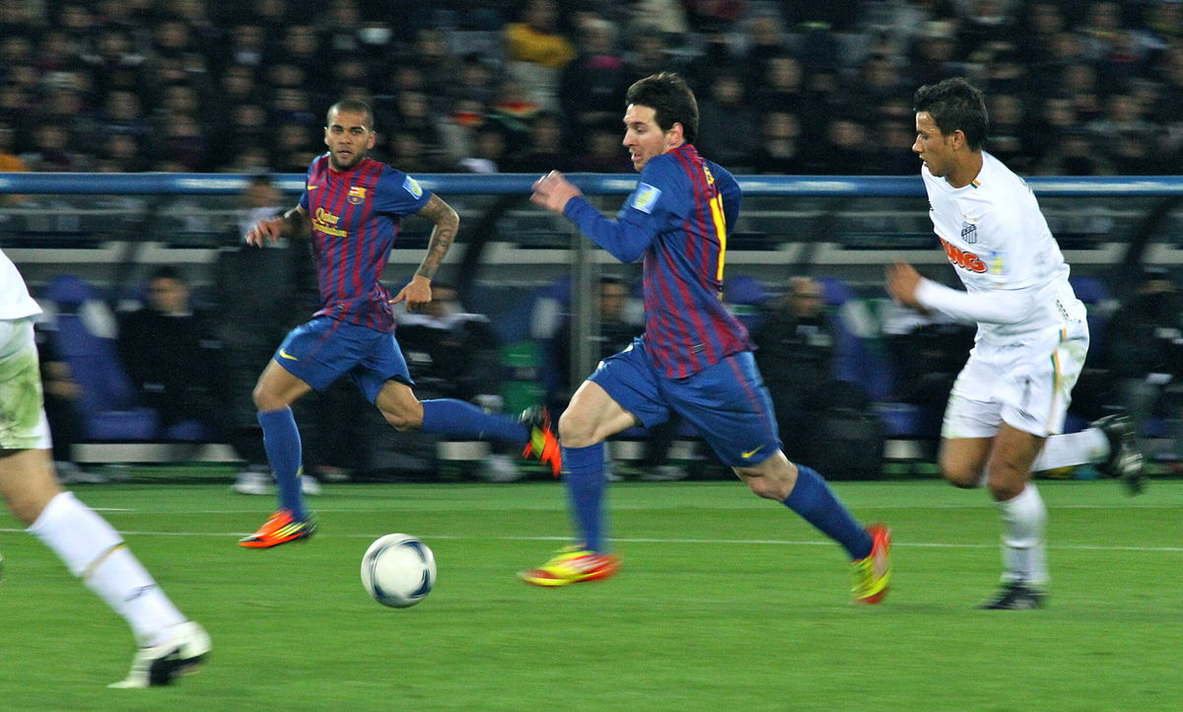
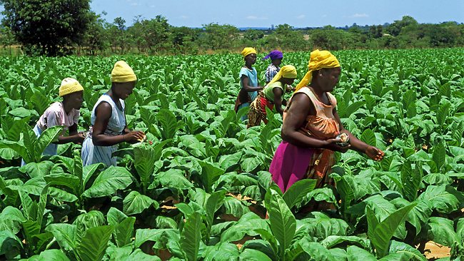

Slide 6
11 Spain won its first World Cup Football title in 2010 , which made the country the 8th country to have ever won.
12 Traditionally, you have two surnames in Spain-the first surname from your father, and the second from your mother.
13 Tomatoes, potatoes ,avocados,tobacco,strawberries and cocoa [for chocolate ] were all imported into Europe by Spain.

