Slide 1
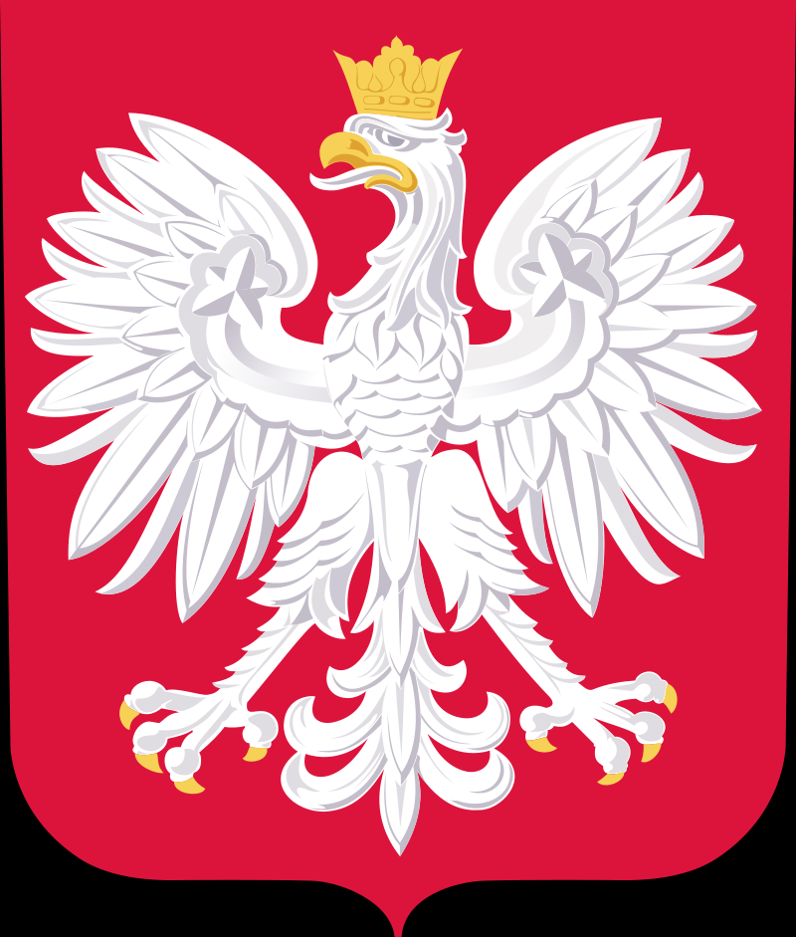
Poland
Poland is a country in Central Europe. It is on the east of Germany

Slide 2
People
In the past, Poland was inhabited by people from different nations and of different religions (mainly Catholics, Orthodox and Judaism). This changed after 1939, because of the Nazi Holocaust which killed many Polish Jews. After World War II, the country was changed into a communist country, by the Warsaw Pact which included most central European countries and Russia.
Today 38,038,000 people live in Poland (2011). In 2002 96.74% of the population call themselves Polish, while 471,500 people

Slide 3
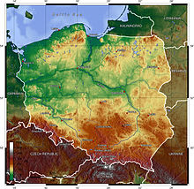
Geography
Poland has 70 mountains over 2,000 metres (6,600 feet) in elevation, all in the Tatras. The Polish Tatras, which consist of the High Tatras and the Western Tatras, is the highest mountain group of Poland and of the entire Carpathian range. In the High Tatras lies Poland's highest point, the north-western summit of Rysy, 2,499 metres (8,199 ft) in elevation. At its foot lie the mountain lakes of Rysami (Black Lake below Mount Rysy) and Morskie Oko (the Marine Eye).
The second highest mountain group in Poland is the Beskids, whose highest peak is Babia Góra, at 1,725 metres (5,659 ft). The next highest mountain groups are the Karkonosze in the Sudetes, the highest point of which is Śnieżka at 1,603 metres (5,259 ft), and the Śnieżnik Mountains, the highest point of which is Śnieżnik at 1,425 metres (4,675 ft).

Slide 4
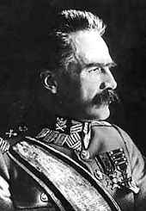
Reconstruction
During World War I, all the Allies agreed on the reconstitution of Poland that United States President Woodrow Wilson proclaimed in Point 13 of his Fourteen Points. A total of 2 million Polish troops fought with the armies of the three occupying powers, and 450,000 died. Shortly after the armistice with Germany in November 1918, Poland regained its independence as the Second Polish Republic (II Rzeczpospolita Polska). It reaffirmed its independence after a series of military conflicts, the most notable being the Polish–Soviet War (1919–21) when Poland inflicted a crushing defeat on the Red Army at the Battle of Warsaw, an event which is considered to have halted the advance of Communism into Europe and forced Vladimir Lenin to rethink his objective of achieving global socialism. The event is often referred to as the "Miracle at the Vistula"

Slide 5
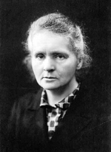
Science and technology
Over the course of history, the Polish people have made considerable contributions in the fields of science, technology and mathematics. Perhaps the most renowned Pole to support this theory was Nicolaus Copernicus (Mikołaj Kopernik), who triggered the Copernican Revolution by placing the Sun rather than the Earth at the center of the universe. He also derived a quantity theory of money, which made him a pioneer of economics. Copernicus' achievements and discoveries are considered the basis of Polish culture and cultural identity.

Slide 6
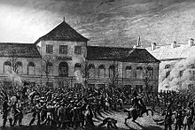
Tourism
Poland experienced an increase in the number of tourists after joining the European Union in 2004. Tourism contributes significantly to the overall economy and makes up a relatively large proportion of the country's service market.
Tourist attractions in Poland vary, from the mountains in the south to the sandy beaches in the north, with a trail of nearly every architectural style. The most visited city is Kraków, which was the former capital of Poland and serves as a relic of Polish Golden Age of Renaissance. Kraków also held royal coronations of most Polish kings. Among other notable sites in the country is Wrocław, one of the oldest cities in Poland. Wrocław possesses a huge market square with two city halls, as well as the oldest Zoological Gardens with one of the world's largest number of animal species and is famous for its dwarfs. The Polish capital Warsaw and its historical Old Town were entirely reconstructed after wartime destruction. Other cities attracting tourists include Gdańsk, Poznań, Szczecin, Lublin, Toruń and the historic site of the German Auschwitz concentration camp in Oświęcim

Slide 7
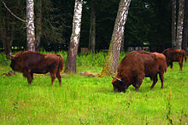
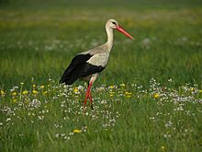
Biodiversity
Phytogeographically, Poland belongs to the Central European province of the Circumboreal Region within the Boreal Kingdom. According to the World Wide Fund for Nature, the territory of Poland belongs to three Palearctic Ecoregions of the continental forest spanning Central and Northern European temperate broadleaf and mixed forest ecoregions as well as the Carpathian montane conifer forest.
Many animals that have since died out in other parts of Europe still survive in Poland, such as the wisent in the ancient woodland of the Białowieża Forest and in Podlaskie. Other such species include the brown bear in Białowieża, in the Tatras, and in the Beskids, the gray wolf and the Eurasian lynx in various forests, the moose in northern Poland, and the beaver in Masuria, Pomerania, and Podlaskie.

Slide 8
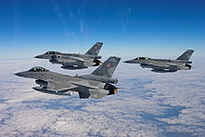
Military
The Polish armed forces are composed of five branches: Land Forces (Wojska Lądowe), Navy (Marynarka Wojenna), Air Force (Siły Powietrzne), Special Forces (Wojska Specjalne) and Territorial Defence Force (Wojska Obrony Terytorialnej) – a military component of the Polish armed forces created of 2016. Plans call for the force, once fully active, to consist of 53,000 people who will be trained and equipped to counter potential hybrid warfare threats. The military is subordinate to the Minister for National Defence. However, its commander-in-chief is the President of the Republic.

Slide 9
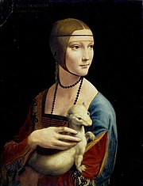
Art
Art in Poland has always reflected European trends while maintaining its unique character. The Kraków Academy of Fine Arts, later developed by Jan Matejko, produced monumental portrayals of customs and significant events in Polish history. Other institutions like the Academy of Fine Arts in Warsaw were more innovative and focused on both historical and contemporary styles. In recent years, art academies such as the Kraków School of Art and Fashion Design, Art Academy of Szczecin, University of Fine Arts in Poznań and Geppert Academy of Fine Arts in Wrocław gained much recognition.

Slide 10
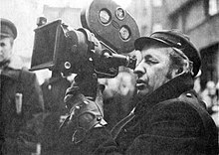
Cinema
The history of Polish cinema is as long as history of cinematography itself. Over decades, Poland has produced outstanding directors, film producers, cartoonists and actors that achieved world fame, especially in Hollywood. Moreover, Polish inventors played an important role in the development of world cinematography and modern-day television. Among the most famous directors and producers, who worked in Poland as well as abroad are Roman Polański, Andrzej Wajda, Samuel Goldwyn, the Warner brothers (Harry, Albert, Sam, and Jack), Max Fleischer, Lee Strasberg, Agnieszka Holland and Krzysztof Kieślowski.

Slide 11
Credits
Teo Pirva Curelar Bogdan

