Slide 2
Economy of Lithuania

Slide 3
Problems
High rates of emigration. Young people move abroad due to the expectations of getting a well-paid job and because of better living conditions.
Low salaries, small pension… Monthly minimum wage in Lithuania is 555€, while the average monthly minimum wage in EU - 927€
Aging population, lack of labor power, because high - qualified people travel abroad.

Slide 4
Problems
We will discuss the main problems, reasons, consequencies and the impact on Lithuania's economy.

Slide 5
What factors improved economy?
One of the main factors - becoming a member of EU in 2004. EU supports the creation of new job posts, takes care of agriculture, provides funding for a great variety of different projects and programmes, makes it easier to invest money in other EU countries, creates possibilities of working abroad and much more. Consequently, the economy and prosperity are growing.
We are going to talk about importance of EU to Lithuania.

Slide 6
What factors improved economy?
Lithuania bought a liquefied natural gas floating storage and regasification unit terminal. The main vessel of the terminal is called Independence. FSRU Independence has floated in the port of Klaipėda since 2014.

Slide 7
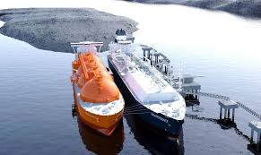
FSRU Independence
Lithuania had depended on Russian “Gasprom” before the FSRU Independence was bought and had to buy gas for the highest price in Europe. Now, in terms of gas, Lithuania is independent and gets gas for almost the lowest price in Europe.
We are going to talk about the importance of FSRU Independence.

Slide 8
What factors improved economy?
The adoption of euro in 2015. Becoming a member of eurozone was a step forward, because it boosted trade with EU, it facilitated investment opportunities. However, it also had a negative impact - prices started rising.

Slide 9
What boosts the economy?
Well-known international companies have been established in Lithuania. Companies such as:
Barclays bank
Microsoft
Transcom
SEB
Phillip Morris
Thermo Fisher Scientific
Danske Bank
Nasdaq Nordic

Slide 10
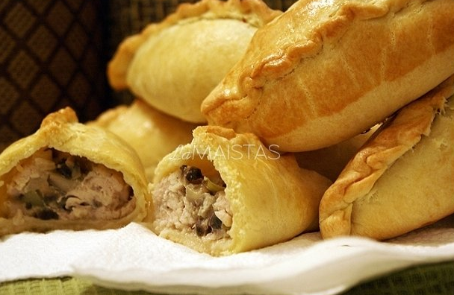
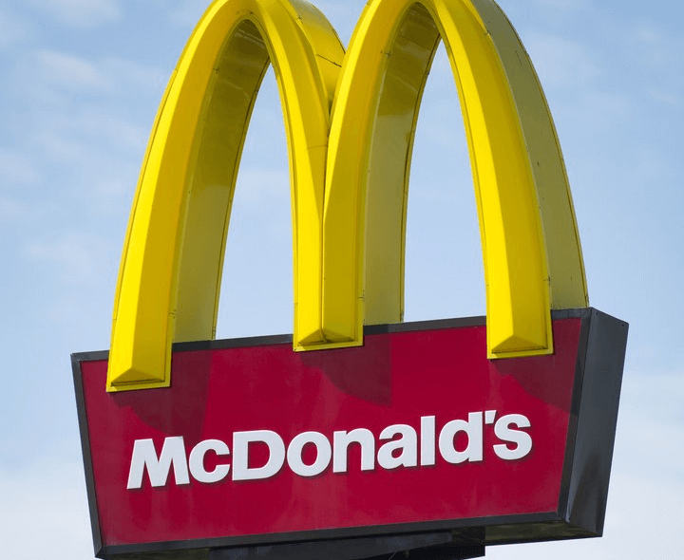
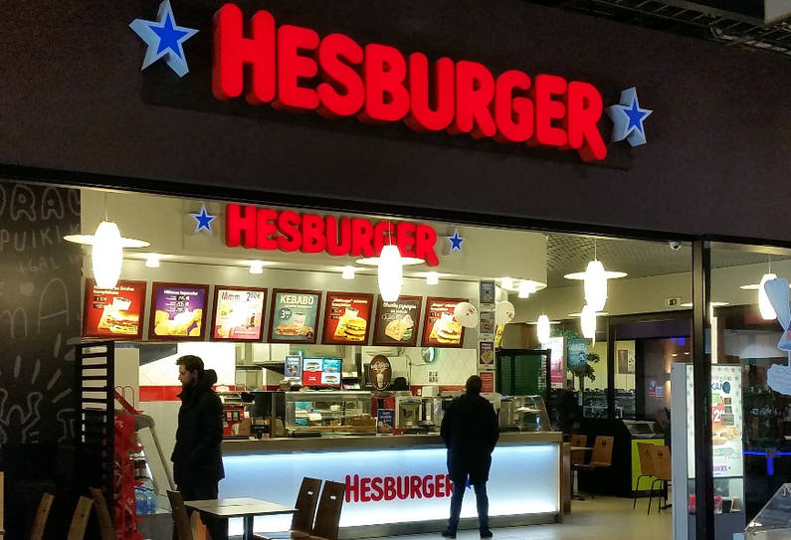
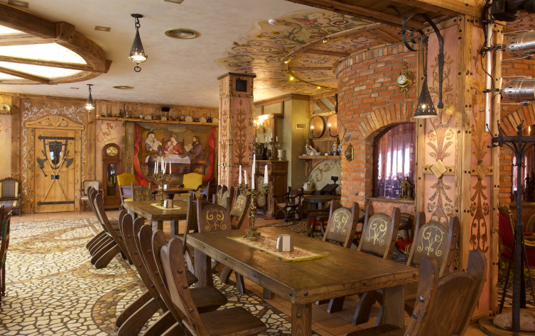
International compnies
Global vs. local fast food
McDonald's
Hesburger
Senoji Kibininė

Slide 11
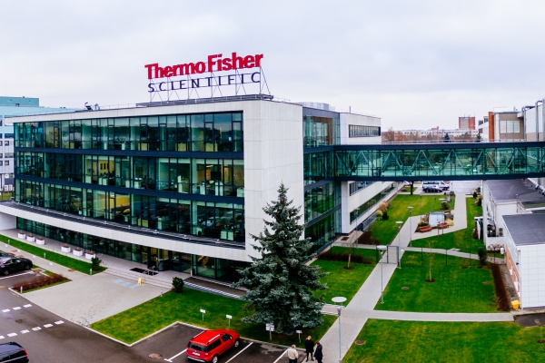
International companies
We are going to discuss which companies are the most significant to the Lithuania's economy, explain how this contributes to the country's economy.

Slide 12
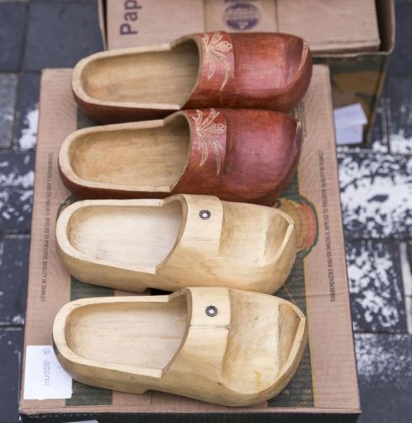
From global to local. Economical – cultural traditions
Lithuania has a unique economical-cultural tradition – Saint Casimir's Fair (in Lithuanian - “Kaziuko mugė”). It is a large annual folk arts and crafts fair in Vilnius. Craftsmen can sell their hand-made goods , such as woven and knitted clothes, toys, pots, jewelry, souvenirs, and paintings, food (candies, cookies, buns, honey, cheese, gingerbread...)

Slide 13
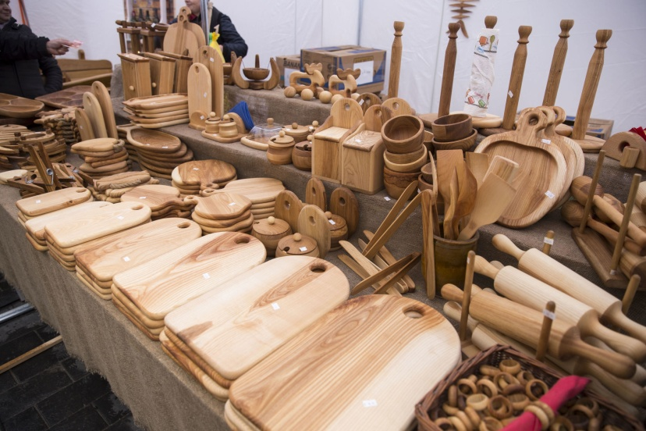
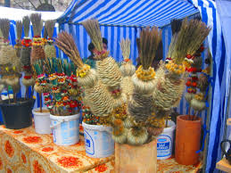
Saint Casimir's Fair
We are going to go to Saint Casimir's Fair, which will take place on March 6-8, to show the beauty and uniqueness of it. We will try to talk to the craftsmen and ask to tell about their goods.

Slide 14
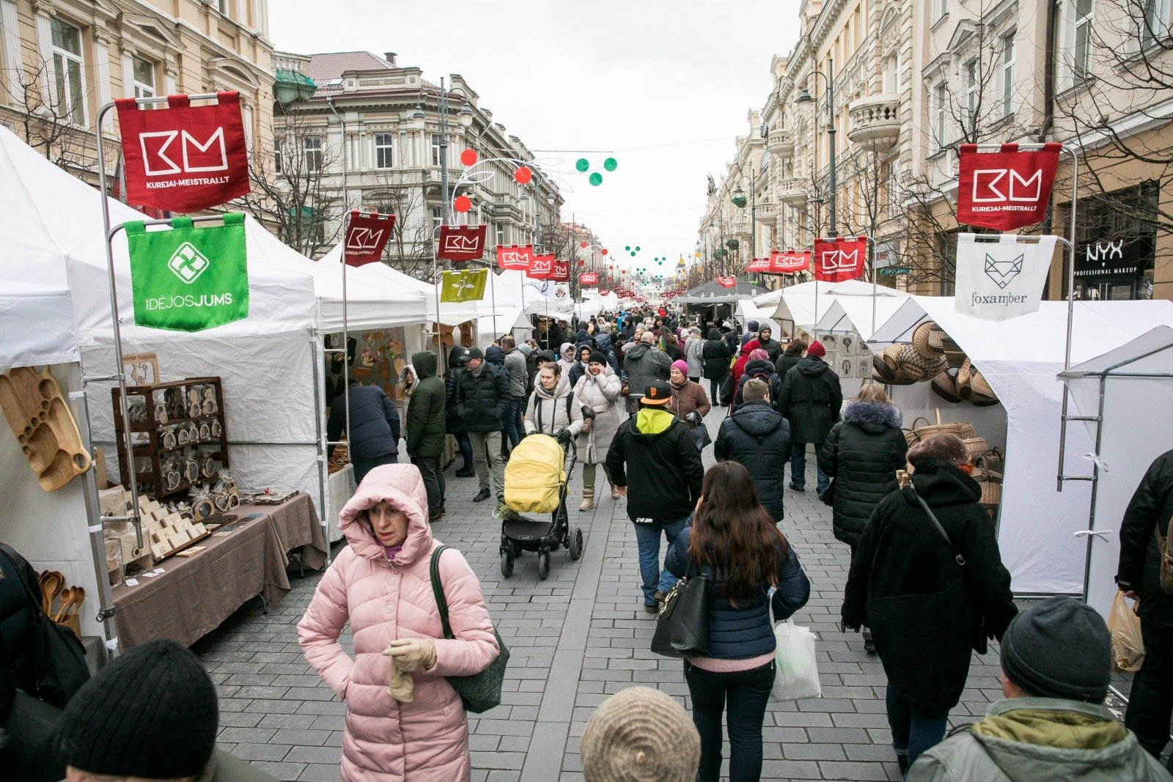
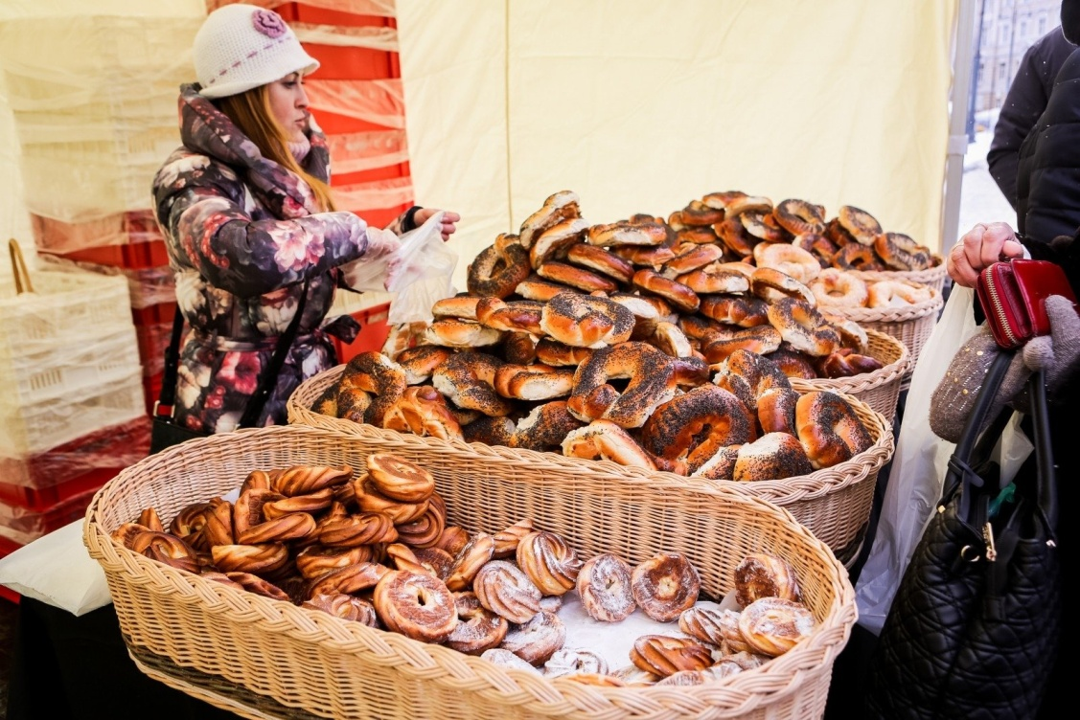
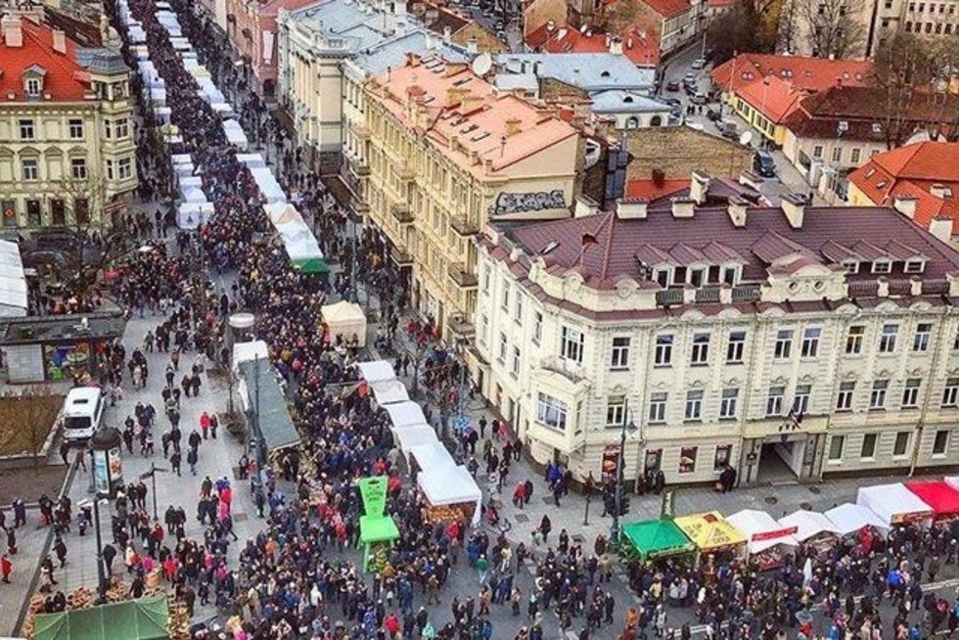
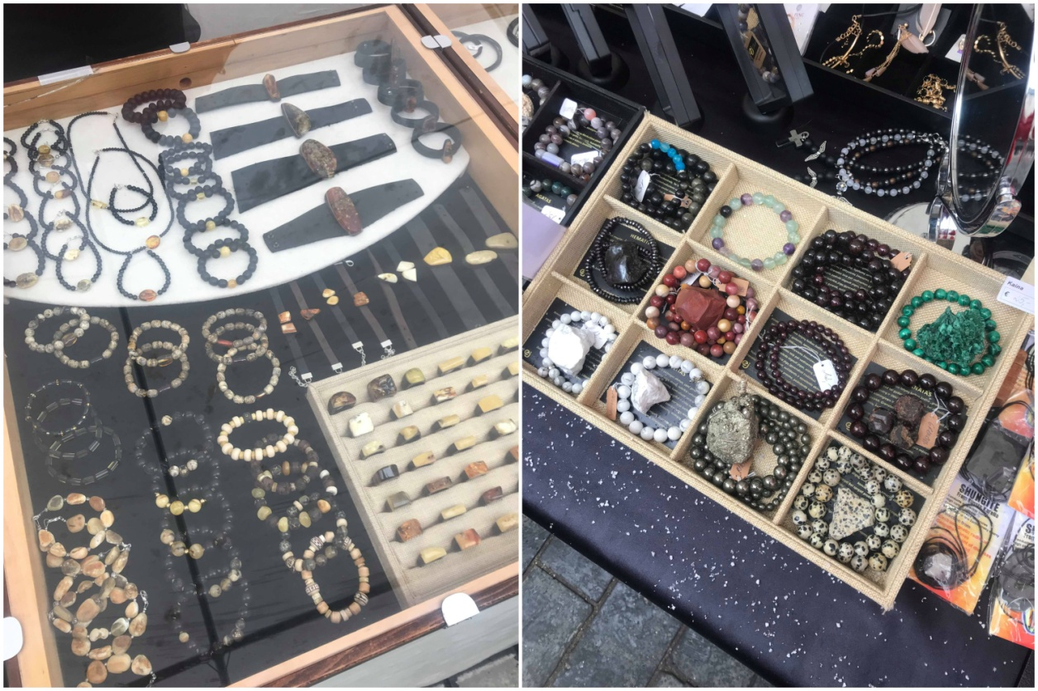

Slide 15
Junior Achievement
In Lithuania there are some global non-profit organisations, such as Junior Achievement, which provides education for stundents about economics, business, etc... JA motivates students to go into real business for themselves. Consequently, young people get insight into business and gain valuable experience that will be beneficial if they try to set up their own business one day.

Slide 16
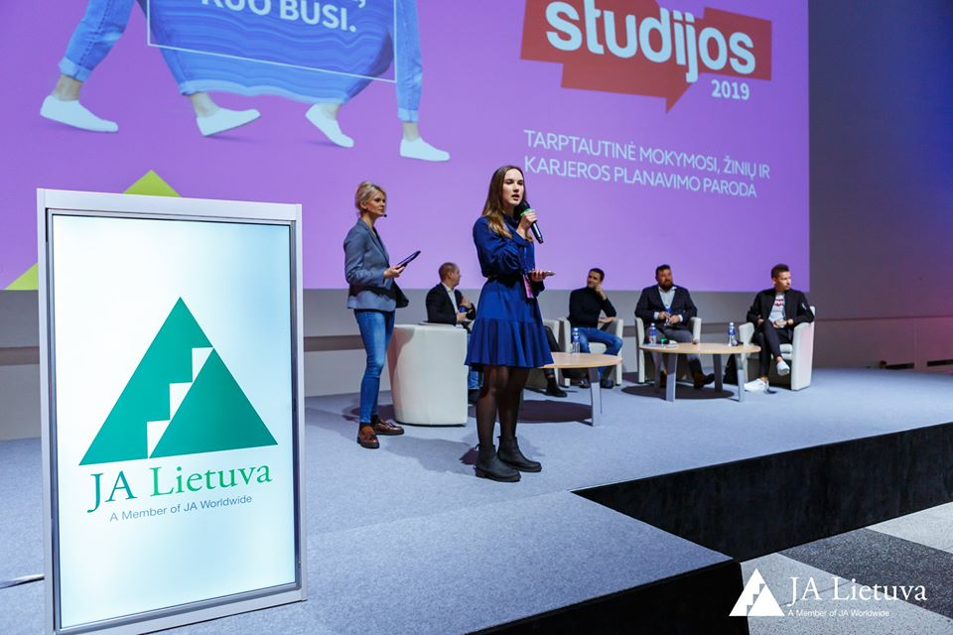
Junior Achievement
We are going to visit the main fair where student companies will present their innovative products or ideas. We are going to interview this year companies' leaders and meet last years fair winners.

Slide 17
Thank you for your attention!

