Slide 1
One of the Most significative innovation of the History
Looking At the Un (United nation) Innovation Day, we students of the Italian team have decided to take into consideration the so-called "archimedes' principle of buoyancy"

Slide 2
A short presentation of the Un innovation day
From 2017 on the 21 April the World Day of Creativity and Innovation is celebrated during which Creativity and Culture are essential elements for archieving the 17 objectives set by the 2030 Agenda that revolve around the so-called 5 Ps: People, Planet, Peace, Prosperity and Partnership.

Slide 3
ARCHIMEDES
This principle takes its name from the scientist of the same name who emanated it. Arichimedes was a scientist, a mathematician and much more, and originally from Syracuse, a city located in Sicily (an island that is part of the Italy).

Slide 4
A PICTURE OF SYRACUSE

Slide 5
"ARCHIMEDES' PRINCIPLE OF BUOYANCY"
This principle explains why some bodies sink while others do not, saying that "every body immersed in a fluid (it can be a liquid or a gas) undergoes a force directed from below towards the high intensity comparable to the force-weight of the moved fluid".

Slide 6
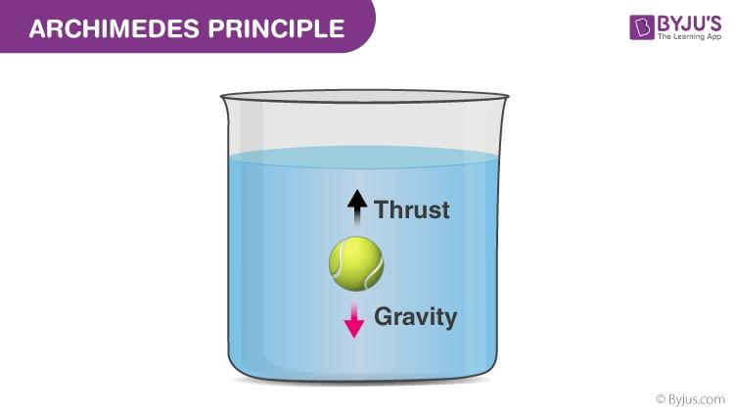
Examples

