Slide 1
Our topic brands
Authors: Anastasia Yasinskaya, Anzhelika Stepanovaite

Slide 2
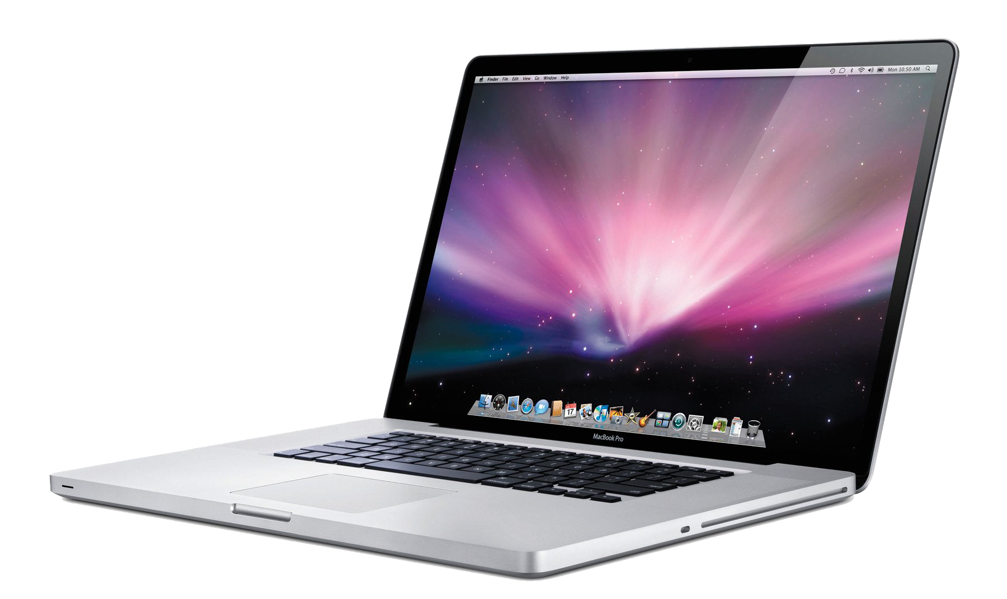
Apple
Apple Inc. is an American multinational technology company headquartered in Cupertino, California, that designs, develops and sells consumer electronics, computer software, and online services.

Slide 3
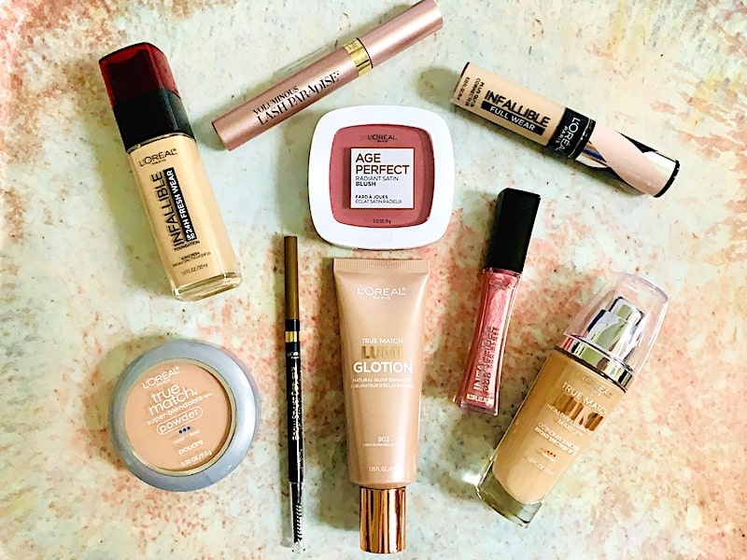
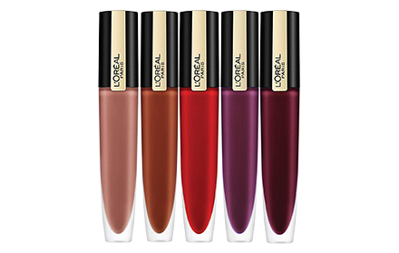
L’Oréal
L'Oréal is a French personal care company with a registered office in Paris. It is the world's largest cosmetics company and has developed activities in the field concentrating on hair colour, skin care, sun protection, make-up, perfume, and hair care.

Slide 4
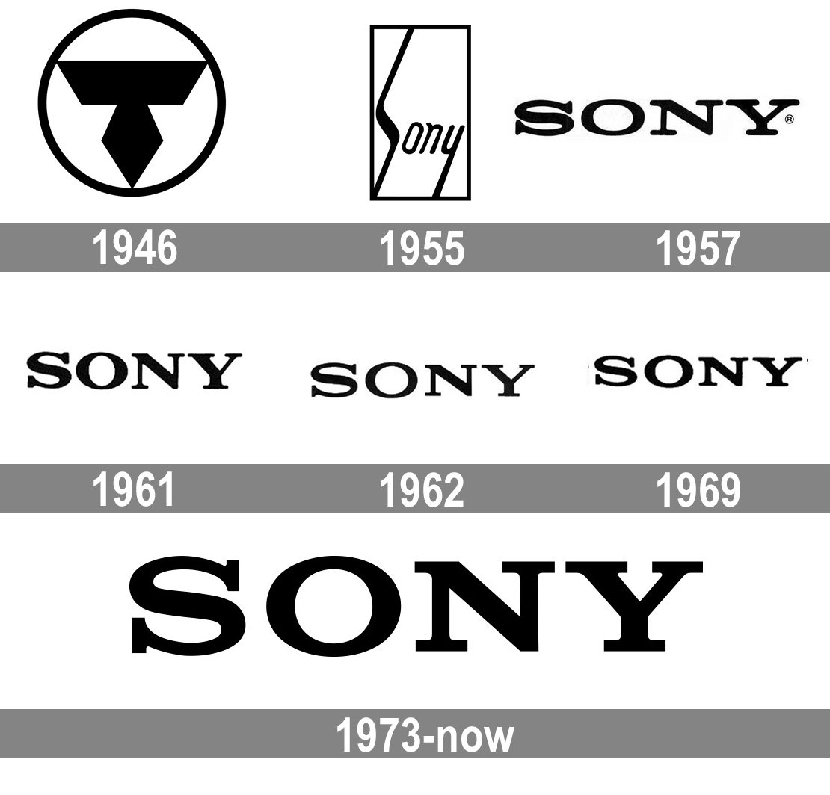
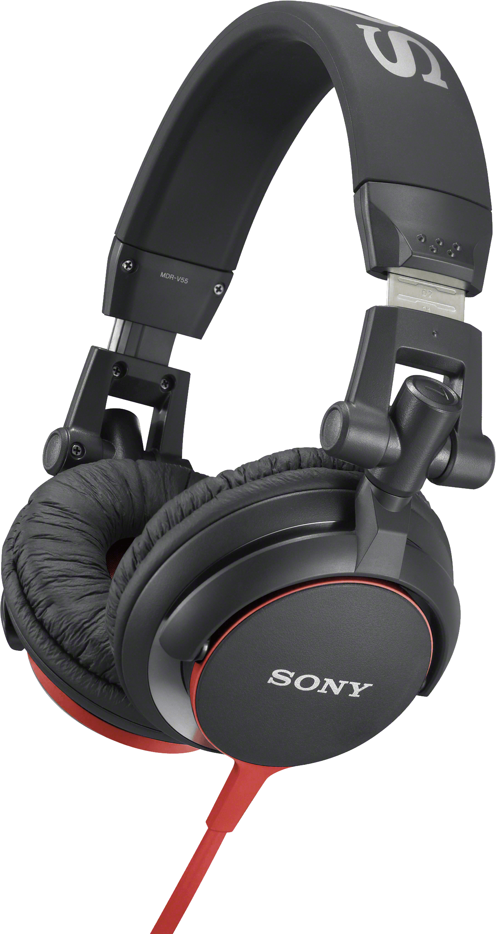
SONY
Sony Corporation is a Japanese multinational corporation headquartered in Tokyo. The company operates as one of the world's largest manufacturers of consumer and professional electronic products.

Slide 5
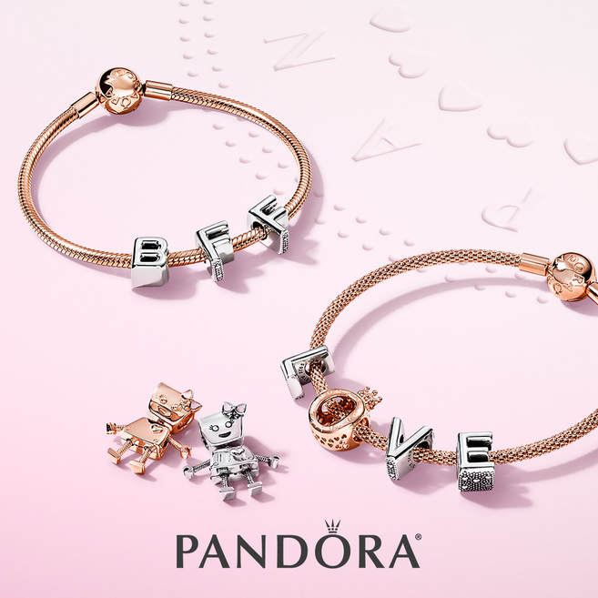
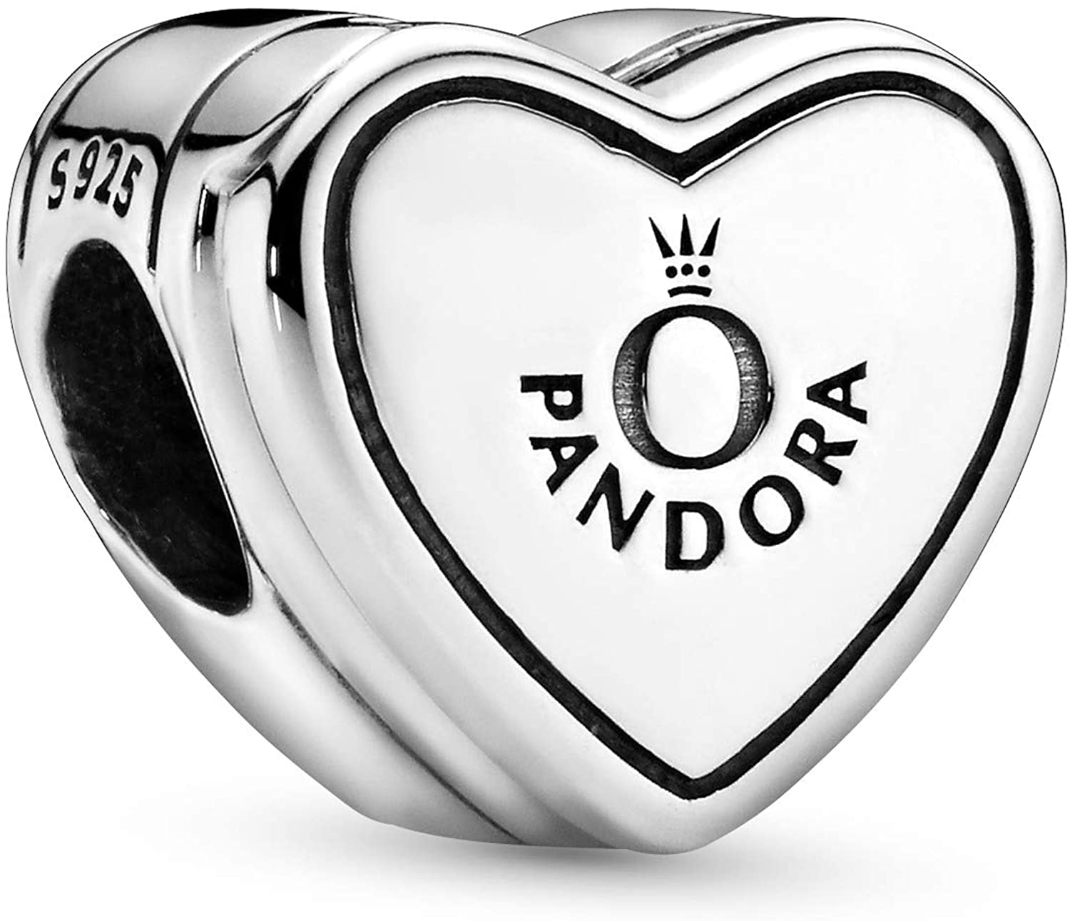
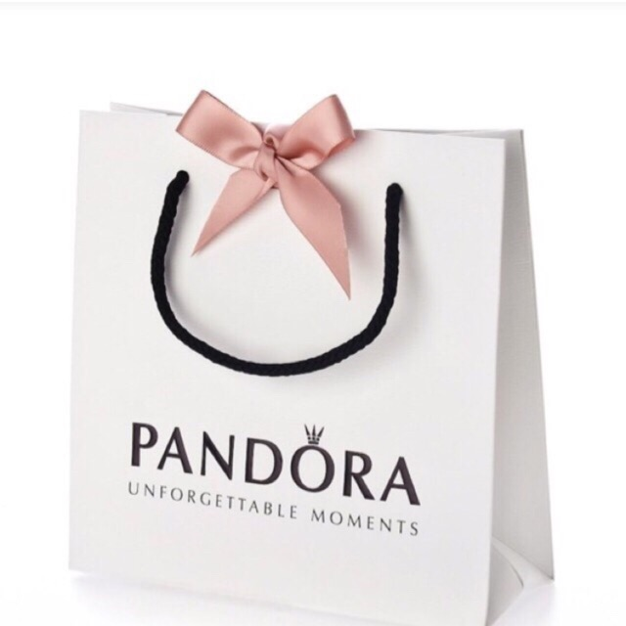
Pandora
Pandora is a Danish jewellery brand witch was founded in 1982 by Per Enevoldsen. Pandora is known for its customizable charm bracelets, designer rings, necklaces and (now discontinued) watches.

Slide 6
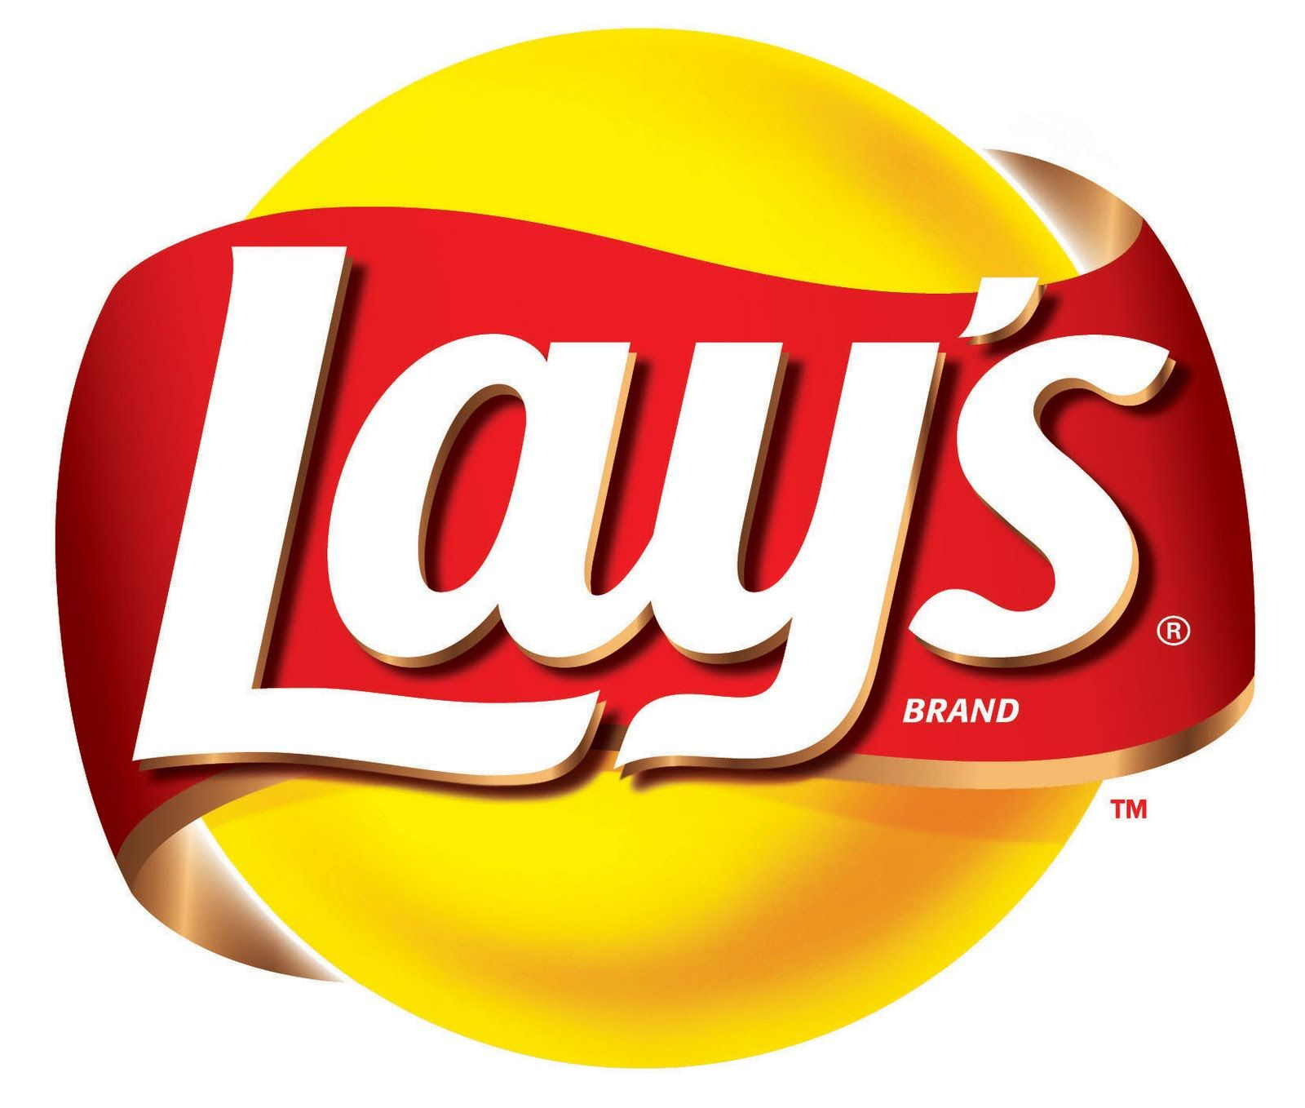
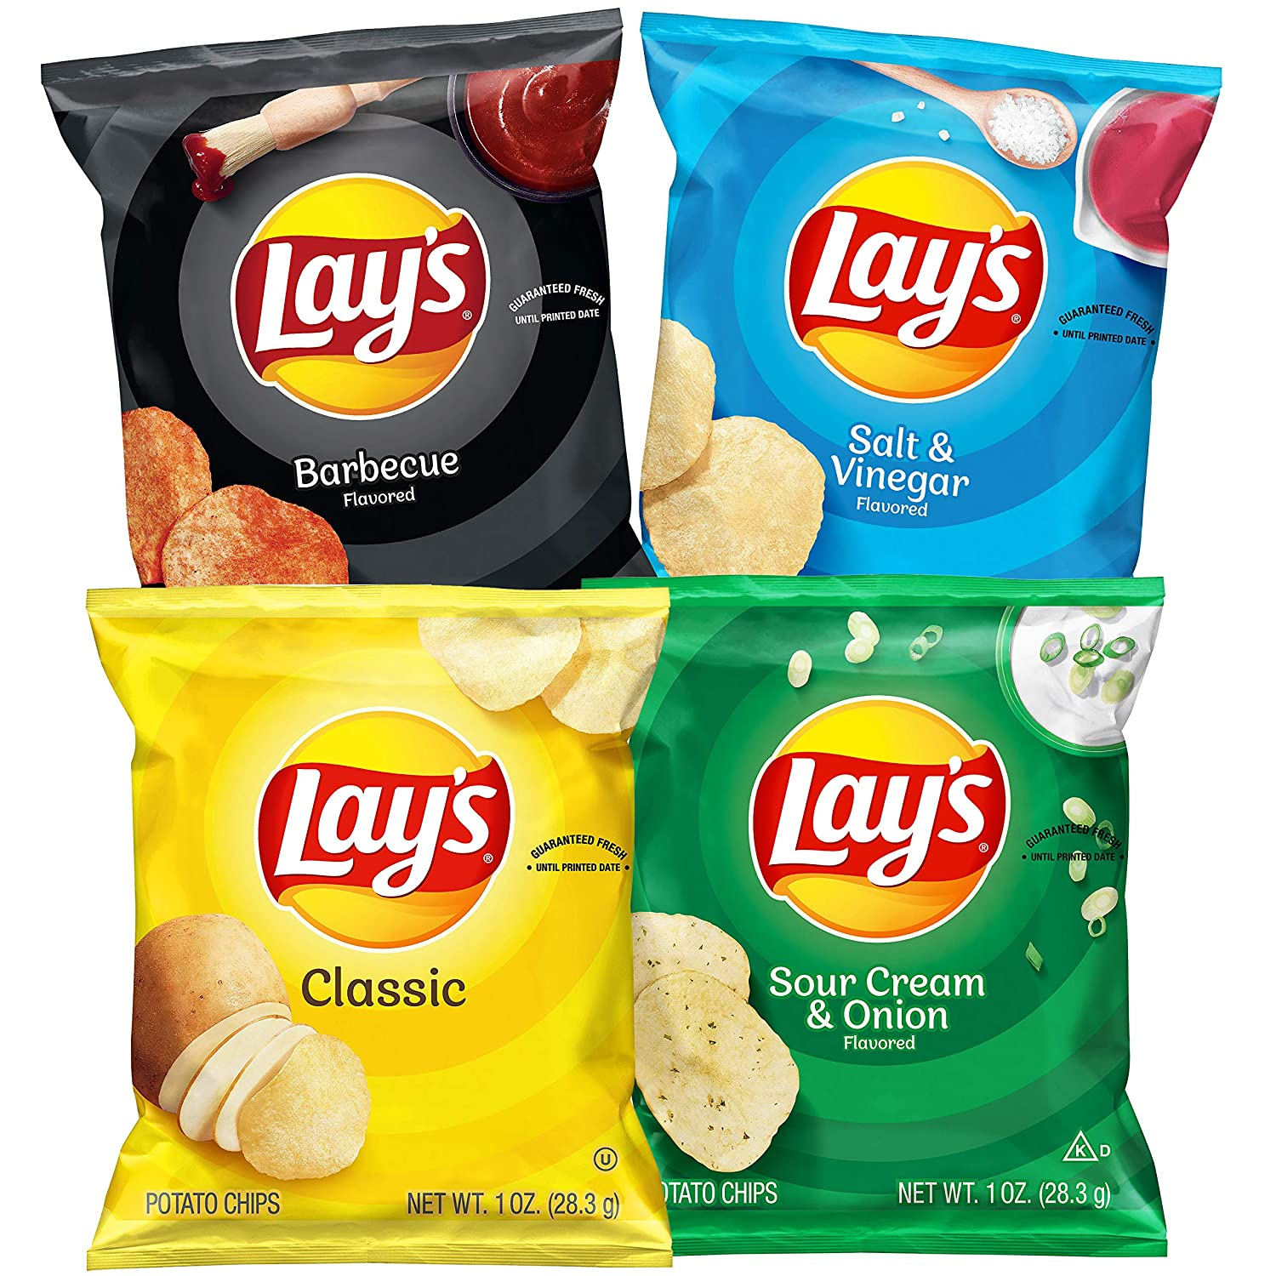
LAY'S
Lay's is a brand of potato chip varieties, as well as the name of the company that founded the chip brand in Canada. It has also been called Frito-Lay with Fritos. Lay's has been owned by PepsiCo through Frito-Lay since 1965.

Slide 7
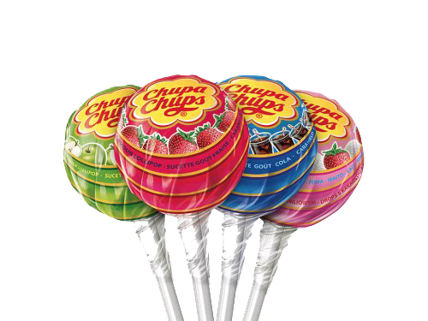
Chupa Chups
Chupa Chups is a Spanish brand of lollipop and other confectionery sold in over 150 countries around the world. The brand was founded in 1958 by Enric Bernat, and is owned by the Italian-Dutch multinational corporation Perfetti Van Melle. The name of the brand comes from the Spanish verb chupar, meaning "to suck".
The Chupa Chups logo was designed in 1969 by the surrealist artist Salvador Dalí.

Slide 8
IKEA
IKEA is a multinational group of Swedish origin headquarted in Delft, Netherlands, that designs and sells ready-to-assemble furniture, kitchen appliances and home accessories, among other useful goods and occasionally home services. Founded in Sweden in 1943 by 17-year-old Ingvar Kamprad, IKEA has been the world's largest furniture retailer since 2008.

Slide 9
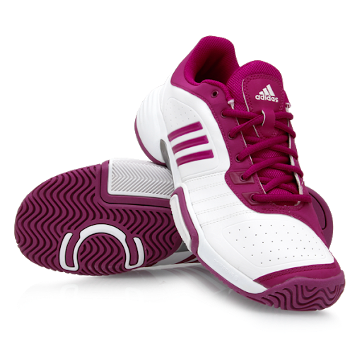
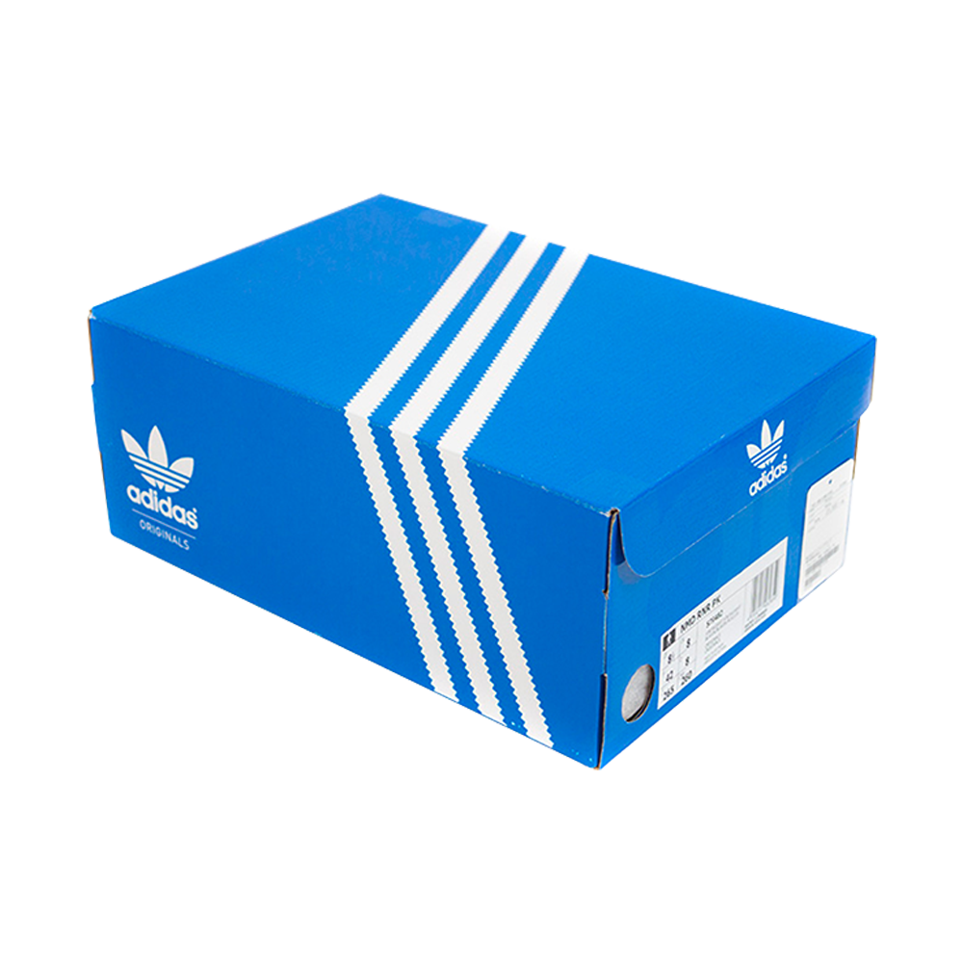
adidas
Adidas is a German multinational corporation, founded and headquartered in Herzogenaurach, Germany, that designs and manufactures shoes, clothing and accessories. It is the largest sportswear manufacturer in Europe, and the second largest in the world, after Nike. Adidas' revenue for 2018 was listed at €21.915 billion.

Slide 10
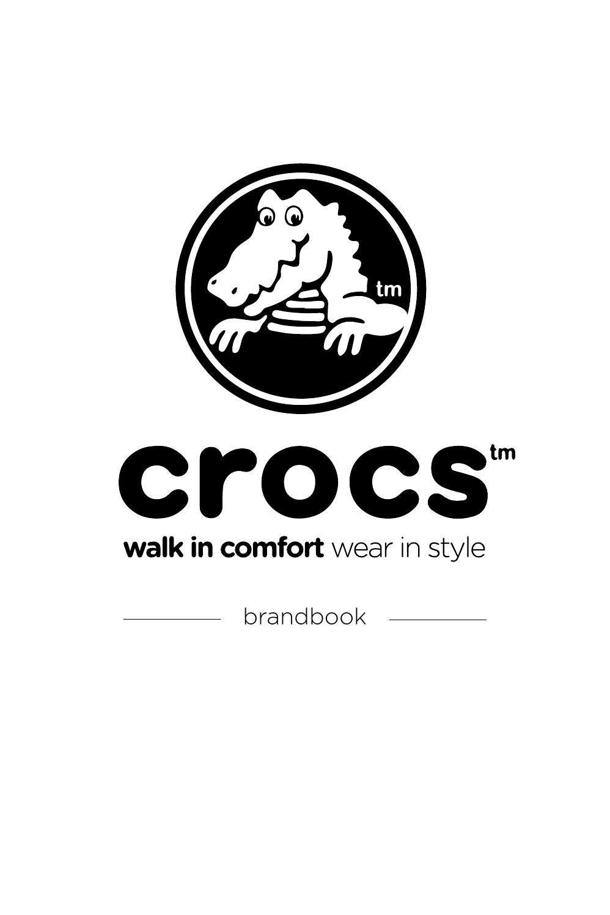
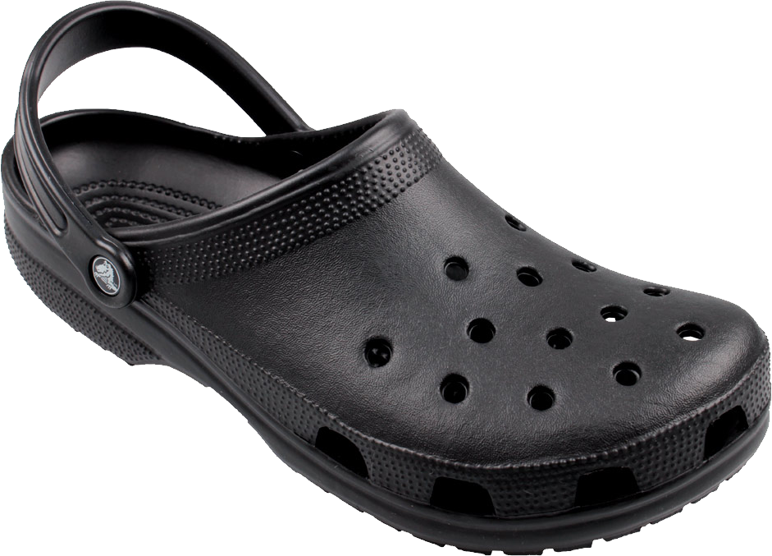
crocs
Crocs, Inc. is an American brand, based in Niwot, Colorado, that distributes and once manufactured foam clog shoes. Crocs was founded by Lyndon "Duke" Hanson, and George Boedecker Jr. to produce and distribute a foam clog, the design of which was acquired from a company called Foam Creations. The shoe was originally developed as a boating shoe.

Slide 11
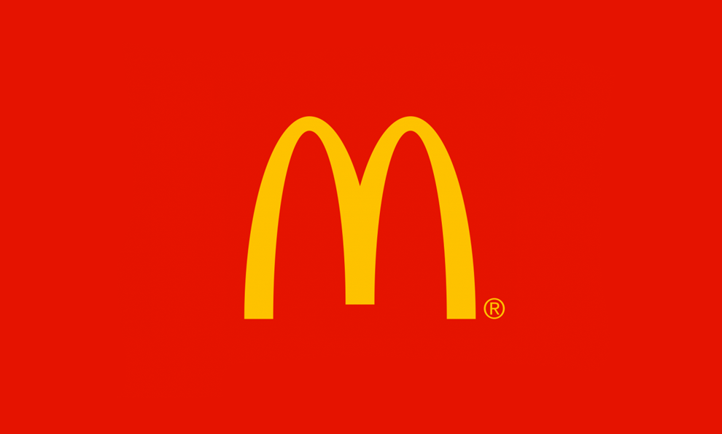
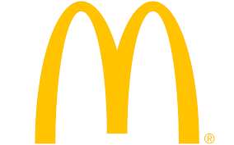
McDonald's
McDonald's is an American fast food company, founded in 1940 as a restaurant operated by Richard and Maurice McDonald. They rechristened their business as a hamburger stand, and later turned the company into a franchise, with the Golden Arches logo.
McDonald's is the world's largest restaurant chain by revenue.

Slide 12
Thanks!

