Slide 1
Local museums
(Brzozów - Sanok – Haczów – Blizne)

Slide 2
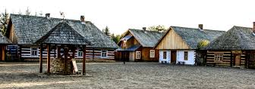
The Museum of Folk Architecture in Sanok
Museum of Folk Architecture, also known as Skansen is first and also the biggest museum of such type in Poland. It was created in Sanok after second world war by Aleksander Rybicki, former soldier of AK to save local culture from being destroyed and forgotten. Thanks to his work and outstanding museologists, it was possible to save many valuable traces of ethnic and religious diversity in this area, inhabited through the ages by Poles, Ruthenians, Germans, Boykos, Lemkos and Pogórzans.

Slide 3
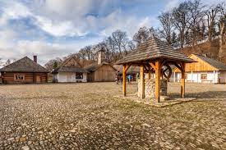
What can you see in Museum of Folk Architecture in Sanok?
There are many interesting things you can see in skansen. The tour begins from the Galician Marketplace, surrounded by shops and the houses of medieval craftsmen, doctors, bakers and clerks. Of course those aren’t the only buildings you can admire in the museum, there are over 120 objects such as wooden churches of different religions, mills and mansions of nobility. The oldest buildings date XVII century.

Slide 4
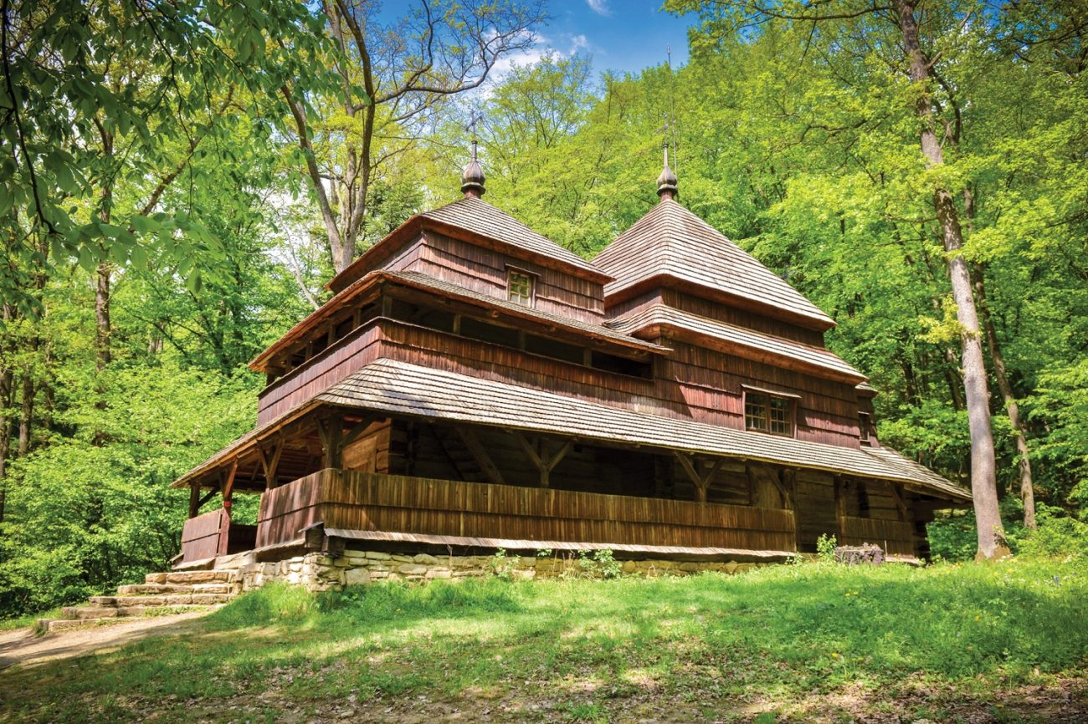
Interesting buildings in the scansen’s area
A Greek Catholic Church from Grąziowa, built in 1731 , it is based on a stone foundation and made entirely out of wood. It is made out of 3 segments - double vestibule and a sanctuary of Virgin Mary

Slide 5
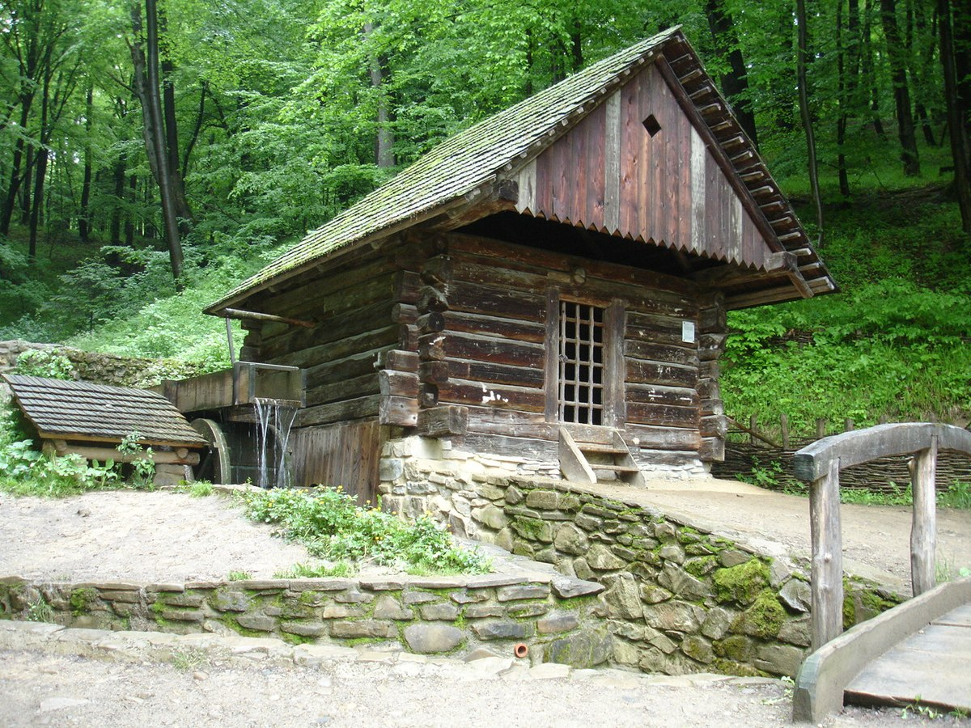
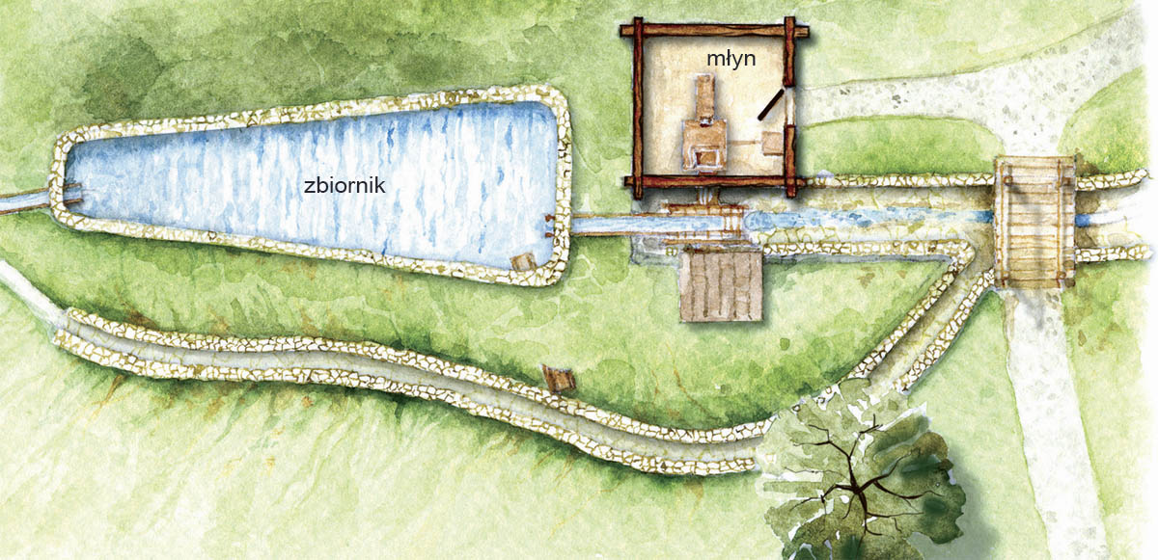
A working watermill made by the Boykons in 1880. It is a one-room log house covered with a sloping roof extended over the entrance.

Slide 6
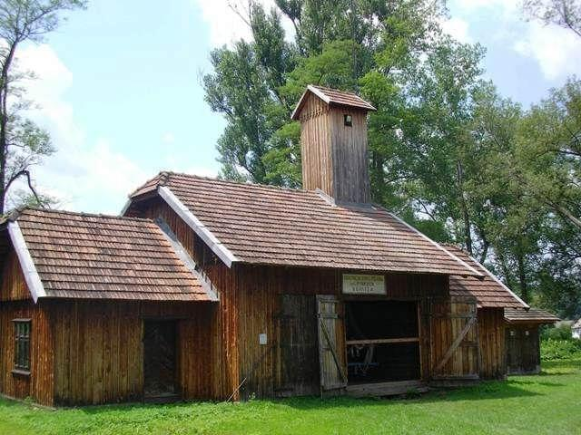
Wooden Firehouse from 1934
Consists of 3 rooms, the central one was used for parking fire engines, left as an office and right served as a storeroom. All items such as firemen helmet, belts, hatchets found within the building are kept there on a display.

Slide 7
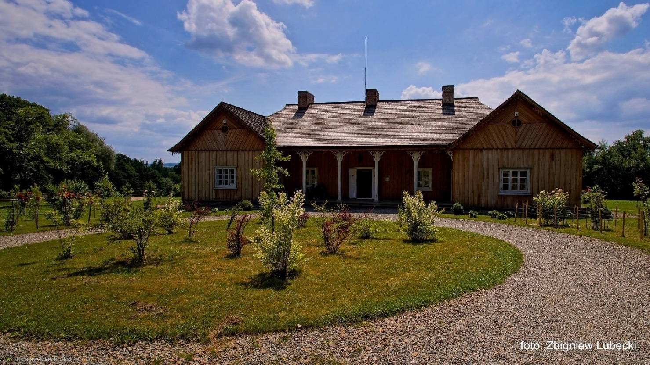
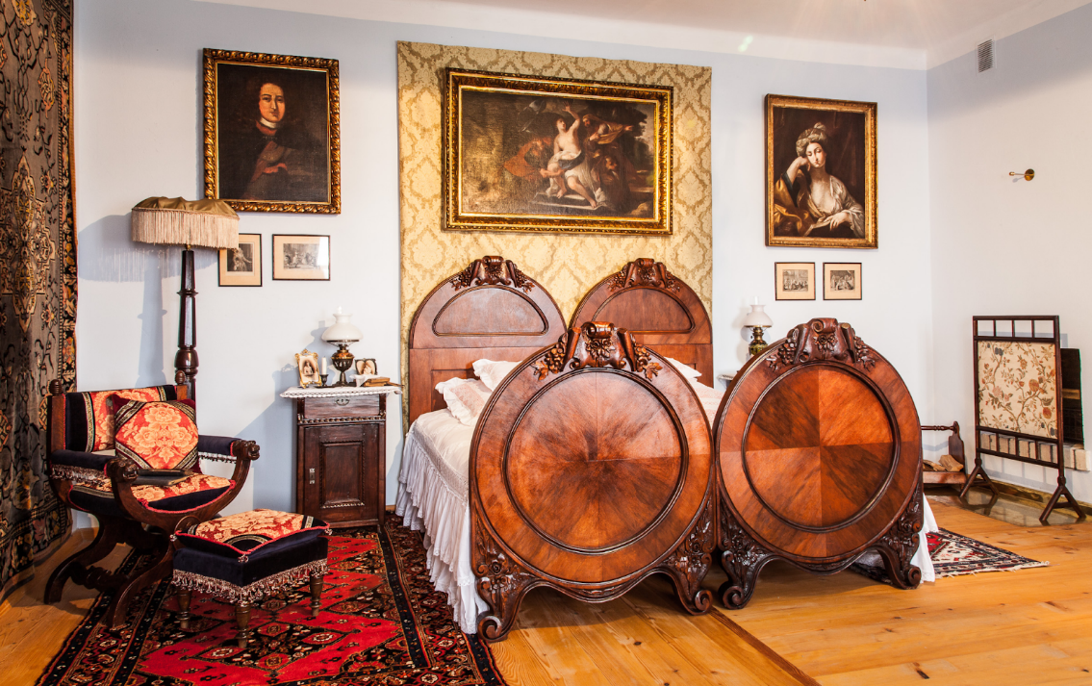
The Święcany Manor - beautifully set on a hill, offering a panoramic view of the town and the Castle Hill. It was built in 1861 and consists of 11 residential and utility rooms.

Slide 8
Church of the assumption of the Blessed Virgin Mary and St. Michael the Archangel in Haczów
Haczów - village founded around the mid-14th century and the local parish comes from 1388. However, it is difficult to say how long it took to organize the parish and the type of church that might have been built in the village in the 1st half of the 15th century. The present church was erected at the end of the 1450s: dendrochronological examination on the wood used for its construction proved that the temple was built of fir wood from trees that had been cut down in 1458-59 and which were over 100 years old at the time. Wooden buildings were then erected from non-seasoned rough wood, so the church could have been built in 1459. Church ceilings were usually added at a later time, which was the case here as well, as a study of the ceiling boards showed that they had come from trees felled in 1472. On the other hand, samples from the walls of the added sacristy appeared to have dated from the 1860s.

Slide 9
The origin of the church and Haczów
The founder of the church in Haczów is still unknown. Interestingly, the same carpentry workshop that erected the church in Haczów may have built a temple in nearby Iwonicz(1464). According to tradition, the church in Iwonicz was founded by King Casimir IV Jagiellon, so maybe both these churches were founded by the Polish king. We know that, in 1624 Haczów was destroyed by the Mongol (Tatars) invasion and old literature assumed that the present church in Haczów was built after the invasion and referred to it as a 17th-century monument. Meanwhile, the existing church was rebuilt in the 17th century, with a tower-bell, arcades, ridge turret, and new windows added. According to Piotr Łopatkiewicz, these changes were made a bit later than 1624. Right after the Tatars’ invasion, in the face of the devastation, the parishioners did not have the means to reconstruct the church. But a few years later, in 1631, the king handed over the parish in Haczów to the Krosno mansionary canons who, in turn, had property that allowed them to carry out architectural work, so the reconstruction of the church in Haczów may have started after 1631.

Slide 10
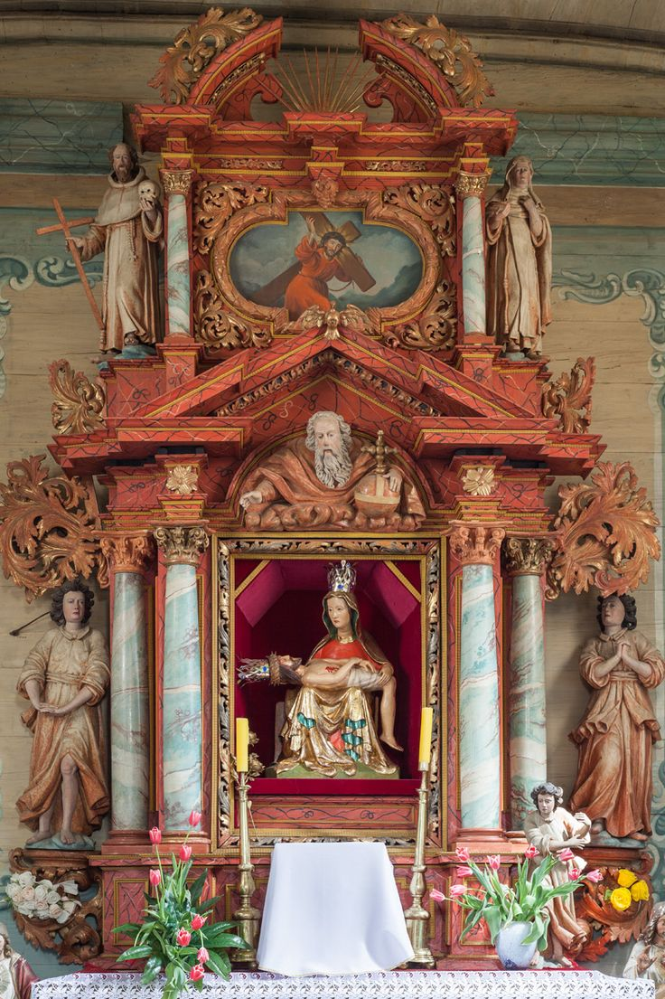
How the church has entered the UNESCO list
A comprehensive renovation of the paintings and subsequent discoveries took place in the early 1990s, but it was not until 2000 that 10 of the boards were exhibited on the ceiling, arranged according to the 1993 concept by Prof. Jerzy Gadomski. Today, the church in Haczówdisplays the exposed elements of most of the preserved 15th-century paintings, although parts of later polychrome showing the character of the decorations from the turn of the 19th and 20th centuries also remain. The side altars from the 18th century and polychrome church benches (around 1700) returned to the interior as well. In 2003, the church was added to the UNESCO World Heritage List.

Slide 11
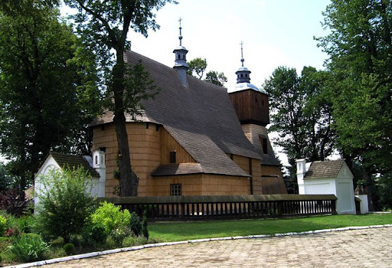
Blizne – Church of All Saints.
The church in Blizne is a building with was mentioned in 1470; the current building is generally assumed to have been built in the 2nd half of the 15th century. The building has stone foundations and a log construction (it is a structure built with horizontal logs interlocked at the corners by notching). The ceilings of the nave and of the three-sided closed chancel are on the same level; the nave has zaskrzynienia (extended beams of the upper part of the side walls in the chancel, which is narrower than the nave, forming a support for the timber roof truss that covers the entire church). The original timber roof truss has survived until today and we can find carpenters’ marks on its trusses. The ceiling beams of the chancel are reinforced with hooks.

Slide 12
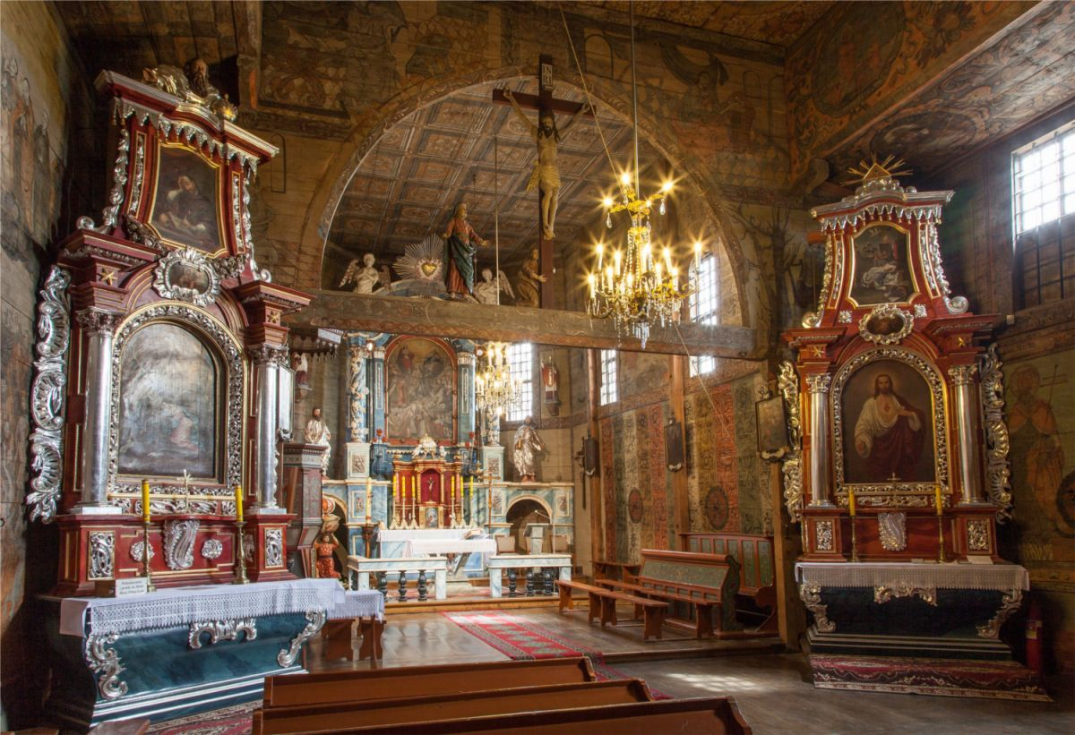
The origin of the church and Blizne
The most valuable monument in Blizne is the late-Gothic church of All Saints from the 15th-16th centuries with a log structure, in the 17th century with ramparts. In 2003, the church was inscribed on the UNESCO World Cultural and Natural Heritage List. The interior of the temple is decorated with rich polychrome. The paintings on the walls and ceilings were made from the 15th to the 17th century and on the so-called the book of the poor, i.e. biblical images intended for uneducated people. The decorations are the foundations of peasants: Dorota and Maciej Skarbek, Piotr Mońek, and Marcin. In the side altar there is a miraculous linden figure of Our Lady of Grace Pelnaj, which probably came from the chisel of Vita Stoss himself around 1500. It used to be part of the altar triptych, then it was carried to the church fair. Once, a resident of Blizne dreamed that an old linden tree should be placed in a hollow, 2 km from the church. From then on, people gathered under the linden tree. When the tree caught fire from candles, the figurine was saved. In place of the linden tree, a chapel was erected, but without a figurine. Also noteworthy is the wooden complex of parish complexes from the 18th-19th centuries: a vicar from before 1699, which is located in the parish museum, a barn with a coach house, an outbuilding, a hospital for the poor and a parish school.

Slide 13
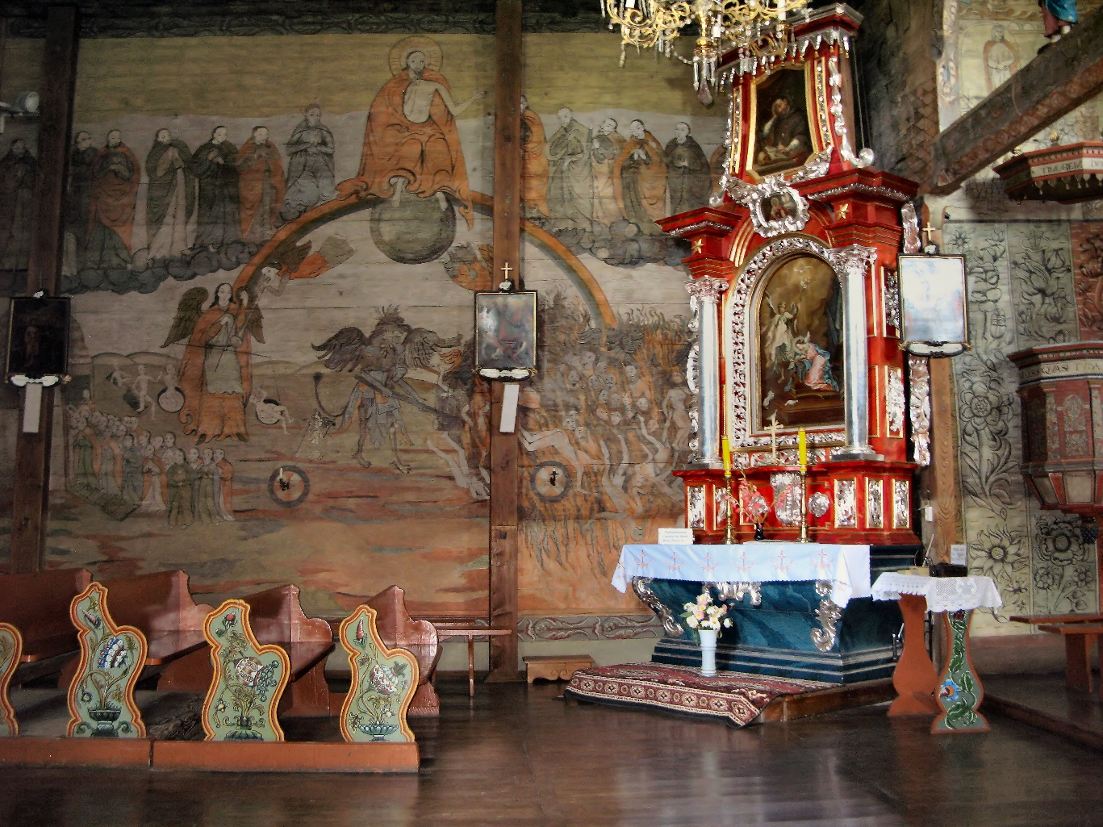
Church’s murals
Consecration crosses are the oldest of the decorations preserved inside the church; they are painted encircled Greek crosses showing where the church was anointed in order to be consecrated. In 1549, the entire interior was covered with polychrome; the late-Gothic and renaissance murals in the chancel have survived until today. The lower parts of the chancel’s walls now show a later, ornamental polychrome (ca. 1700), which might be hiding the earlier murals (as evidenced by the uncovered fragments showing a woman’s head). The polychrome was uncovered, renovated, and partially reconstructed in the years 1964-1971.

Slide 14
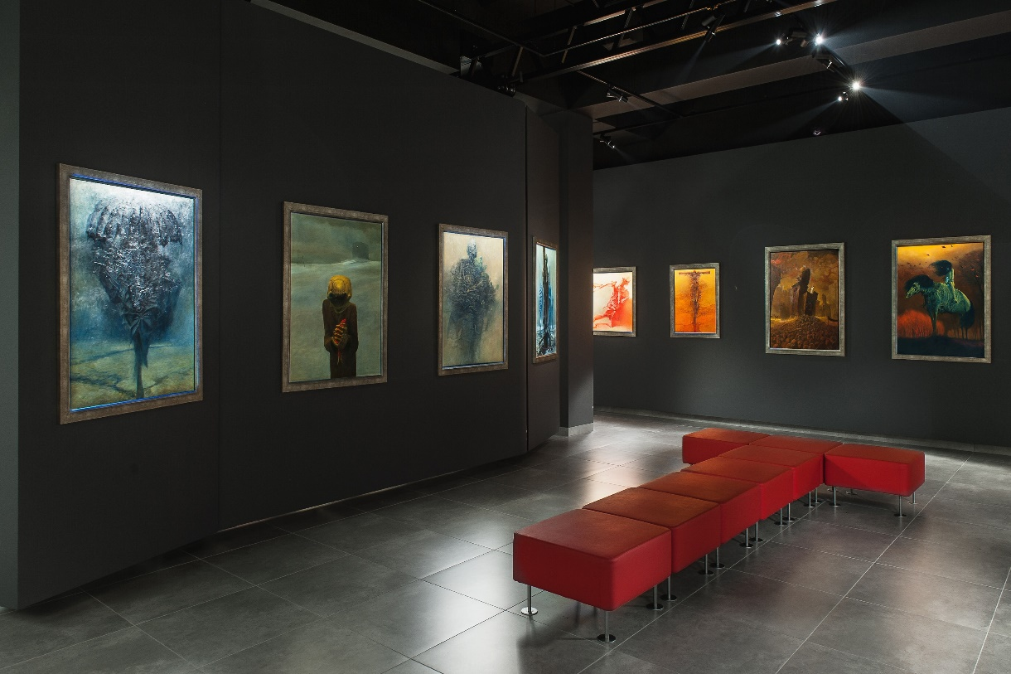
Gallery of Zdzisław Beksiński
The biggest exhibition in the world, numbering around 600 works, presents rich and diverse creativity of one of the most interesting contemporary artists. Having, to a large extent, author's profile the exhibition has retrospective character reflecting development and stylistic-formal transformations of the art in the course of time. The gallery begins with co-called Sanok chamber where are presented, apart from outstanding photographs from the 50s, early works created in abstract manner along with the set of unique pictures painted on glass and equally interesting sculptures. Next room, being faithfully reconstructed Warsaw studio. It gives the possibility of direct penetration of intimate, everyday world of the master. Wide spectrum of the exhibited works, being presented in drawers of display cases, such as sketches, drawings and graphics coming from various periods, reveal continuous improving of technique and seeking for own, autonomous forms of expression. There is no lack of computer works, although as the most significant are concidered two chambers situated on the lower storeys where there are exhibited the most important paintings of the entire oeuvre. The paintings, through which the artist fully expressed himself, give the opportunity for a spiritual walking through the labyrinth of extraordinary talent and unlimited imagination. There is also possibility to see an exceptional work – the last painting finished on the day of the artist's death.

Slide 15
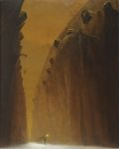
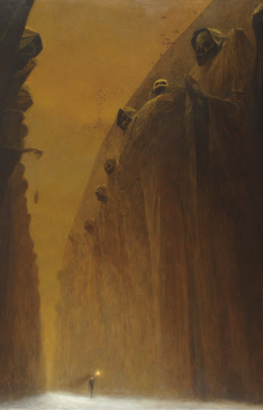
Paintings
Beksinski is recognized by recipients of art, above all, as a creator of original and evocative painting. The museum's collection of the paintings had been gradually expanding during the life of the artist. After his death, it was significantly enriched by the works inherited by the museum, according to the artist's will. The current collection contains over 200 paintings, representative for all periods from the earliest works to the last painting painted in February 2005. In the early artistic path, Beksinski's art evolved and transformed its character. Starting from the abstract painting, the artist quickly found his own, unique and recognizable style. Surprizing discovery of 29 paintings on glass from 1957 took place two years after his death. Free and spectacular play of colours is characteristic of these paintings. Some of these works are parallel to the works painted in pastels, but expressiveness is intensified here by the matter of painting and more intensive palette of colours

Slide 16
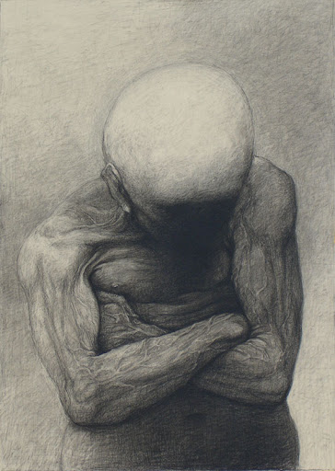
Drawings
The museum has got several thousand sketches and drawings of the artist from all periods of his creativity. There are even the works which were executed by the few years old future artist. They are records of his first strokes. Missing out the juvenile attemps, consisting mostly in copying art works of masters, the first drawings are kept in expressive convention. Some of them reveal also relations to surrealism. These early projects are the important documentation of artistic explorations. From the beginning, the theme of the works oscillates around the alienated, trapped in the inner drama, evoking painful experience human figure. Its form is geometrized and simplified after 1957. Being interested in geometrical relations, the artist continued traditions of the pre-war avant-garde. In the 60s, the works gradually gain spaciousness through plasticizing modeling and delicate chiaroscuro. The drawings as well as graphics appearing in the years of 1956-1969 which were made by means of the cliché-verre and monotyping technique, are still variations on the theme of the human and animal figure. Initially, they revealed inspirations of the cubism.

Slide 17
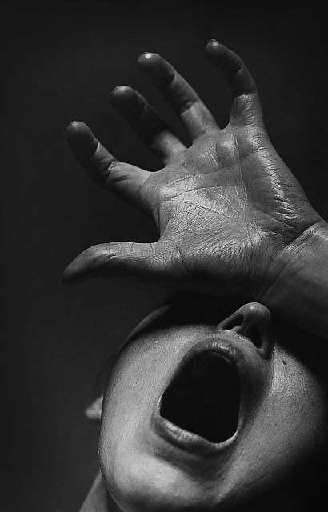
Photography
The museum has got the rich collection of artistic and documentary photography and thousands of negatives (some of them has never been developed) by Beksinski. These works are characterized by an innovative approach, creativity and high quality. Unquestionable artistic qualities caused that Beksinski is still regarded as one of the greatest and the most inventive photographers of the 50s. Individual perception of reality was already revealed in these early works but the first encounter with this medium had occurred much earlier: I have photographed probably since 1940. Someday, at the beginning of the war, my father gave me his old camera (...) Although I photographed a lot of, it was not artistic creativity. I photographed friends, situations which had happened, tanks with soldiers, even airports (...). These pictures are stored in the museum archive and are important historical testimony to those times.

Slide 18
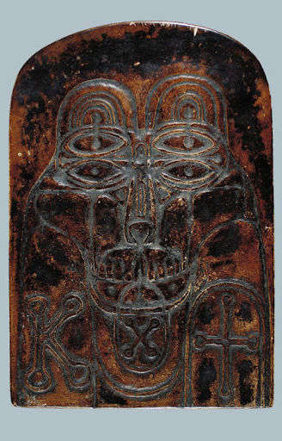
Sculptures
In comparison with painting and drawing works there were relatively few sculptural works of Zdzislaw Beksinski. The artist constantly stressed that it had not come from the lack of interest in this type of creativity (far from it), but had always been the cause of space limitations and the lack of appropriate conditions. The first art works – paintings-reliefs, which made Beksinski well-known in Polish art in the mid-50s, were created in the spirit of the allusive abstraction. Entering into the mainstream of the abstraction, the artist created his works in his own, independent way. In the 60s almost simultaneously with these extremely interesting, multi-plane, abstract works (which the substantial collection was given to the National Museum in Wroclaw by the artist at the time of his moving out from Sanok) there were made figural sculptures with literary titles. Apart from the large-size figural sculpture of Hamlet the Sanok Museum is held an interesting cycle of heads made out of patinated plaster. Their irregular shape with many holes resemble somewhat skulls.

Slide 19
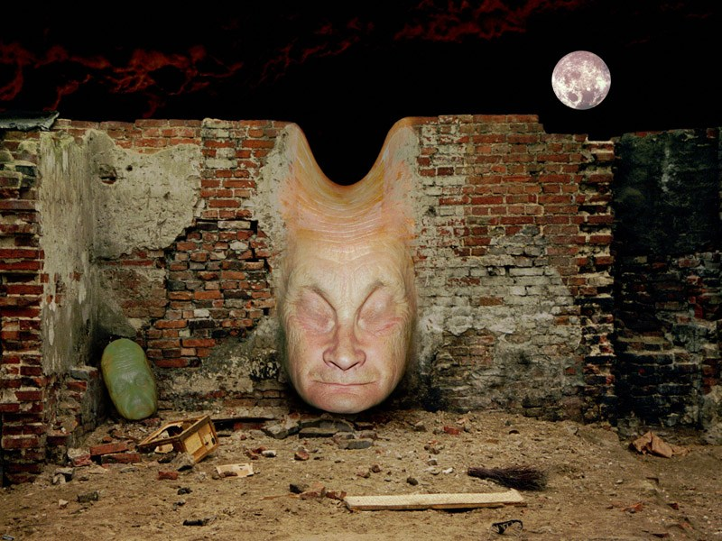
Graphics
The artist had interested in computer graphics in the late 90s. It was a kind of return to photography. The first works made by means of a computer, in a sense, refer to the photomontages from the 50s. After decades, Beksiński again creates photographical compositions using his own and other's photographs. Yet, this time the photographs are inputted into a computer by means of a scanner then compiled and processed. Visions created in that way are similar to the painting works of the fantastic period in which dominate unrealistic, metaphysical space built through realistic chiaroscuro.

Slide 20
The end
Prepared by
Maksymilian Kamiński
Szymon Szczepek
Jakub Rzepka
Tomasz Słomski

