Slide 1



UN WORLD TOURISM DAY
The most important museums of Palermo:
● Antonio Salinas regional Archaeological Museum
● Antonio Pasqualino International Puppet Museum

Slide 2

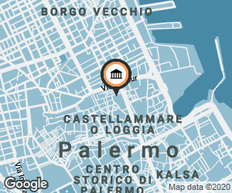
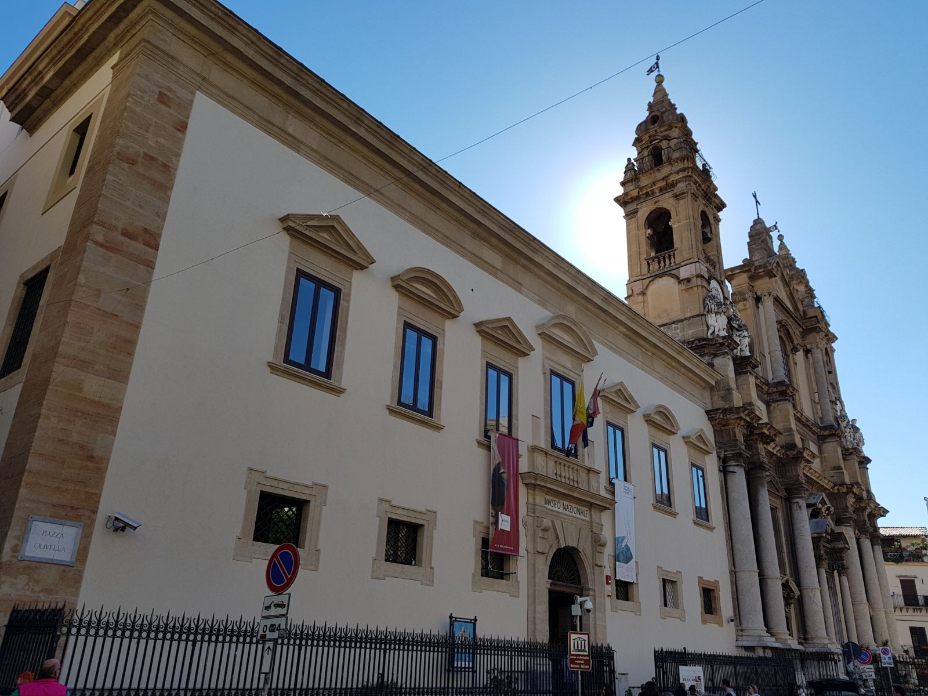
Antonio Salinas regional Archaeological Museum
The museum is located in piazza Olivella, in the historic center of the city.

Slide 3
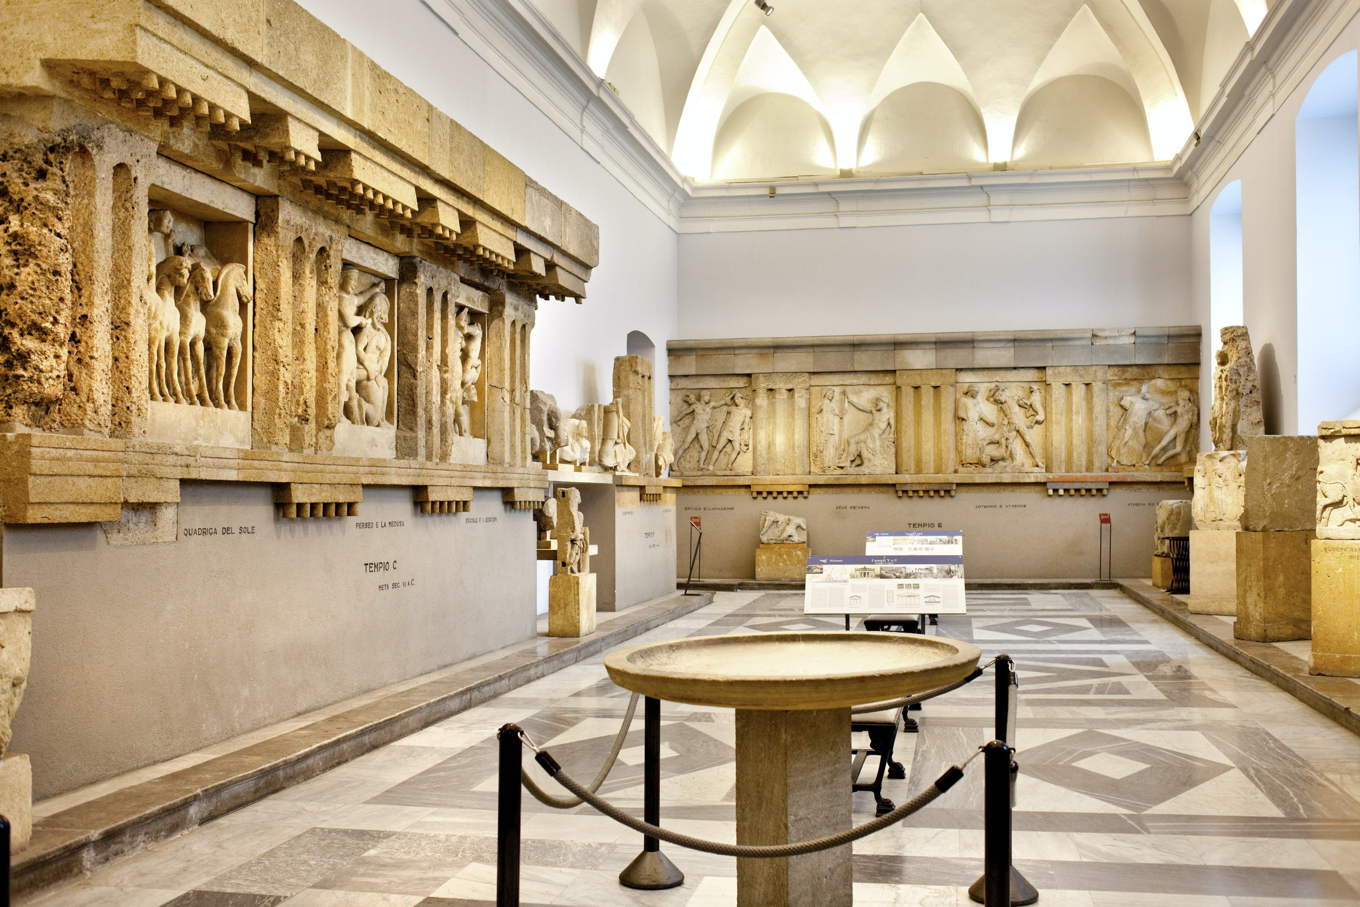
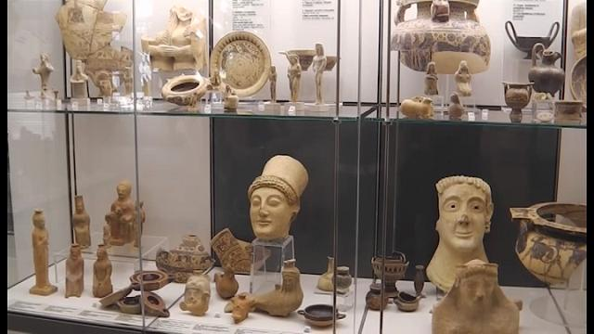
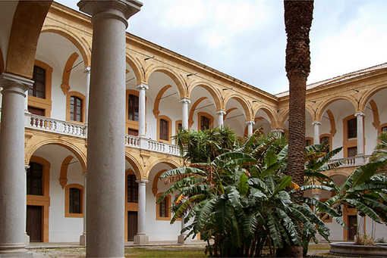
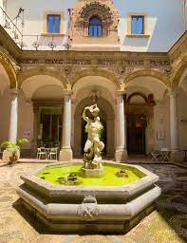
It has one of the richest archaeological collections in Italy and evidences Sicilian history

Slide 4
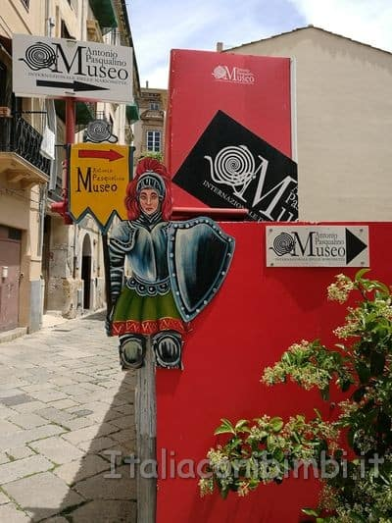
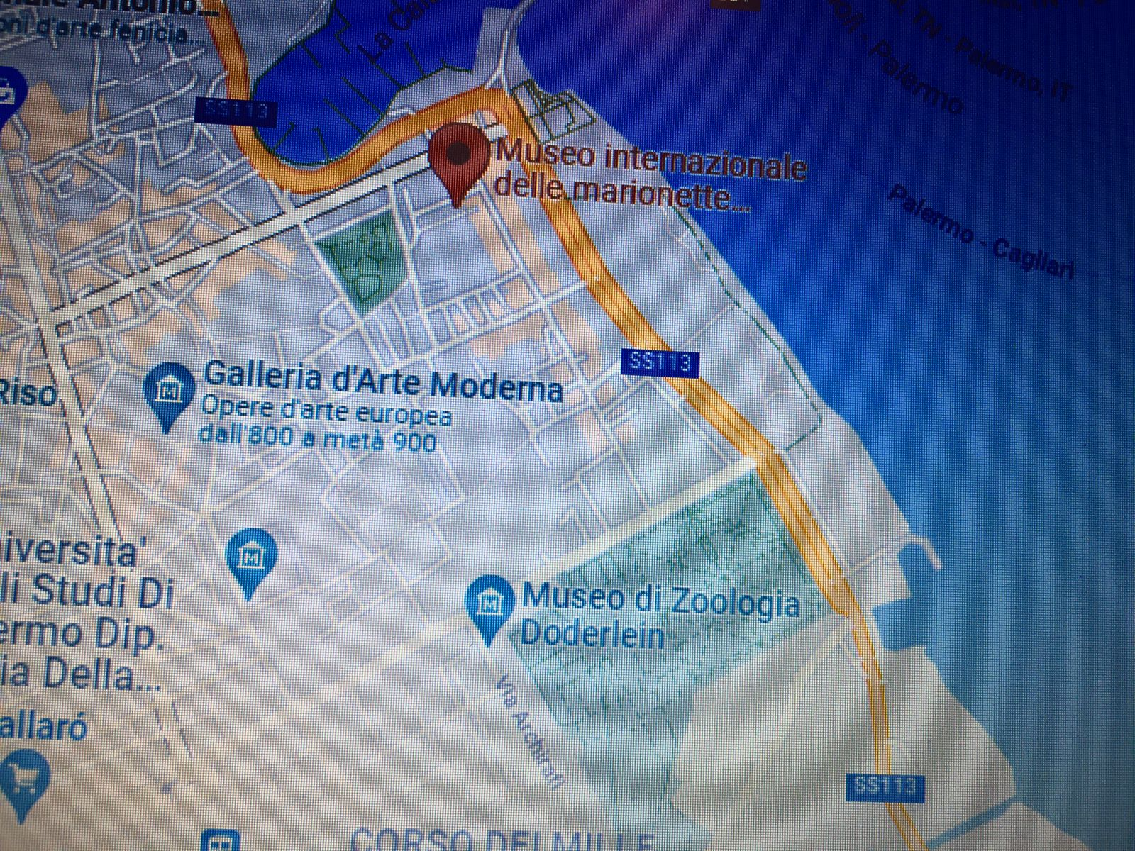
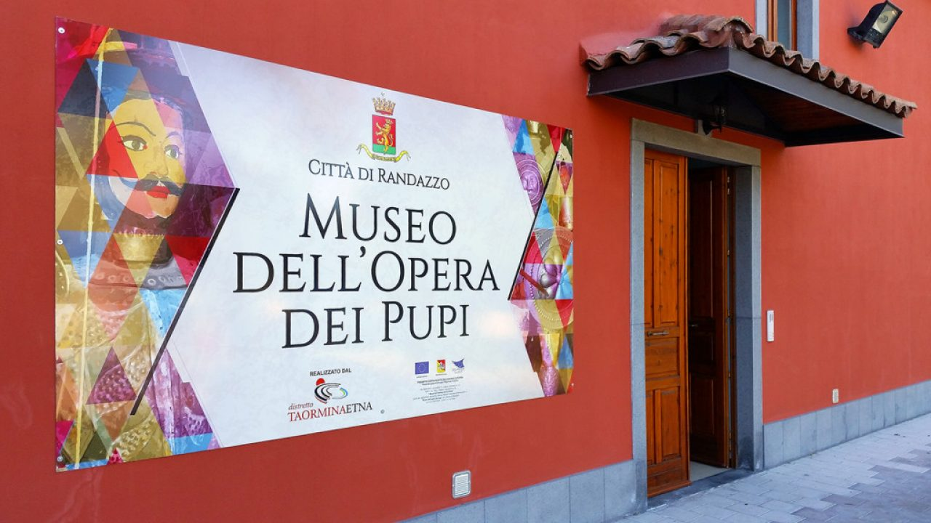
Antonio Pasqualino International Puppet Museum
The museum is located in piazza Antonio Pasqualino, near Porta Felice

Slide 5
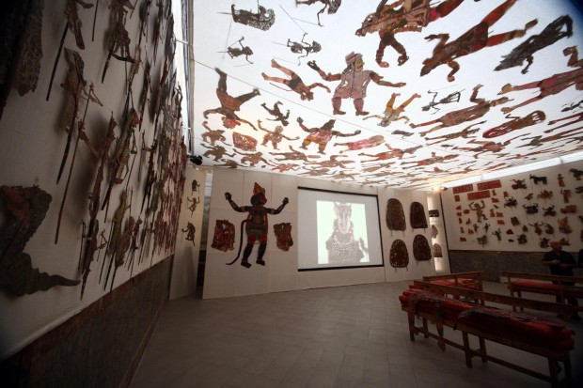
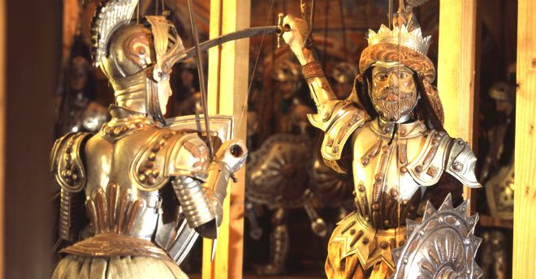
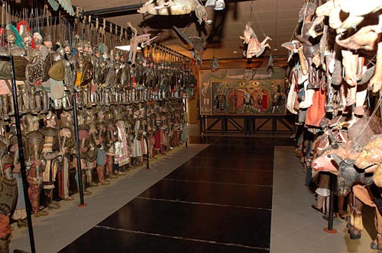
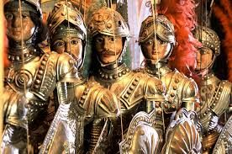
It is a museum of popular traditions in Palermo, named after Antonio Pasqualino, who collected the first nucleus of the collection of Sicilian puppets, puppets and marionettes from all over the world.

