Slide 1
Lithuania

Slide 2
Our logo and our company ,,Kibiniukai”
About our logo:
Logo color is very similar to kibinai dough color.
Scientists proved, that orange color awakens appetite.
We think this logo feed is original and unique.

Slide 3
Vision: we want to make a kibinai global.
Mission: Adapt our product to foreign countries market’s, changing some ingredients. For example changing the types of meat or vegetables.
Goal: Our goal is to produce other types of tipical products, adapting them to all the foreign markes.

Slide 4
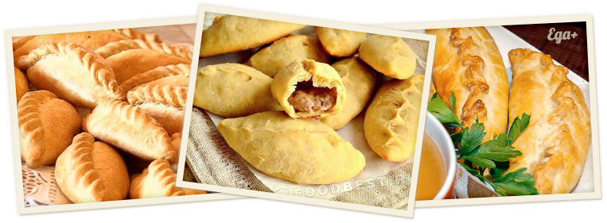
KIBINAI
The kibinai is a traditional Lithuanian’s food, it is a dough with meat and onin cooked in the oven.

Slide 5
About it
All the ingredients are supplied by ,,Kauna’s farm”, this farm offers the best products of Lithuania. All the animals are free to graze and all the meat is treated in the best ways for give her softness and flavor, while there aren’t additives and preservatives in the agricultural fields.

Slide 6
Strengths | Weaknesses
It has made of local products. There aren’t similar recipes in the world. There aren’t a additives. | It has a lot of calories. Unique recipes.
Opportunities | Threats
There is a vegan alternative. There aren’t global competitors. It can be advertise as slow food. | There are locals competitors. It hasn’t an original recipe. The price for transports etc. could drive up the general price.

Slide 7
For opening we need:
Business structure
Business name
Register your business
Permits
Pay taxes
License
Necessary bank account
Trademarks, copyrights or patents

Slide 8
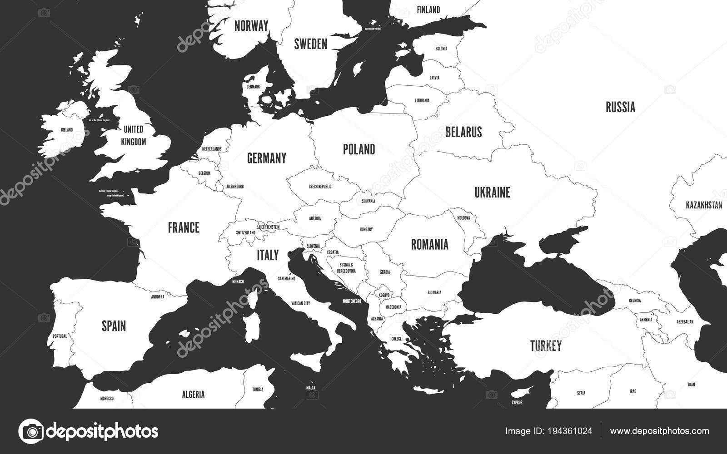
Our company will be opened in other countries as well

Slide 9
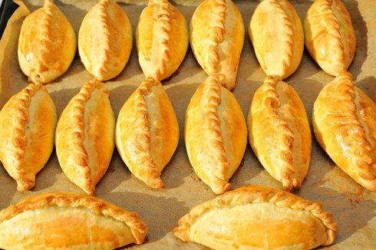
We interviewed 120 people, who were asked with what filling they prefer kibinai. We displayed our results in a diagram.

Slide 10
Opinion poll

Slide 11
Business plan:
We plan to find good suppliers who will transport our product to different wolves of the world.
If people in another country don’t eat or prefer another filling, we are ready to listen to the people and come up with a filling that will suit to that country .
We plan to make an excursion for people who are interested in cooking process, but in order not to reveal the secret of cooking, we will give a ready-made dough

Slide 13
1. Brief Investment Memorandum
2. Description of the business, product or service
3. Description of the sales market
4. Sales and Marketing
5. Production plan
6. Organizational structure
7. Financial plan
8. Risk factors

Slide 14
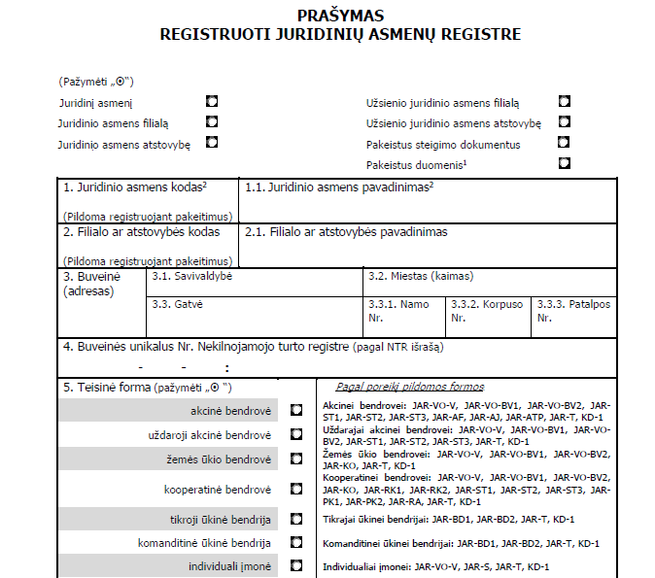
Forms to open a firm

Slide 15
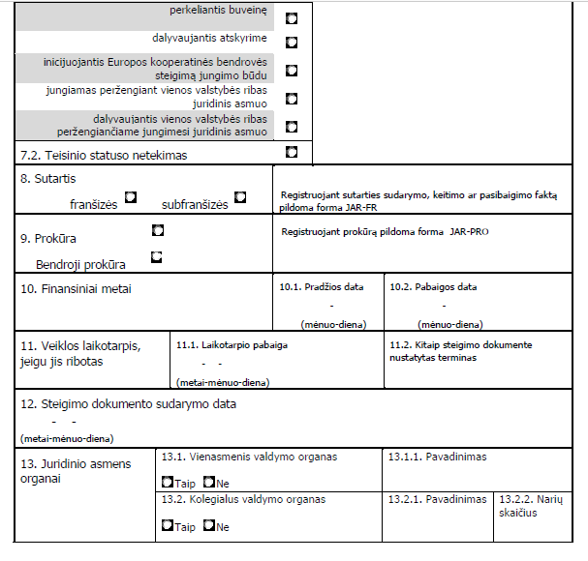

Slide 16
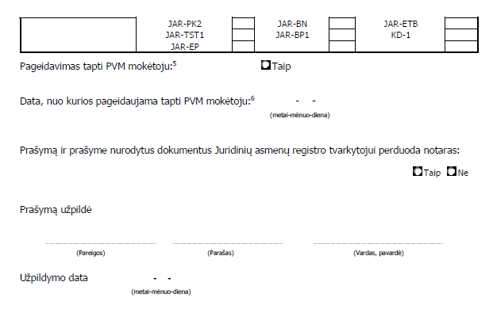

Slide 17
Flyer

Slide 19
Ideas for ecommerce
Create an attractive, user friendly, b2b web page.
The definition of business-to-business (B2B) sales is a sales model that involves one business selling products or services to other businesses.

Slide 21
Glocalization for Spanish market
For glocalization in Spanish market we will use beef instead of pork because pork would be too stodgy for warm Spanish climate. Also, we will use local ingredients: local spices, ingredients, flavouring and traditional Spanish dressings.

Slide 22
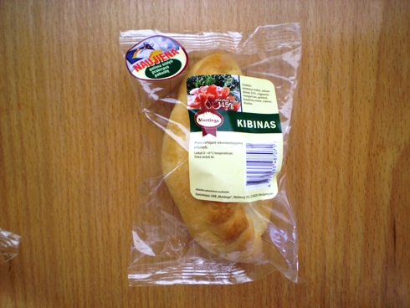
Packaging for Kibinai
We decided to make two types of packaging: economy and exclusive

Slide 23
Thanks for attention!

