Slide 1
UNESCO Heritage
By: Anastasija Parshonak , Olivija Vaidak and Darja Safonova
Notes:
1

Slide 2
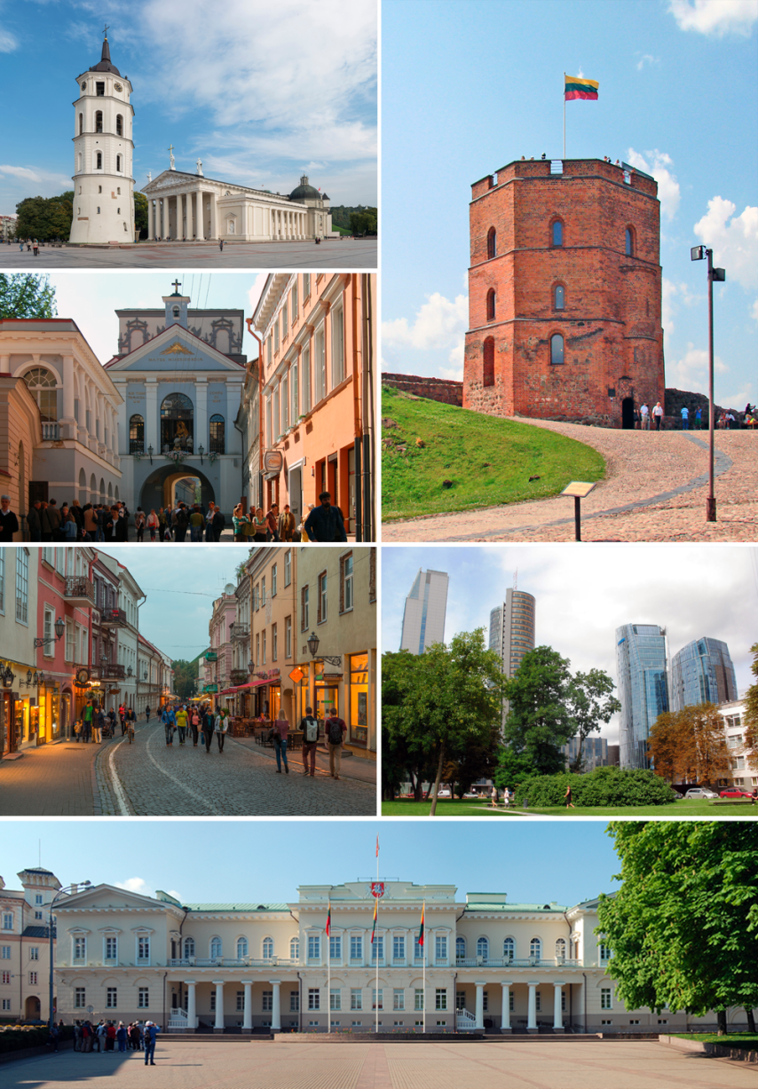
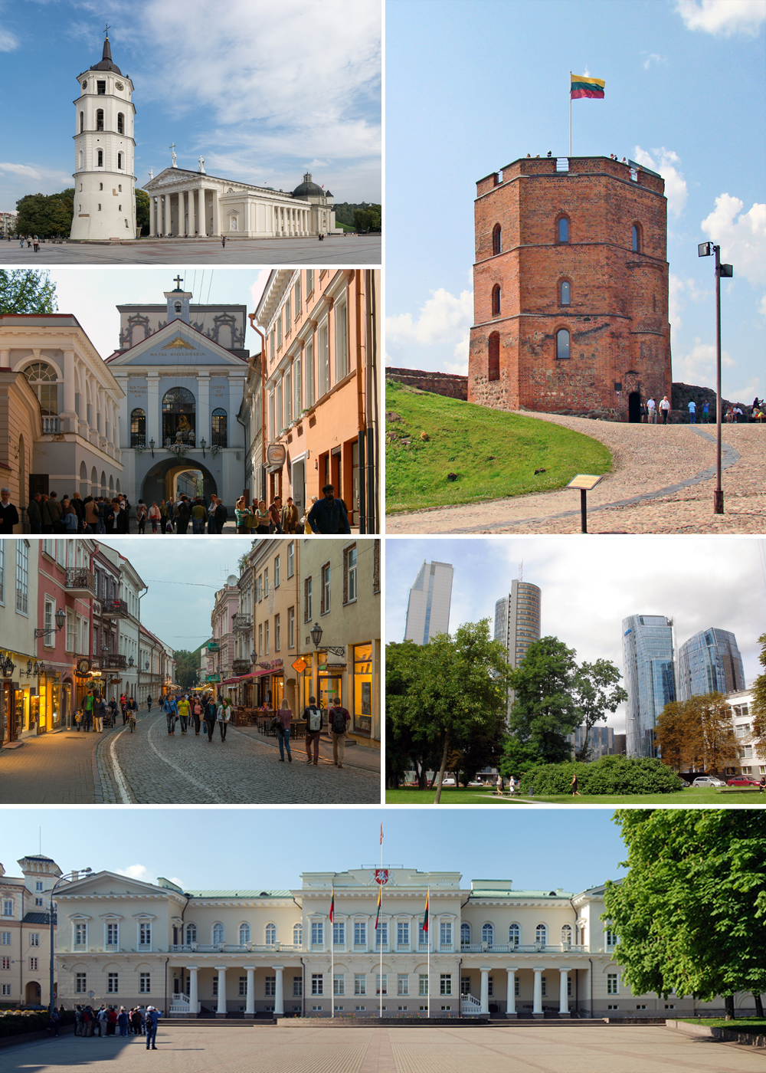
Content
Gediminas' Tower
Vilnius University
The Palace of the Grand Dukes
Vilnius Cathedral
Vilnius Town Hall
Three Crosses Hill
St. Anne's Church
The Republic of Užupis

Slide 3
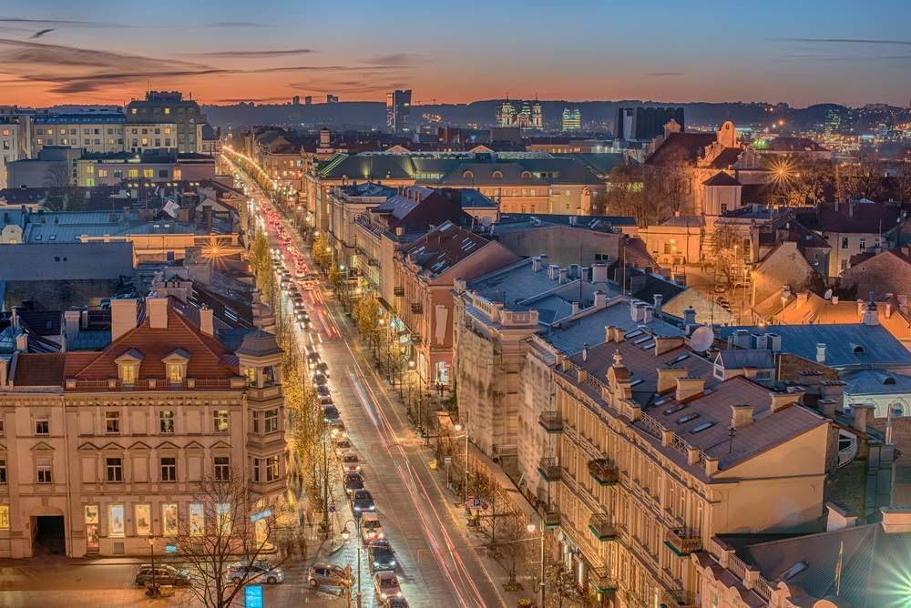
The subject of the presentation - Vilnius UNESCO Heritage.
The aim of the presentation is to introduce with Vilnius Historic Centre UNESCO Heritage.
The following objectives are going to be realized:
Acquaint with sights of Vilnius Centre
Inform the legends of some attractions
Recommend some places to visit in Vilnius Historic Centre

Slide 4
Introduction
The UNESCO designates World Heritage Sites of outstanding universal value to cultural or natural heritage. The first site added to the list was the Vilnius Historic Centre, in 1994. Three further sites were The Curonian Spit, Kernave Archaeological Site, and The Struve Geodetic Arc.
Vilnius Historic Centre was the first of the four Lithuanian sites added to the prestigious UNESCO World Heritage list. It is the diverse combination of buildings of different periods that makes Vilnius townscape exceptional in Central Europe.
Vilnius Historic Center

Slide 5
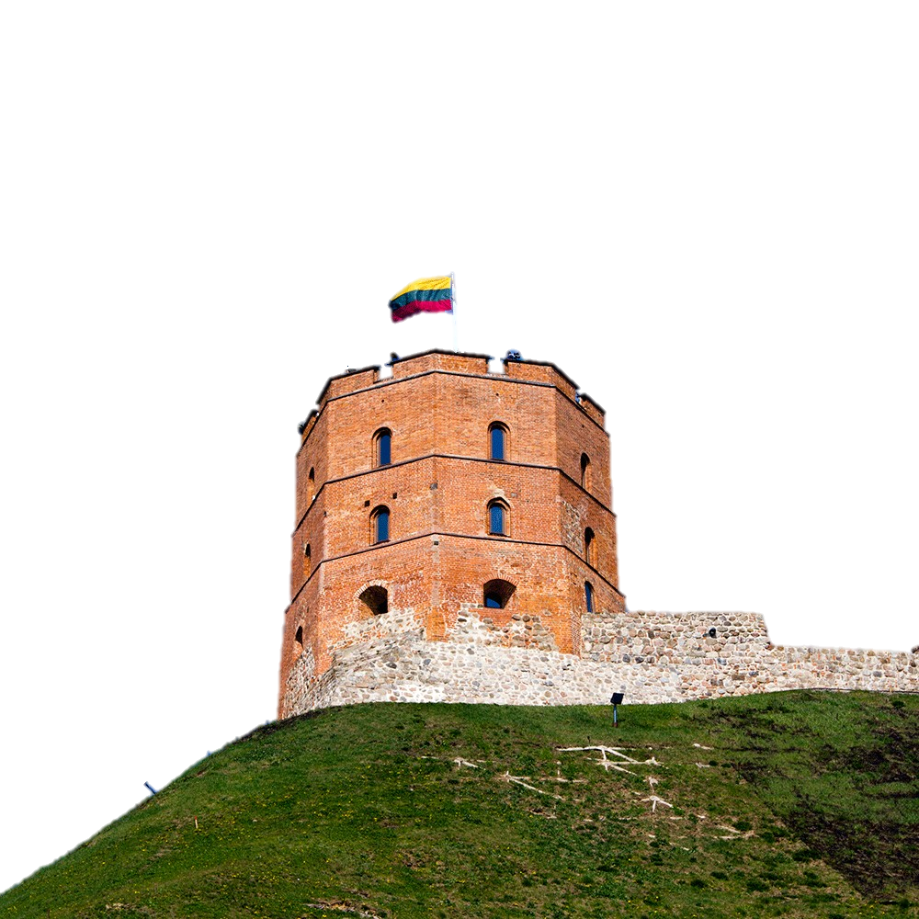
Gediminas' Tower
The Lithuanian Grand Duke Gediminas after hunting spent the night on a hilltop where he had a dream about building a city in this place which will become a capital of Lithuania

Slide 6
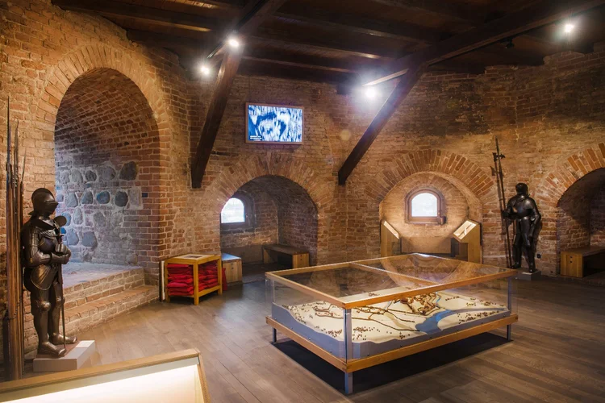
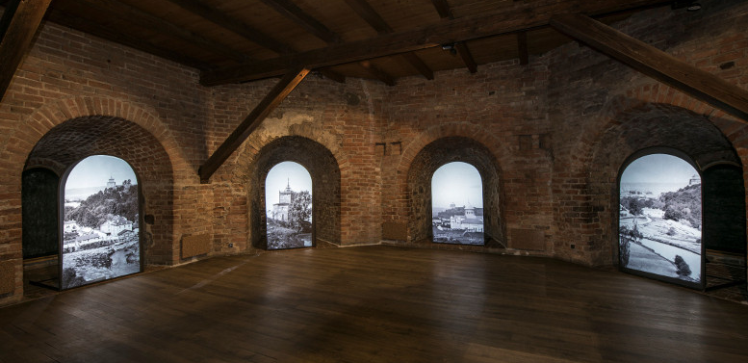

Slide 7
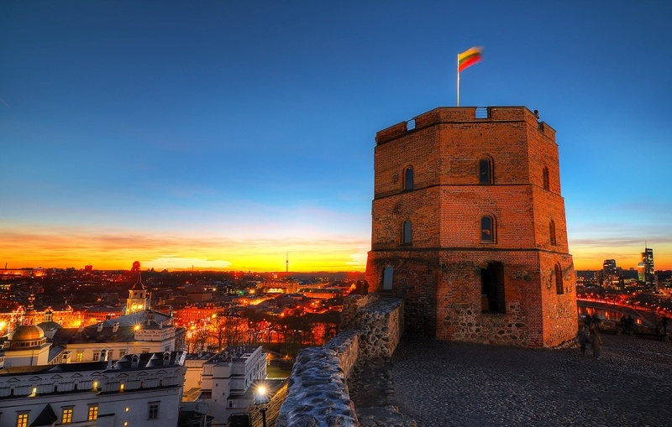
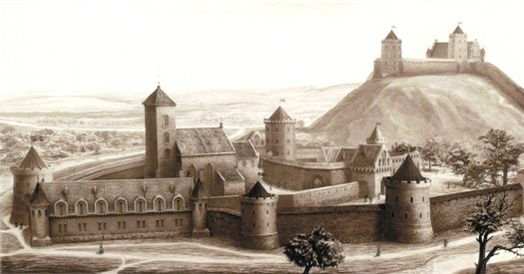

Slide 8
Vilnius University
The oldest university in the Baltic states, and one of the oldest and most famous in Northern Europe. The university was founded in 1579.

Slide 9
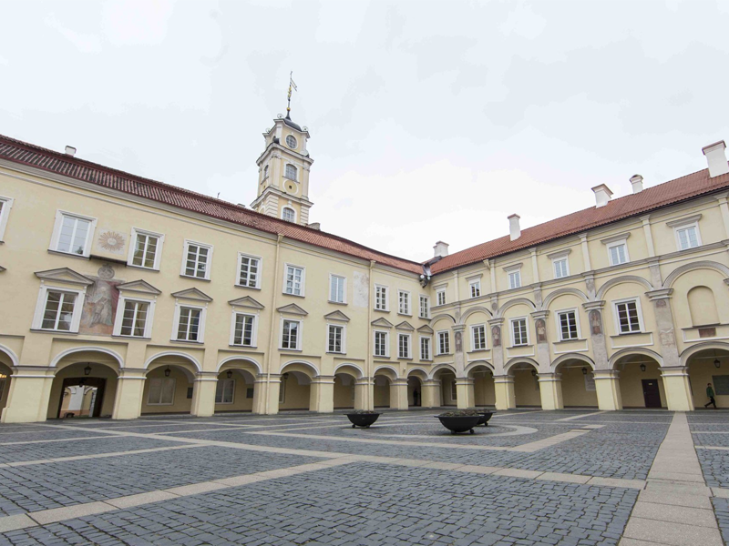

Slide 10
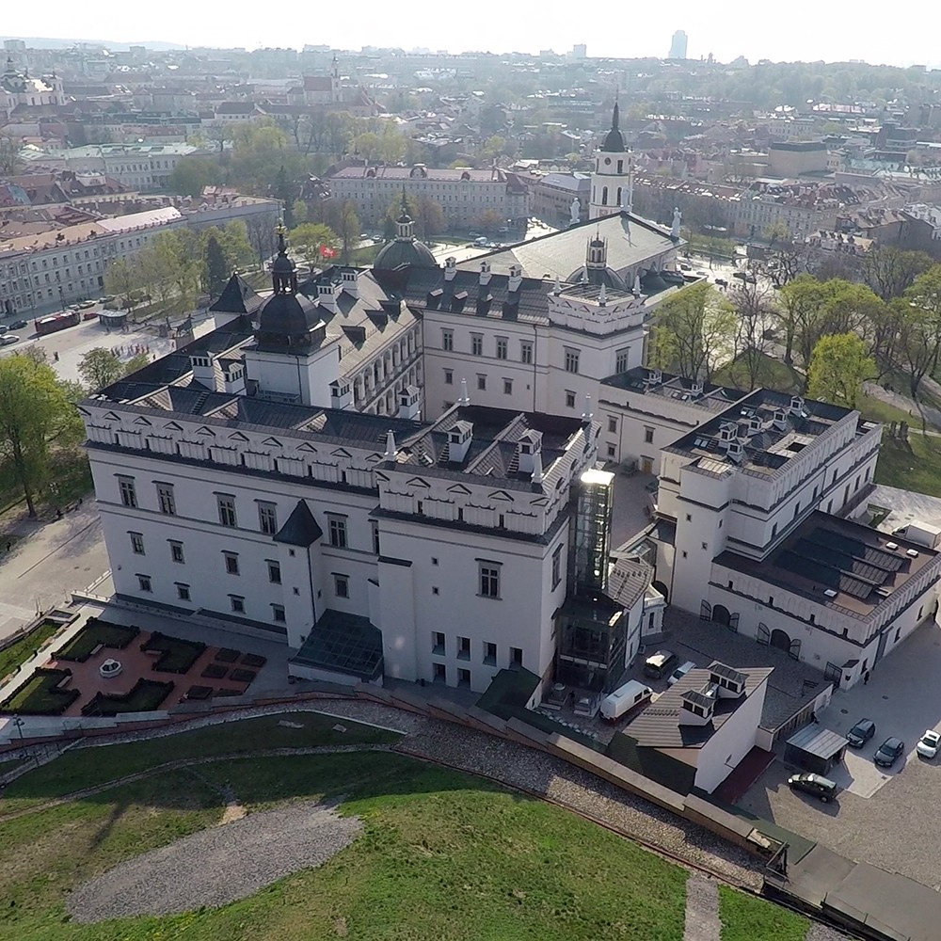
The Palace of the Grand Dukes
The National Museum, at the Palace of the Grand Dukes of Lithuania, four permanent exhibitions can be viewed that reflect the functions of this historic residence.

Slide 11
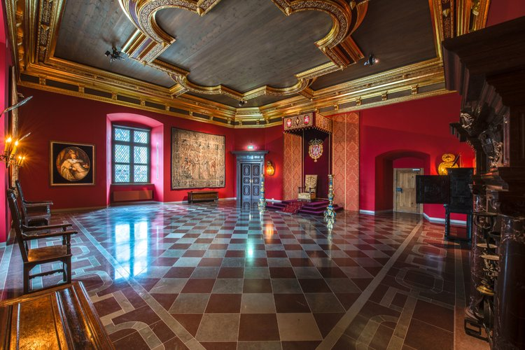
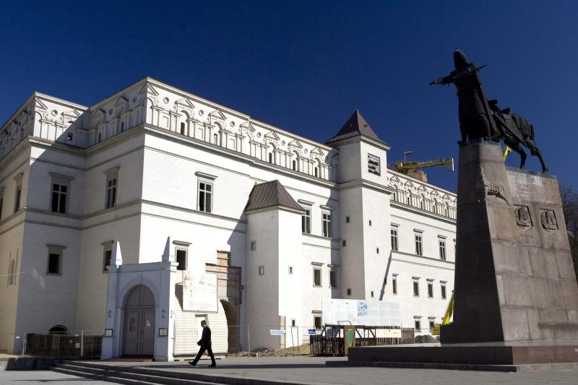

Slide 12
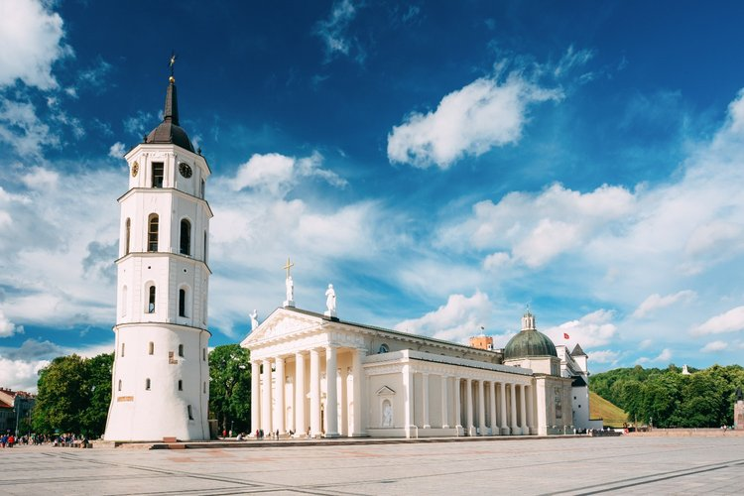
Vilnius Cathedral
The country’s most important Catholic shrine, the Cathedral, is the symbol of Lithuania’s baptism.

Slide 13
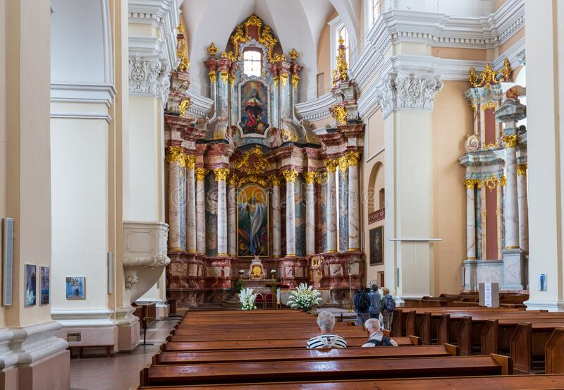
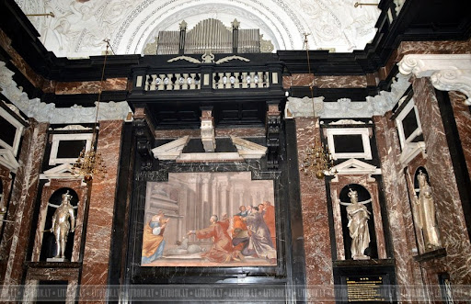

Slide 14
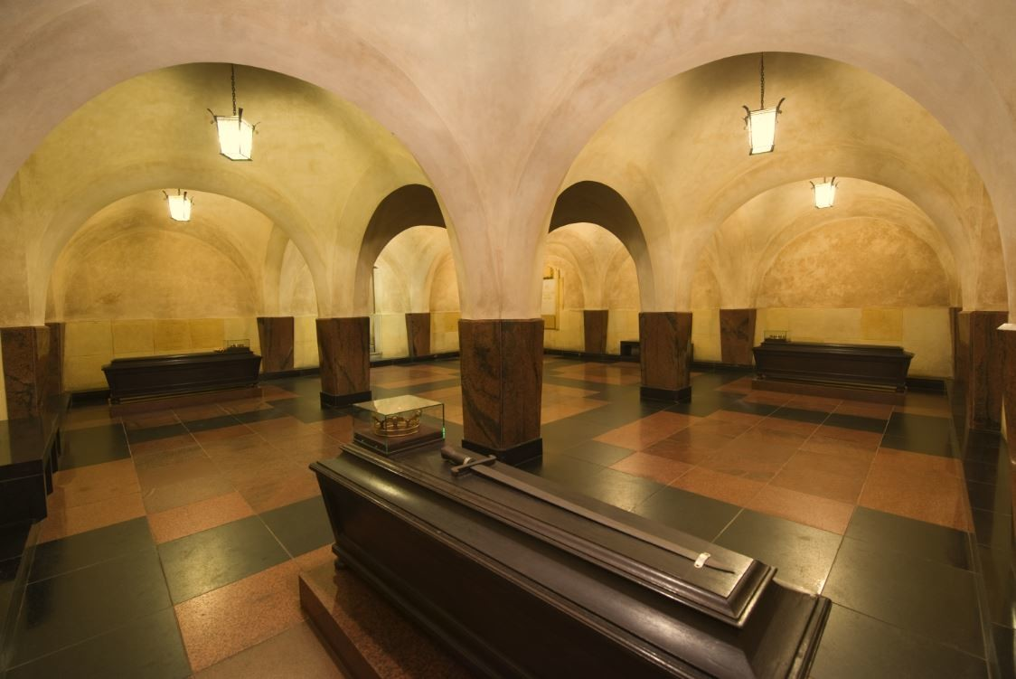
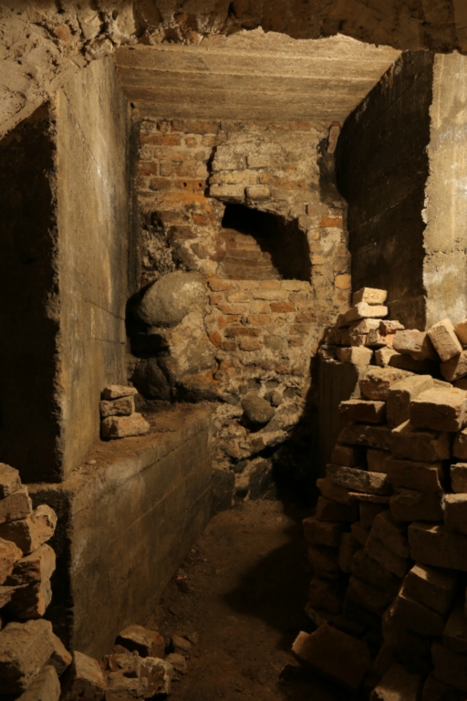

Slide 15
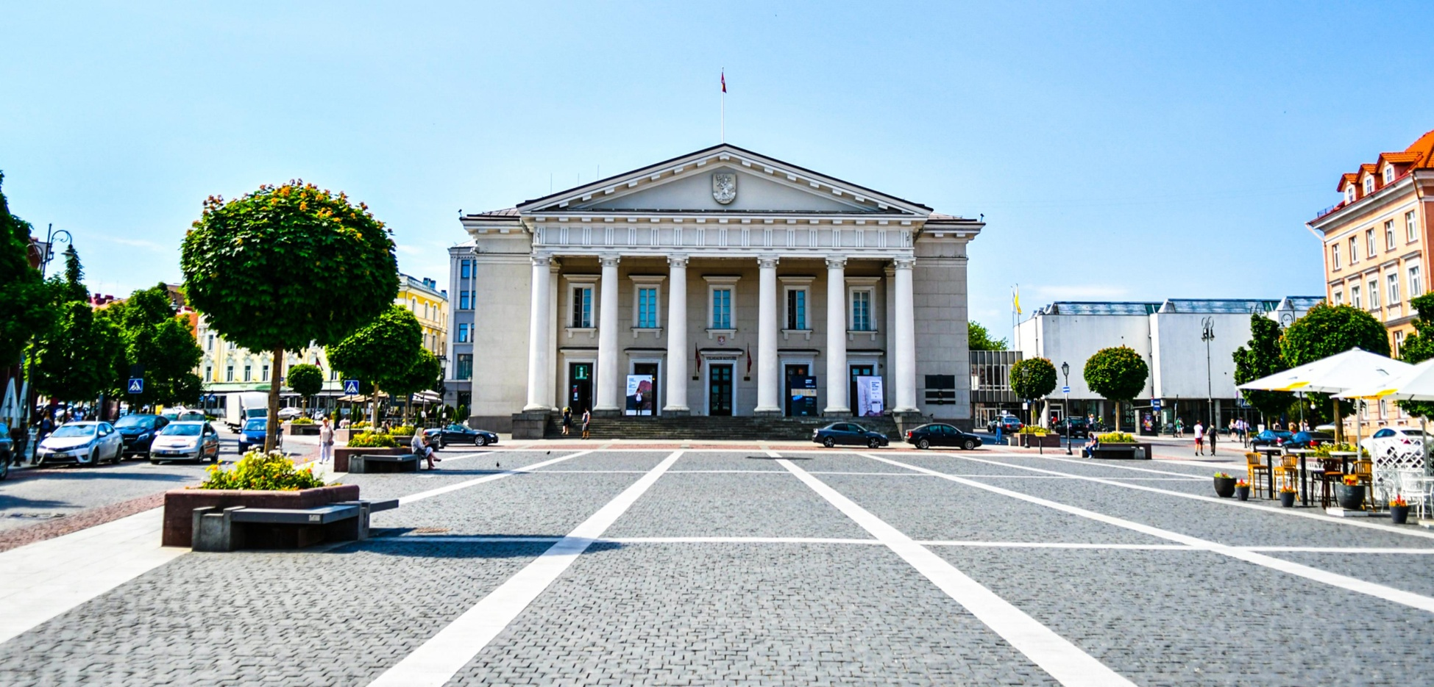
Vilnius Town Hall
It is a popular location for concerts, literature, theatre evenings, and art exhibitions.

Slide 16
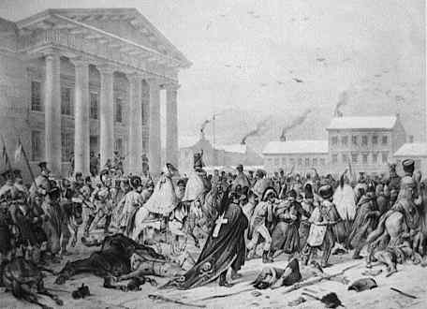
Basilisk of Vilnius

Slide 17
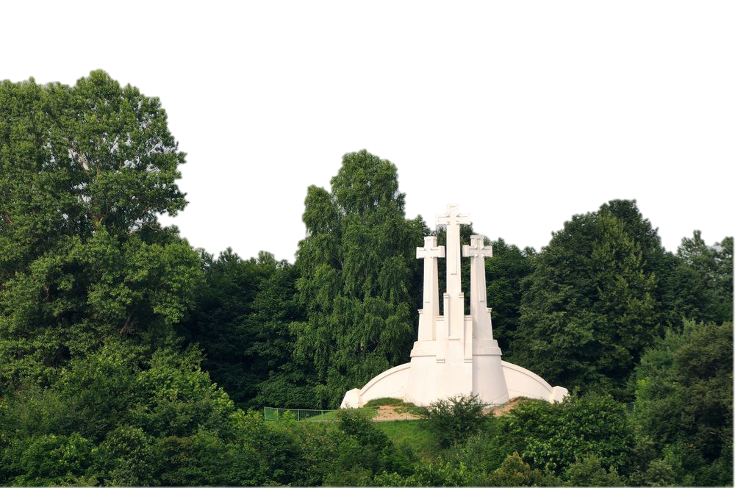
The Three Crosses Hill
Is a prominent monument in Vilnius, Lithuania, on the Hill of Three Crosses

Slide 19
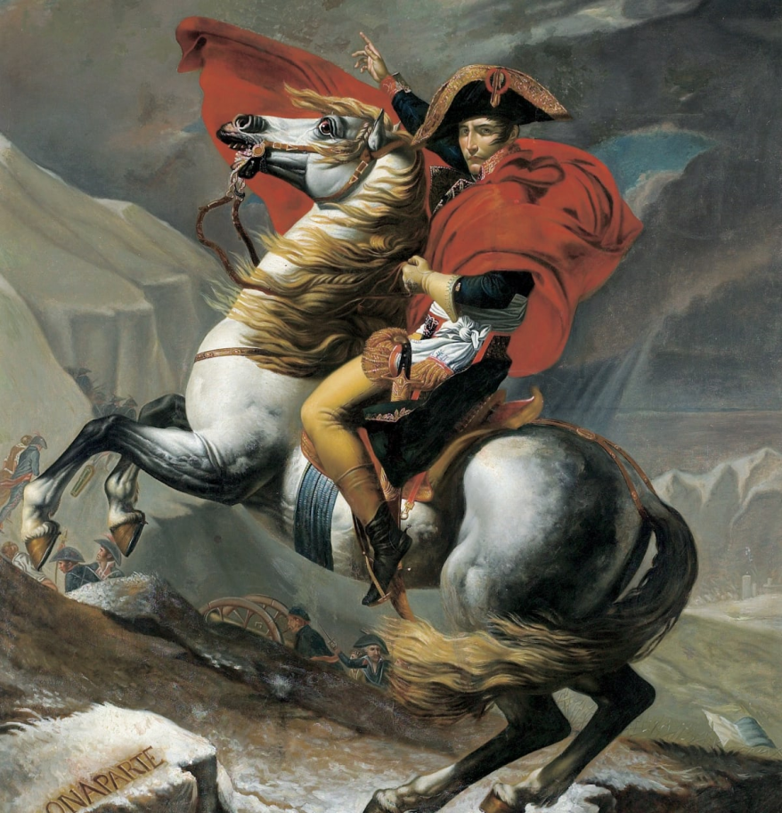
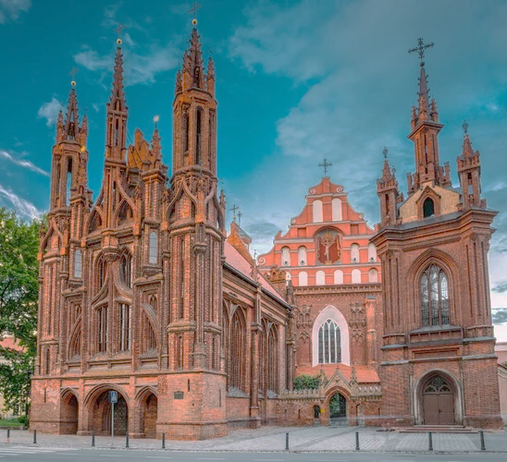
St. Anne's Church
Emperor Napoleon, after seeing the church during the Franco-Russian War, expressed a wish to carry the church home with him to Paris 'in the palm of his hand'.

Slide 20
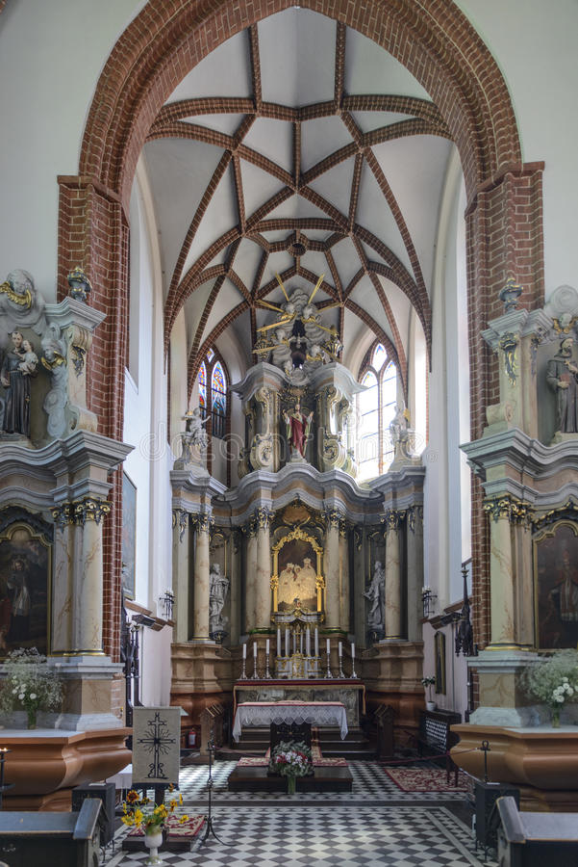

Slide 21
The Republic of Užupis
A neighbourhood in Vilnius,largely located in Vilnius's old town, a UNESCO World Heritage Site. Užupis means "beyond the river". The district declared itself an independent republic

Slide 22
Flags of Republic of Užupis
Winter
Spring
Summer
Autumn

Slide 23
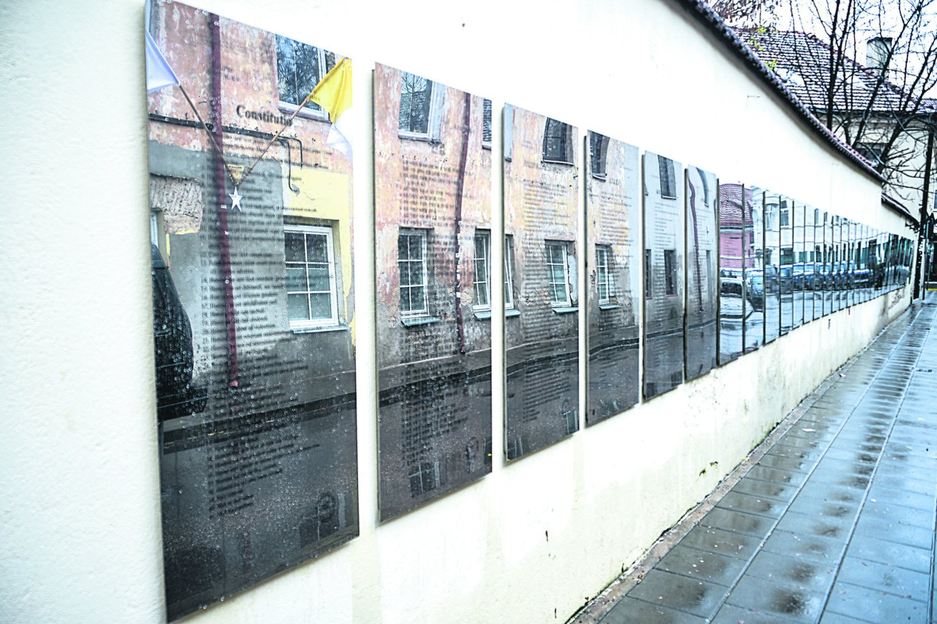
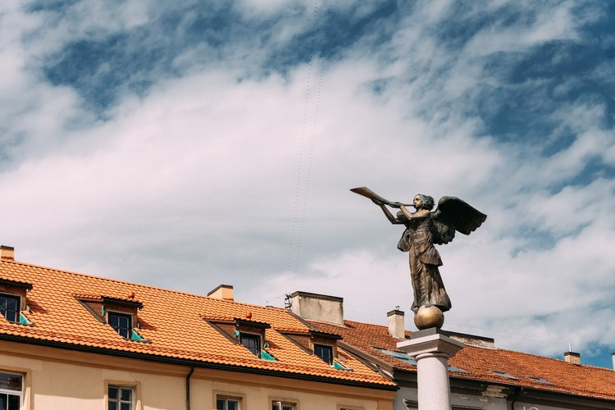

Slide 24
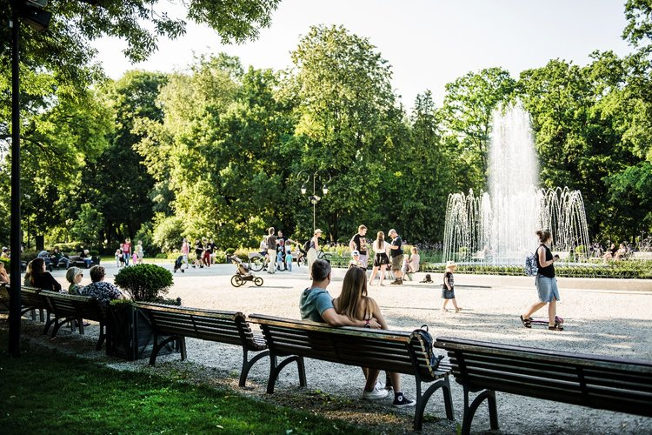
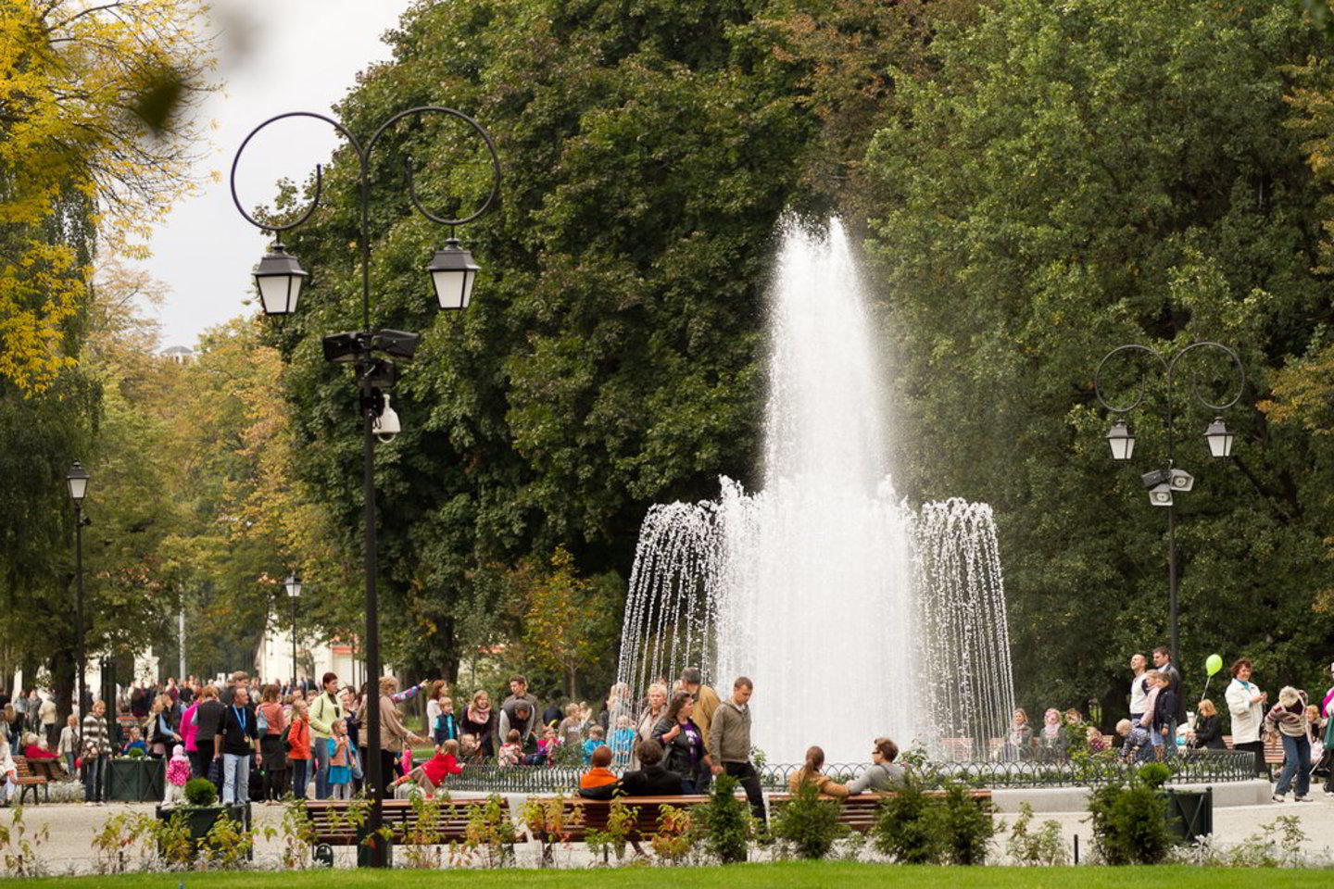
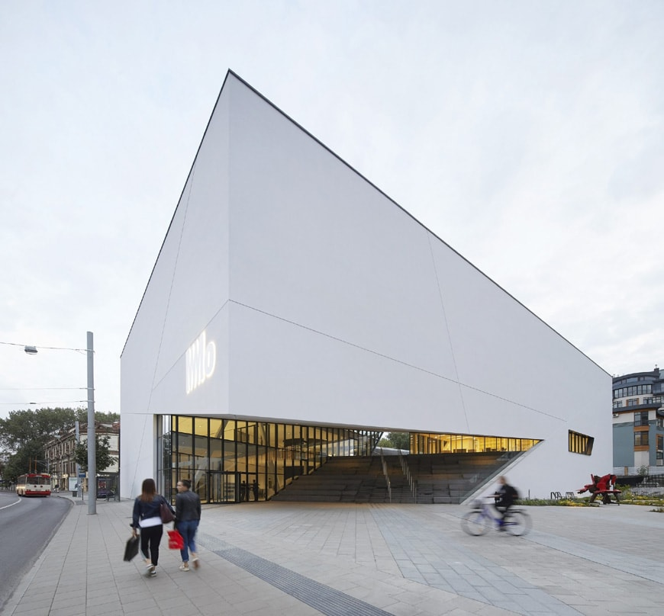
Places in Vilnius Historic Centre we recommend you to visit
MO museum

Slide 25
Bernardinu garden

Slide 26
Open gallery

Slide 27
Lukiškiu prison

Slide 28
VILNIUS HISTORIC CENTRE
https://www.youtube.com/watch?v=twYOmtdyQJM

Slide 29
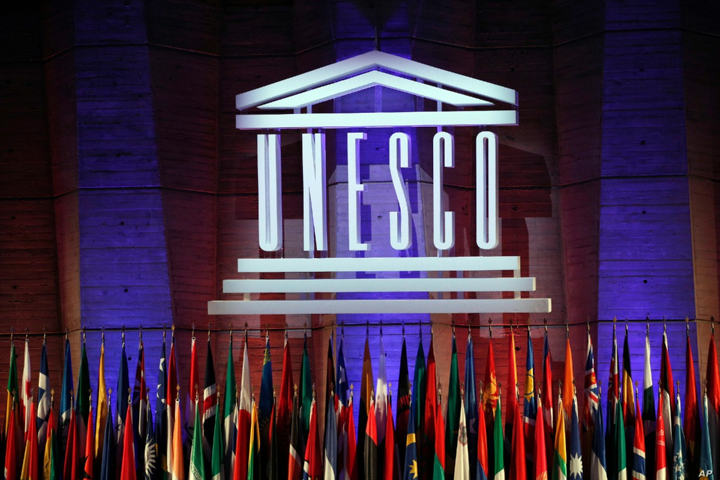
Conclusion
We hope what we clearly introduced you with Vilnius Historic Centre UNESCO Heritage, acquaintedwith sights of Vilnius and informed the historical legends of some local attractions.

