Slide 1
Evolution of Lithuanian money

Slide 2
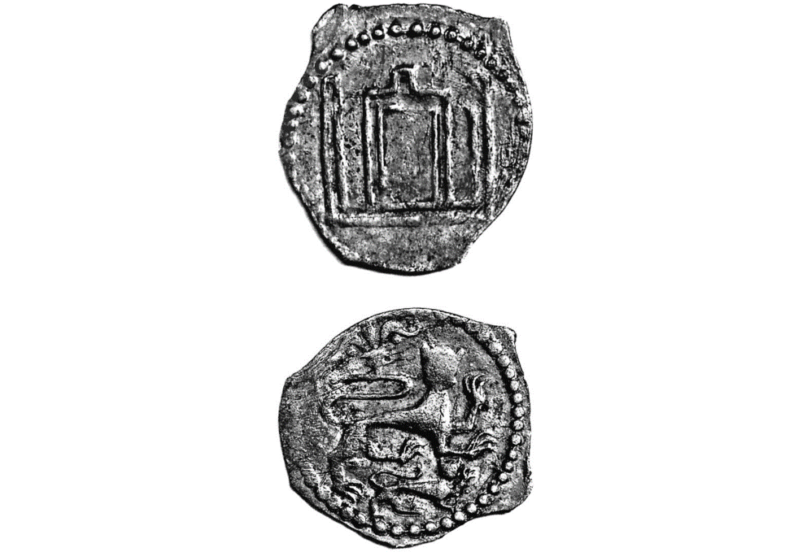
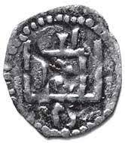
The oldest money found in Lithuania
The oldest coins found in Lithuania are coins of ancient Greece and ancient Rome that were traded. 9–12 a. Lithuania was dominated by Arabic silver dirhams and Scandinavian spirals. About the 11th c. pieces of locally produced silver (elongated round sticks) appeared. The value of the sticks was determined by their weight, and after the average weight of about 104 g, they became Lithuanian money. It is not known what these sticks were called by the ancient Lithuanians, but eventually scientists called them long (grave) or graves.
Money in the Grand Duchy of Lithuania (13th century - 1795)
The main mint of the Grand Duchy of Lithuania was located in Vilnius, on the territory of the Lower Castle (Vilnius Mint).
In the second half of the 20th century, the first Lithuanian coins were issued. According to the latest data, the earliest (after 1362) regional coins of Prince Vladimir Algirdaitis were minted in the Grand Duchy of Lithuania in the XIV century. At the end of the 19th century, small coins, the so-called denarii, were minted by the Grand Dukes of Lithuania Algirdas, Kestutis, Jagaila and the Jagellonian vassals of Skirgaila in Vilnius, Karibut in Northern Novgorod.

Slide 3
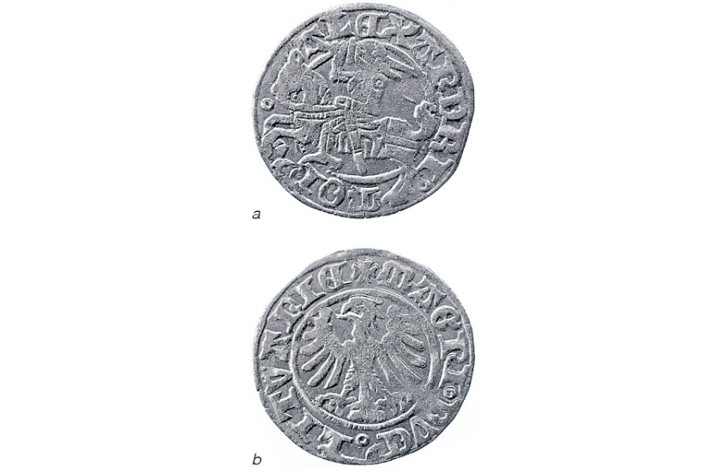
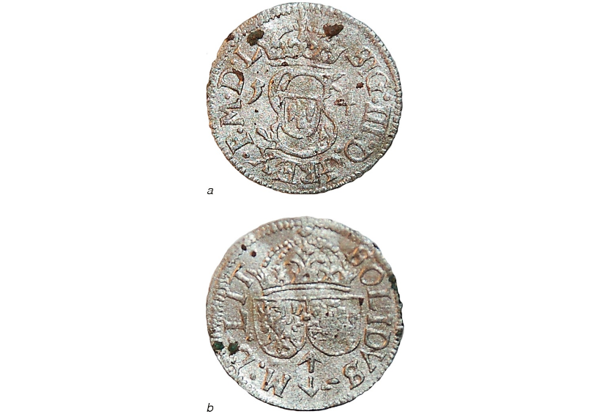
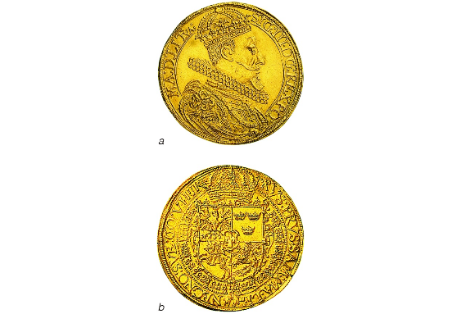
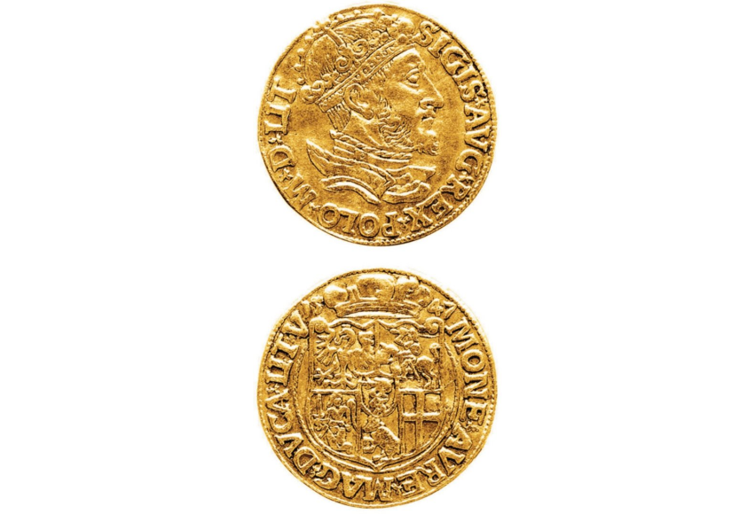
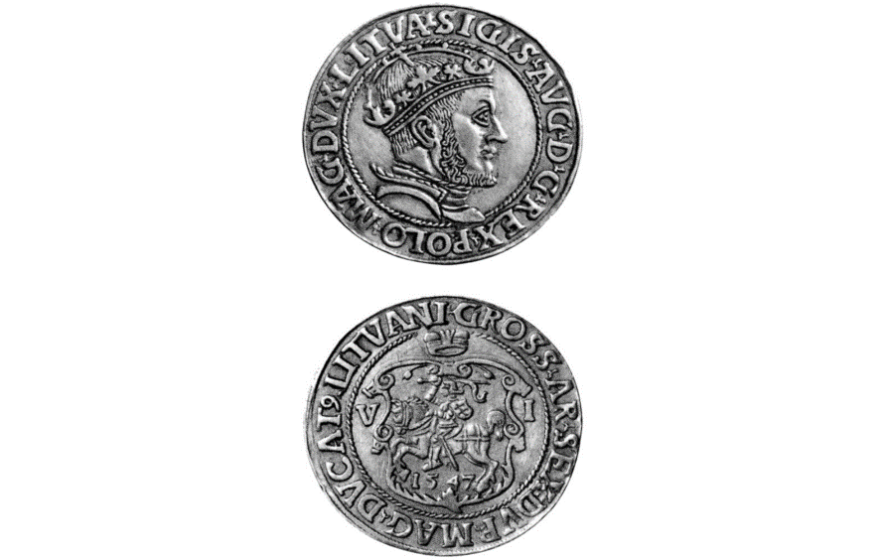
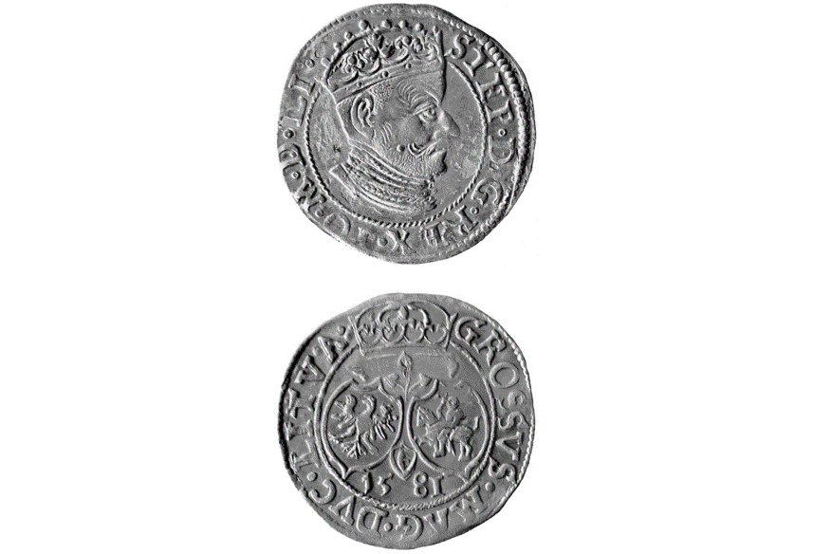
1580 The Grand Duke of Lithuania Steponas Batoras (reigned 1576-1586) carried out a monetary reform of the Grand Duchy of Lithuania, uniting the norms of the minting of Lithuania and Poland. The largest number of coins was minted during the reign of the Grand Duke of Lithuania Zigmantas Vaz (1588-1632).
Probably the greatest variety of Lithuanian coins was minted by the Grand Duke of Lithuania Vytautas, who was the first to use Latin inscriptions on coins, i.e. denote the denomination of the coin with the Roman numeral II (denarius).
1545 Sigismund August opens a new modern mint in Vilnius (Vokieciu Street). During his reign, a wide variety of Lithuanian coins were minted, the designs of which were characterized by artistry due to the influence of the Renaissance.
In 1547 the first Lithuanian gold ducat coin was minted, in 1562 the largest gold coin was 10 florins (Portugal).

Slide 4
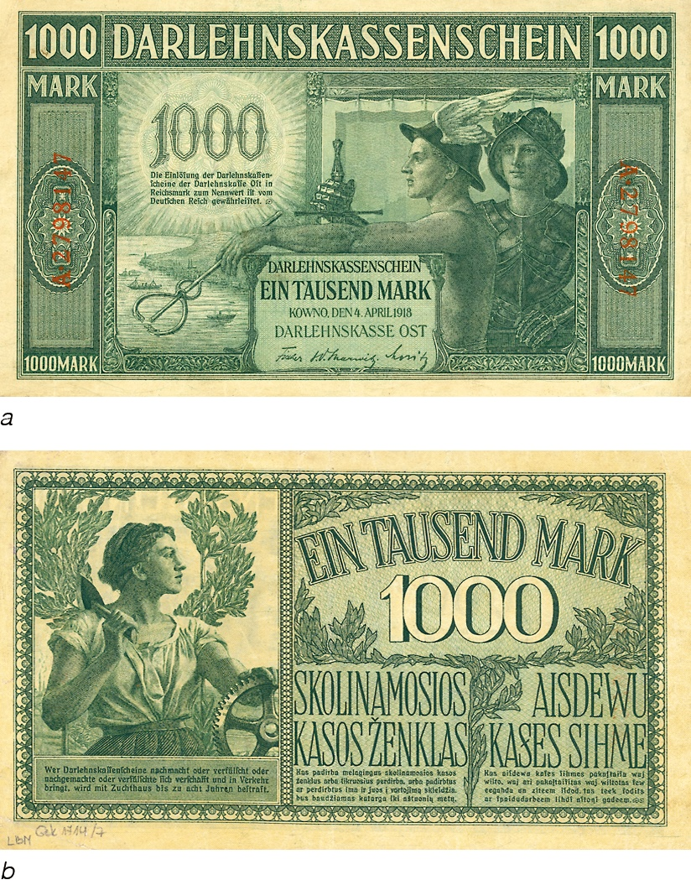
Lithuanian money 1795–1918
1000 ostmark banknote (1918)
After the annexation of Lithuania to the Russian Empire, Russian money was introduced in rubles. In 1825, Tsar Nicholas I forbade Lithuanians to pay with old money. Lithuania, together with the Russian Empire, experienced inflation that lasted for about 100 years. The value of money stabilized with the introduction of the gold coin standard only during the monetary reform of 1895-97. At the end of 1915, after the German occupation of Lithuania, brands began to circulate along with rubles. The circulation of foreign currency economically linked Lithuania with Germany and contributed to the redistribution of the country's national income in favor of Germany.The goal was to collect gold from the Lithuanian population.
During the struggle for independence, with the formation of the borders of the Lithuanian state, in its various parts (the army of Bermont, Latvia, Poland, Russia, Klaipeda, , etc.), about twelve different types of money circulated. Currency chaos, depreciation and a variety of exchange rates have caused losses to people, and thats all impeded economic recovery. The variety of money persisted until early 1921.

Slide 5
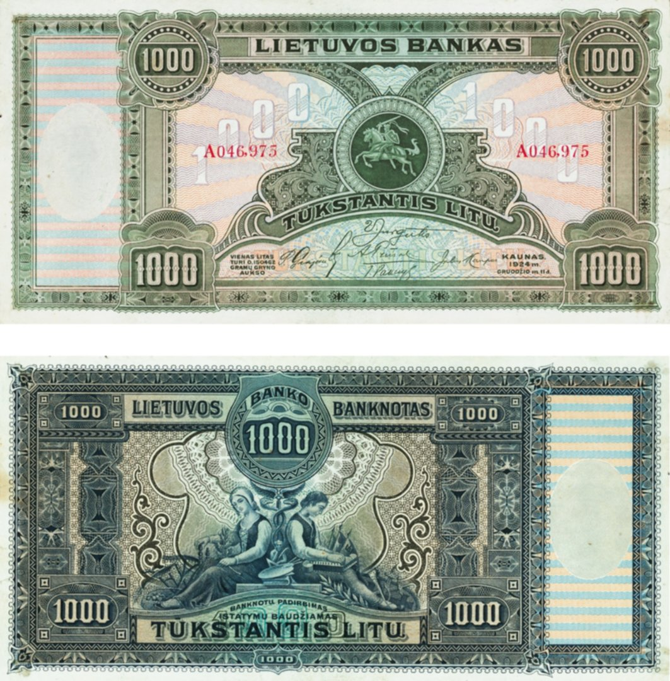
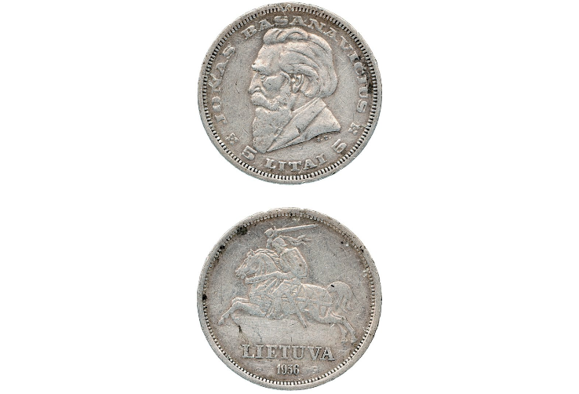
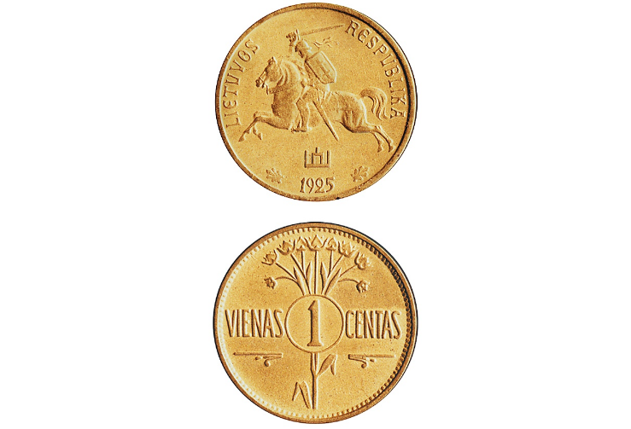
Money during the years of occupation in Lithuania (1940-1990)
Preparations began for the immediate introduction into circulation of the litas and one hundredth of a cent of its own currency, which were put into circulation on October 2, 1922.
The exchange rate of the litas was immediately stabilized, but prices rose and the depreciation of the litas continued until 1925. The introduction of the litas put an end to the monetary union with Germany, eliminated the influence of its economy on Lithuanian money. Lit was equated to 0.150462 g of gold. Maintaining the stability of the litas was a priority task of the government of the Bank of Lithuania.
After the beginning of the occupation of the USSR on October 25, 1940, the Soviet ruble was introduced along with the litas. The litas were not issued into circulation and were not exchanged for rubles, residents could buy goods and pay taxes for their litas. Until March 25, 1941, Soviet rubles were circulated together with litas in a 0.9: 1 ratio.
On March 25, 1941, a secret decree prohibited payments in litas, and the Soviet ruble was the only legal tender. Litas banknotes were burned, silver coins were taken to Moscow and melted down.

Slide 6
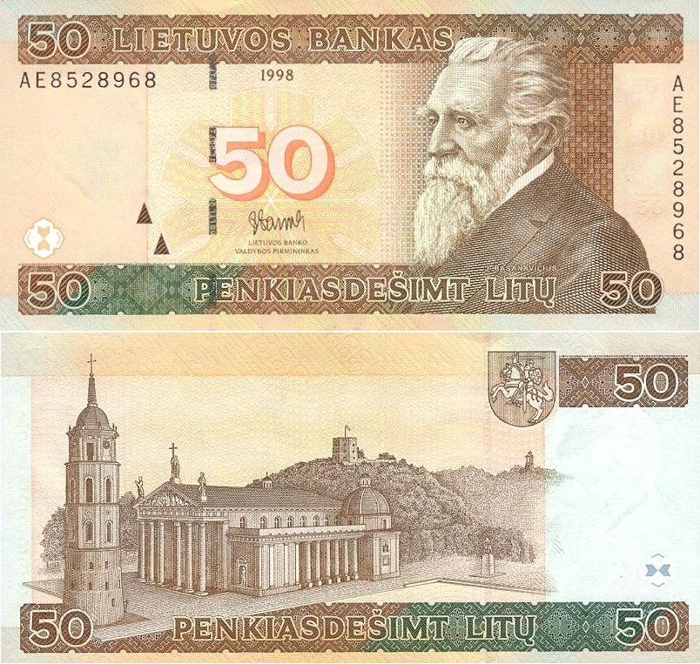
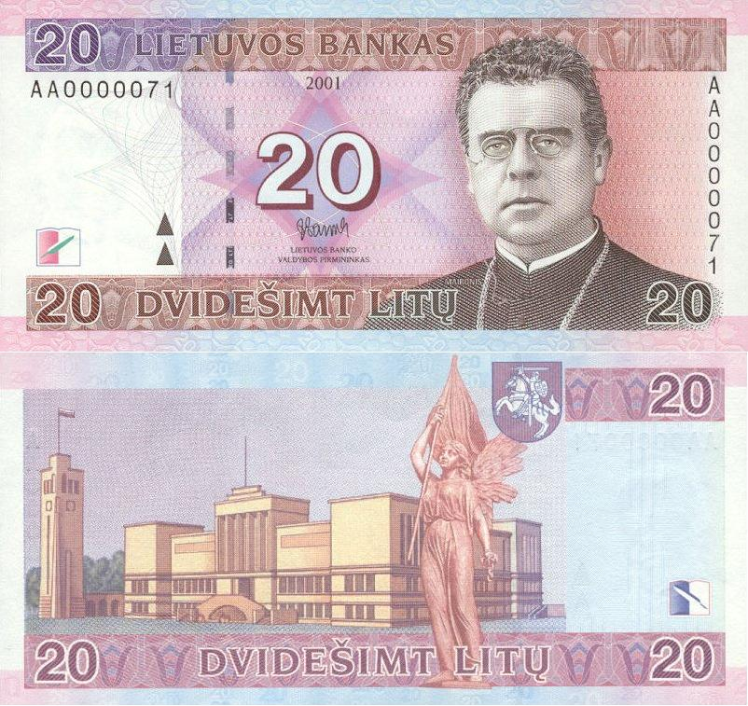
Lithuanian money after independence (after 1990)
In 1989, preparations began for the introduction of their own money (a bill on the Bank of Lithuania was prepared, draft banknotes and coins were developed, an agreement on printing banknotes in litas was signed with the American company Banknote Corporation). At the end of 1990, the Lithuanian Mint was founded (started work in 1992).
When in the spring of 1992 there was a shortage of rubles (net) to pay wages, pensions and scholarships, general vouchers began to be used for this purpose.
On September 24, 1992, rubles were withdrawn from circulation by exchanging them for vouchers in a 1: 1 ratio. In this ratio, deposits, funds of companies, organizations and institutions in bank accounts were rewritten. The created national monetary system allowed Lithuania to regulate money circulation and protect the market from the ruble.
On June 25, 1993, from 1994 to 2014, a currency board operated in Lithuania, which ensured a fixed exchange rate of the litas in relation to use: the circulation of the litas was pegged to the US dollar (4: 1 ratio), and in 2002 it was pegged to the euro. (Ratio 3.4528: 1).

Slide 7
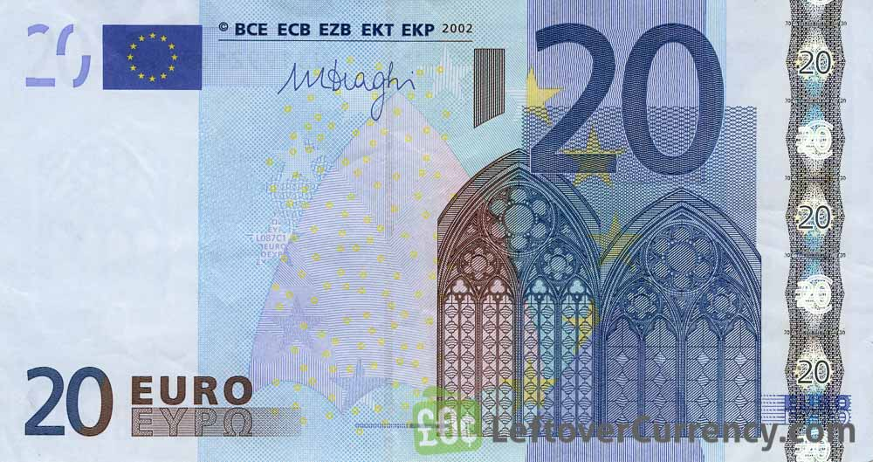
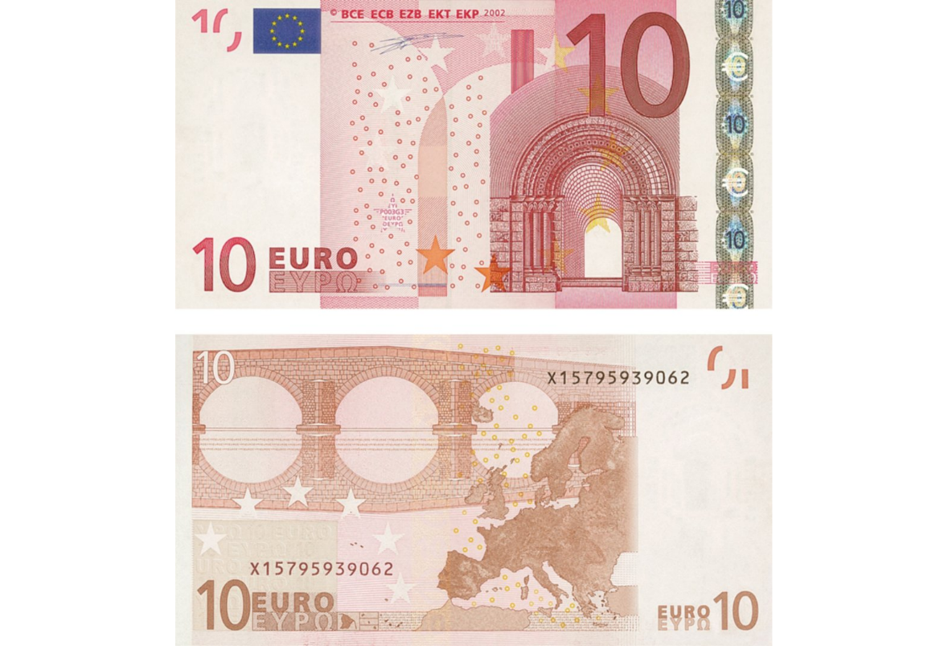
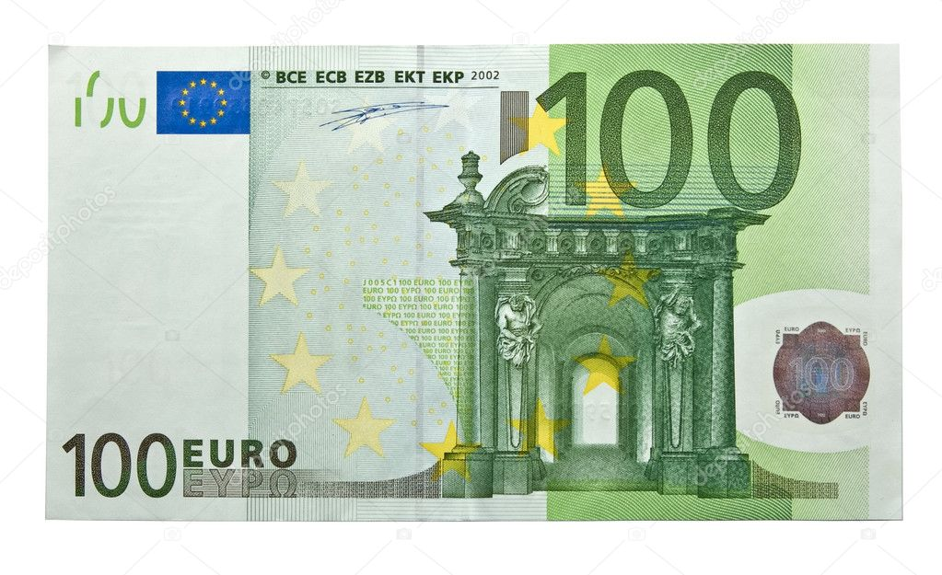
Lithuania joins the european union
2015 1 January In Lithuania, instead of the national currency, the litas, a single European currency, the euro, is introduced. Lithuanian banknotes and coins were exchanged for euros at the same constant exchange rate and withdrawn from circulation on January 15, 2015.
And to this day, the euro is used in Lithuania

