Slide 1
VIRTUAL COMPANIES
ERASMUS+ PROJECT:
LOCAL SOLUTIONS FOR GLOBAL CHALLENGES

Slide 2
TAAC - Tradition at a click! (online company)
Logo: The innovative characteristic of the online service contrasts with the traditional services and products of the local companies.

Slide 3
Mission
VISION
We are an online company that aims to promote the best of Portugal's regional products to the world, ensuring that traditions are not forgotten.
We want to be recognized by the quality of our services and the proximity to the customers and local partners, promoting their image and the products and services they offer.

Slide 4
Values
To be the customer’s
first choice
Focus on results
Integrity with all audiences
Innovation and
entrepreneurship
Citizenship
Dynamism

Slide 5
SWOT Analysis
Strengths
Weaknesses
S
W
Quality of our local partners’ products
Proximity to the customer
Team management skills
Excellence in the service provided
Attractive and easy to consult website
Lack of experience
Difficulties in obtaining information from local traditional companies
Difficulties in updating companies’ information
O
T
Opportunities
Threats
Network of European partners (ERASMUS +)
Growth of companies with traditional products
Promoting traditions
Competition
Theft of technology and essential information

Slide 6
Timeless - Back to the present! (tour operator)
Logo: The vintage clock conveys the idea of tradition and sophistication, of services and products without age, but always present in our lives.

Slide 7
Mission
VISION
Our aim is to organize events that provide unforgettable experiences while promoting traditional companies and their regional products.
We want to be a worldwide reference as a distinguished tour operator and offer unique experiences and sensations with the best regional services and products we have in Portugal.

Slide 8
Values
Competence: we try to do our best with the services we provide
Quality: quality of the service provided and of the local companies that work with us
Dedication: a dedicated team
Availability: we are available 24/7
Trust: we trust our partners and want them to trust our company

Slide 9
SWOT Analysis
Strengths
Weaknesses
Variety of interactive local experiences/ workshops
Presence in social networks
Partner companies with varied traditional products
Promoting Portugal’s products and image
S
W
The company does not offer an effective customer service
Lack of experience of team members
Small team
Company does not have its own web domain
Problems with online booking
O
T
Opportunities
Threats
Partnerships with local companies
Network of Erasmus + partners
Promoting traditions
High potential of market growth
People are looking for different experiences (tourism)
Local competitors
New companies on the market

Slide 10
Our first local partner
Pão de Ló Burguês is a small company, located in our district of V.N. Famalicão, which produces a typical portuguese sponge cake with a modern twist – a meringue layer. The company was created 12 years ago and is now selling to private homes and the food service industry in the entire country.

Slide 11
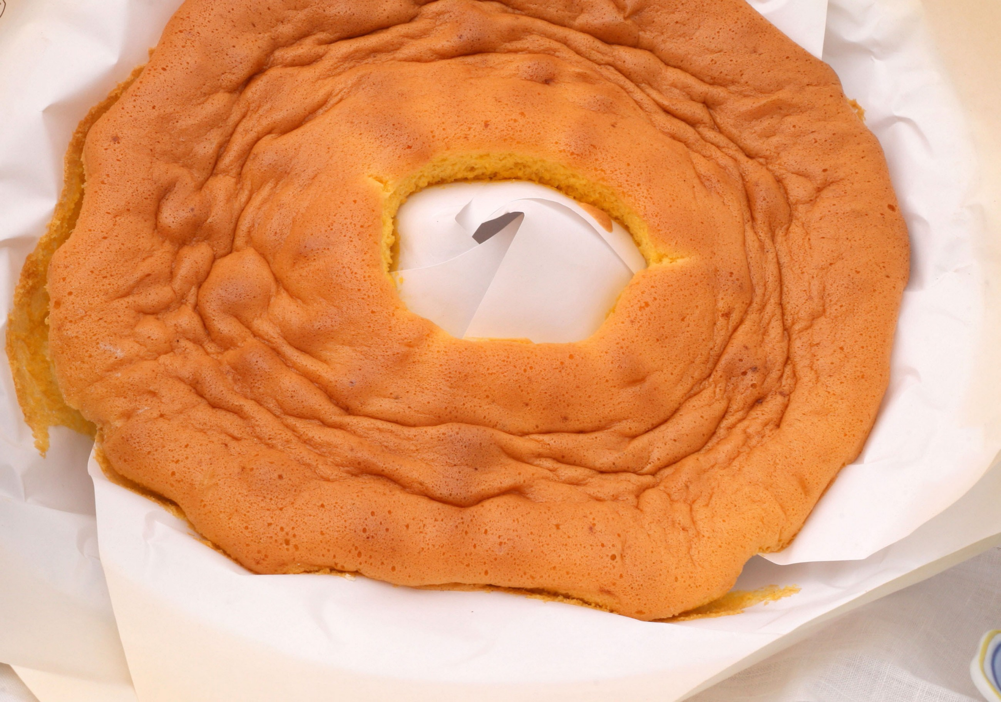
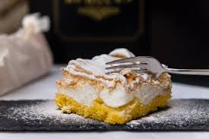

Slide 12
VIRTUAL COMPANIES
ERASMUS+ PROJECT:
LOCAL SOLUTIONS FOR GLOBAL CHALLENGES

