Slide 1
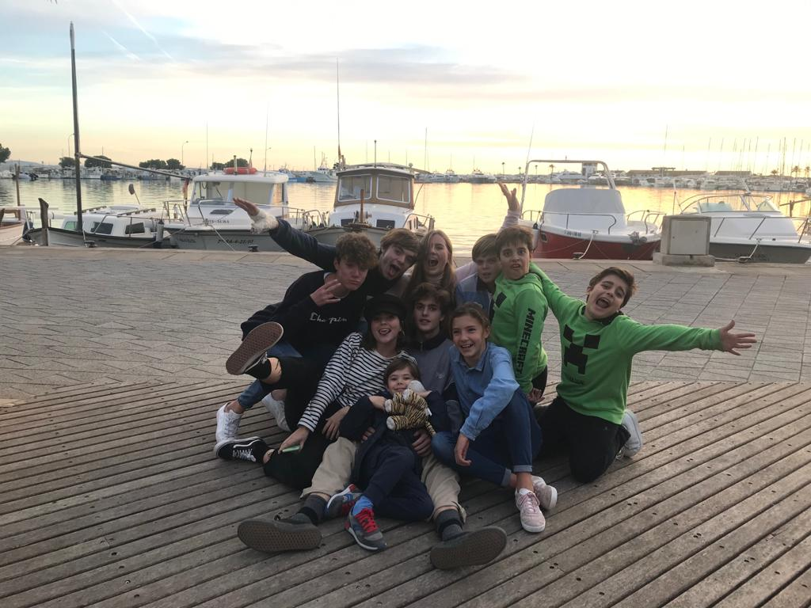
CHRISTMAS BREAK IN MALLORCA
Santo Tomás De Aquino
Spain

Slide 2
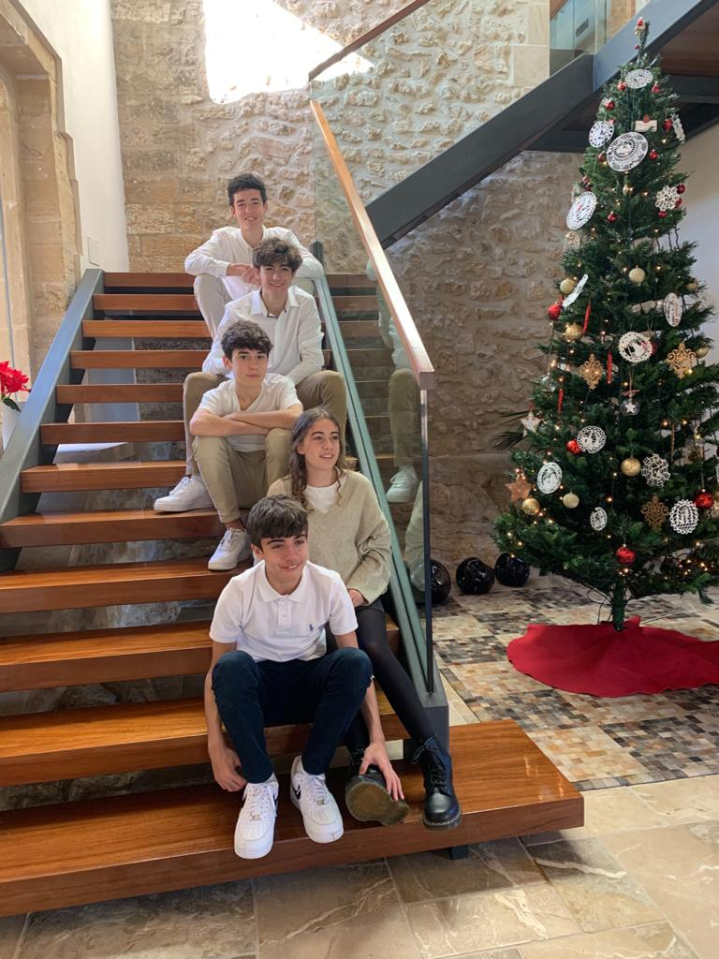
SANTA CLAUS
Santa Claus is a man who gives presents all
around the world riding on his sled with
magical reindeers that make the sled fly
and travel around the world handing out the
presents. Normally we make the Christmas
tree so that Santa Claus can leave the present
under the tree.

Slide 3
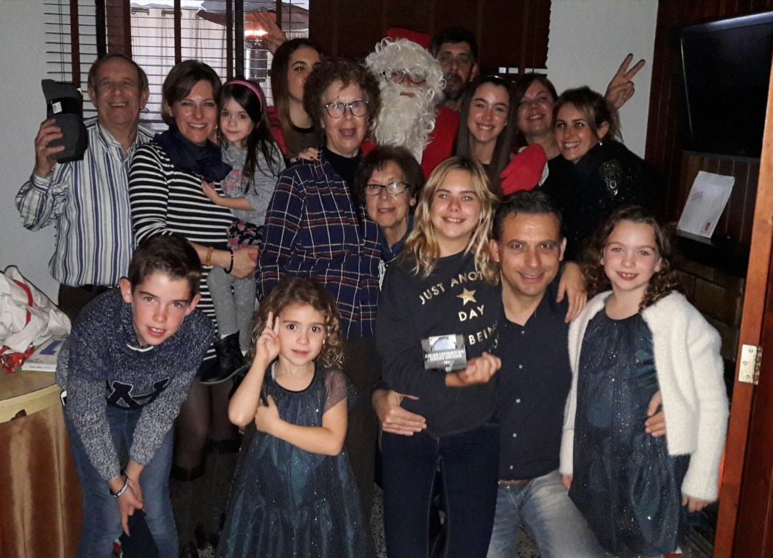
That is Santa Claus

Slide 4
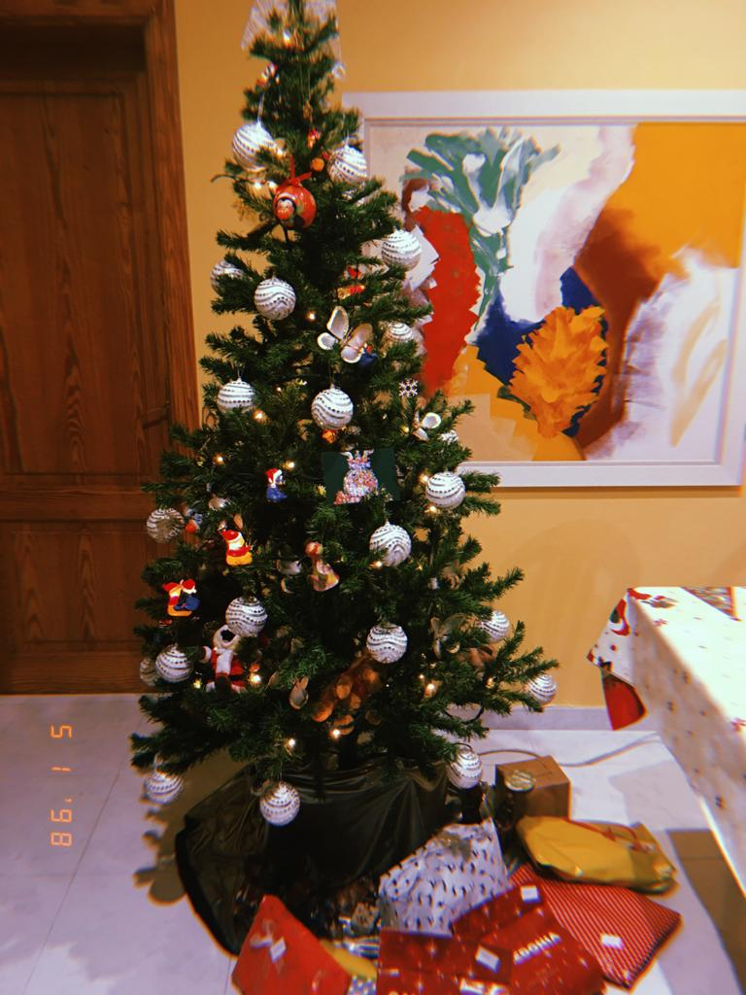

Slide 5
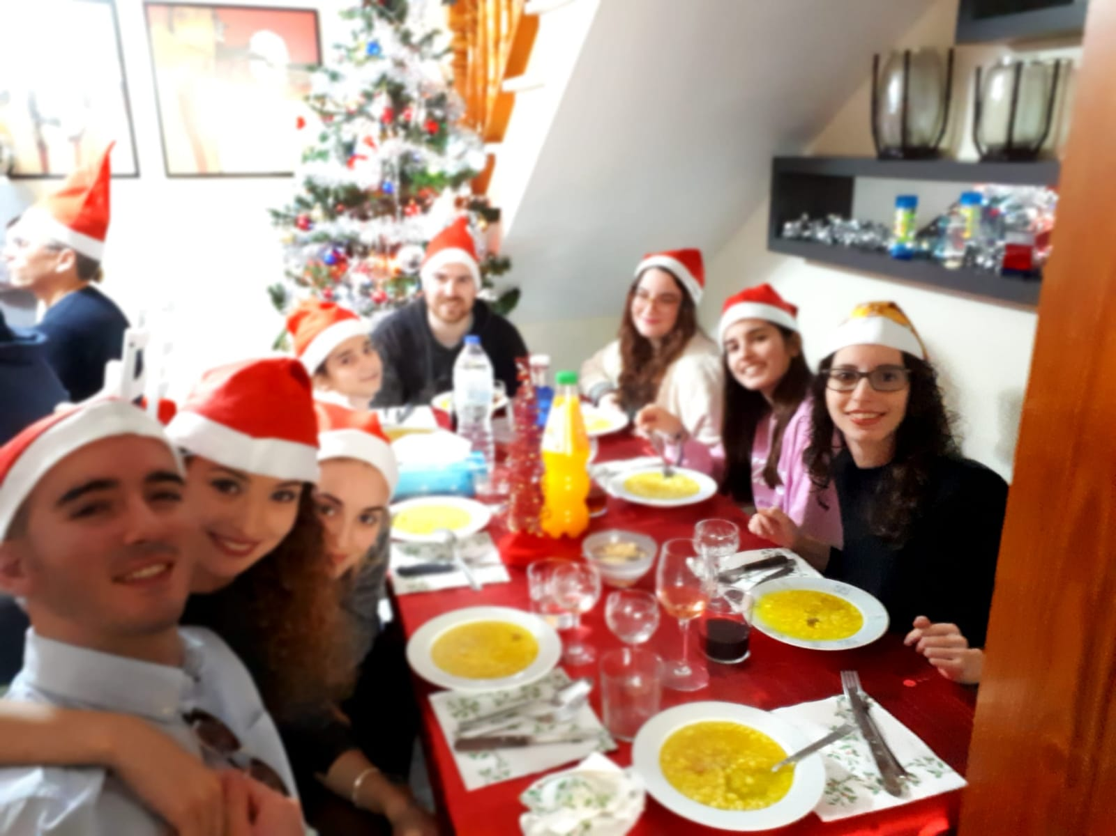

Slide 6
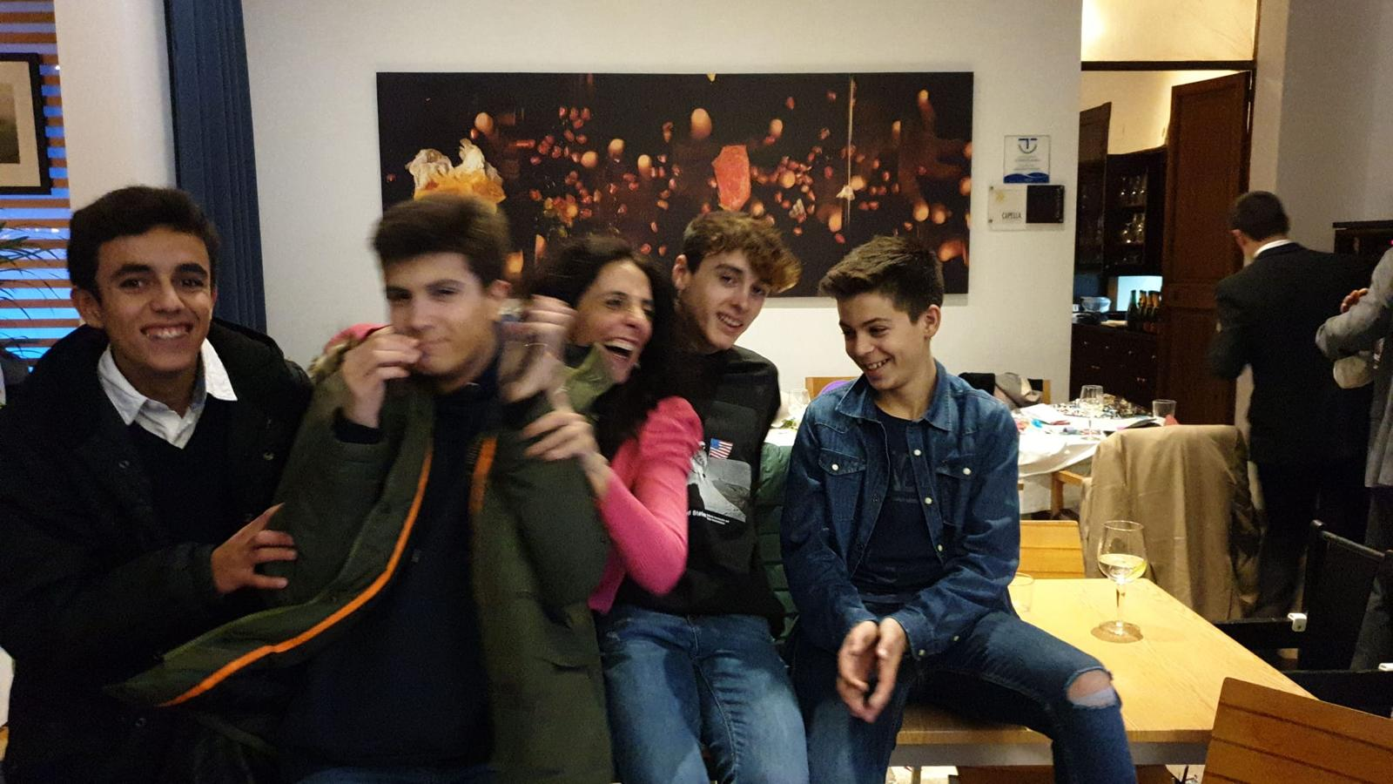
WE SPEND TIME WITH THE FAMILY AND FRIENDS

Slide 7
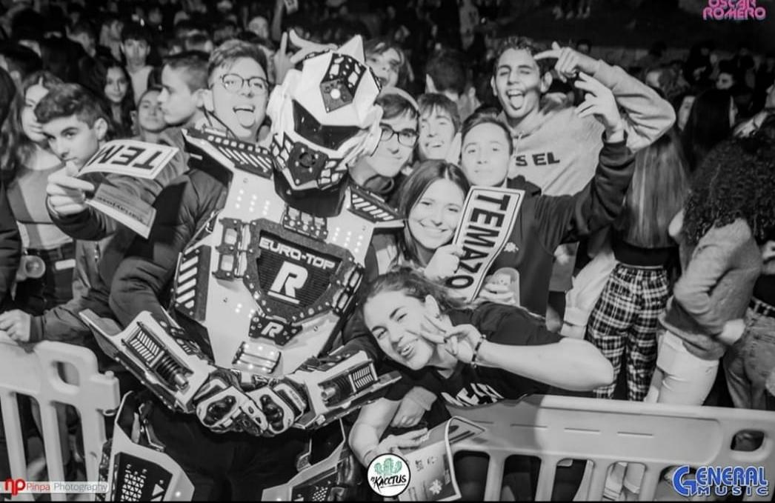

Slide 8
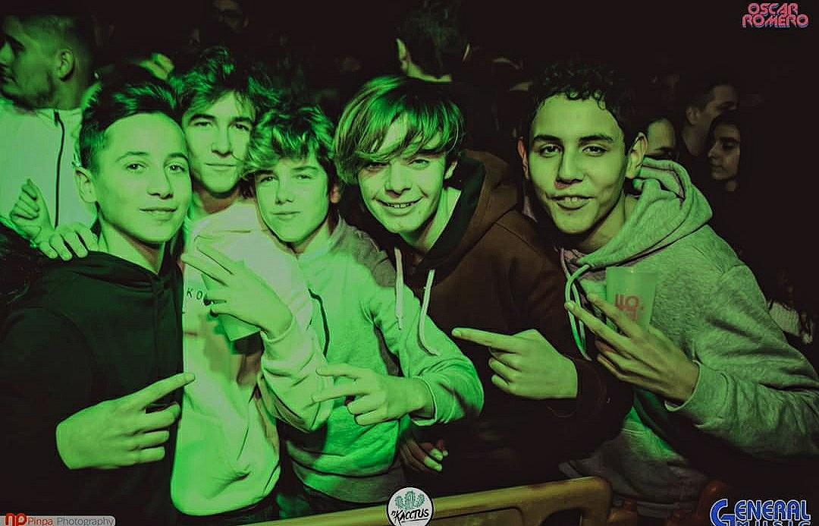

Slide 9
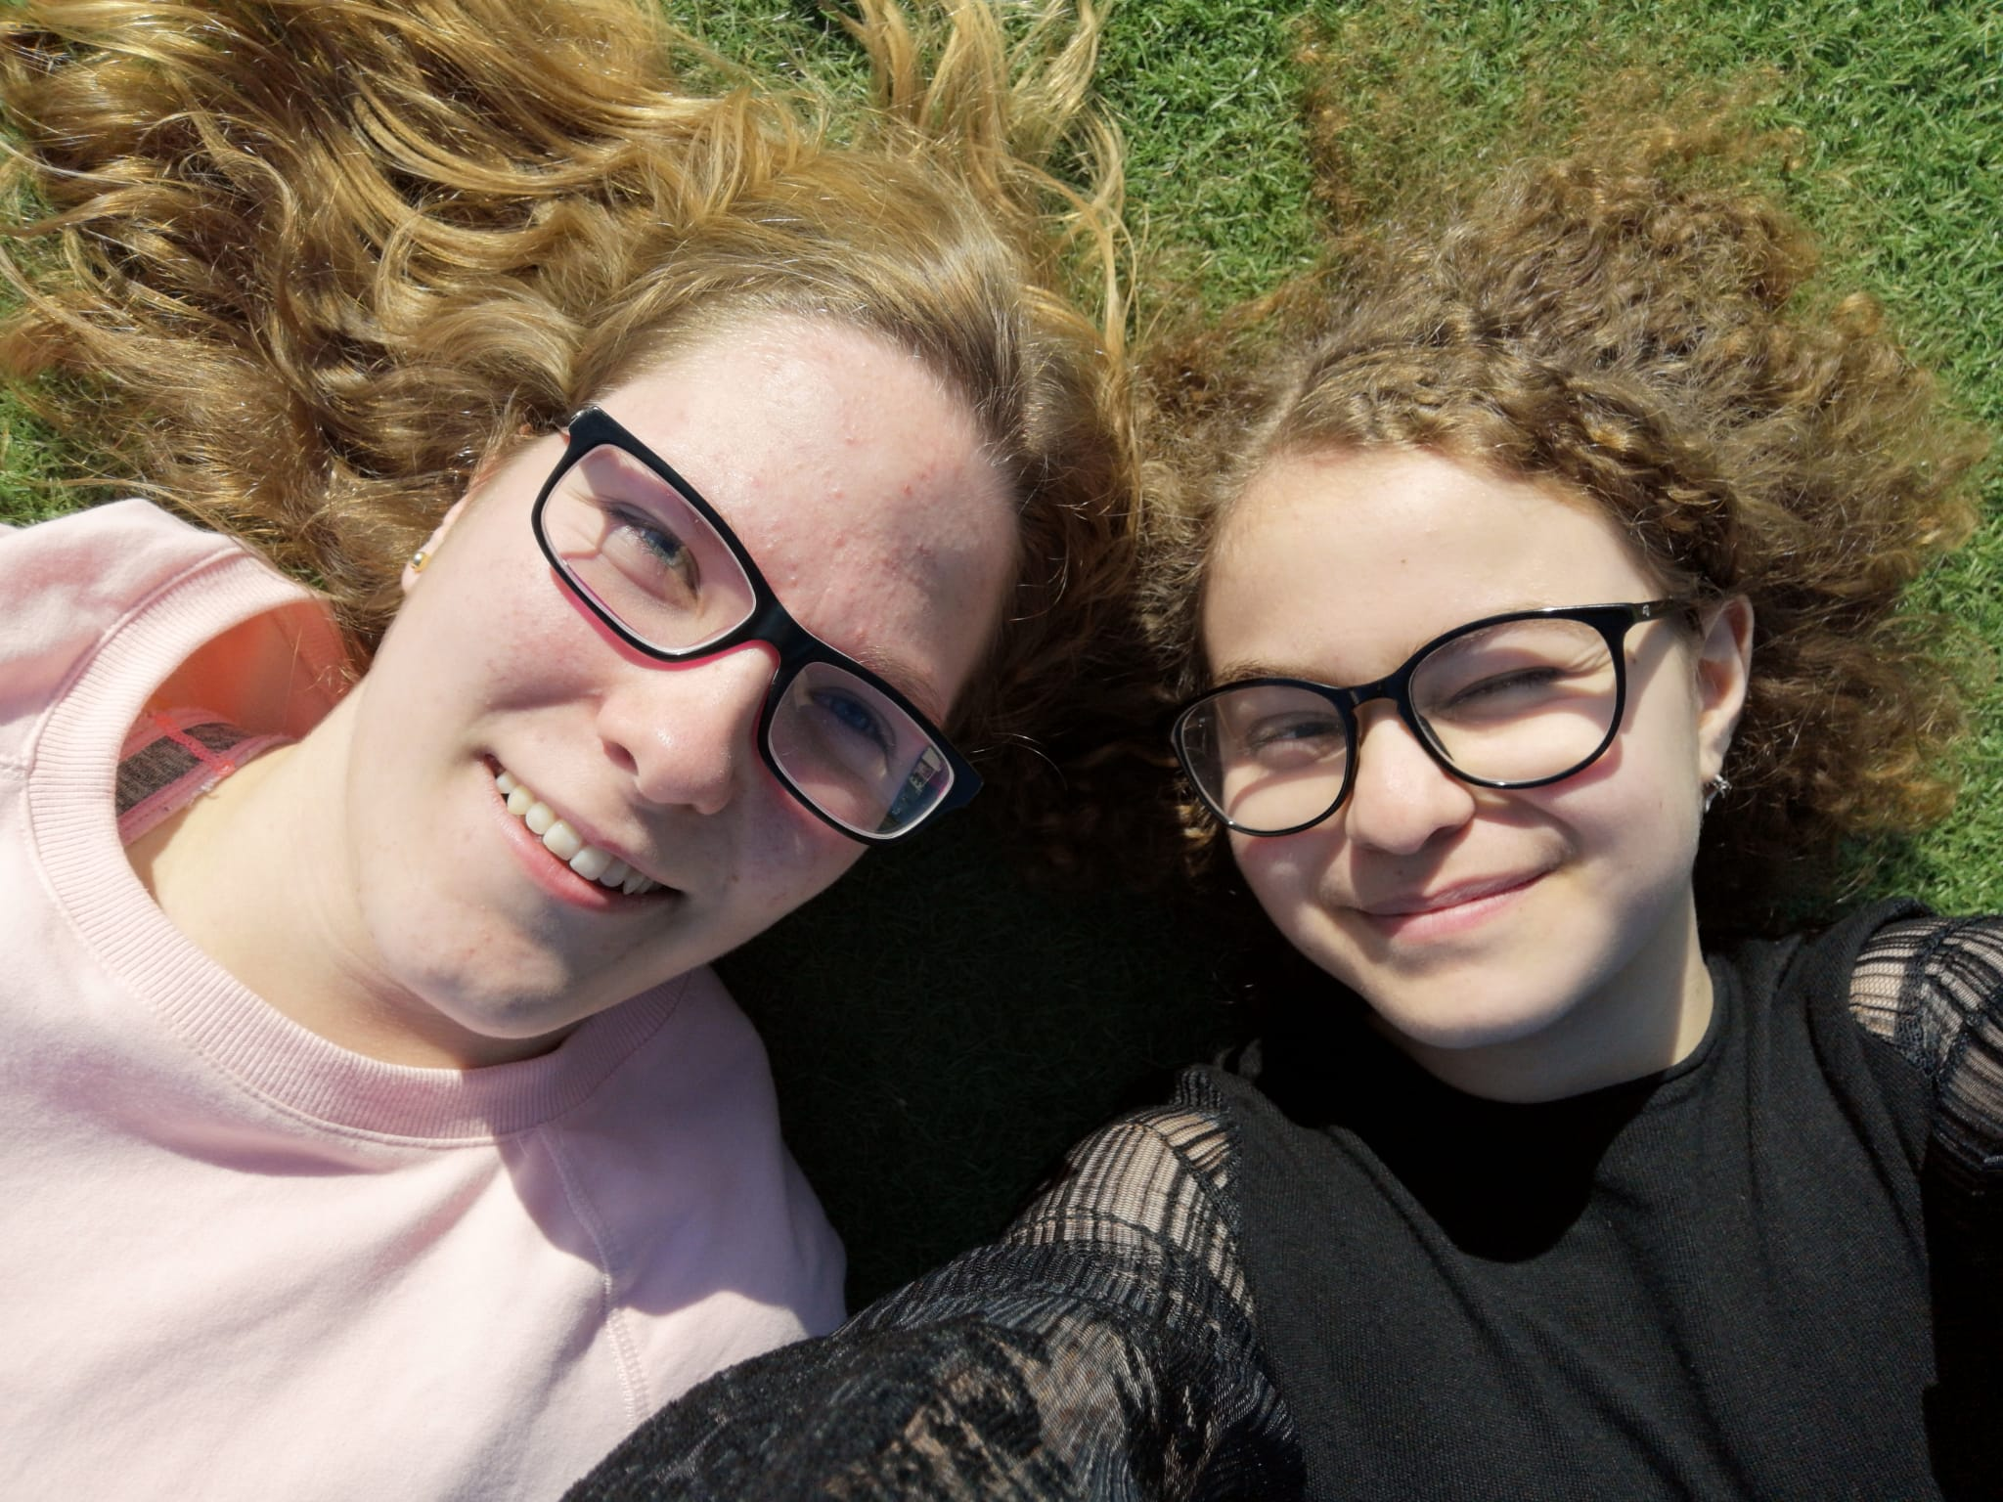

Slide 10
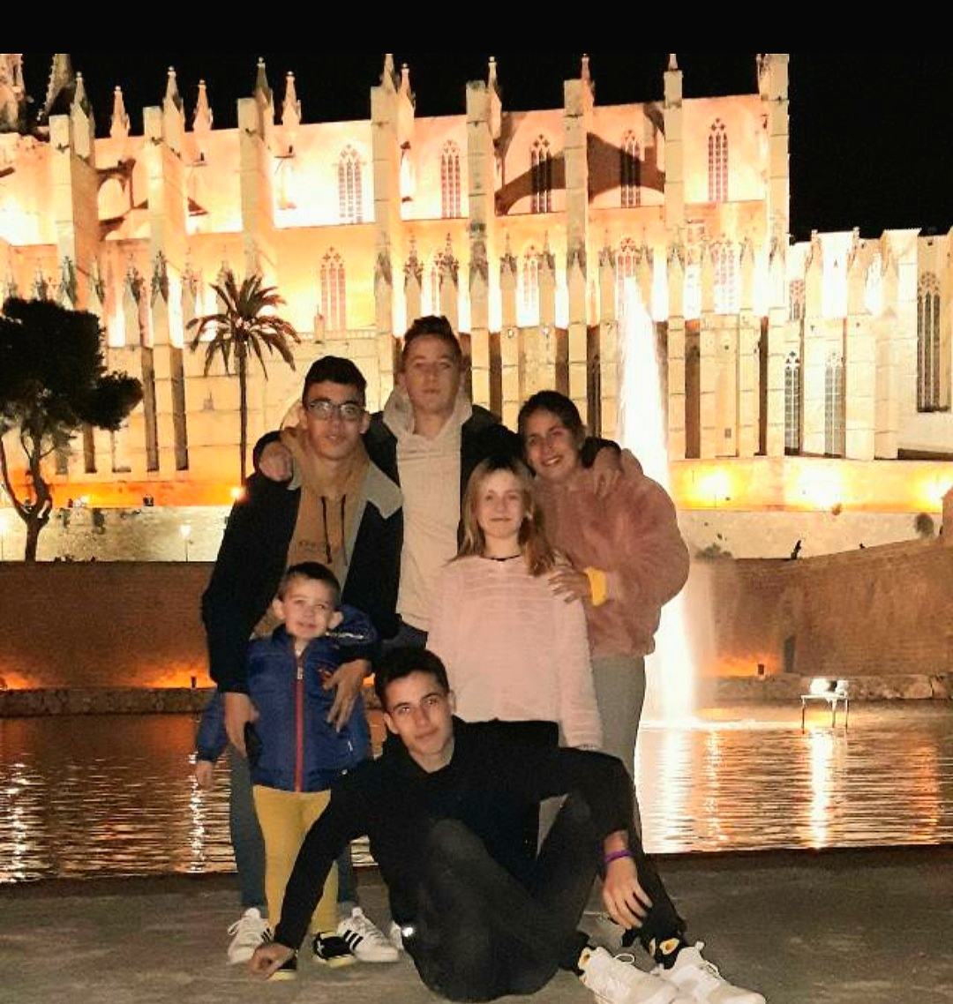

Slide 11
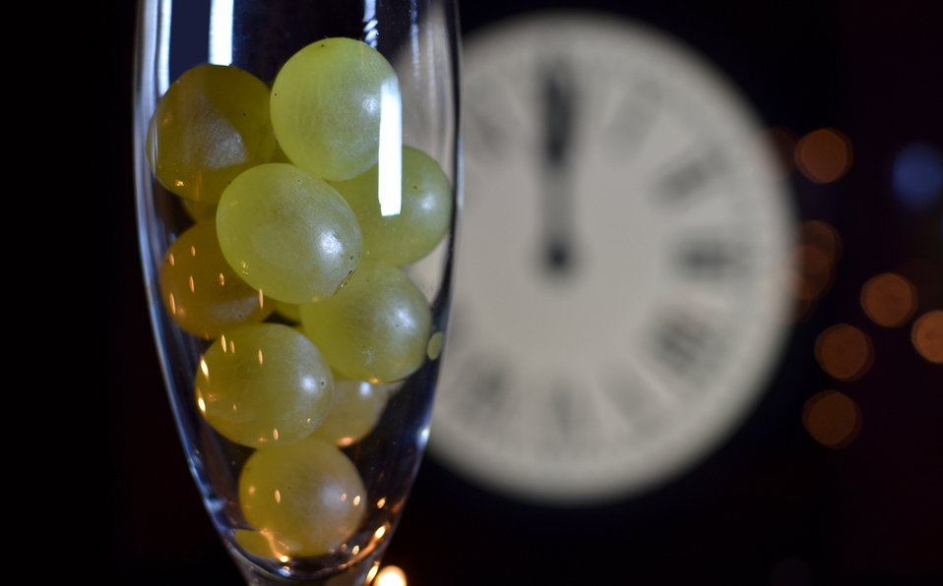
NEW YEAR´S EVE
We celebrate the last night of the year with the 12 bells.
The 12 bells consists in eating one grape each bell, there are 12 bells. When the last bell sounds it means that is New Year.

Slide 12
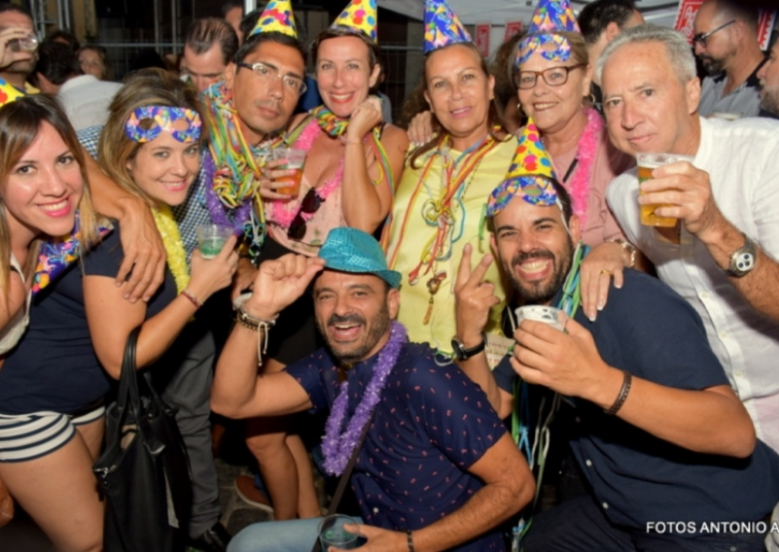
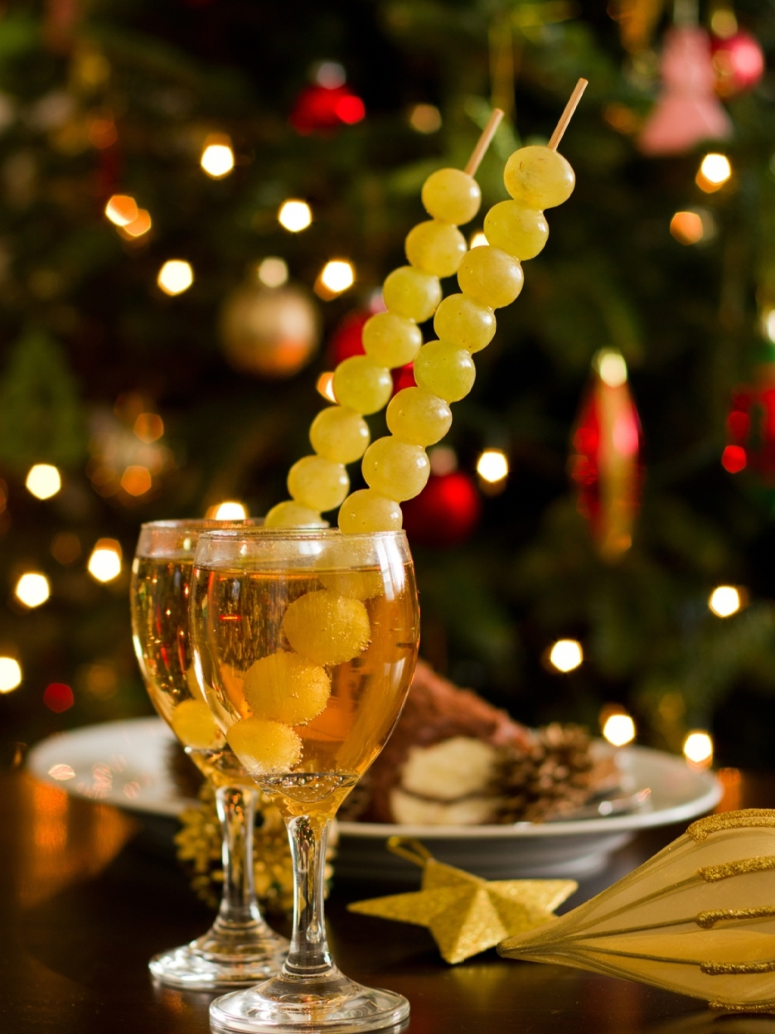

Slide 13
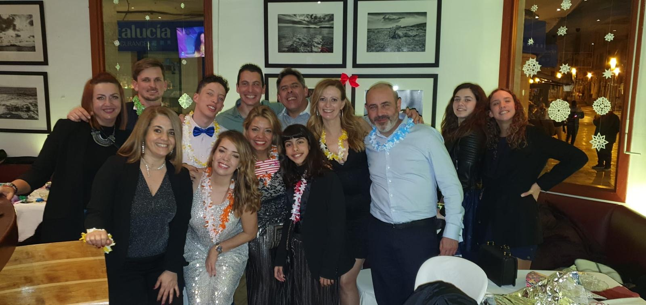

Slide 14
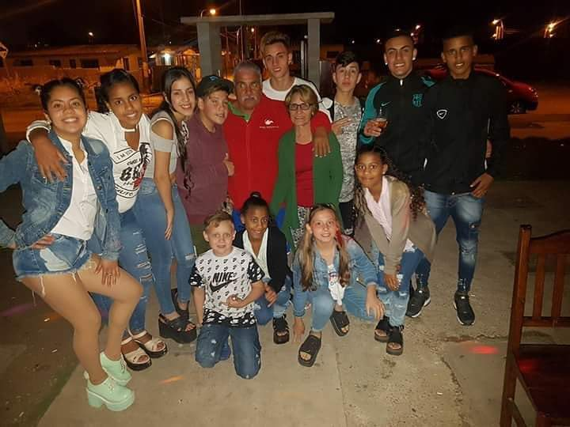

Slide 15
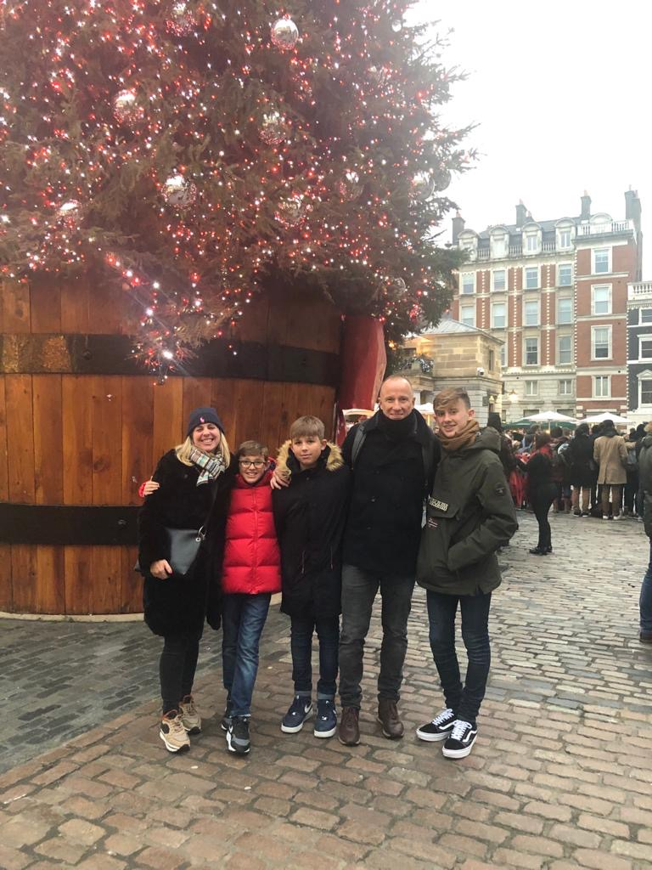
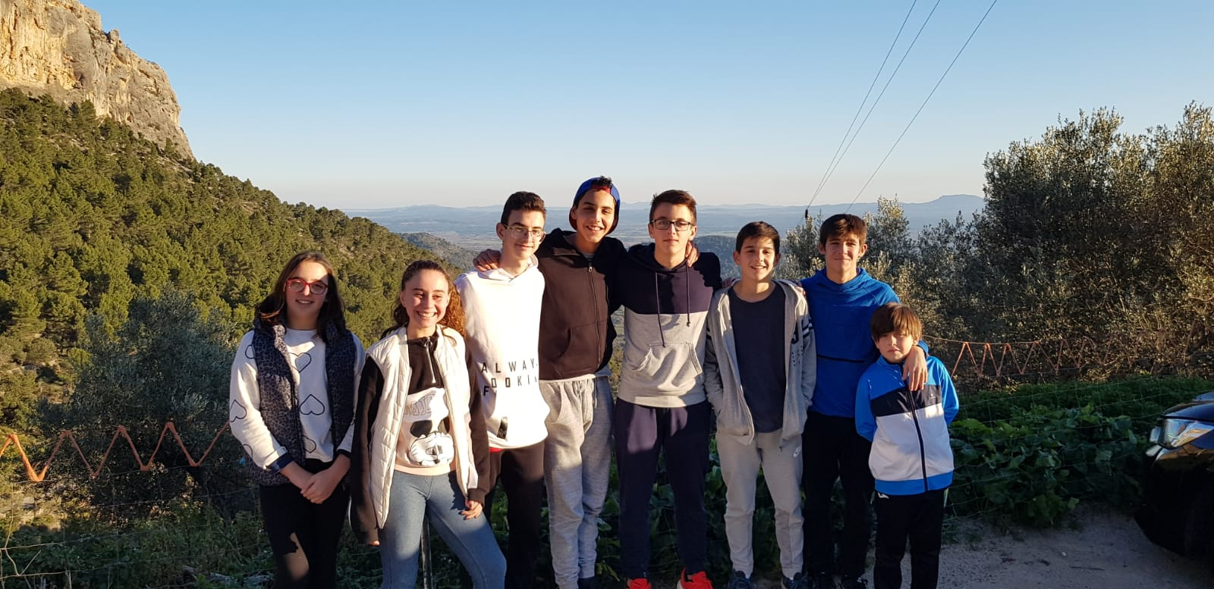
WE TRAVEL AROUND THE WORLD
OR WE DO EXCURSIONS

Slide 16
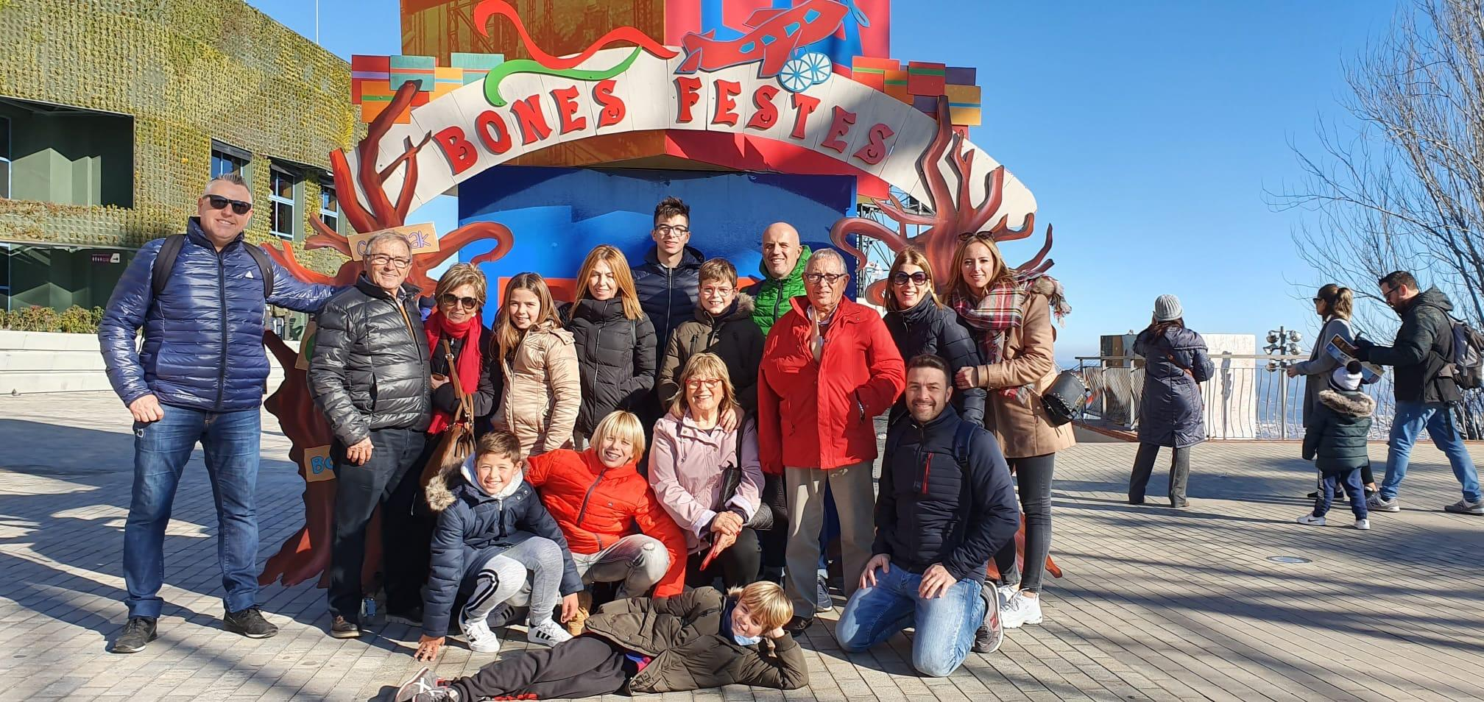

Slide 17
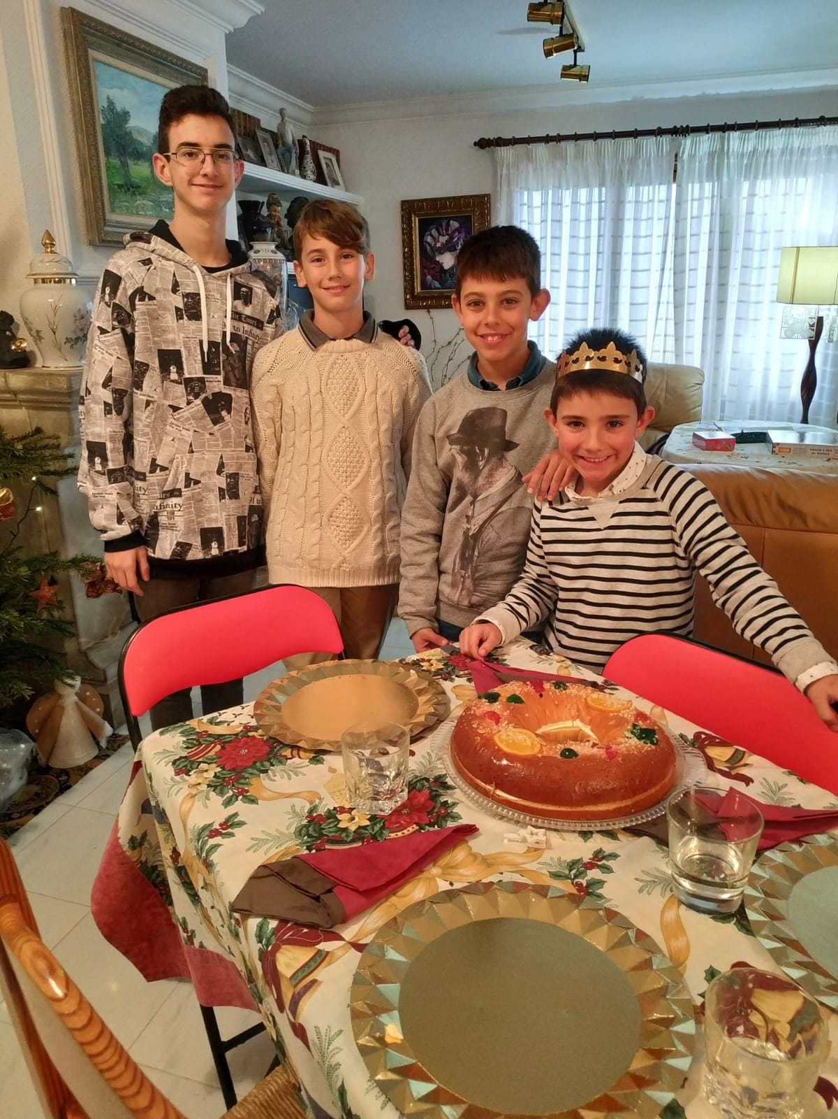
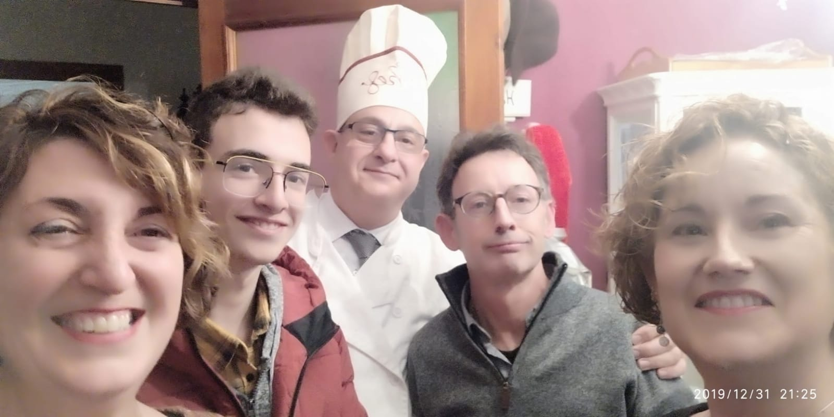
WE CELEBRATE “LOS REYES”

Slide 18
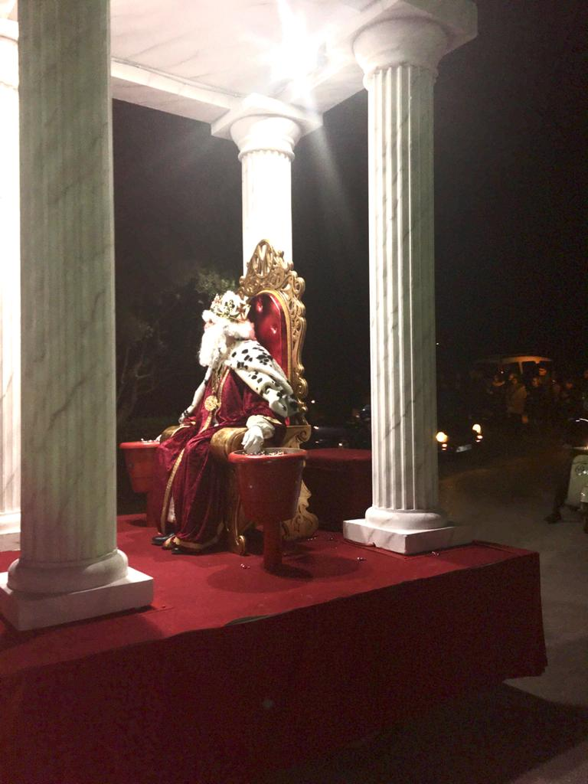
WHAT DO WE MEAN WITH “LOS REYES”
Los reyes are the three kings, called the Three Wise Men, that gave three presents to the baby Jesus.
We celebrate this by going to watch a procession the 5th of January the three kings come to visit us and sit in their thrones.
The 6th of January we open the gifts that the three kings have given us and later we have lunch with our family.

Slide 19
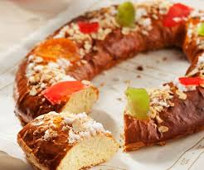
TRADICIONS IN “LOS REYES”
We usually eat “Roscón”, this cake has a king and a bean inside. If you find the king in your piece of “Roscón” you get a plastic crown. But if you get the bean you will have to pay the “Roscón”.
We sing songs called “villancicos” that are about something religious like Jesus, the kings or Mary and Saint Joseph.
https://www.youtube.com/watch?v=yfpBMrJZt1Q
https://www.youtube.com/watch?v=lJawRaON8h0
https://www.youtube.com/watch?v=acspyOTJQv4

Slide 20
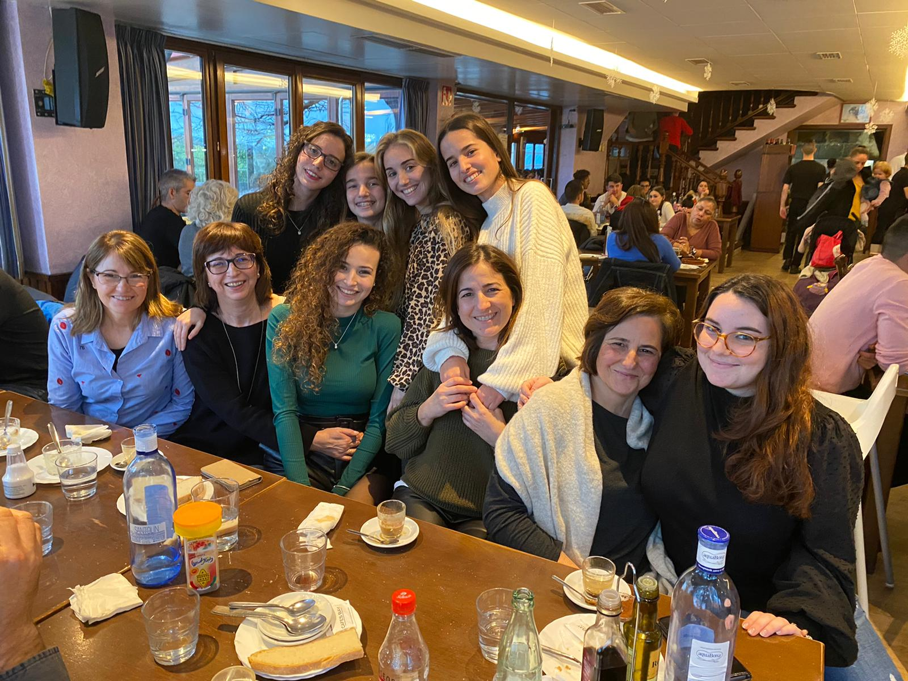

Slide 21
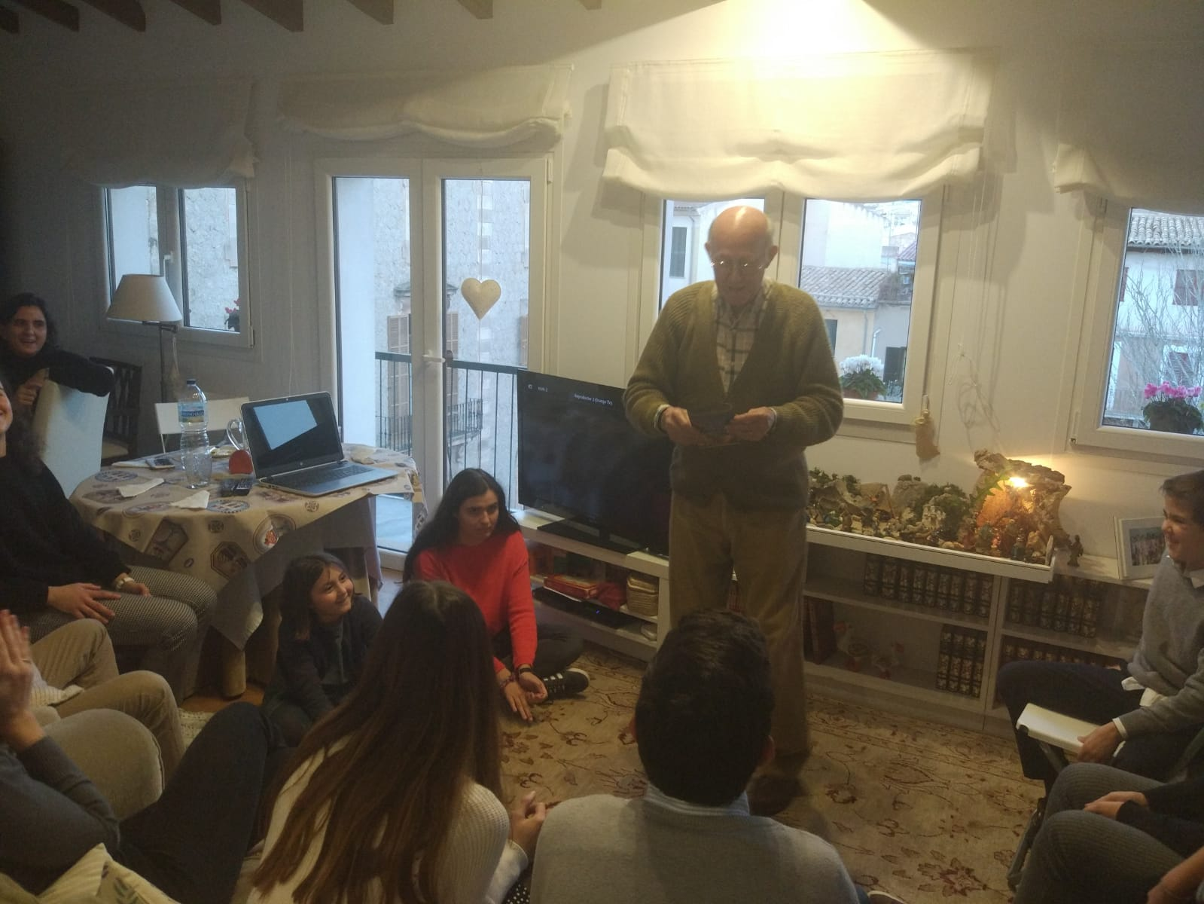

Slide 22
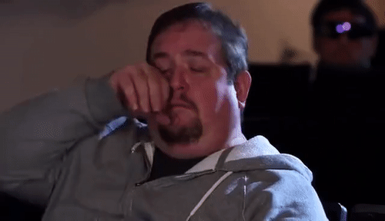
Thank you for watching our presentation, we hope you liked it

