Slide 1
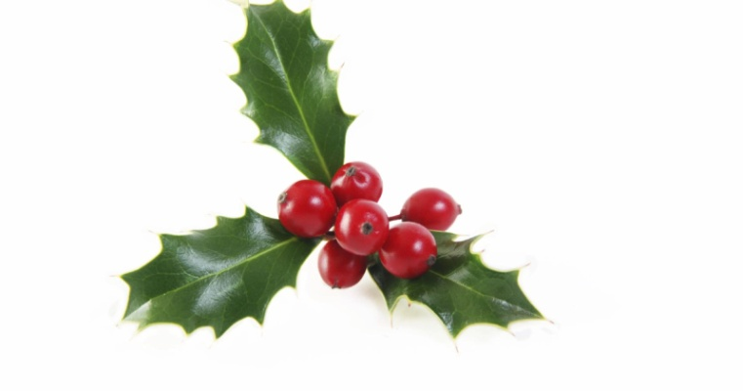
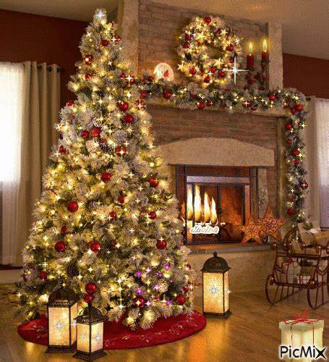
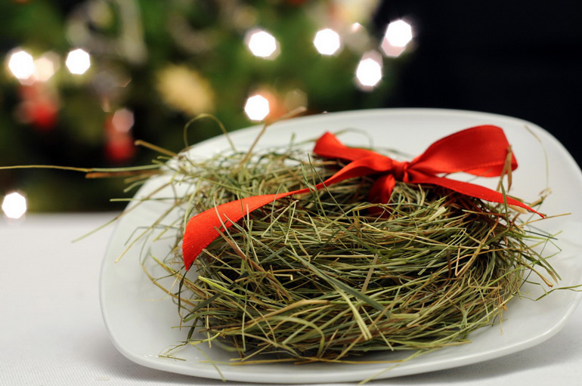
Our best Christmas moments

Slide 2
Christmas preparations
Christmas preparations are the most beautiful moment during Christmas time. We spend this time with family and we rest from school.

Slide 3
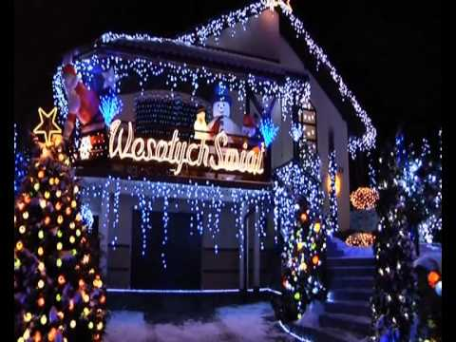
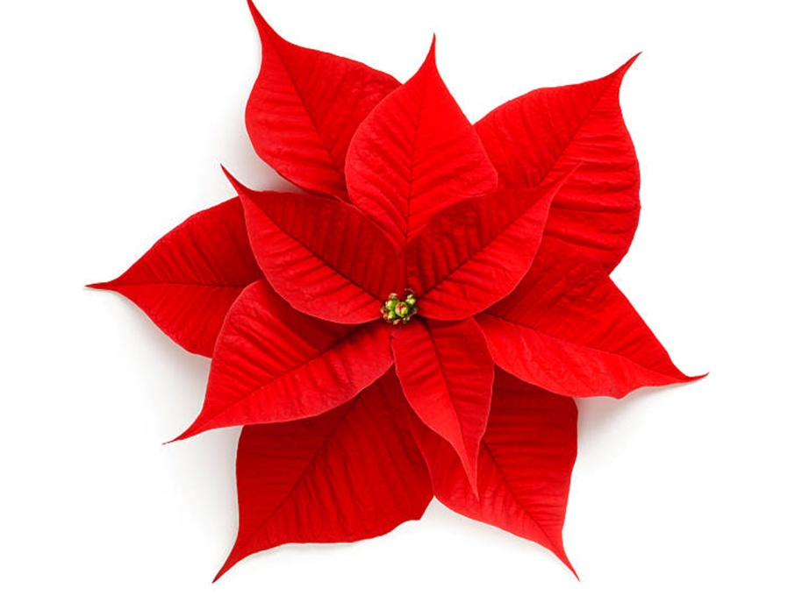
Decorating our houses
My favourite thing in Christmas is decorating the house. We usually have lights in front of the house. We have a christmas trees inside and a big one outside. We decorate the rooms with Christams flowers.

Slide 4
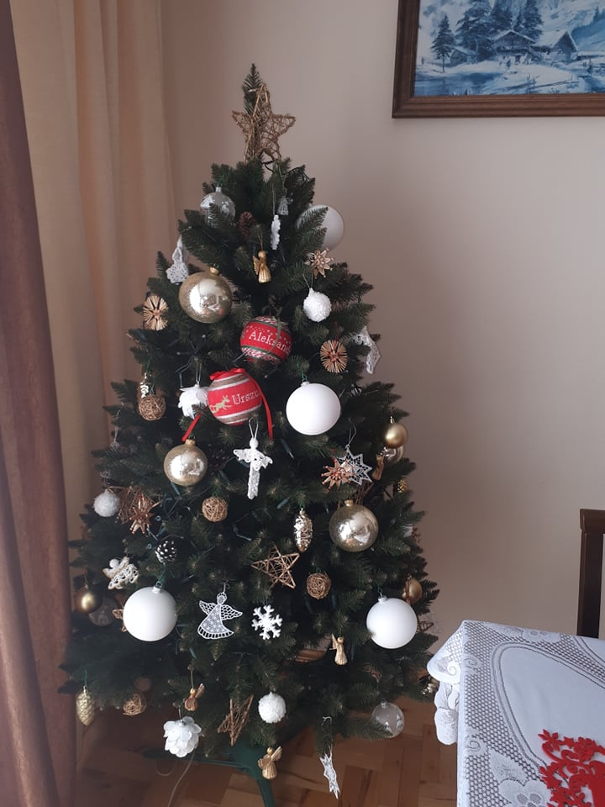
Decorating Christmas Trees
Dressing the Christmas tree is my favourite pastime before Christmas. Especially when the whole family is at home and we dress it together. I love all this confusion and questions: where are the lights, baubles and chains? I think that dressing the Christmas tree gives each of us a lot of joy and is one of the best moments during Christmas

Slide 5
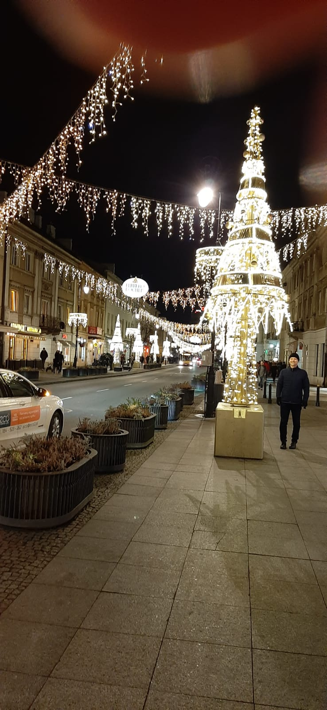
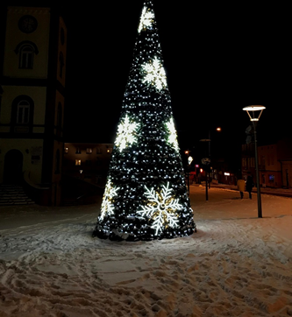
Our town
Brzozów is decorated during Christmas. There is a Christmas tree on the square market every year. Street lamps are decorated and a Christmas crib is located near the church.Various Christmas concerts are held ( concert) In our town you can feel the atmosphere of this joyful and happy time of the year…

Slide 6
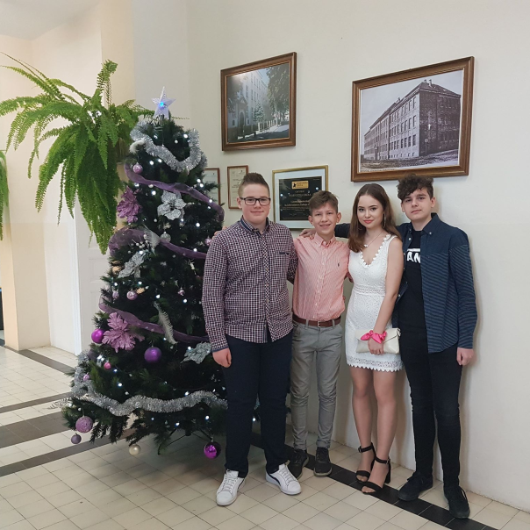
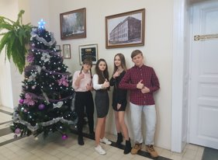
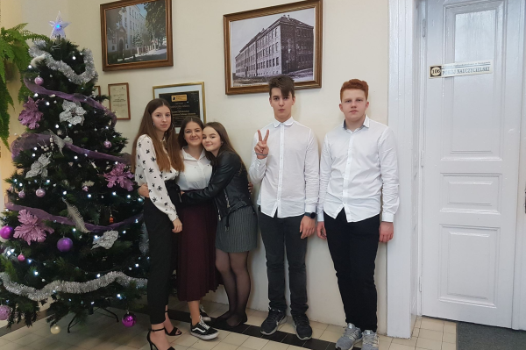
Decorating our school
Decorating our school is a really joyfull way of spending time with friends. We did this thing for the first time this year, so it was fun to spend time together and get to know one another better. We could leave a little bit of our artistic fantasies in our school.

Slide 7
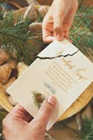
Preparing Christmas Eve
Christmas is a very beautiful time with many things you just can’t dislike but my most favourite is... Christmas Eve. It’s a day when you attend to a dinner with family, share the holy wafer and make wishes, listen to carols and receive gifts. Before the Christmas Eve dinner the Holy Bible is read.

Slide 8
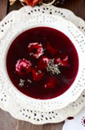
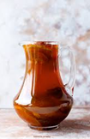
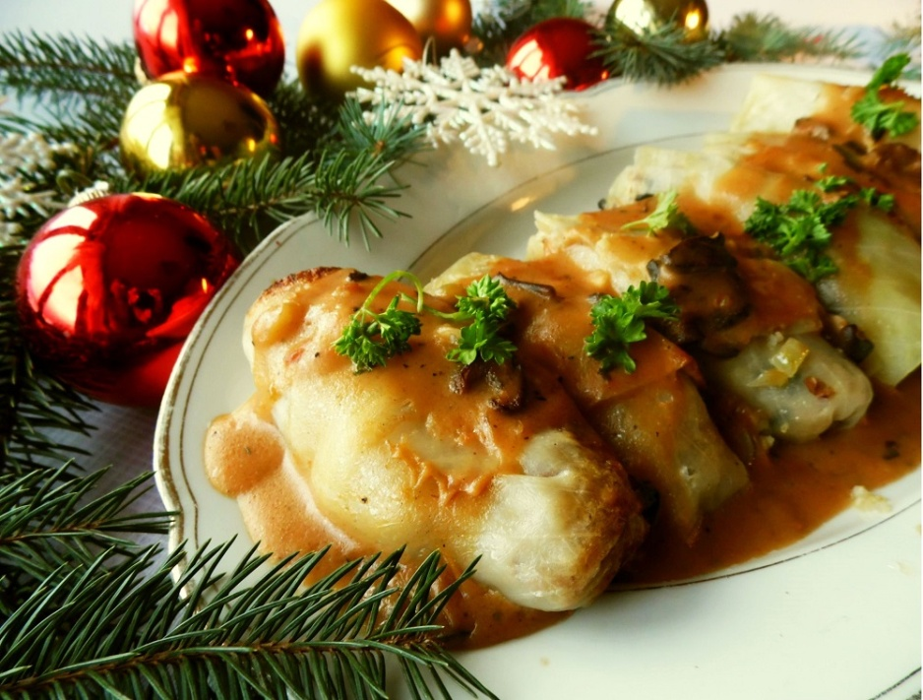
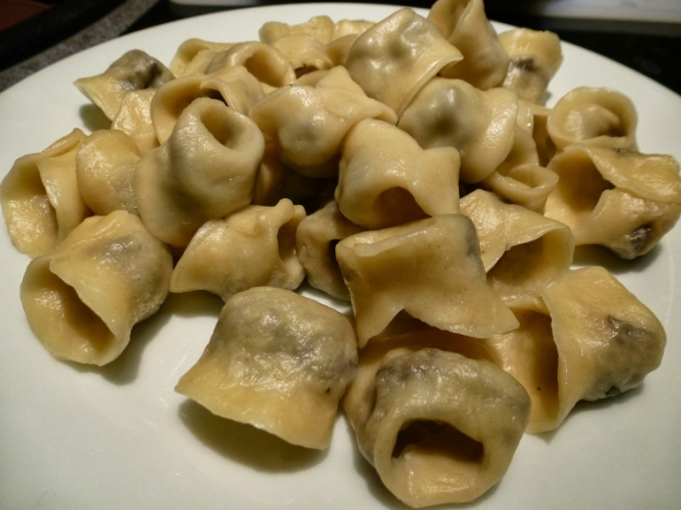
12 Christmas Eve dishes
Christmas Eve Supper consists of 12 dishes as a sign of the 12 apostles. There is a space left for a wanderer at the table. On the table there are dishes such as: dumplings, beetroot soup, dried fruit compote.

Slide 9
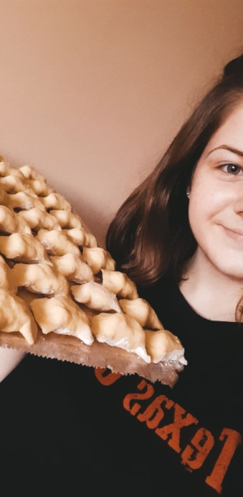
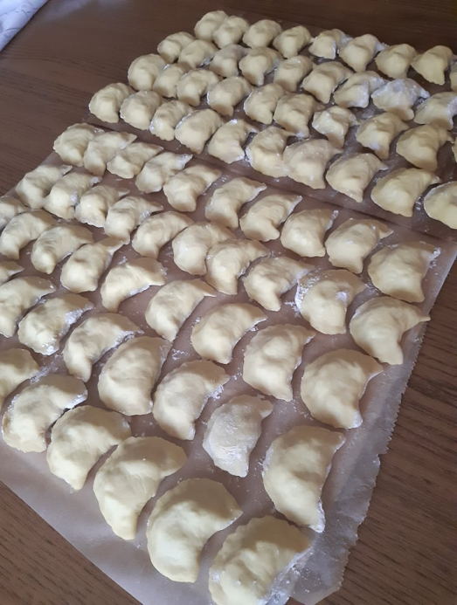
Making Christmas Dishes
In the morning of Christmas Eve, together with my mother and sisters, we prepare dumplings. We all spend time together and laugh. I love it. Dumplings are a favorite dish of my whole family. They are the most important dish on the Christmas table.

Slide 10
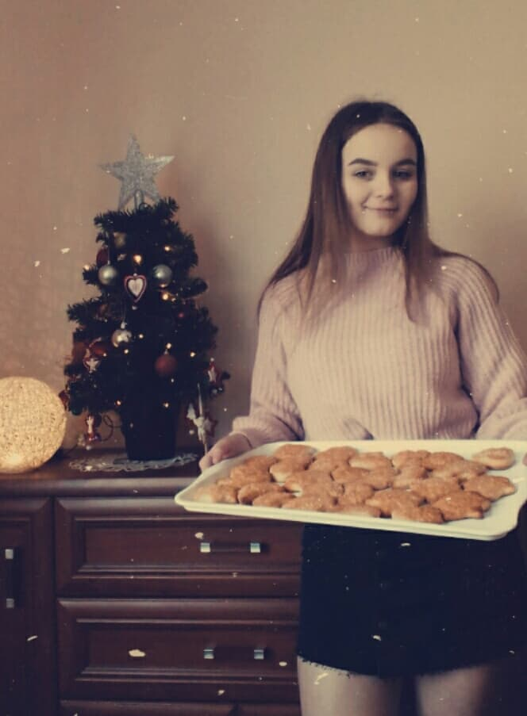
Baking Cookies
My best moment of christmas is definetly baking cookies for the christmas party. I make them with my mom and sister. We devote the whole Day decorating them, but this way we can spend more time together than usual. I can't imagine Christmas without baking!

Slide 11
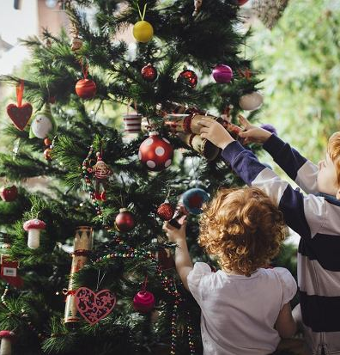
Christmas Routine
We used to have two trees, one little one for us girls upstairs, and a big family one downstairs. Now we just have the big family one downstairs. We pick a tree, go home and set it up, take all the ornaments out of the attic while mom makes cocoa and cider, then decorate it while listening to Christmas carols. We also decorate my grandparents' tree, which is just as fun and special.

Slide 12
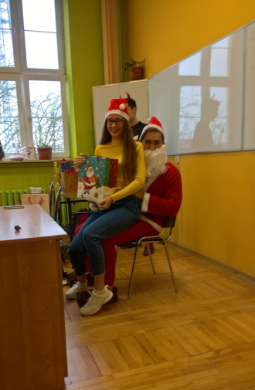
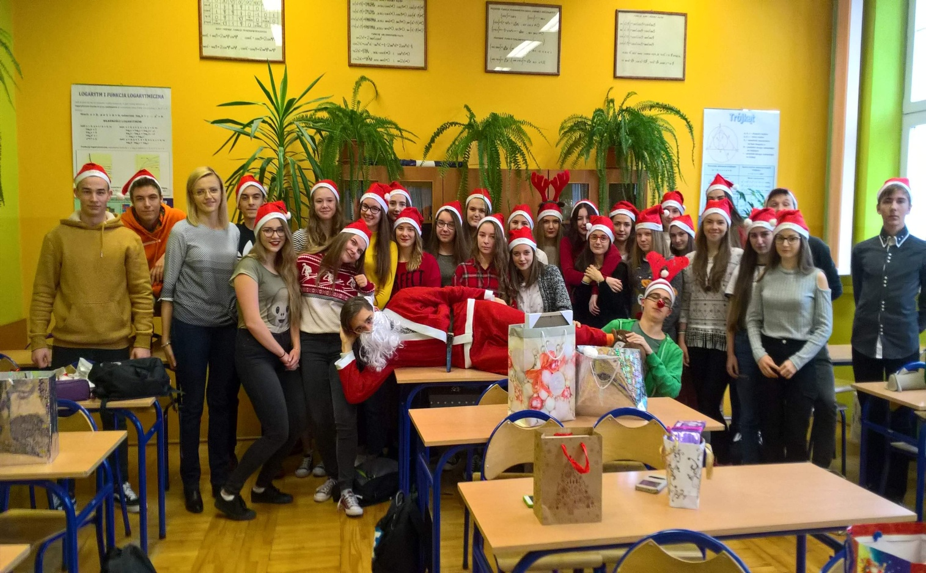
Visit of Santa Claus
Santa visit is an event is our school, when some of our student dress up like a Santa Claus and visit every class. At that day we get presents and we some challenges from Santa Claus. It's a good day to think back to your childhood years

Slide 13
Christmas Eve in Class
Christmas Eve Supper in class usually takes place on the last day before we start our Christmas break. It is a day when we can
spend toogether some time sing, eat, talk and simply have fun.

Slide 14
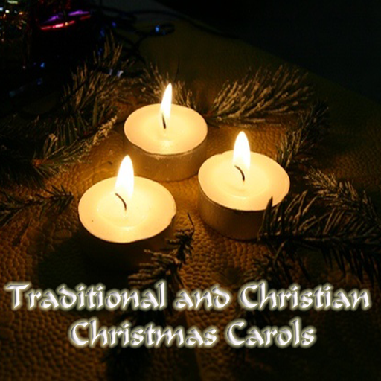
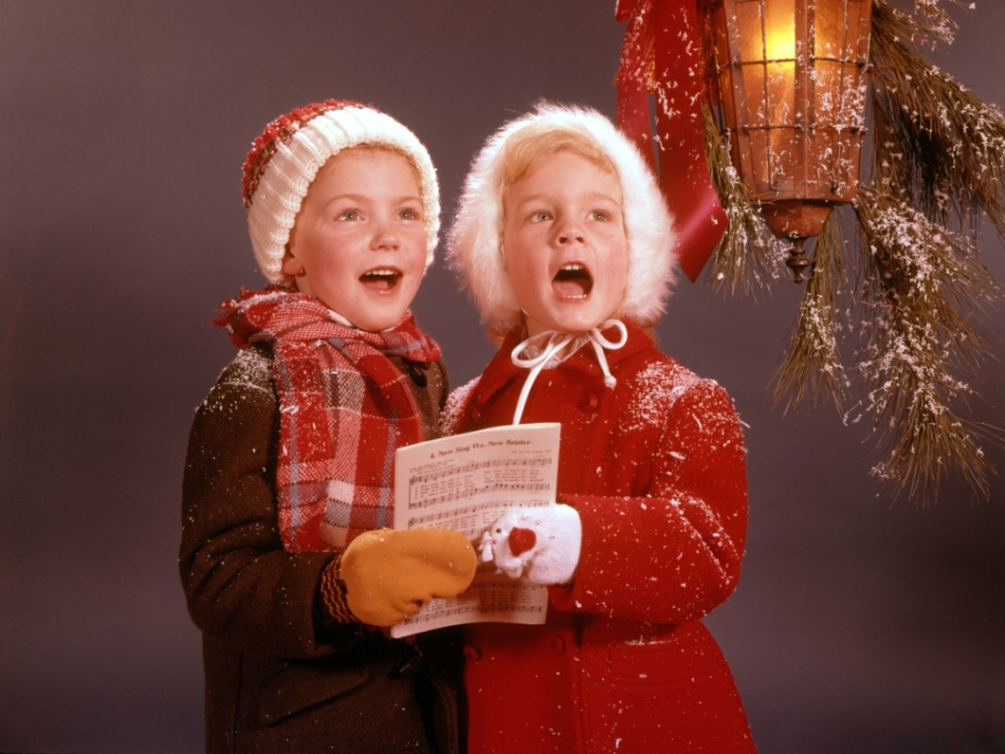
Singing carols
CAROL 1
CAROL 2

