Slide 1
Stravagant¡
-Vita da bambini-
Notes:
jjenfjndcjdncjndcjndcj

Slide 2
CONTENT
1. Identify your products
2. Starting your business
3. Design your business
4. Make it official
5. Describe your vision, mission and goals.
6.Legal aspect

Slide 3
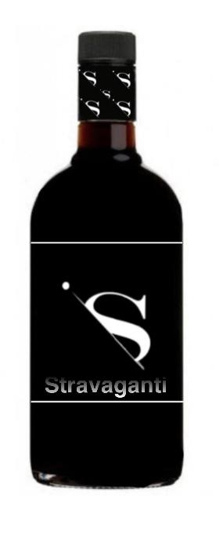
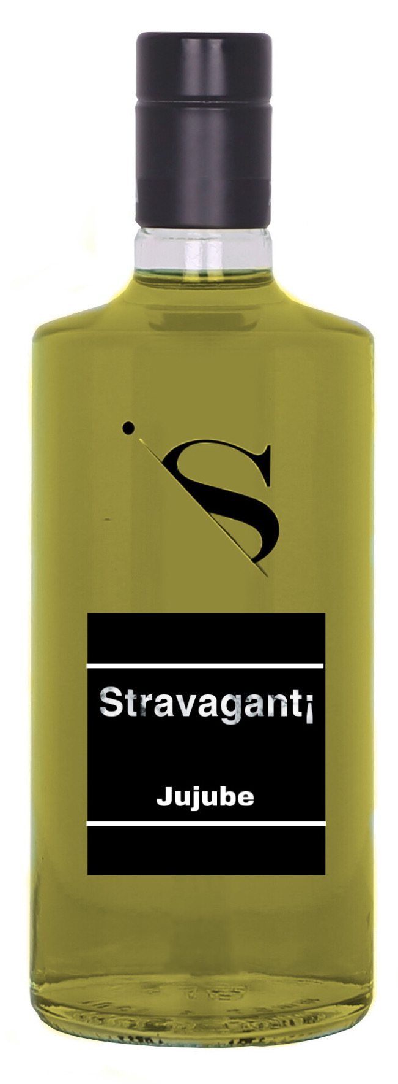
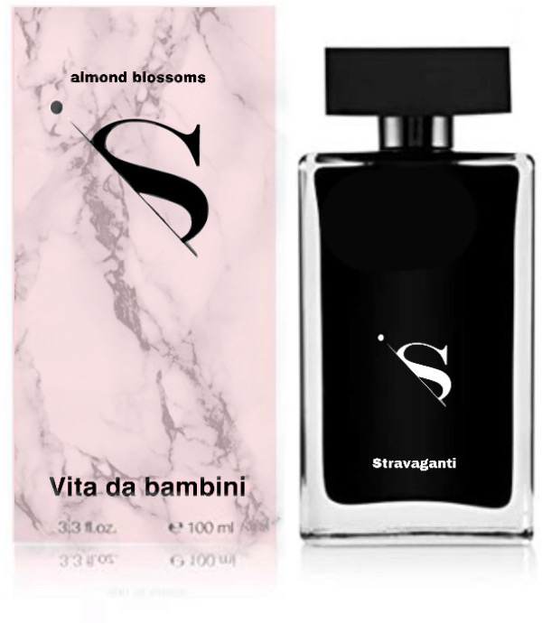
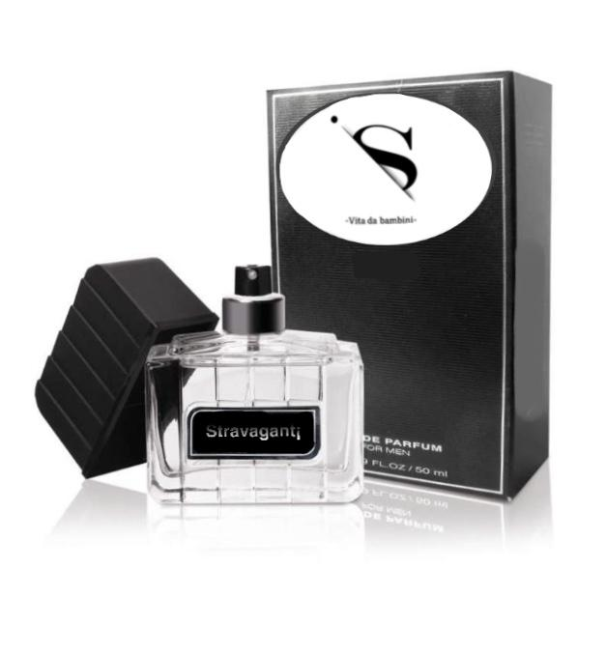
IDENTIFY YOUR PRODUCTS
Our products are two liquors, one with ensaimada flavour and the other one with jujube. The liquors come in two sizes, the large size for normal consumption and the small size (100ml) to carry with you. If you buy two of our liquors we will give you a sample of the perfume and if you like the essence you can buy the perfume bottle. The essence is composed of typical flowers from Mallorca. We sell a product.

Slide 4
STARTING YOUR BUSINESS
Study your market and your products answering these questions.
-What is your product?
Our product is a liquor made of typical products from Mallorca.
-Who needs it?
The liquor is needed by the people that like drinking liquor and would like to discover new tastes.
-Are there other companies offering other products/services now?
No.
-Is there a good reason why?
No.Because the liquor with the typical products of Mallorca there only in Mallorca and there aren’t any product like this over the world.

Slide 5
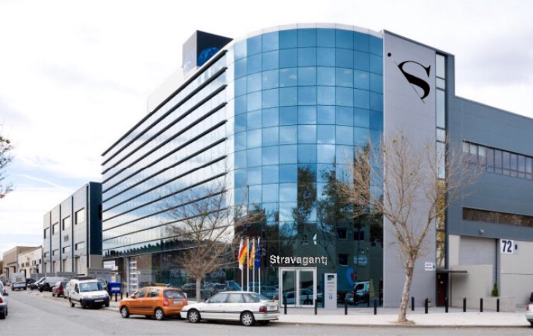
LOCATION OF THE COMPANY
The company is situated on the Paseo del Born [Palma] because there are tourists and in Palma there are very few shops that sell liquors and we have another shop at the Palma de Mallorca airport.

Slide 6
DESIGN YOUR BUSINESS
STRENGTHS:
Quality is our priority.
Original products, made with typical food from Mallorca.
Skilled and knowledgeable staff.
Intellectual property.
Technologies.
WEAKNESSES:
That other companies start creating or copingour product.
As we live in an island, exporting our product becomes more challenging.
OPPORTUNITIES
Make our business and our product famous.
THREATS
Competitors with more experience
We don’t have much recognition by the media, we need more publicity. We can get publicty

Slide 7
VISION, MISSION AND GOALS
The vision of our company is to create and sell a quality product that consumers like.
Our goal is to globalize our company and try to make people from all around the world consume it.
Another objective is to make Mallorca known as a liquor producer.

Slide 8
MAKE IT OFFICIAL
- Our company is a “SL”
-The name of our company is Stravaganti
-Permits
-Our company have to pay their taxes:
IVA”Impuesto sobre el Valor Añadido”
IRPF”Impuesto de Rédito sobre las Personas Físicas” IAE”Impuesto sobre Actividades Económicas”

Slide 9
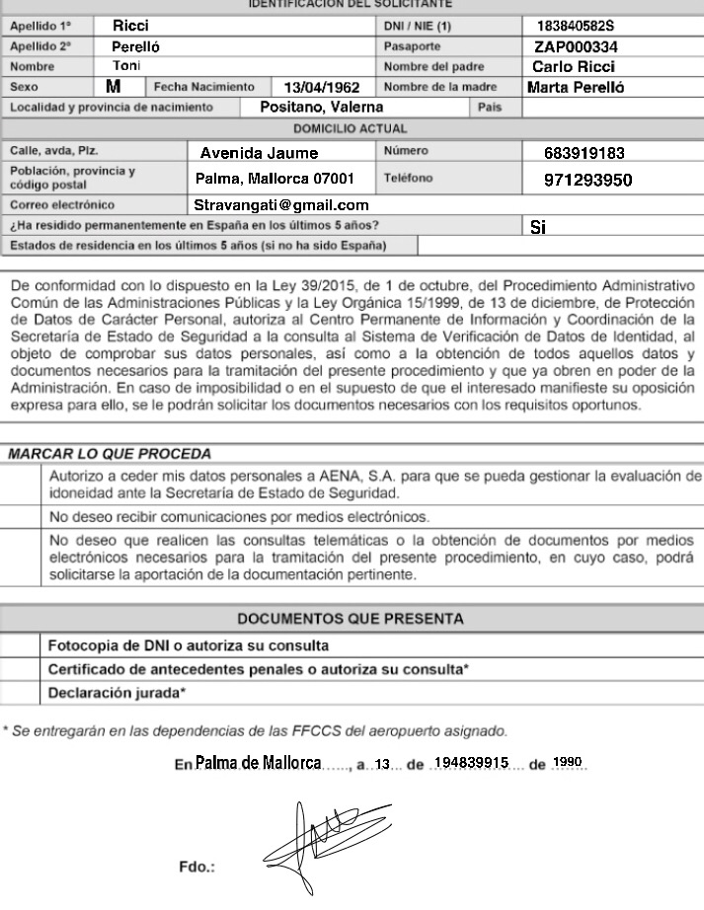
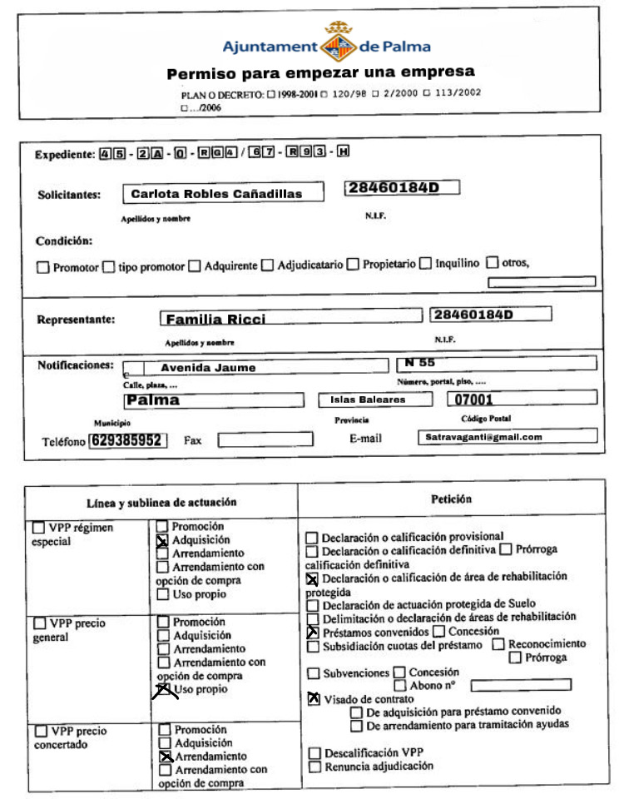
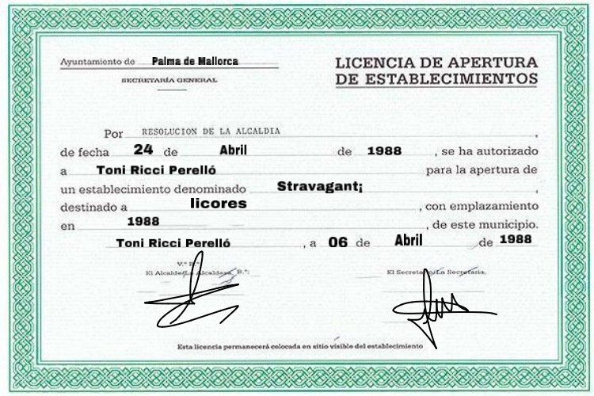
LEGAL ASPECTS
Request Permit License

Slide 10
END

