Slide 1
Lithuania

Slide 2
Our logo and our company ,,Kibiniukai”
About our logo:
Logo color is very similar to kibinai dough color.
Scientists proved, that orange color awakens appetite.
We think this logo feed is original and unique.

Slide 3
Vision: we want to make a kibinai global.
Mission: Adapt our product to foreign countries market’s, changing some ingredients. For example changing the types of meat or vegetables.
Goal: Our goal is to produce other types of tipical products, adapting them to all the foreign markes.

Slide 4
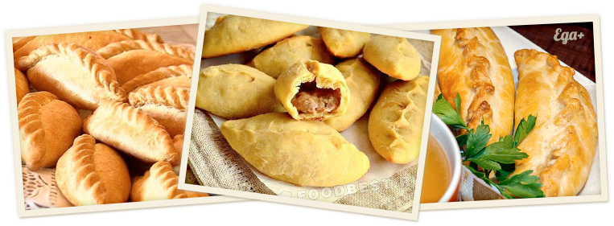
KIBINAI
The kibinai is a traditional Lithuanian’s food, it is a dough with meat and onin cooked in the oven.

Slide 5
About it
All the ingredients are supplied by ,,Kauna’s farm”, this farm offers the best products of Lithuania. All the animals are free to graze and all the meat is treated in the best ways for give her softness and flavor, while there aren’t additives and preservatives in the agricultural fields.

Slide 6
Strengths | Weaknesses
It has made of local products. There aren’t similar recipes in the world. There aren’t a additives. | It has a lot of calories. Unique recipes.
Opportunities | Threats
There is a vegan alternative. There aren’t global competitors. It can be advertise as slow food. | There are locals competitors. It hasn’t an original recipe. The price for transports etc. could drive up the general price.

Slide 7
For opening we need:
Business structure
Business name
Register your business
Permits
Pay taxes
License
Necessary bank account
Trademarks, copyrights or patents

Slide 8
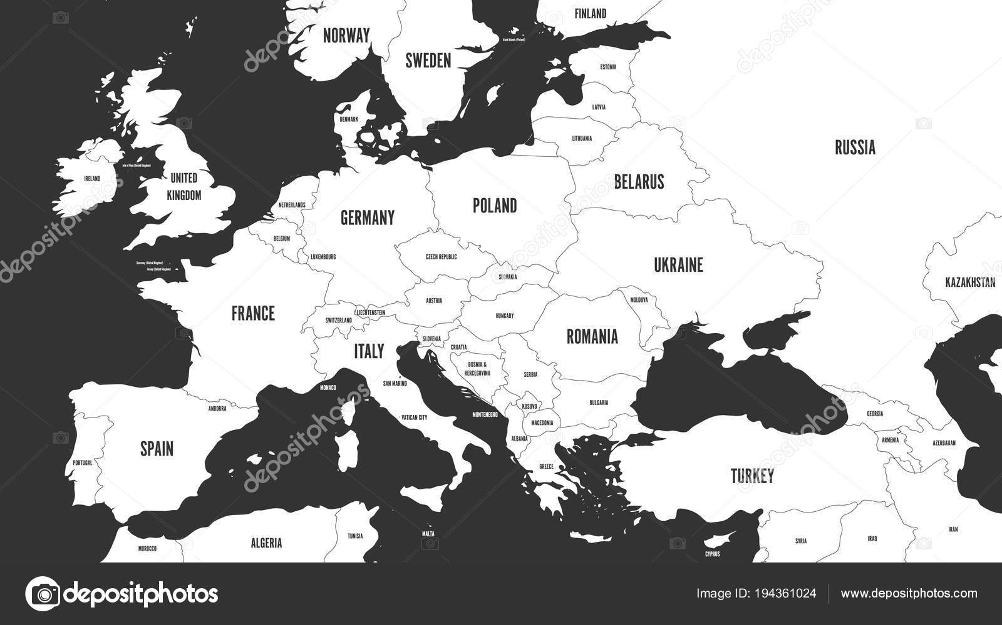
Our company will be opened in other countries as well

Slide 9
Business plan:
We plan to find good suppliers who will transport our product to different wolves of the world.
If people in another country don’t eat or prefer another filling, we are ready to listen to the people and come up with a filling that will suit to that country .
We plan to make an excursion for people who are interested in cooking process, but in order not to reveal the secret of cooking, we will give a ready-made dough

Slide 10
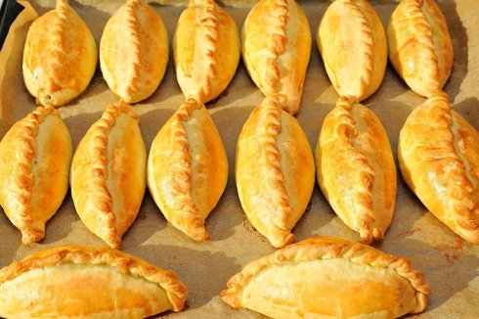
We interviewed 120 people, who were asked with what filling they prefer kibinai. We displayed our results in a diagram.

Slide 11
Opinion poll

Slide 12
Thanks for attetion!

