Slide 1
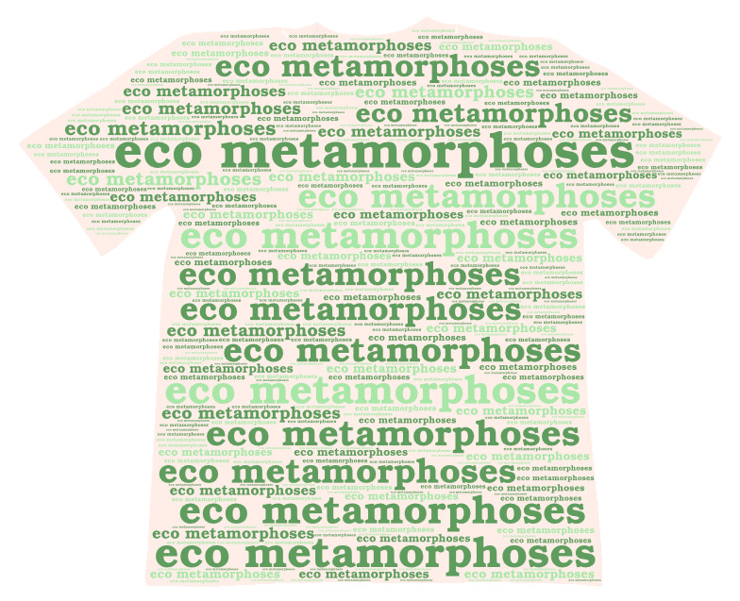
„Eco metamorphoses”

Slide 2
How does our company work?
Do you have old clothes and you don't know what to do with it? Our company will take care of it. We remake old clothes and produce recycled clothes, including PET bottles caught from the oceans. We are based in Warsaw, old clothes can be sent to our address.

Slide 3
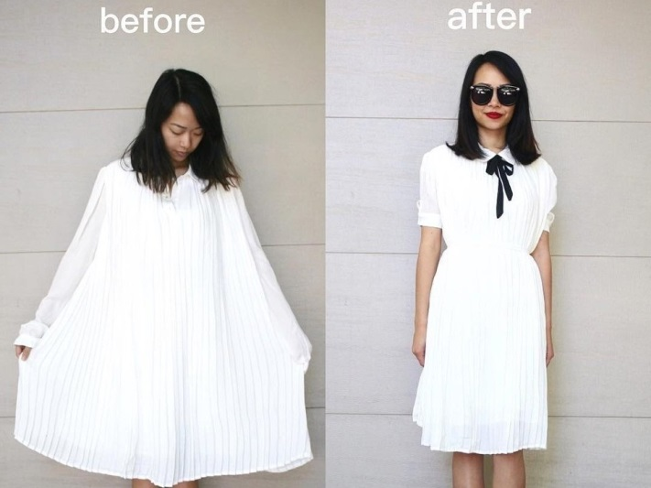
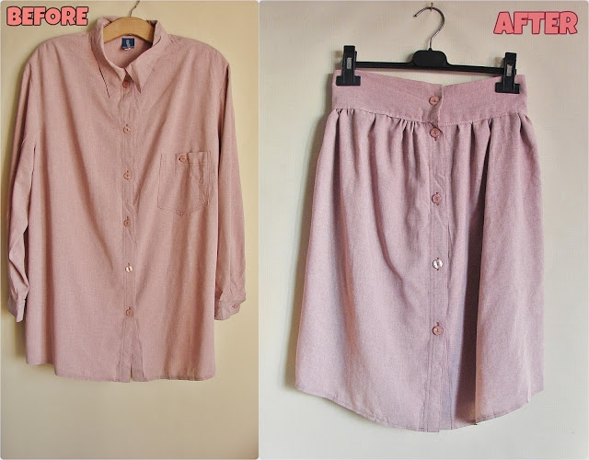
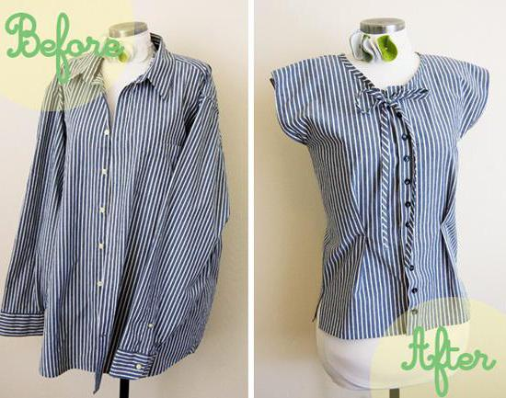
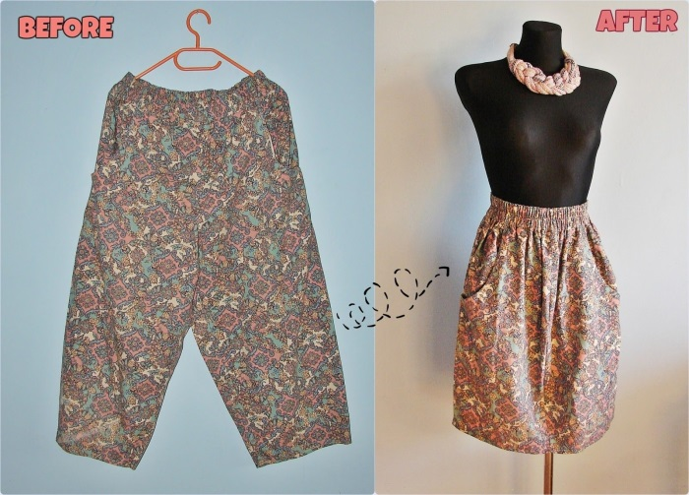
Metamorphoses of old clothes: (more on the website)

Slide 4
Price list of our company's services
Lengthening / shortening of sleeves and legs | 10$
Widening / shortening the garment | 12$
Decoration of fabric (studded pearls, studs, beads, sewing in laces and other decorations) | 15$
Pocket stitching | 8$
Narrowing / widening at the waist | 15$
Bag remakes | 20$
Collar alterations | 10$
Neckline remakes | 8$
Other | Price negotiable individually with the client

Slide 5
Fill in the card (include it in the package with old clothes)
metamorphosis of old clothes
Information for the seller:
The number of items:
Size:
Other (decorations, sewing):
If you want our company to remake your old clothes,
send them to us together with this card to the following
address: Kościelna 8, Warsaw 00-218.

Slide 6
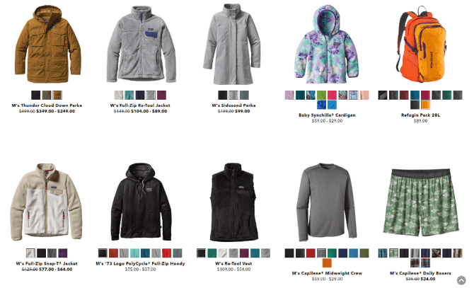
Clothes made from recycling: (more on the website)

Slide 7
Thank you for your attention!
Welcome to services and purchases in the company! Authors: Dominika Świderska, Amelia Balcerzak

