Slide 1
Cootea

Slide 2
Our leaflet

Slide 3
About us
We are a student company from Czech Republic.
Our company is devided into two halfs. In this group are 4 people.
Our names are Blanka Jušková – director, Petra Zemanová – deputy director, Nikola Bruzlová and Kateřina Čížková – financial workers.

Slide 4
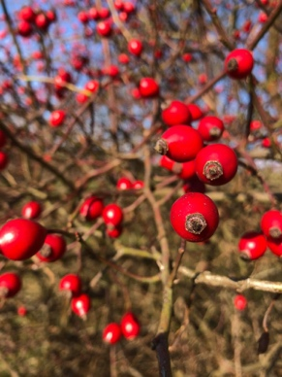
Our products
We are producing a different types of tea.
We offer hot and ice tea, tea mixture and baked tea.
Our products are mostly BIO and from homemade ingredients.
You can choose from this flavors: herbal tea, apple tea, peach tea, rosehip tea and strawberry tea.
Our hot and ice tea costs 1€, tea mixture and baked tea costs 2€.

Slide 5
contact
If you want to contact us we have an e-mail address: cootea@email.cz
If you wanna see something from backstage of our company make sure you follow us on Instagram: cootea_

