Slide 1
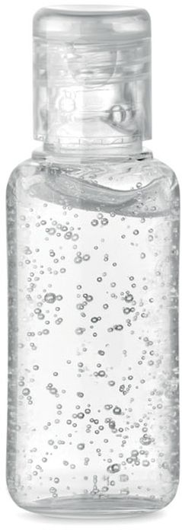
,,If you want to have clean hands, our gel must be in your pocket."
Second group of inPocket-
Filip Voleš, Hanka Musilová,
Denis Šimbera, Karel Kašpar

Slide 2
ABOUT US
Because of this situation with the corona we decided to produce hand sanitiser to help people encrease their safe zone. All available hand sanitisers are unpleasant on the skin or stink disgustingly and suitable hand sanitisers are too expensive. That's why we wanted to give people quite cheap and good hand sanitiser. Our product costs 2€ and has very pleasant and beautifull fragrance of fruit.

Slide 3
ABOUT OUR PRODUCT
you can buy only one type of our antibacterial gel- with the scent of wild berries
costs 2€ in total
50 ml bottle
doesn't stink of alcohol
moisturizes your skin
kills 99,9% of all bacteries

Slide 4
Contacts on us
- inPocket
- _inPocket_
- inpocket@email.cz

