Slide 1
A student company

Slide 2
About us
Greetings, we are independent student company from Brno, Czechia.
Our field of market is making products from honey.
All of our products are homemade, organic, and also made from local ingredients.
.

Slide 3
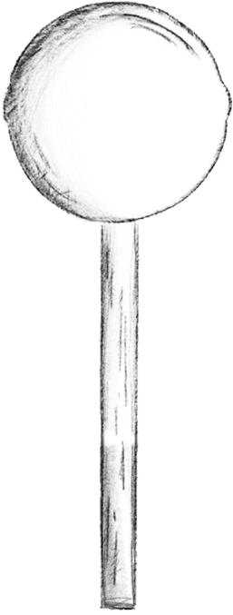
Our products
Lollipops
Our company‘s main product
Lollipops are mainly made from honey, supplied by local beekepers
They‘re mixed with caramel, making a delicious and sweet combination
The cost of one Lollipop is 26 Kč = 1 €

Slide 4
Honey biscuits
Chewy and crunchy sweet biscuits that taste like freshly gathered honey.
Lots of variants, including:
The cost of one biscuit is
30 Kč = 1,15 €
Honey & Chocolate chips
Honey & Mixed nuts
Honey & Lemongrass

Slide 5
Thanks for your attention.
We‘re looking forward to our further collaboration.
@_honeypop._
honeypop@seznam.cz

