Slide 1
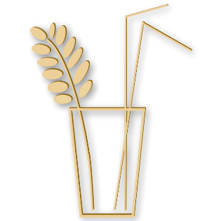
NATURALSTRAWS

Slide 2
About us
NaturalStraws- fully natural straws, great alternative for single-use straws
They are made of rye straw, which is a by-product of rye cultivation
The straws are cut by hand
The straw comes from an organic farmer from Poland
NaturalStraws straws are absolutely 100% biodegradable and compostable!
They are better than disposable paper straws because they do not soften or change the taste of the drinks

Slide 3
We pay bills and bill our customers for our goods. Moreover we deal with taxation and draw up balance sheets
Our department devises, organizes and coordinates everything related to the employees within our company and the overall workplace.
We are responsible for dealing with customers before, during and after the sale. We ensure that our consumers have a smooth and enjoyable experience throughout.
We are responsible for converting raw materials and other inputs into finished goods. During the process of manufacturing our department woeks to improve the efficiency of the manufaturing process so that our company`s output targets and finished products offer consumers the best the best value and quality.

Slide 4
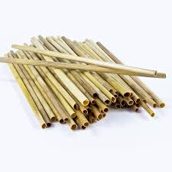
Product Presentation
Single straw dimensions;
length 22cm (+/- 1cm)
diameter 3-4mm
The package contains 50, 100 or 250 straws.
Straw straws are not suitable for thick drinks (Milkshakes, etc.)
Polish product

Slide 5
Thank you for your attention!
Authors; Jakub Bugaj
Aleksandra Woźniak

