Slide 2
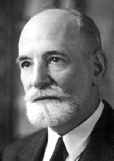
1°) History
• 1898
• founded by a group opposed to the imprisonment of Dreyfus
• Dreyfus Affair
• The League of Human Rights or« LDH » in French is a non-profit-making charitable organization
Victor Basch

Slide 3
2°) Objectives
The objectives of « LDH » are varied : It
• Fights against Racism and Antisemitism
• Defends Equality between Men and Women
• Defends Democracy
• Defends Migrants
• Defends Freedom of Expression

Slide 4
3°) How is it financed?
Subscriptions
Gifts
Grants; Local Council, Regional Authority and European Union

Slide 5
4°) Structure
16-17 employees working full-time
Voluntary workers
Members
About 8000 ‘Leaguers’

Slide 6
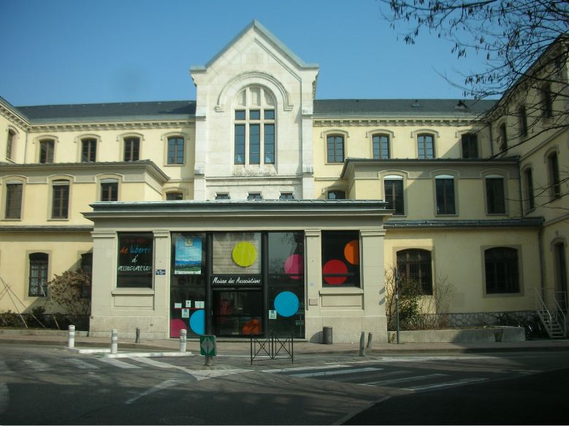
5°) How does it function at the local level?
• Meetings every Thursday
• 100 members
• 20 volunteers
• régulation
Maison des association

Slide 7
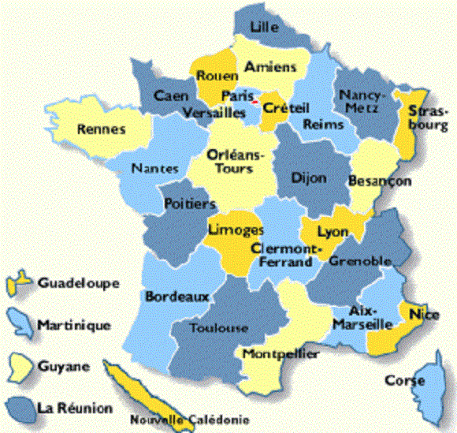
6°) Organisation at the National Level
• 300 posts
• Outre-mer (France Overseas)
• Refugee Seekers
• Migrants
• Prisoners

Slide 8
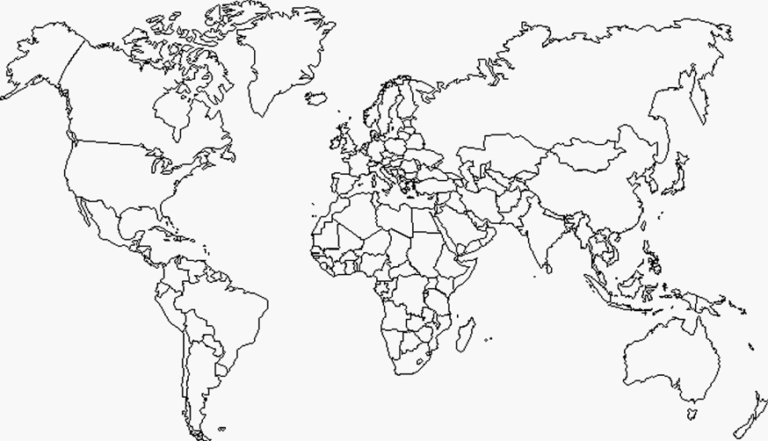
7°) How does it fonction at the international level?
International Law Courts
Recognition of the Rwanda Genocide
Palestinian Nation
Saudi Arabia
Palestine
Saudi Arabia
Rwanda

Slide 9
The Universal Declaration of Human Rights

Slide 10
- Sources -
Interview on the 7 October 2015 at the ‘Maison des Associations’ with Mireille Bertho who is the President of the local section in Chambéry
The Official Site of The League of Human Rights :
http://www.ldh-france.org/

