Slide 1
«Better to light a candle than curse the darkness»

Slide 2
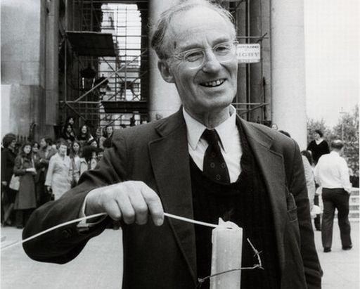
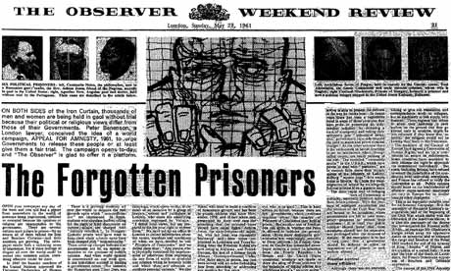
Amnesty international Creation
Peter Benenson (1961)

Slide 3
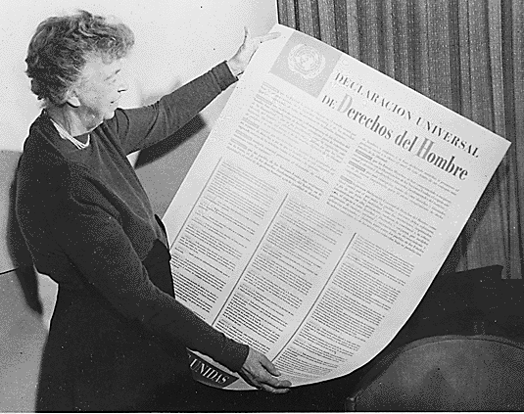
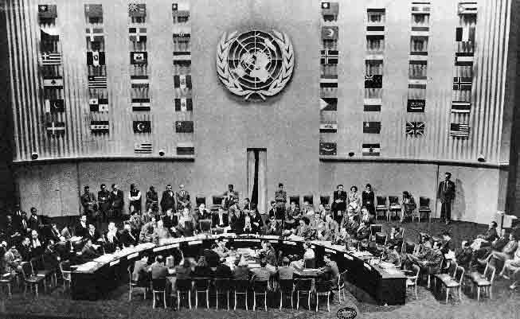
Universal Declaration of Human Rights
Human Rights Assembly
Eleanor Roosevelt

Slide 4
Structure
London
72 National
Structures
Groups
*300 in France

Slide 5
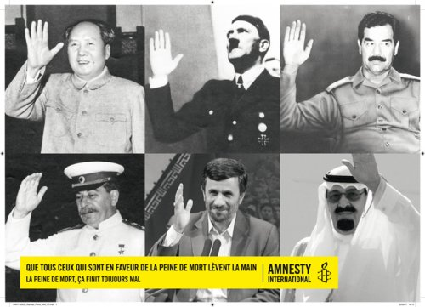
Principles and objectives

Slide 6
Funding

Slide 7
Remarkable Acts
Torture
10 days to sign

Slide 8
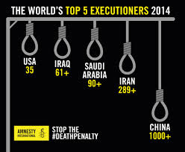
Death Penalty
28% increase in executions from 2013 to 2014
607 persons condemned to death in 22 countries ( without counting China )
China execute the most

Slide 9
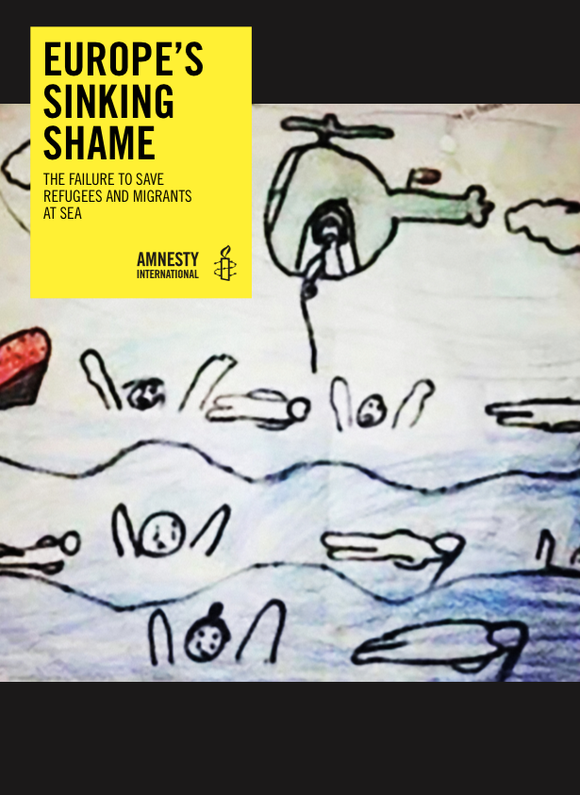
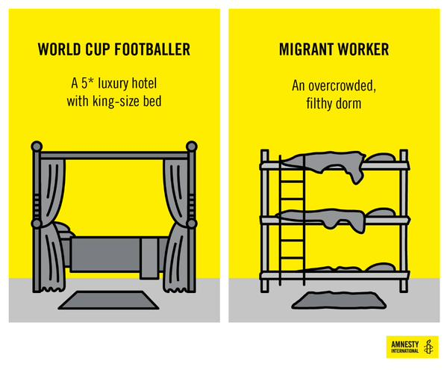
Migrants
A migrant is a person who leaves his country to live in another territory for many reasons and temporarily or permanently .
Particularly because of wars , persecutions .

Slide 10
How to act?
- I invest my time and energy!
- I sign!
- I donate!

