Slide 1
The High school Of Jastrebarsko
Jastrebarsko, Croatia

Slide 2
Out and about
High school Jastrebarsko is placed in a small town near Zagreb named Jastrebarsko
The city of Jastrebarsko itself has about 15 866 people living in it, leading to information from 2001.

Slide 3
About school
The high school of Jastrebarsko has about 359 students yearly
The school also provides the possibility of choosing between four educational directions that students can attend to, there are:
1.General high school course( lasts for four years)
2. Economic, trade and administrative direction for economics (lasts for four years)
3.Economic, trade and administrative direction for sellers( lasts for three years)
4.Direction of mechanical engineering, shipbuilding and metallurgy for auto mechanics (lasts for three years)
5.Direction of mechanical engineering, shipbuilding and metallurgy for JMO heating and air conditioning installers

Slide 4
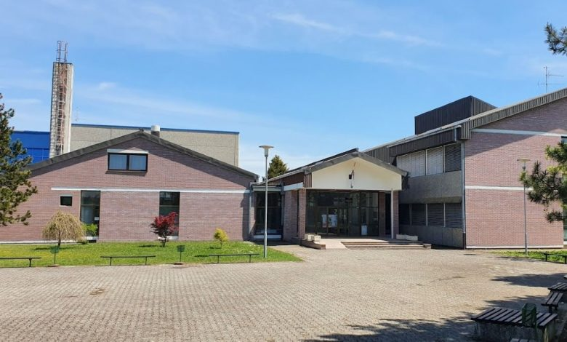
History of the Highschool of Jastrebarsko
The history of secondary education in Jastrebarsko began in 1974, when the school operated as regional department of the Secondary School Center Samobor
Independent work began on March 1, 1987
In 1991, the newly built building of the Jastrebarsko High School with an outdoor sports field was opened and a large green area around the school with an orchard was arranged
In 2008 a sports hall was built, which connected to the school building by a corridor
For its work, the School received numerous awards, including a plaque from City of Jastrebarsko in 2002 for outstanding success in education

Slide 5
Location

Slide 6
Thank you for your attention!

