Slide 1
Mustafa kaynak anatolian high school
Turkey , Denizli

Slide 2
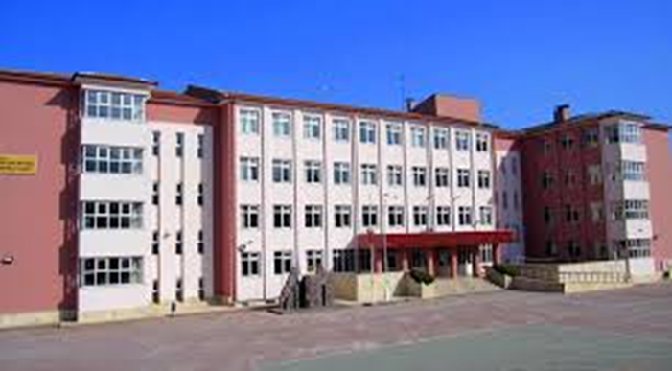
Our school was built by Mustafa Kaynak, one of the well-known businessmen of Denizli.
Located on an area of ​​about 14000 square meters in Denizli
Our school started education in the 2005-2006 period. 12 September 2005
When 240 students who successfully enrolled in our school in the Secondary Education Institutions Examinations gathered in the garden of our school.
Our school, which succeeded in being among the most admired and preferred schools of Denizli in a short time
The school has 25 classrooms, one gym,3 science labs ,one liblary.

Slide 3
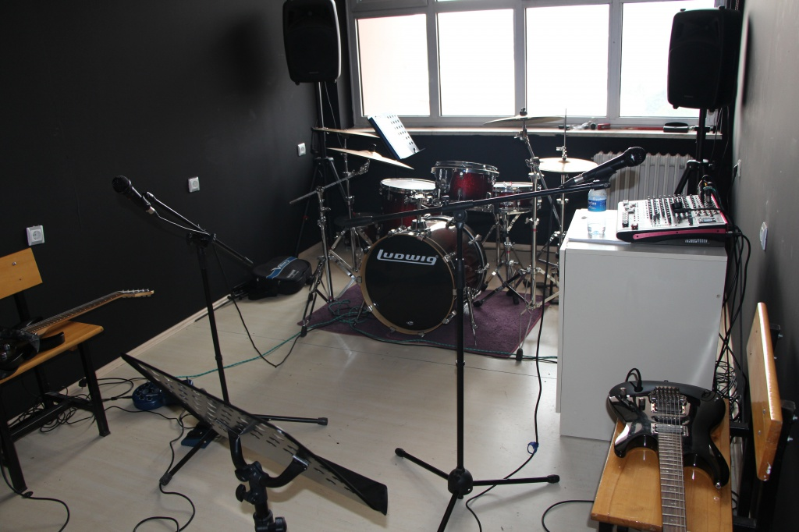
Design and Skill

Slide 4
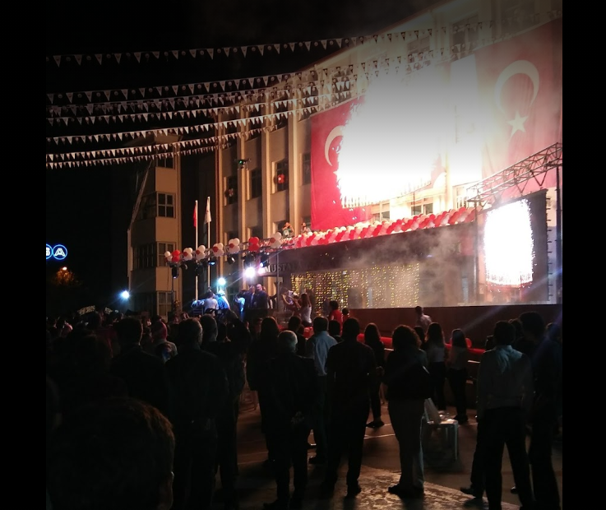
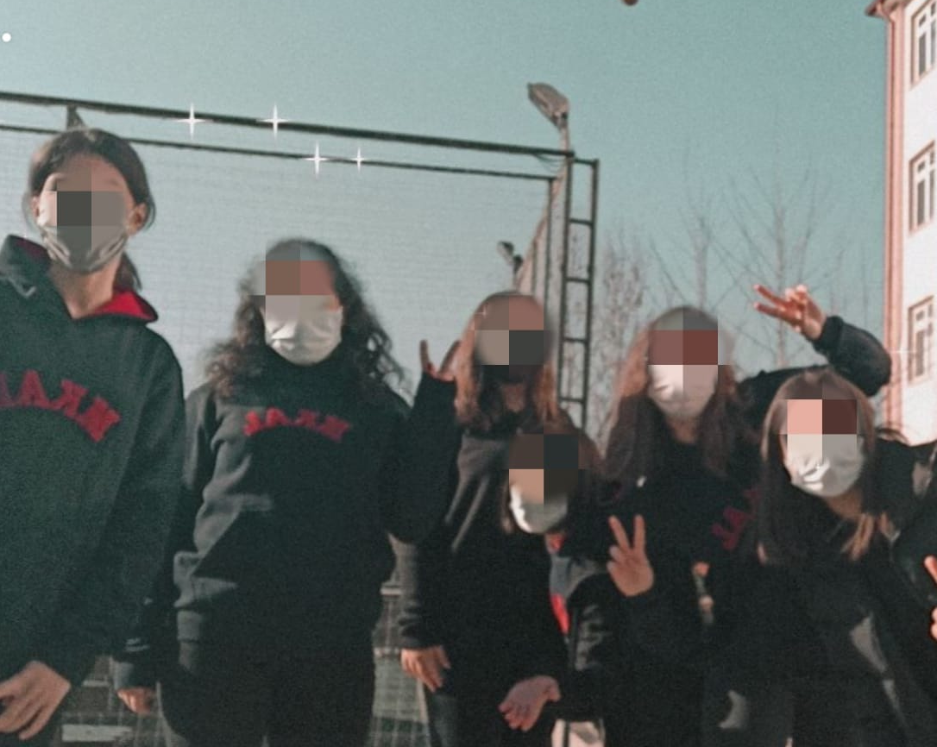

Slide 5
