Slide 1
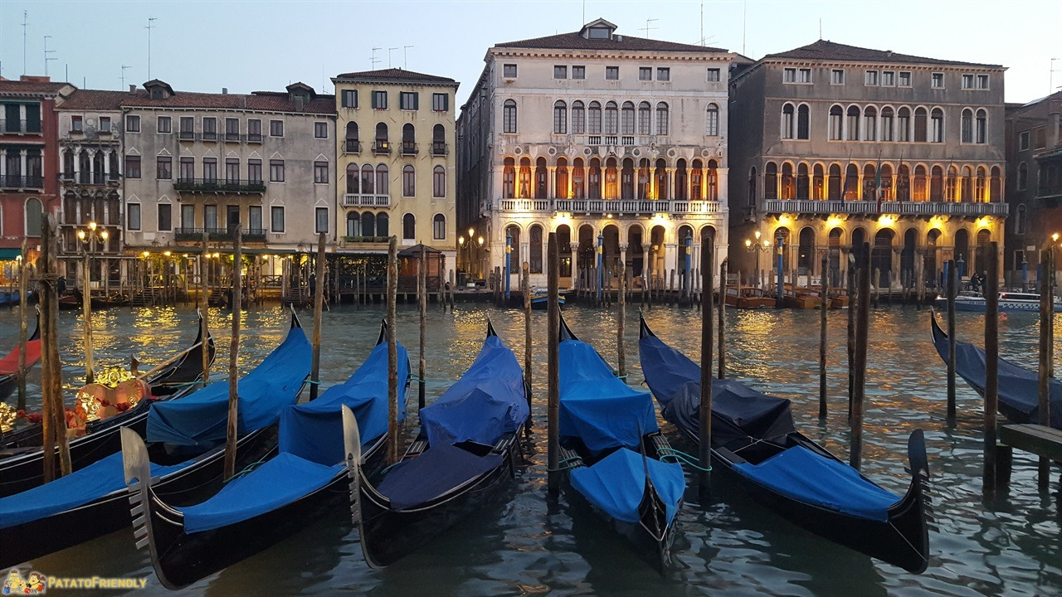
VENICE

Slide 2
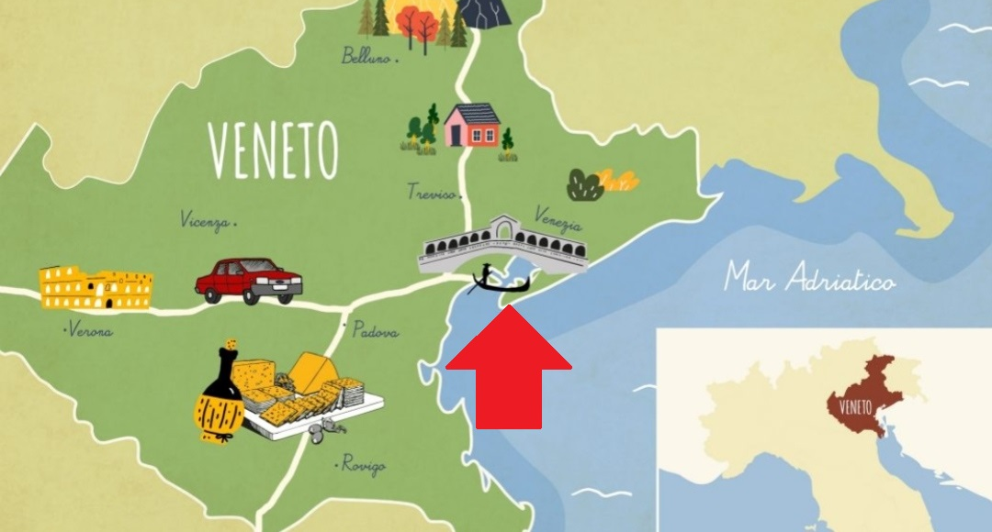

Slide 3
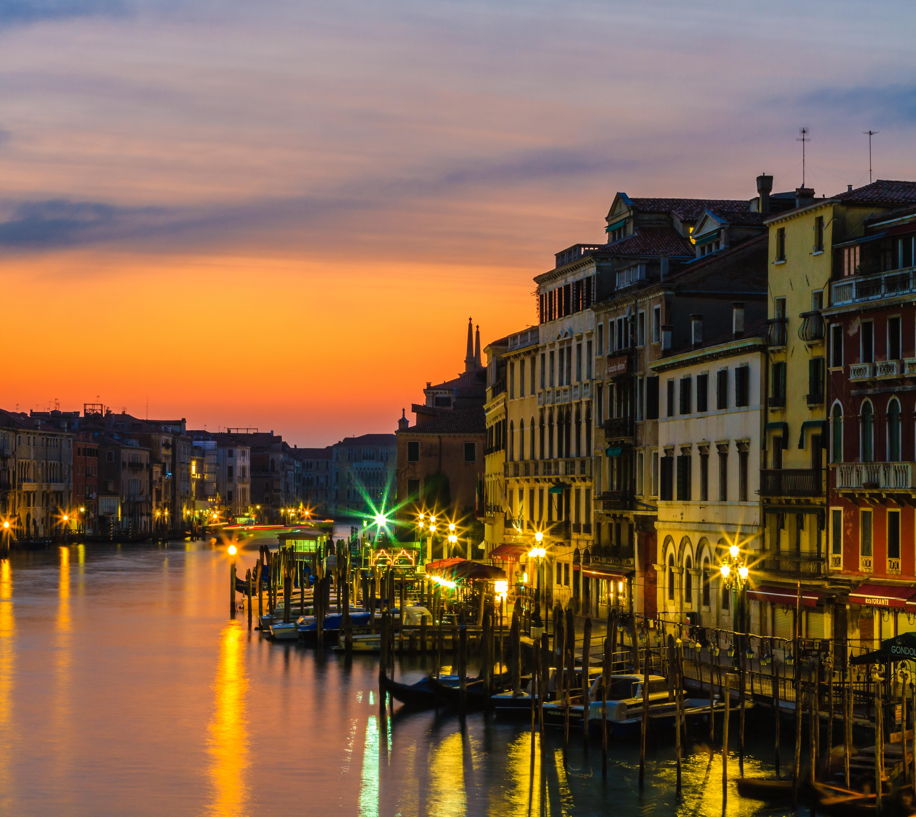
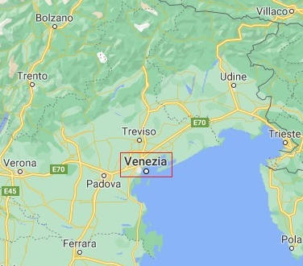
WHERE IS VENICE LOCATED?
Venice is located on the coast of the Veneto region

Slide 4
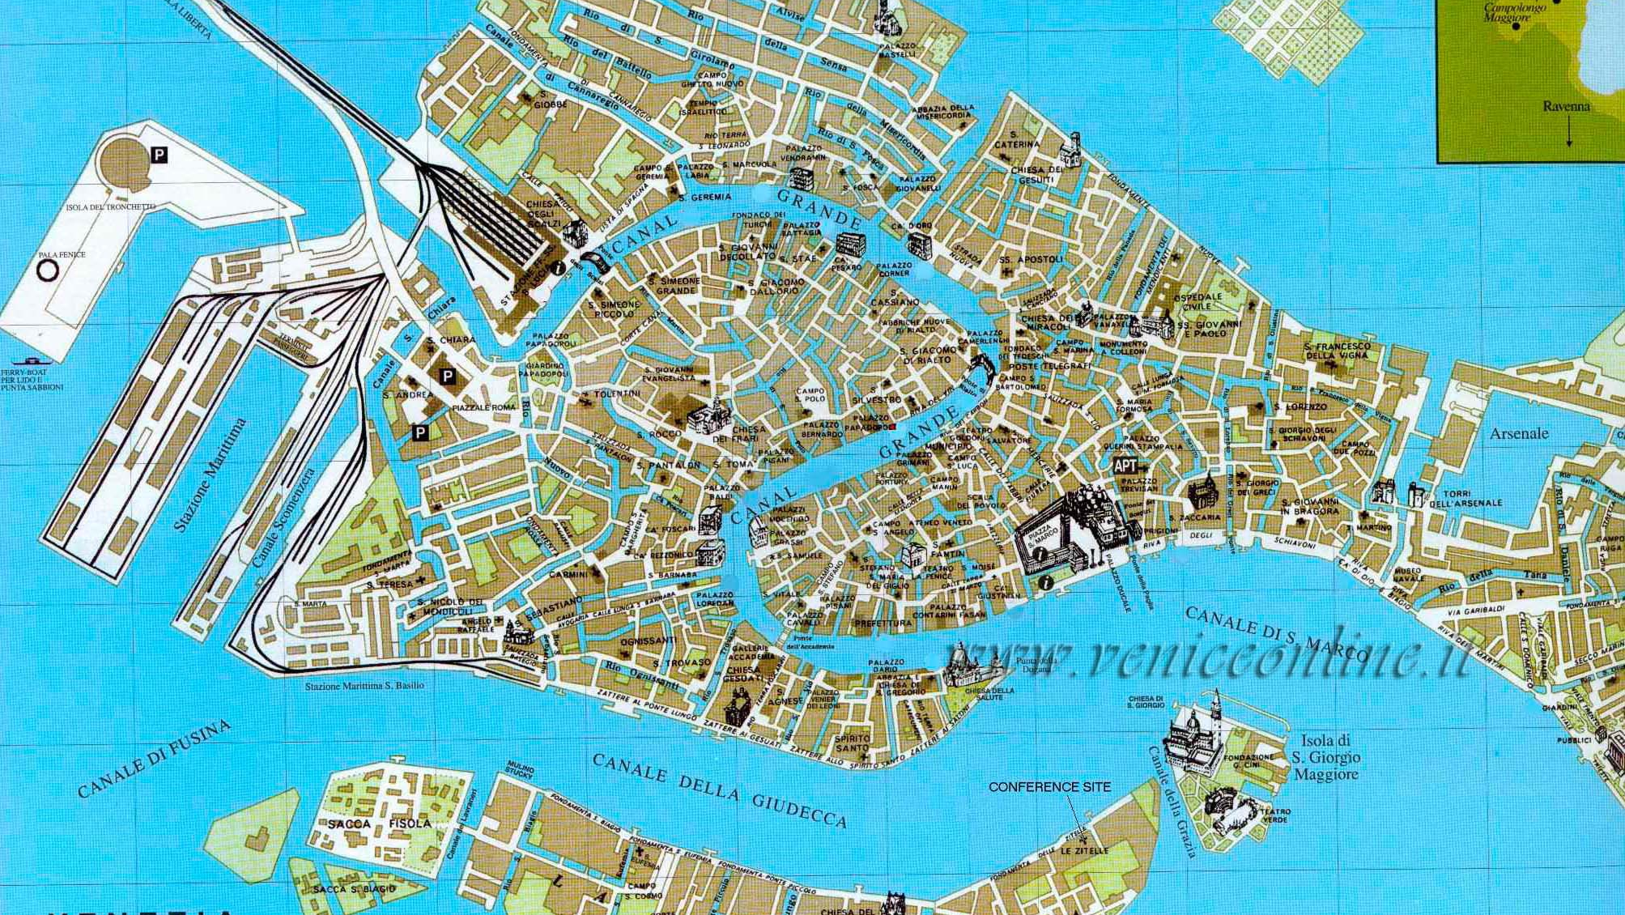
VENEZIA
The city is located on the Venetian Lagoon in the gulf of the same name and is located halfway between Treviso and Padua. The city extends along the mouths of the Po and Piave and has developed into one of the most powerful regions of the whole Mediterranean, for centuries it was the Most Serene Republic of Venice. In 1979 the entire city with the entire lagoon was declared a World Heritage Site by UNESCO.

Slide 5
VENEZIA
One of the most important things in Venice is the PIAZZA SAN MARCO also one of the most famous squares in Italy in fact it attracts many tourists from all over the world.

Slide 6
PIAZZA SAN MARCO
The San Marco square is located in Venice in Veneto is seen that and the lower part of Venice is one of the parts that floods first. The measures of this square are: it is 180 meters long and 70 meters wide.

Slide 7
HOW WAS BORN PIAZZA SAN MARCO?
The square was born around the beginning of the 6th century and paved in 1177. Napoleon defined the square as "the most beautiful hall in Europe". The cost to enter to see the square starts from € 5 while for a group of more than 15 people the price starts from € 2.50.

Slide 8
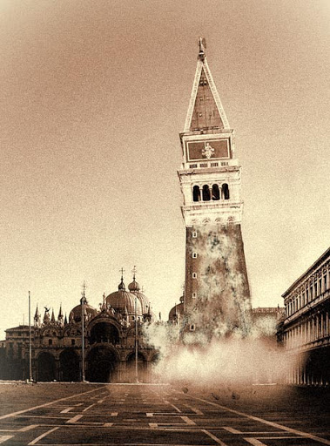
A BAD DAY FOR VENICE
July 14 1902 was a bad day for Venice because the bell tower of St. Mark's square collapsed. The cause of this was the removal of the iron anchors inside the bell tower, to make elevators

Slide 9
WHAT CAN YOU FIND IN PIAZZA SAN MARCO?
The things that can be found in Piazza San Marco are: the Basilica, the bell tower, the Marciana library, the Ducal Palace, the Clock Tower and the Royal Palace

Slide 10
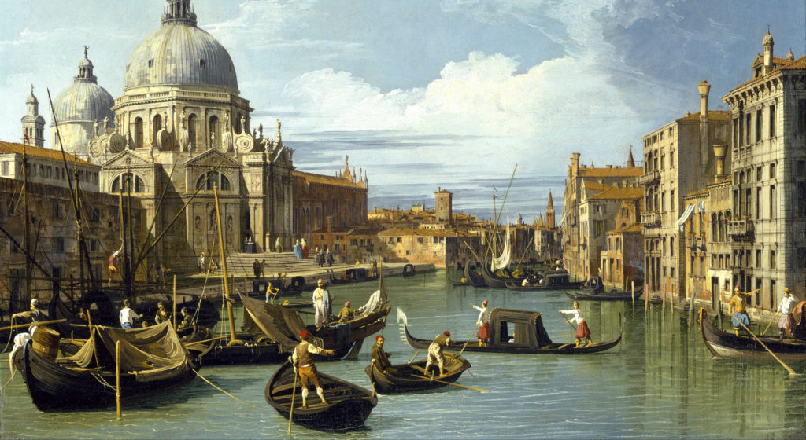
HISTORY OF VENICE
The origins of Venice go back to the Lombard invasion in Italy. It was in this period that a large number of residents of the Veneto, driven by the continuous Lombard raids, began to settle in the lagoon, previously inhabited only by itinerant fishermen.

Slide 11
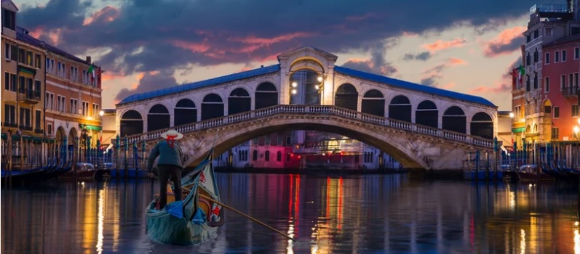
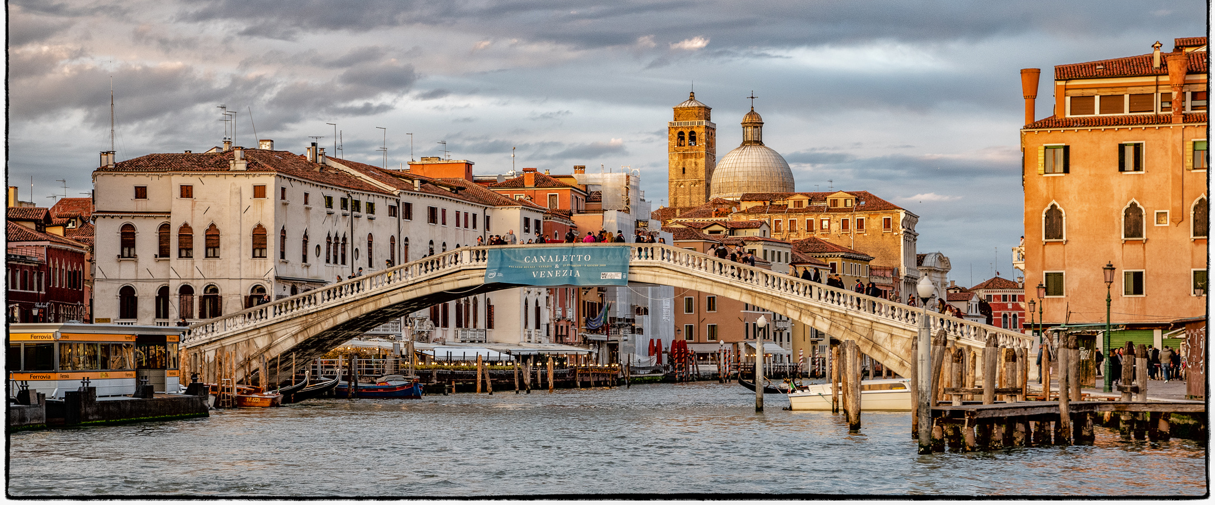
HOW MANY BRIDGE AND ISLAND HAVE VENICE?
The city of Venice is built on 118 islands connected by 354 bridges

Slide 12
Municipal division of Venice
Venice is a city that has 255 926 residents
-The municipality of Venice is divided into 6 municipalities:
-Municipality of Venice-Murano-Burano 60 198 inhab.
-Municipality of Lido-Pellestrina 20 183 inhab.
-Municipality of Favaro Veneto 23 873 inhab.
-Municipality of Mestre-Carpenedo 89 373 inhab.
-Municipality of Chirignago-Zelarino 39 083 inhab.
-Municipality of Marghera 28 645 inhab.

Slide 13
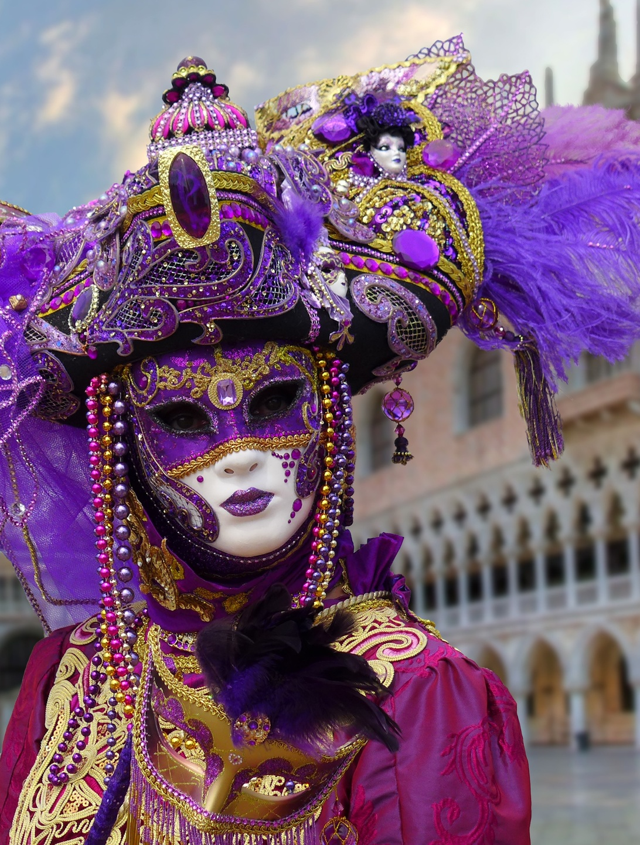
CARNIVAL OF VENICE
The Carnival of Venice is a city festival that takes place annually in Venice. It is one of the best known and most popular carnivals in the world.

