Slide 1
How eco-friendly is our local area
The North Macedonian team

Slide 2
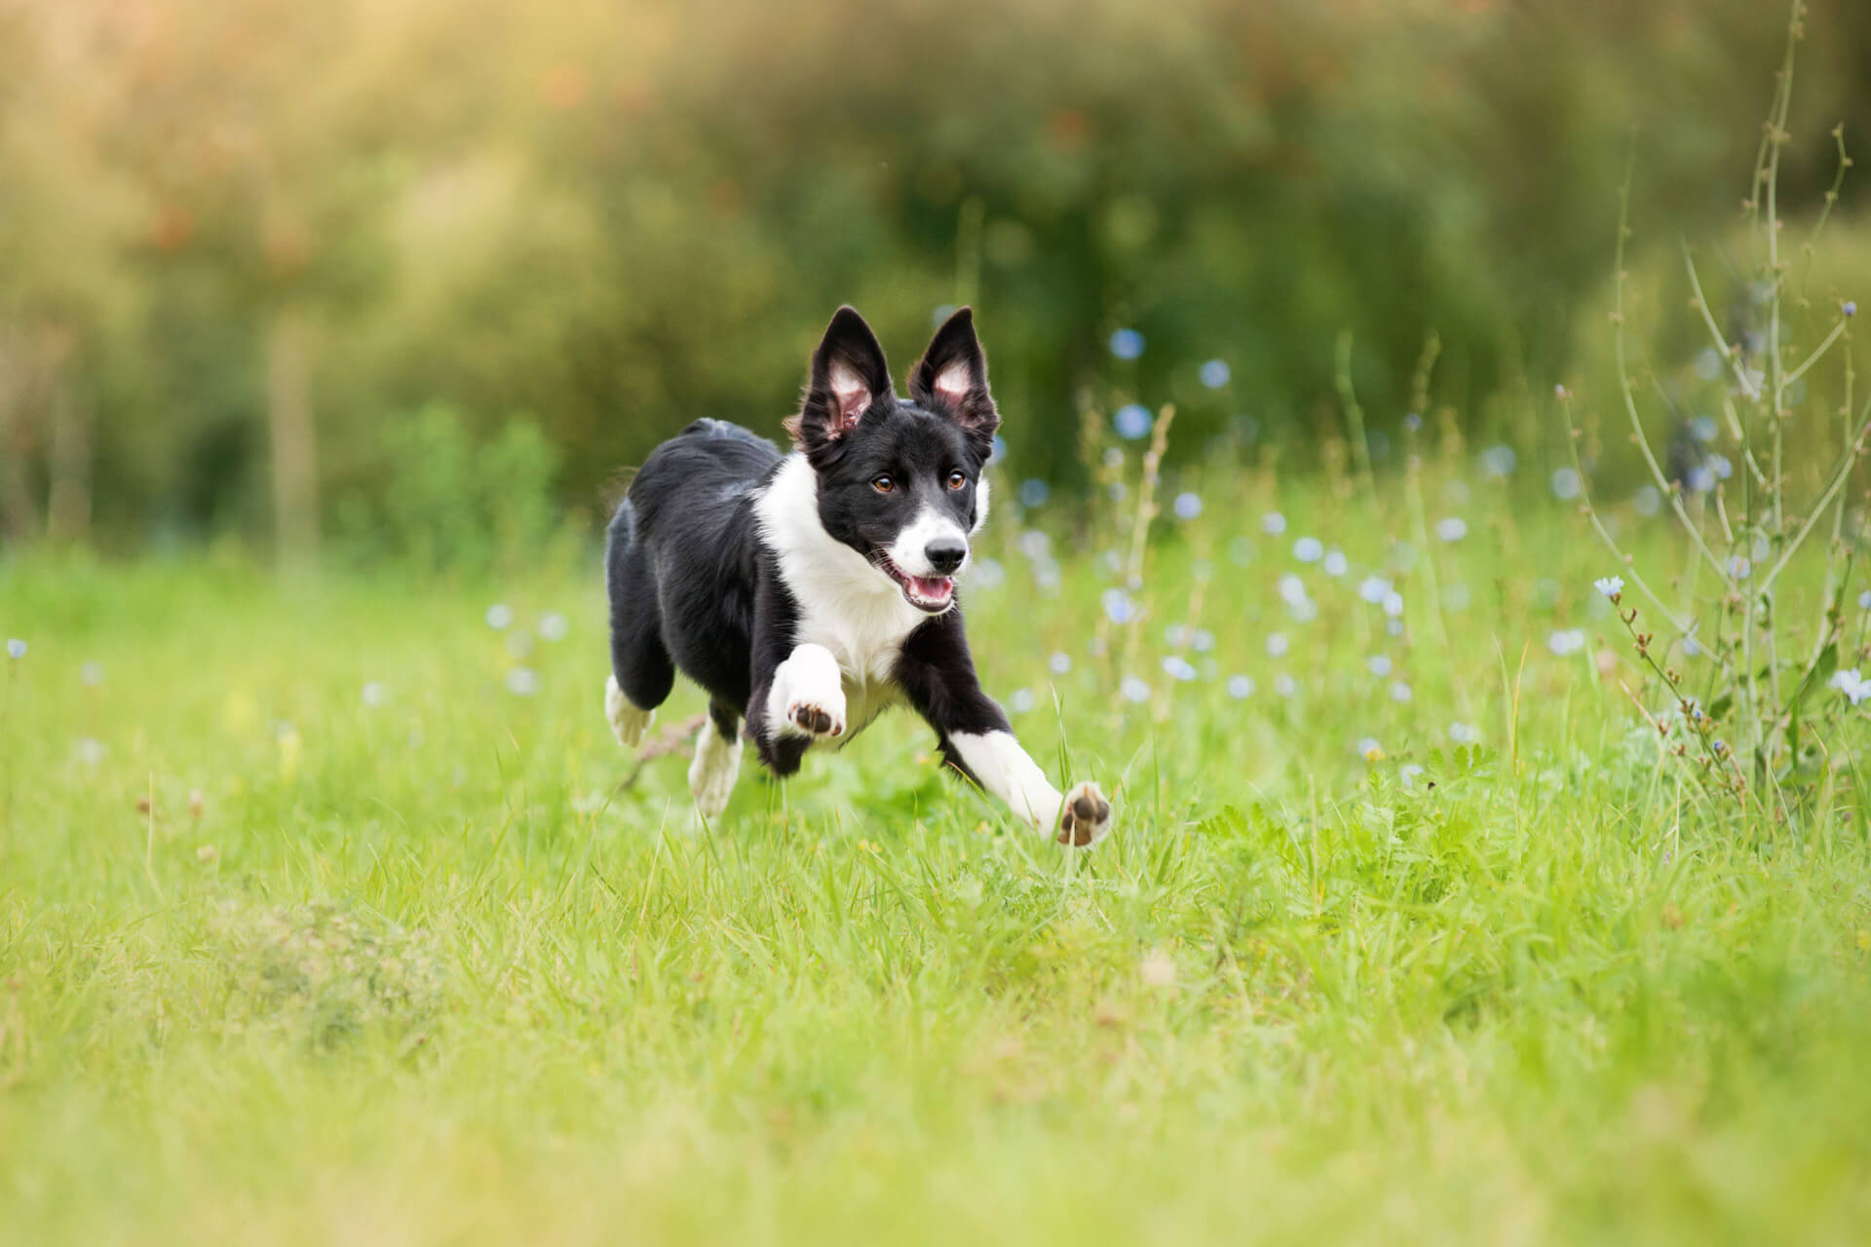
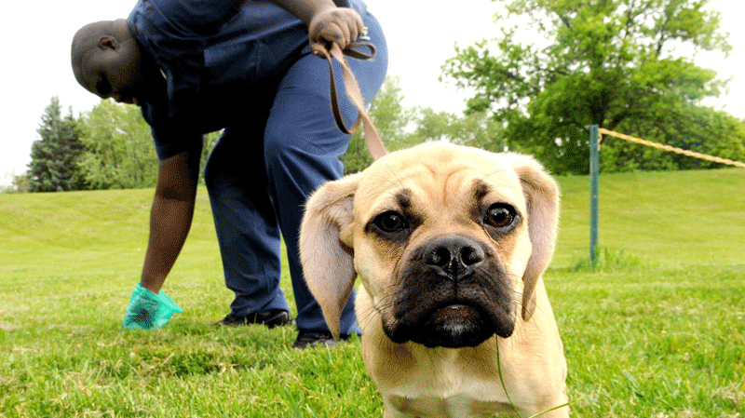
The space for pets
Are you tired of walking your pets tightly tied with a leash?
This question was often asked in the survey questions from our school. Walking the dogs in the school yard is also a problem because they always make mess and the children aren`t safe while playing in the presence of released dogs.

Slide 3
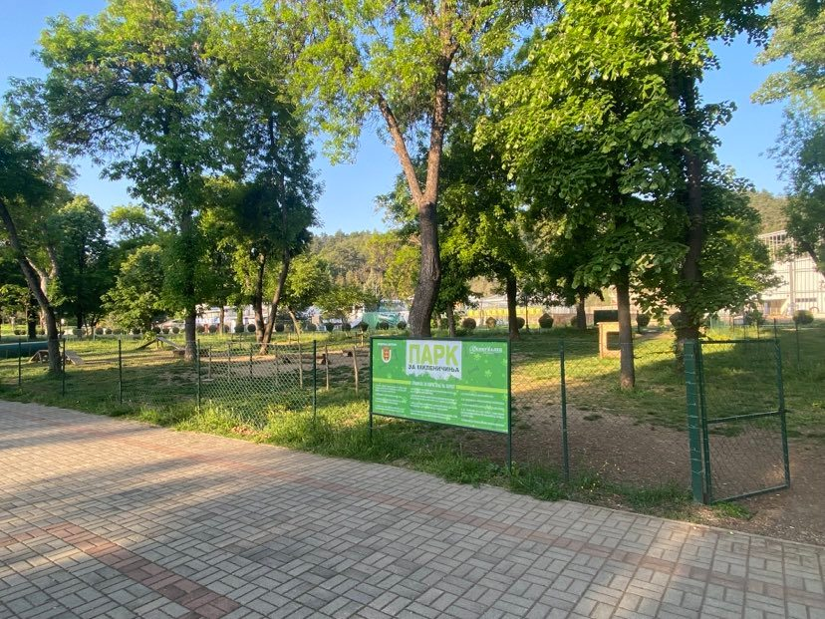
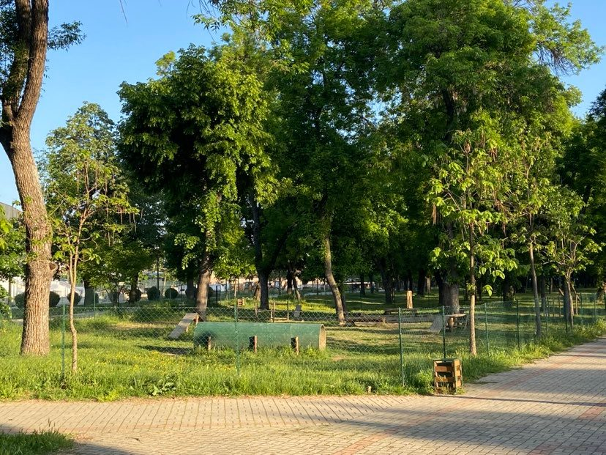
We came to the conclusion that every person needs a space where his pet will walk free, without any danger.
After a while, the news appeared that a pet space has been built in our city. It is located in the City Park in Bitola and every person can visit it and spend some more time with his pet, totally for free.

Slide 4
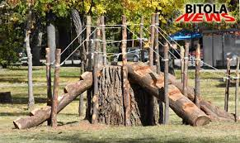
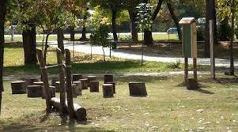
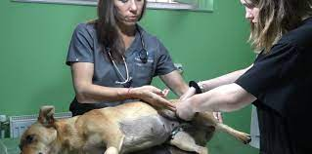
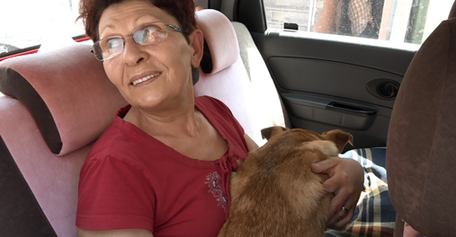
Stray dogs in Bitola
The humanity of the people for all the dogs to be taken care of.
Pavlina Venjanovska, from Bitola who feeds the street dogs around the city. She also takes care of the dogs and their homes.
Pet Park
The woman from Bitola
A park has been built in Bitola, a fenced area with props made of natural materials.
While your dog is playing in the pet park on the other side your children can play in the park made of natural materials.

Slide 5
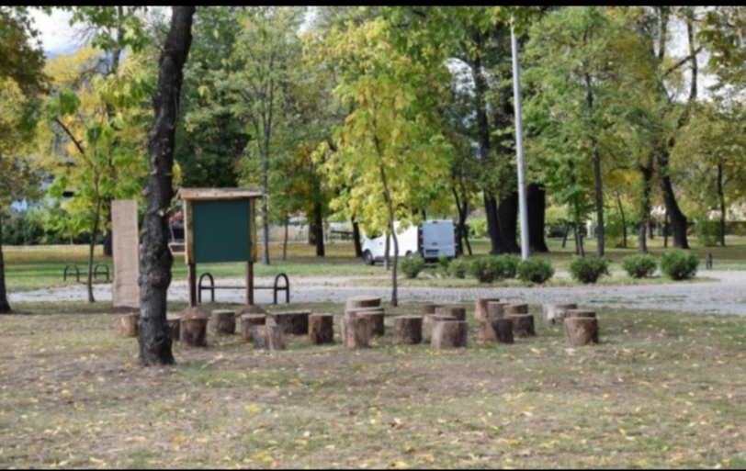
The first park
The first park was built in 2003.It is much larger than other parks, they are intended for walking, running and most of all for rest. It is also located near the city stadium. The park is visited almost all over the Balkans.

Slide 6
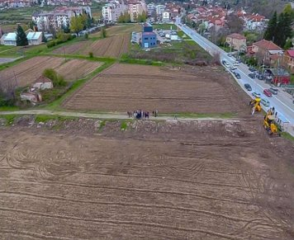
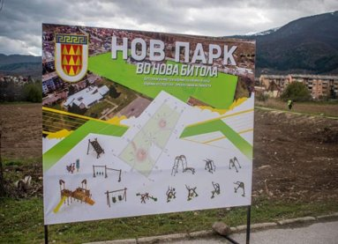
The NEW PARKS ​
Parks are built every year in Bitola, but this year it was decided to build a park that will be intended for more sports, but there will also be a small part for children.

Slide 7
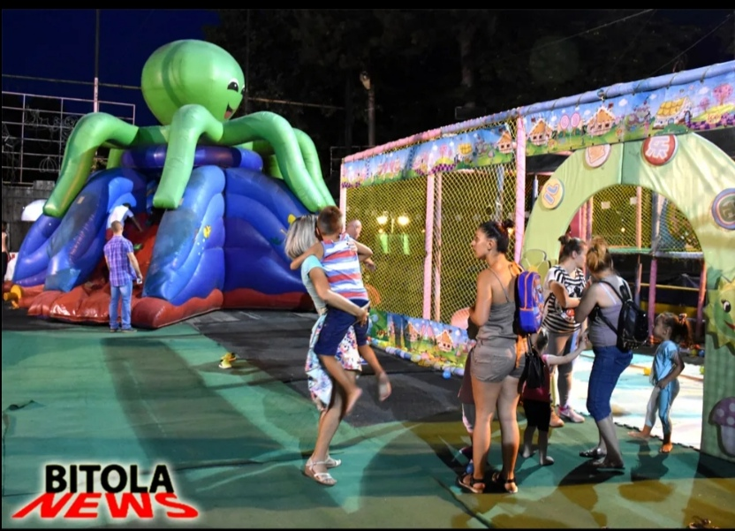
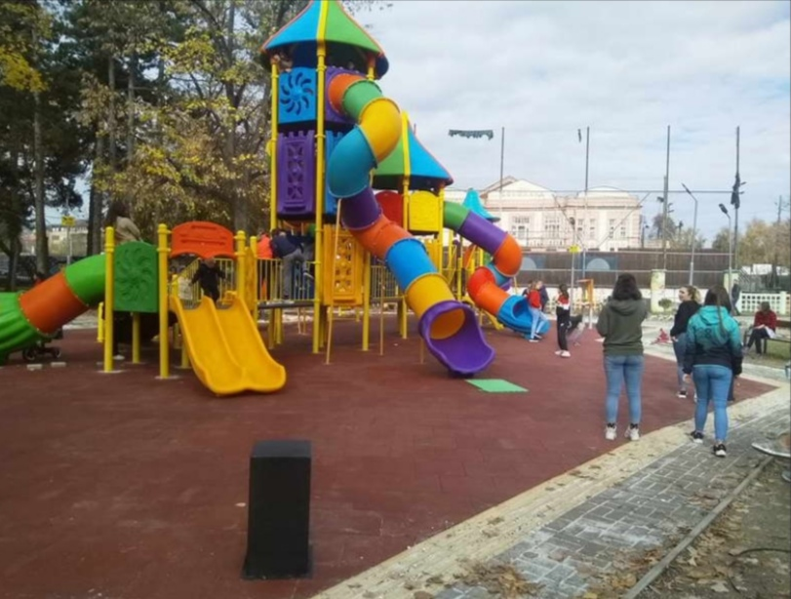
The kids park
In one part of the park there is a smaller park for children under 15 years old. Something more beautiful is added there every year. Two years ago they added a colorful slide, with new swings. And in the summer there are jumping balloons/bouncy castles for small children. Also there is intended small place for indoor soccer and basketball.

Slide 8
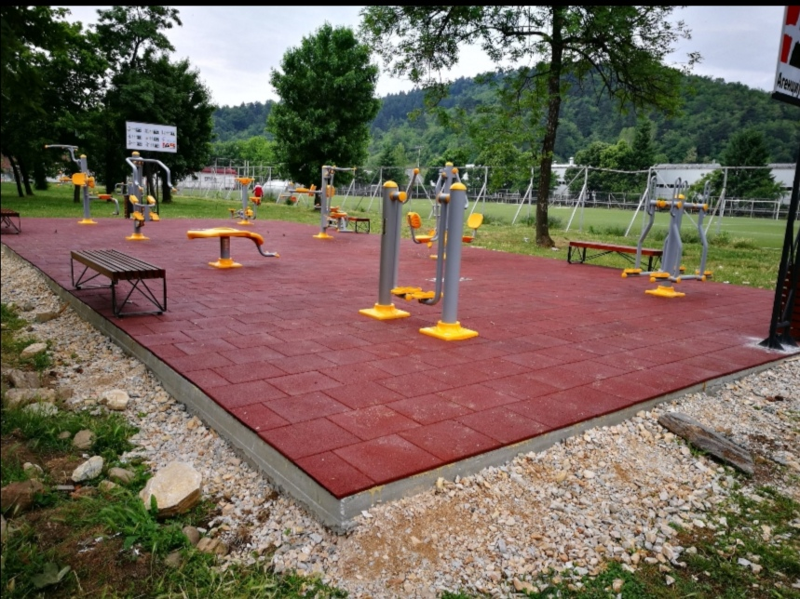
The gym park
And I must not forget to mention that we also have a special exercise park. It is made for young people to go and exercise. There are all kinds of devices in it for exercises for arms and legs.

Slide 9
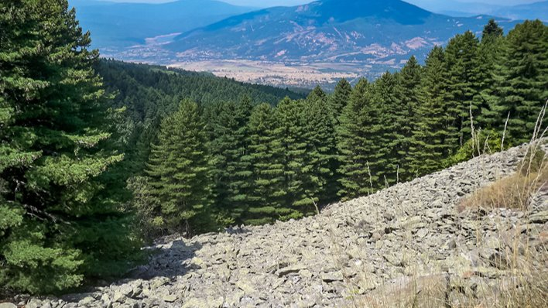
The National Park Pelister​
Pelister - the highest peak of Baba Planina , and with its 2,601m above the sea level , it is the third highest mountain peak in North Macedonia . Often the name of the top Pelister is used as a name for Baba Planina itself and a synonym for the city of Bitola.

Slide 10
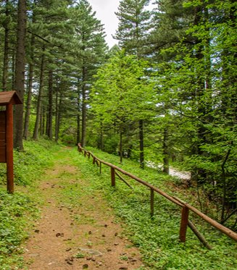
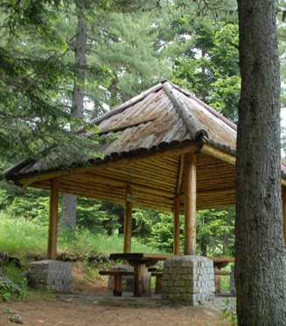
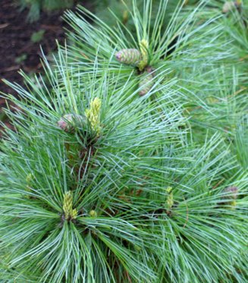
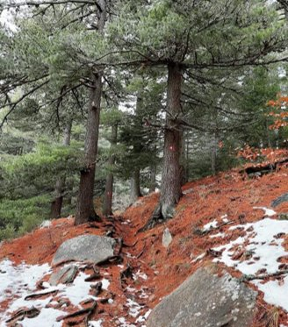
The famous tree Molika
Molika is a symbol of the Pelister National Park on Baba Mountain near Bitola , Republic of North Macedonia . There the moss forests are divided into two communities: the moss forest with fern and the mulberry forest with blueberry .

Slide 11
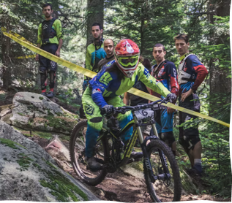
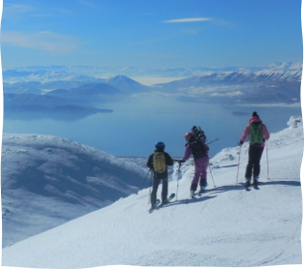
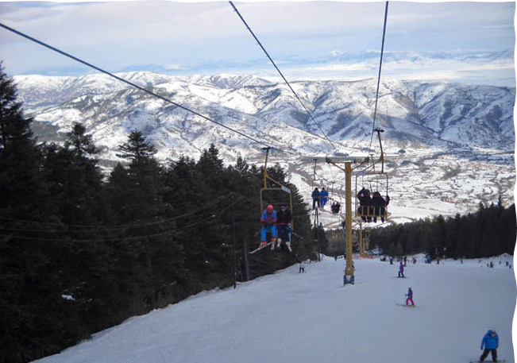
Pelister downhill cup​
Pelister skii center​

Slide 12
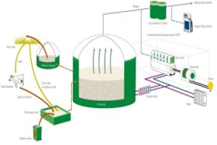
From cow waste to electricity
Do you know that you can make energy from cow waste?
How much energy does cow waste have?
1kg of cow waste can produce 3.75 kwh of electricity - enough energy to power a vacuum cleaner for five hours or 3.5 hours of ironing.

Slide 13
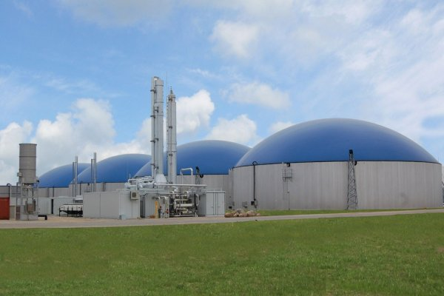
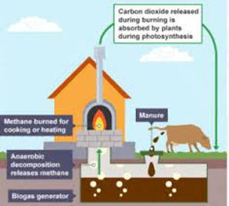
• ZK Pelagonija is a leading company in agriculture in the Republic of North Macedonia.
Zk Pelagonija

Slide 14
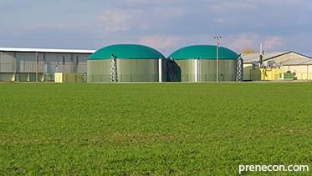
The main activity of the company is agricultural production from: field crops as wheat, barley, oil rapeseed, sunflower, corn grain, corn silage, farming, and the only company in North Macedonia that produces energy from cow waste. ​
​

Slide 15
THANK YOU FOR YOUR ATTENTION ☺

