Slide 1
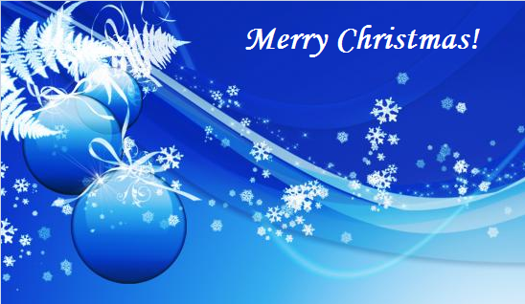
Christmas in Slovakia
Tamara Indrichovičová
Lenka Šušková

Slide 2
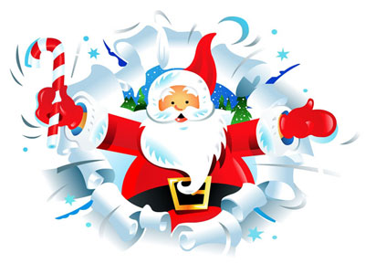

Slide 3
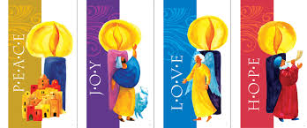
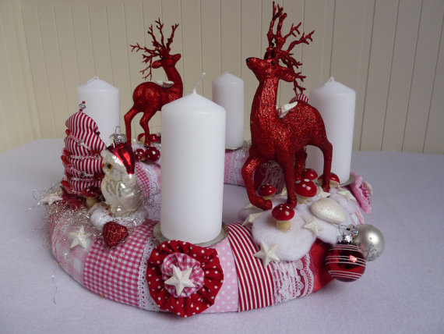
ADVENT
In Slovakia, Christmas
celebrations begin with 4 weeks
Advent. Many Slovaks are Roman
Catholics so this is the start of the important spiritual preparations for Christmas.
During this period, people buy and prepare gifts for their loved ones, decorate their homes with advent wreaths with four candles corresponding to the number of Sundays of Advent.
Each Sunday they light one of the
candles and on Christmas Eve table
there are all four candles burning
on the wreath.

Slide 4
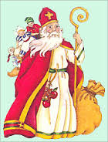
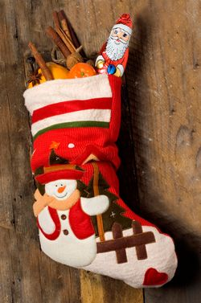
ST.NICHOLAS
Slovaks also celebrate St. Nicholas' day
on the 6th December. In Slovakia he is known as sv. Mikulas. He comes in the evening of the 5th December and gives presents
to good children. Young children
place their shoes near the door so
sv. Mikulas can fill them with
sweets and fruit.

Slide 5
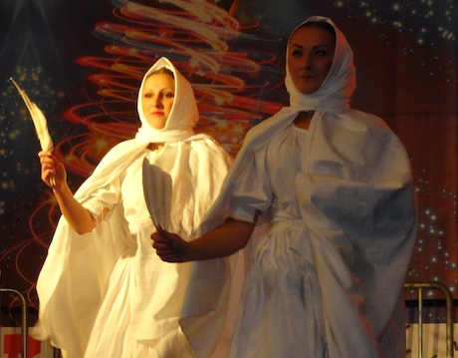
St. LUCY´ S DAY
People in Slovakia
Celebrate St. Lucy´s day
on 13th December. It is the
Shortest day of the year, so it is associated with magical practices that protect home and family from witches. People believe that Lucia was the most powerful witch. This day means " keeping bad luck from home." On this day you can see girls in white dresses with a white veils on their faces. In one hand they have got basket with sweets and in second a brush of feathers. They sweep dust from home with the feathers.

Slide 6
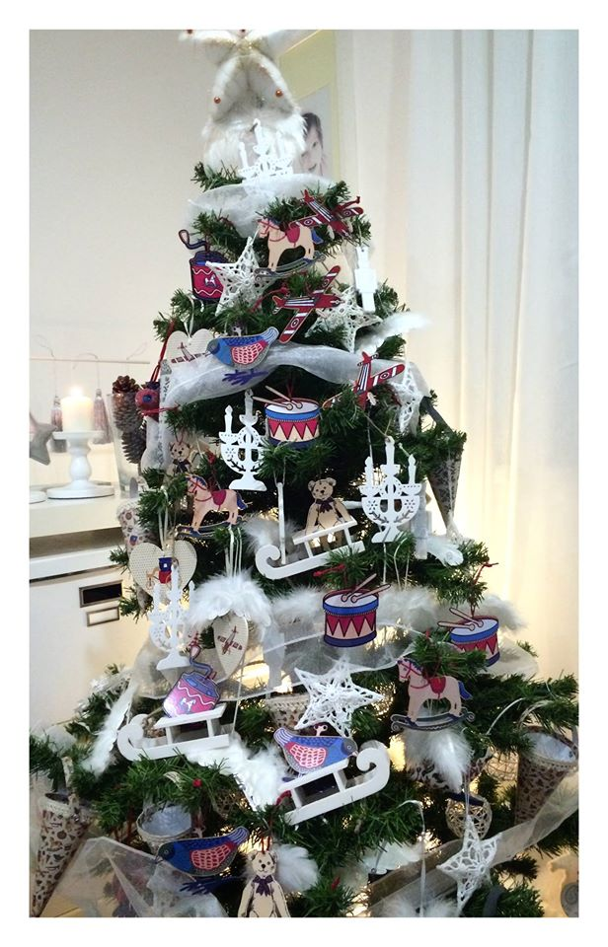
CHRISTMAS TREE
Slovak Christmas Trees are decorated with coloured lights, fruits, hand-made decorations made of wood, baked goods made with honey in the form of Angels and other religious symbols and sweets. Christmas Trees are kept until January 6th, Feast of the Three Kings.

Slide 7
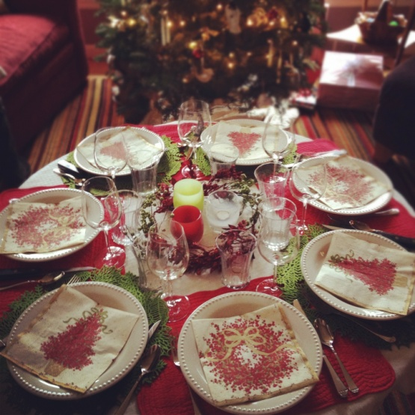
Christmas Eve /24th December/
Christmas Eve is the most amazing day for children in Slovakia. There are a lot of traditional habits in our country. No lights should be lit in the house before the first star comes out. If anybody eats before the star he won´t see the golden pig. When evening finally comes, the dinner is served. If the number of people around the Christmas table was odd, an extra plate should be used and also an extra plate should be prepared in case an unexpected guest or a person in need comes by the house at the dinner time.

Slide 8
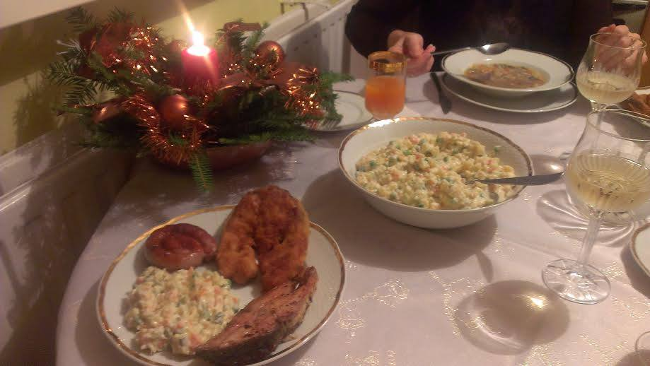
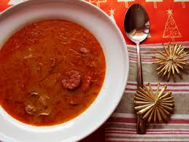
Christmas dinner
Christmas dinner starts with the prayer or with a celebratory drink.We eat a carp with potato salad, a special sauerkraut soup with sausages and mushrooms, lentil or fish soup, wafers with honey, garlic (to ward off demons), dried fruit, nuts, apples and ,,opekance’’ – small pieces of dough – with poppy seed and honey. Menu varies a bit in different regions – some families prefer lentil soup with dried plums, but the fish is served in almost all families as a symbol of Christianity

Slide 9
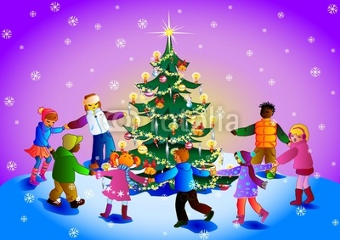
CHRISTMAS TRADITIONS
After dinner a parent rings the bell and everyone rush towards the tree to find presents from a little Jesus. In some families people sing Christmas carols around the Christmas tree.

Slide 10
After supper people might visit the close family or neighbors and give small gifts. Then many people will go to a Midnight Mass Service. This is the busiest Church service of the year.
In Slovakia there are many regional variations of the Christmas Eve celebrations. Some are local folk custom and rituals, that date back many years. One tradition is to clean the house and windows ready for Christmas.
Christmas Day and Boxing Day (26th) are much quieter and days of rest. People might go to Holy Mass Service and visit their family on Christmas Day. Families with children like to go to church and watch 'Bethlehems' (crib scenes) which are displayed in almost every church. Some of them are mechanical!

Slide 11
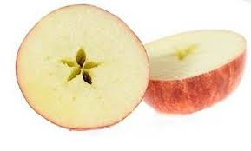
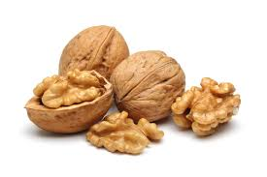
24th (Christmas Eve).On Christmas Eve we usually adher these traditions:
1.We cut an apple before dinner. When the seeds inside are
shaped as a star, all members of the family would be healthy and well, but if they are shaped as a cross, there would be a loss in the family.
2.We throw walnuts into the corners of every room, in order to ensure good luck for the coming year.
3. People also put the carp scale or some
money under the table for the luck and wealth.

Slide 12
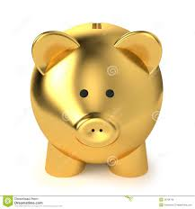
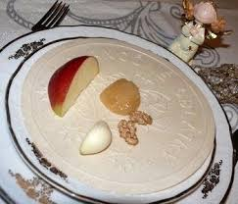
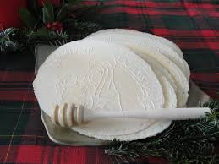
4.If we don´t eat all day before Christmas dinner, we can see a golden piggy. Little kids believe in that.
5.At the beggining Christmas dinner we eat
oplatky (wafers)with honey and garlic in order to be healthly
6. After dinner a parent rings the bell and everyone rush towards the tree to find presents from a little Jesus. In some families people sing Christmas carols around the Christmas tree.
.

Slide 13
Christmas Day /25th December/
Christmas or Christmas Day is an annual commemoration of the birth of Jesus Christ, celebrated generally on December 25 as a religious and cultural holiday by billions of people around the world. Christmas is a civil holiday in many of the world's nations, it is celebrated by an increasing number of non-Christians. This holiday plays a major role in the Roman Church.
Since the Reformation, Christmas is celebrated one day in advance. That means it’s on Christmas Eve, but the 25th and 26th of December are also days of worship of Jesus Christ.

Slide 14
Boxing Day /26th December/
Christians connect 26 December with the death of St.Stephan, who was stoned to death for his belief in 33 A.D.
In many villages and towns it is customary to hold a dance celebration on Boxing Day. Young people feel bored after two days spent together in the
family circle, so they need to have some fun. Families are going to visit their close friends and other family members. People usually spend this day with friends together with good music and wine

Slide 15
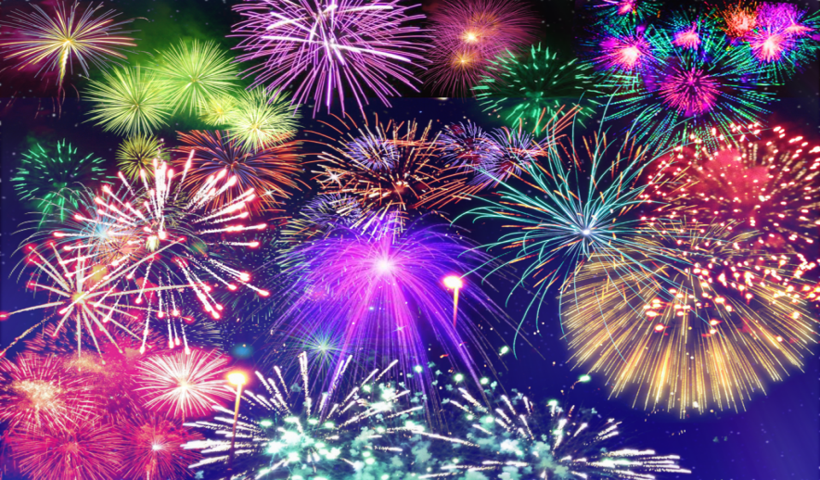
New Year´s Eve /31st December/
People in Slovakia celebrate the end of the year on 31st December. It is called Silvester. People usually eat soup, but they don’t eat fish or chicken, because they believe that eating something able to swim or fly brings bad luck. In the evening people usually have a party with their friends. They dance , play games or talk .
At midnight many youngsters come out in the streets or in the main square and begin to shoot fireworks. All people are watching the fireworks. Some fireworks are beautiful. Some people drink alcohol. Children can have some orange juice.
People keep awake until morning
and wish their family and friends
good luck with the new year.

Slide 17
Quiz for you ☺
http://LearningApps.org/watch?v=pdu08gern15
http://LearningApps.org/watch?v=pg1n2twin15
http://LearningApps.org/watch?v=p72z0odw215

