Slide 1
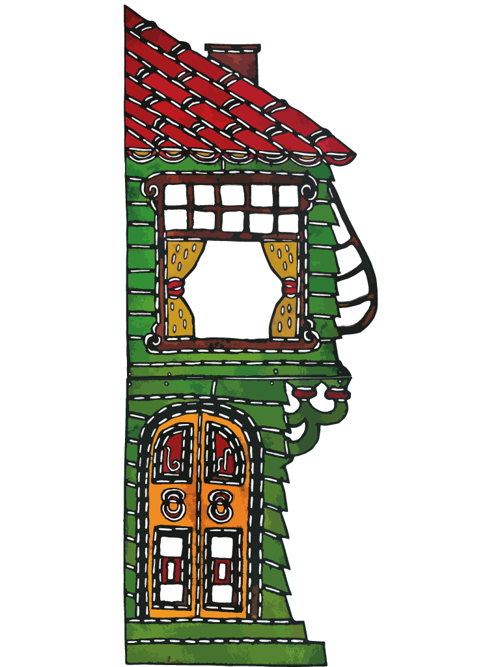
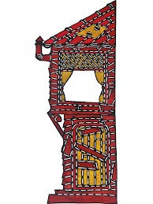
Traditional Turkish Shadow Puppetry
Karagöz’üm the kids’re curious about us.
Okay then. Let’s introduce ourselves.

Slide 2
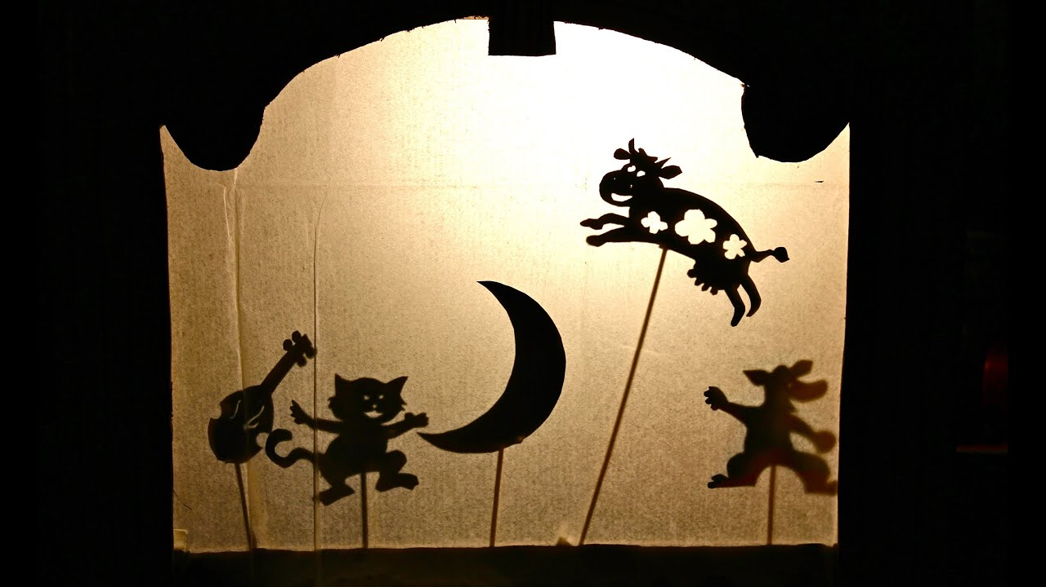
General Information

Slide 3
Shadow play, also known as shadow puppetry, is an ancient form of storytelling and entertainment.

Slide 4
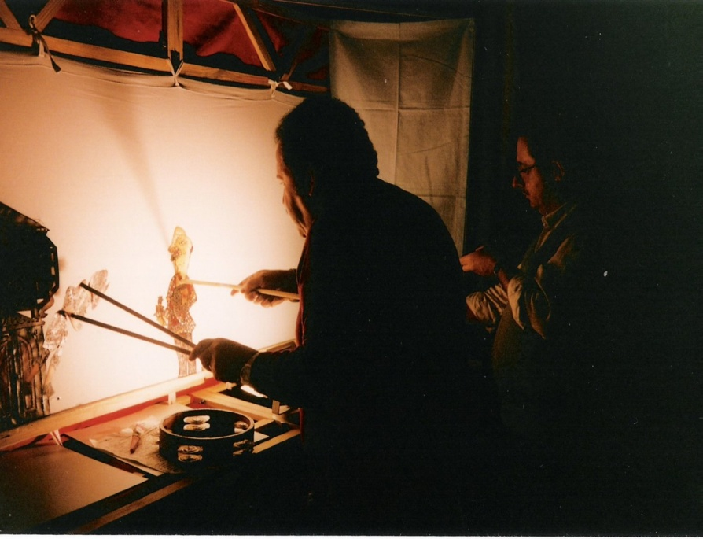
Shadow puppetry is considered the oldest form of puppetry in the world. It began 1,000's of years ago in China and India.
Turkey and Greece also have a history of shadow puppetry, where plays are based on everyday life and contain much physical comedy.

Slide 5
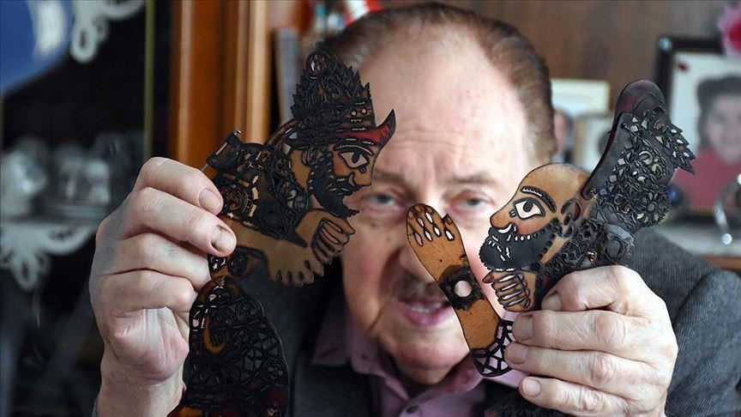
Shadow puppetry uses flat articulated cut-out figures (shadow puppets) which are held between a source of light and a translucent screen or scrim.

Slide 6
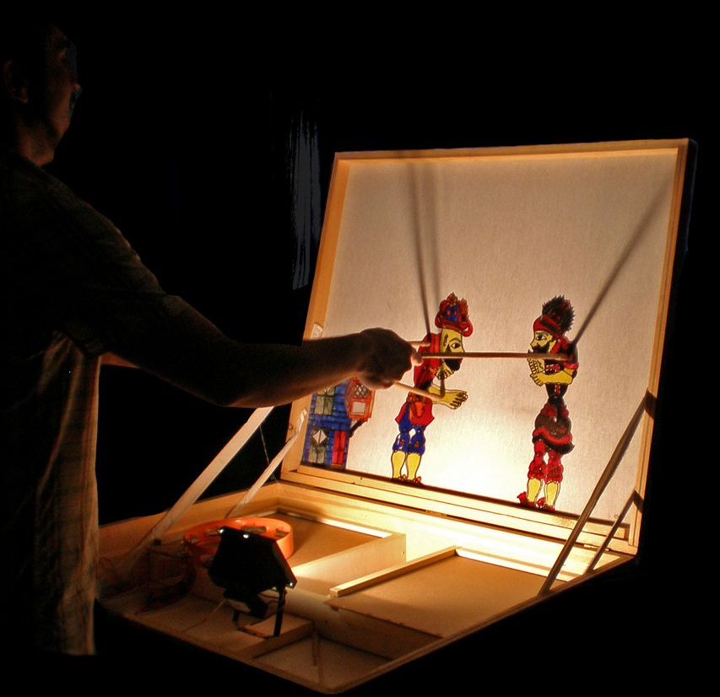
Various effects can be achieved by moving both the puppets and the light source. A talented puppeteer can make the figures appear to walk, dance, fight, nod and laugh.

Slide 7
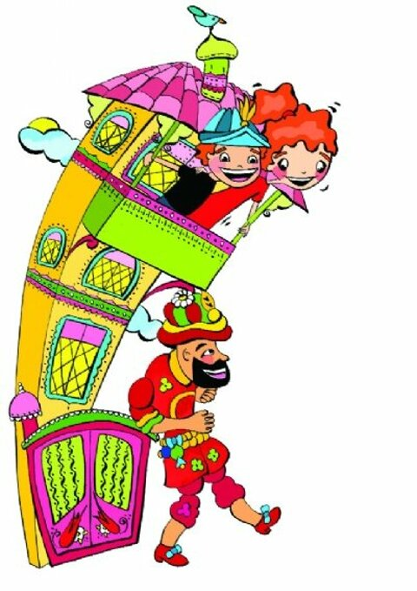
Traditional Turkish Shadow Puppetry: Hacivat and Karagöz

Slide 9
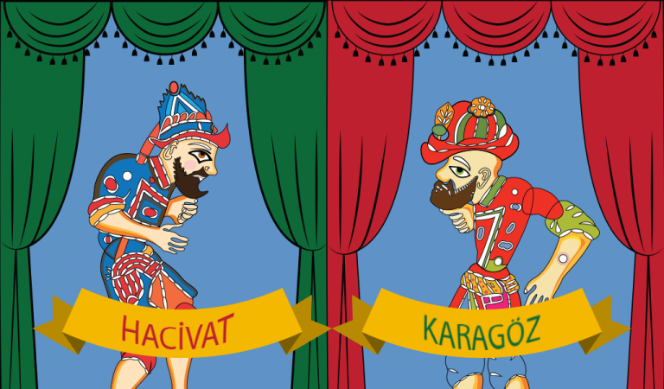
Karagöz and Hacivat are the lead characters of the traditional Turkish shadow play, popularized during the Ottoman period and then spread to most nation states that comprised the Ottoman Empire and most prominently in Turkey and Greece.

Slide 10
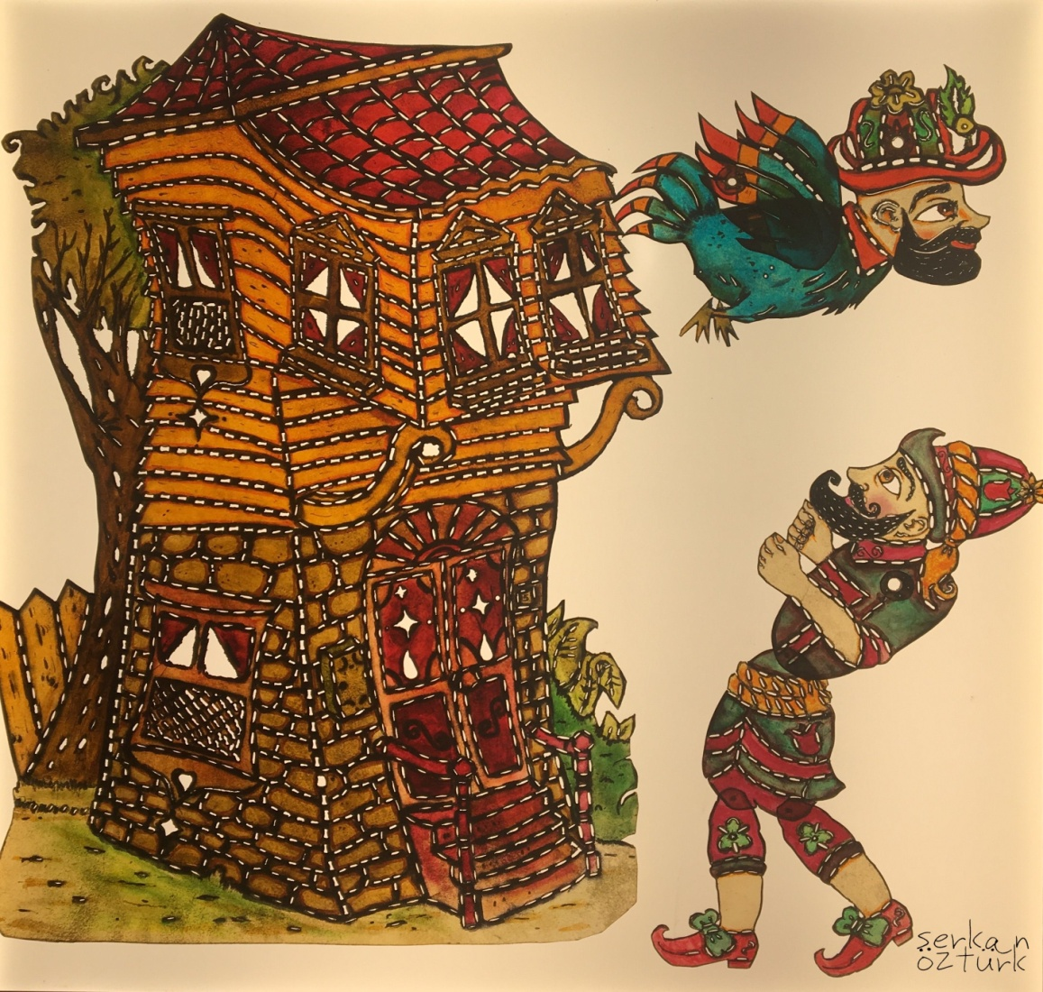
Karagöz is a shadow play performed by an artist and is based on the funny dialogues and squabbles between Karagöz and Hacivat. The comical effect is achieved by the plays on words, dances and movements.

Slide 11
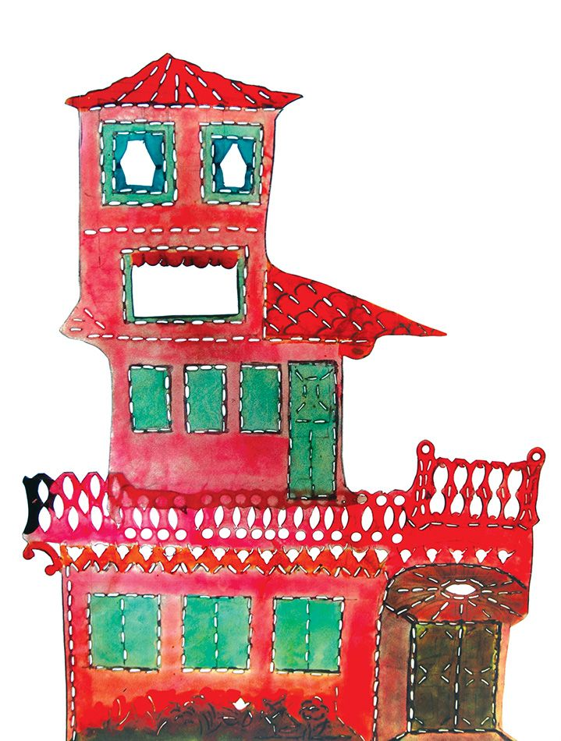
The Karagöz play consists of four parts:

Slide 12
1. The Prologue (Mukaddime)
Hacivat comes on stage singing a semai (a popular tune), and after reciting the curtain poem, he calls for Karagöz, and they have an argument.
The curtain poem that Hacivat recites in this section emphasizes the philosophical and mystical meaning of the play by depicting it as an educational tool and gauge of truth.

Slide 13
2. The Dialogue (Muhavere)
This part focuses on the personalities of Karagöz and Hacivat and how opposite they are. It contains concrete repartee that is separate from the sequence of events
based solely on verbal exchanges between Karagöz
and Hacivat. The muhavere may also be presented
as a rhyme.

Slide 14
3. The Play (Fasıl)
This section contains the actual story and where the other characters make their appearance. The play is named based on the subject matter addressed here. At the end of the fasıl, the other characters leave the stage to Hacivat and Karagöz.

Slide 15
4. The Epilogue
In the final act, Karagöz and Hacivat beg the audience’s forgiveness for the jokes and misunderstandings in the play and announce the next play.

Slide 16
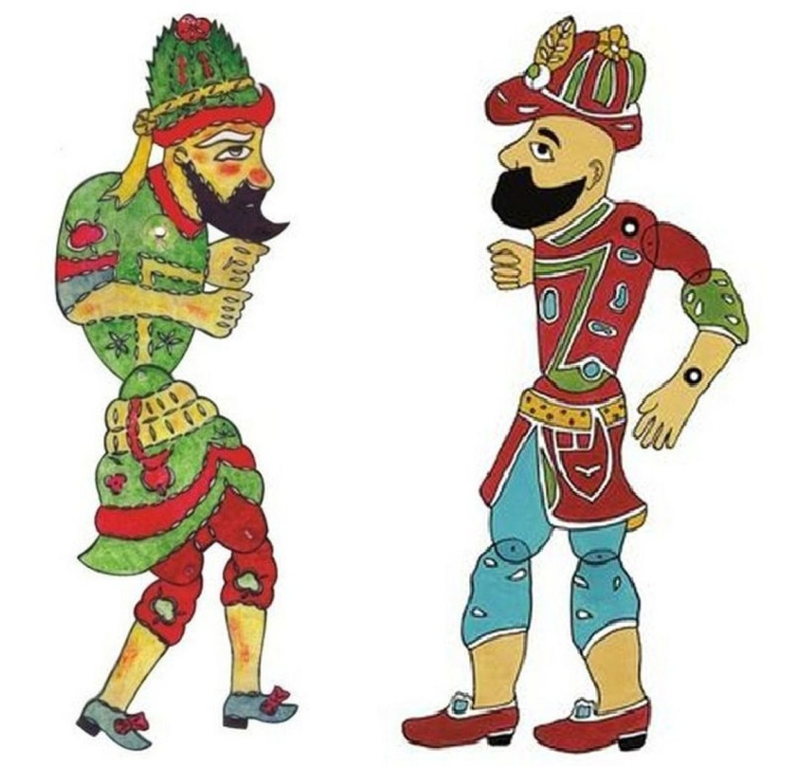
The Characters:

Slide 17
The lead character Karagöz is a realistic commoner who is uneducated, brave, and transparent with his emotions, gets angry and fights at the drop of a hat, but cannot tolerate hypocrisy and lies.
He does not understand what educated characters like Hacivat say, or pretends not to understand, and he misinterprets them.

Slide 18
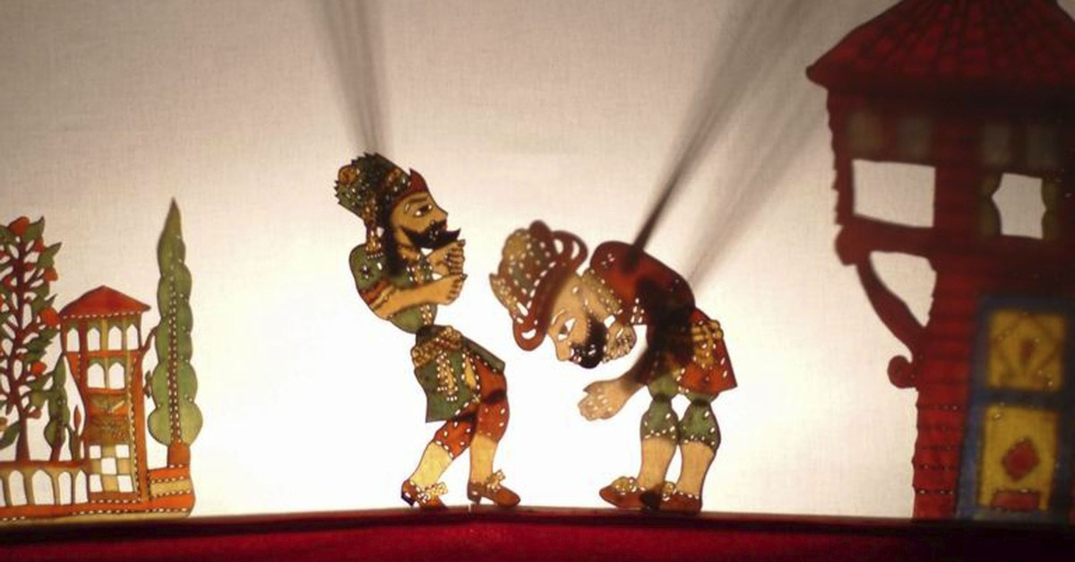
These contrasts result in a variety of comical situations. Karagöz is frequently in trouble because he sticks his nose into everyone’s business and is very blunt, but by the end of the play he finds a way to get out of his troubles.

Slide 19
Hacivat, on the other hand, is the exact opposite of Karagöz. He is a shrewd man of education who is very knowledgeable, speaks well, is consulted for advice by the entire community, and accepts the status quo,
but he is sneaky, tells people what they want to hear, and puts his own interests first. He employs Karagöz and tries to exploit him to make a living.

Slide 20
Around Karagöz and Hacivat revolve a line up of extreme comic stereotypes. Some of them are..

Slide 21
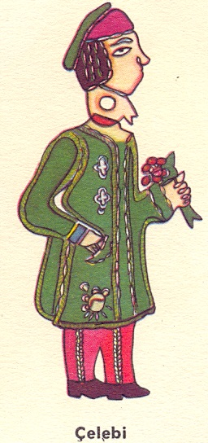
Çelebi, who can be described as a gentle family kid, speaks Ottoman Turkish. He is rich but the source of his wealth is heritage. He loves to read poetry, dresses well and speaks well.

Slide 22
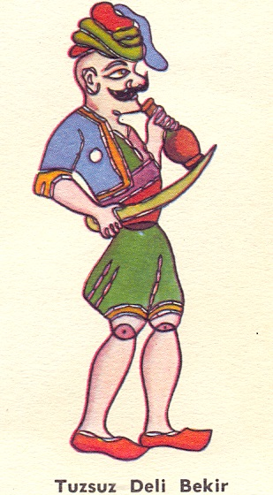
Tuzsuz Deli Bekir, the bully of the neighborhood (according to some a valiant young man). He punishes the criminals and establishes the order in the neighborhood. He’a always ready to fight.

Slide 23
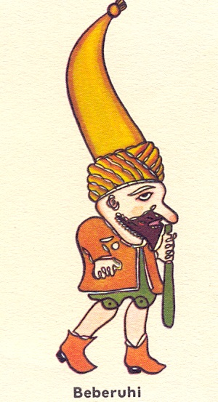
Bebe Ruhi, the dwarf character who asks the same questions over and over again until people become tired of listening to him. He can do feats of strength despite his small size and stupidity.

Slide 24
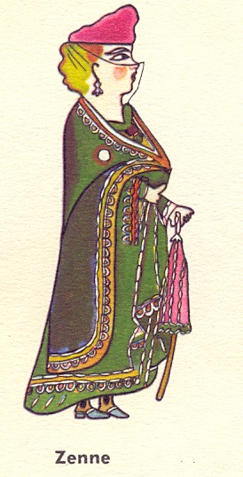
Zenne, generally Karagöz’s wife who doesn’t speak much.
P.S. Women characters in the play can be at any age but always prone to gossip. In almost every play, this character causes a scandal in the neighborhood.

Slide 25
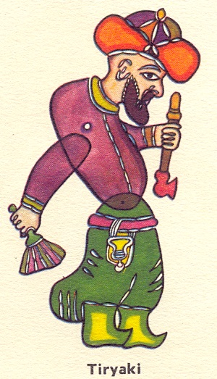
Tiryaki (addict in Turkish) is the opium addict one who spends all his time smoking opium and sleeping in the neighborhood coffee house.

Slide 26
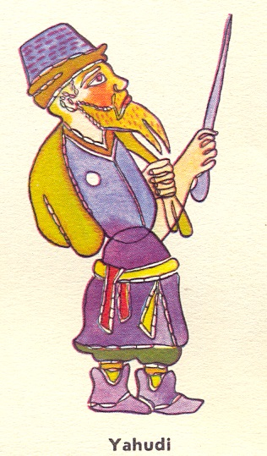
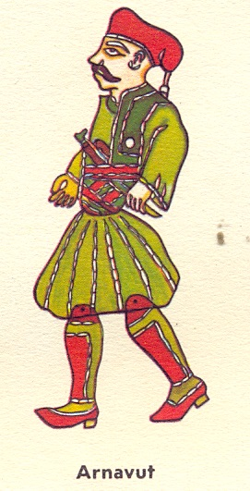
The Jew (Yahudi), a junk dealer, goldsmith and money lender, portrayed as stubborn and a haggler.
Arnavut (from Albania), itinerant tradesman/street vendor, gardener, rural policeman or horse dealer.

Slide 27
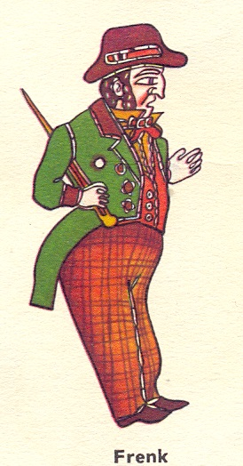
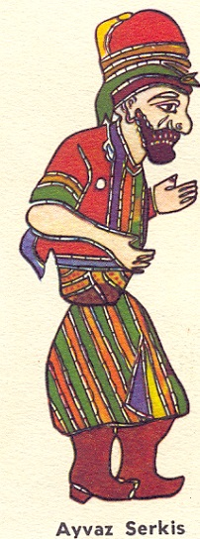
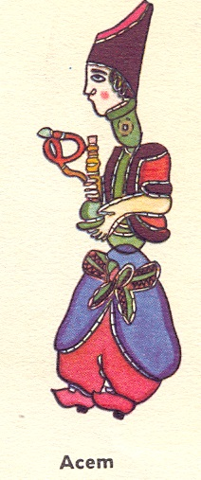
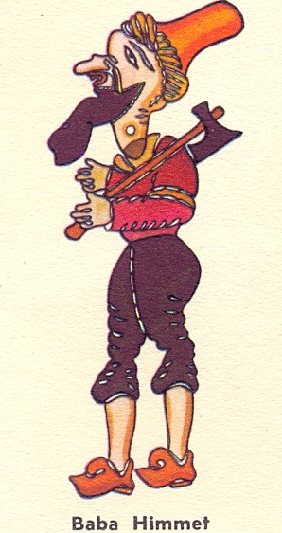
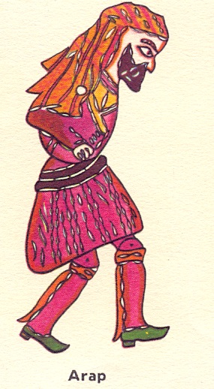
These figures and the others support the plays as side characters, by this way, the style of the people in the country's geography at that time is carried to the stage.

Slide 28
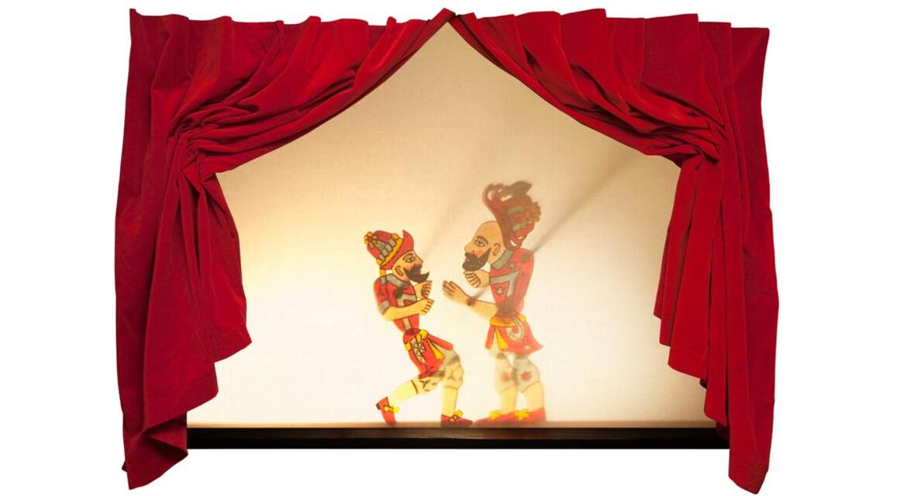
Karagöz Performers:

Slide 29
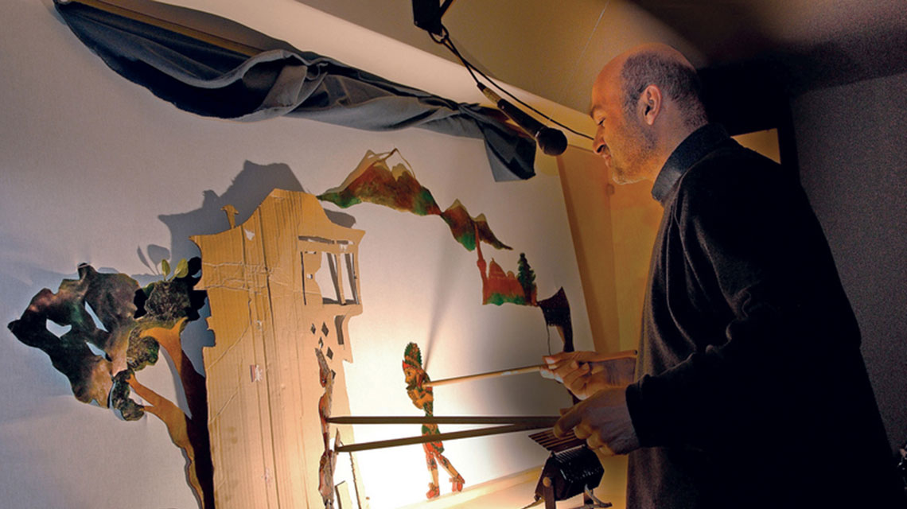
A single hayali, the puppeteer impersonates every single character in the play by mimicking sounds, talking in different dialects, chanting or singing songs of the character in focus.

Slide 30
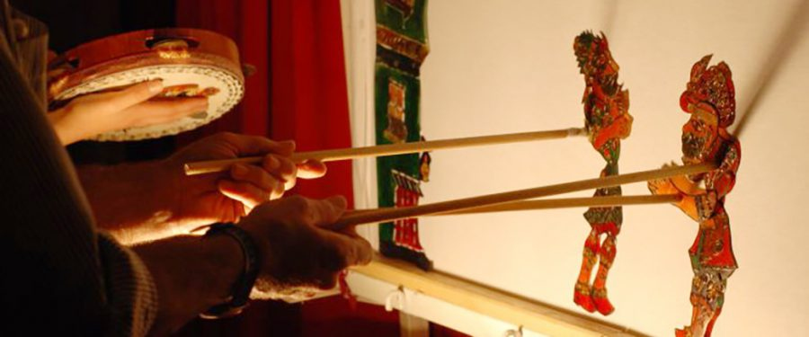
An apprentice, called the sandıkkâr, assists the puppeteer by handing him the puppets in the correct order and setting up the theatre before the show.

Slide 31
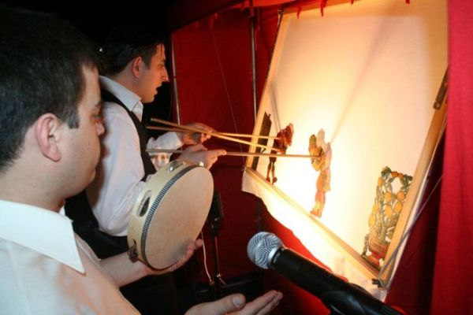
A singer, or yardak, might sing a song in the prelude, but the yardak is never responsible for voicing a character. The yardak may be accompanied by a dairezen on a tambourine.

Slide 32
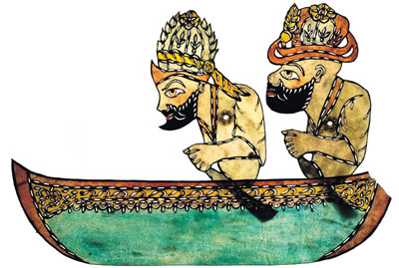
Who were Karagöz and Hacivat?

Slide 33
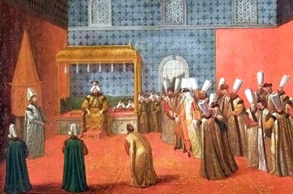
According to one Turkish legend, the first performance of Karagöz occurred when a lowly commoner visited the sultan. Rather than simply making a complaint, as most commoners did, he put on a short puppet show to tell a tale about the sultan's corrupt officials.

Slide 34
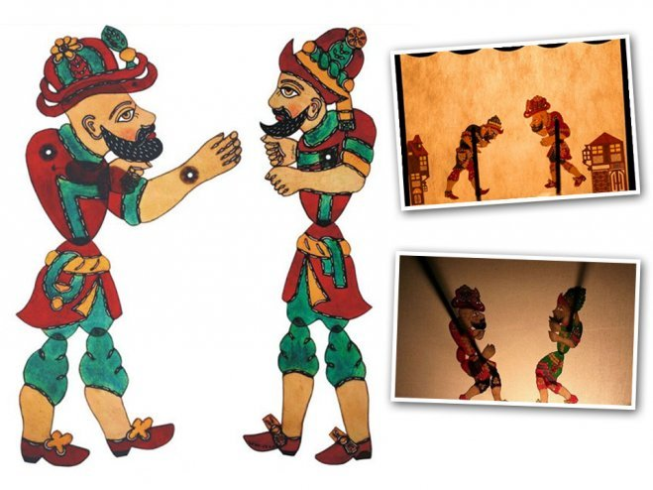
The myth states that
the sultan was delighted
by the performance so
much that he appointed
the puppeteer as his
Grand Vizier and punished
the corrupt officials that
had inspired the puppeteer's tale.

Slide 35
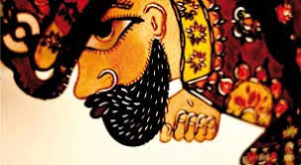
Especially, Karagöz and Hacivat plays were used as a fun way to voice social problems and complaints.

Slide 36
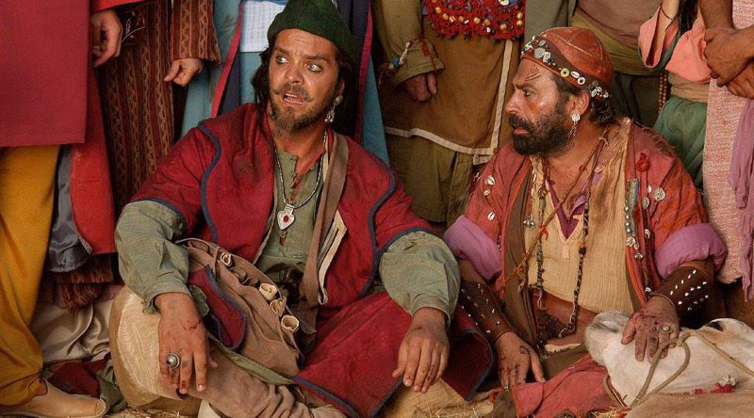
Another story is that the two main characters, Karagöz and Hacivat were actual people. These two legendarily clownish individuals were construction workers on a mosque in Bursa sometime in the mid-14th century.

Slide 37
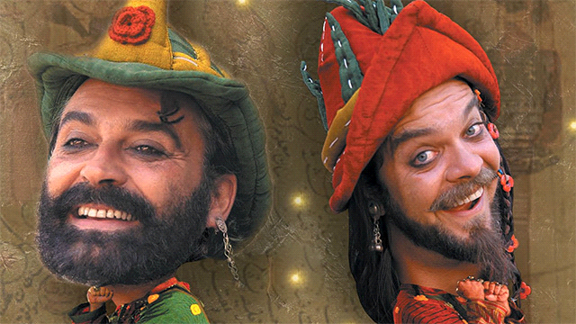
Their silly antics distracted the other workers, slowing down the construction, and the ruler at the time ordered their execution. They were so sorely missed that they were immortalized as the funny puppets that entertained the Ottoman Empire for centuries.

Slide 38
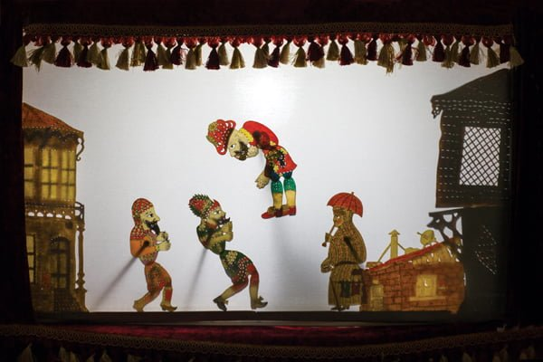
This old Turkish traditional art of entertainment reflects the most entertaining memories of Turkish culture that have accumulated for centuries.

Slide 39
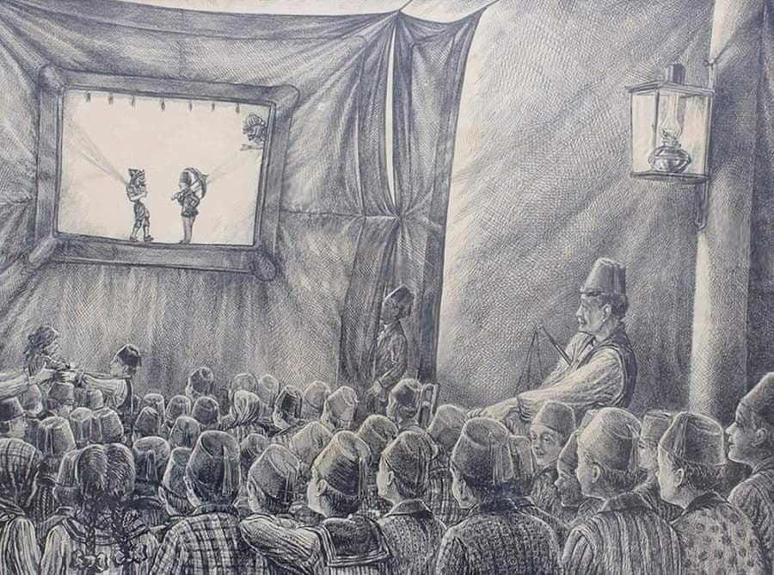
The plays are especially associated with the Ramadan in Turkey. After a day of fasting, people go to the coffeehouses to see Karagöz plays that drew large crowds.

Slide 40
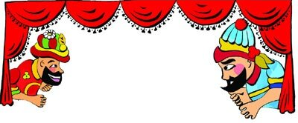
Above all, Karagöz and Hacivat represent the quick wit and educated side of society, and social tolerance.
We should not forget that even the biggest problems can be resolved with the right tone, tolerance and understanding.

Slide 41
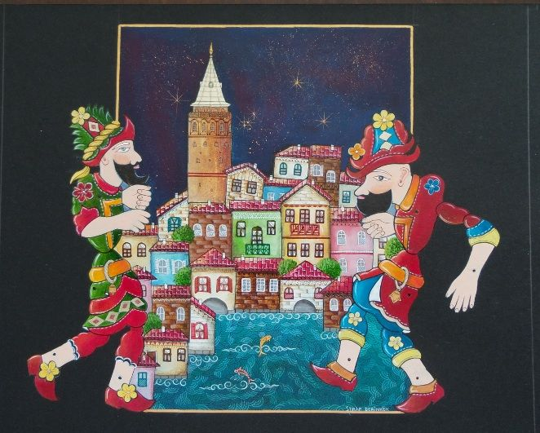
QUIZ TIME!

