Slide 1
Ernő Szép:Play
Made by Zsófi Beke, Bori Varga, Lilla Lakatos, Szabina Vig and Petra Szima

Slide 2
Content
The poem
About the poem
About the poet

Slide 3
Play
No story books — that was the rule — I only had the books from school. How nice to sit at home at night, At home at night, At home at night, To turn the pages by lamplight!
I never played with coloured bricks Or little castles, towers or ricks, With farms or ships or little trains, Or little trains, Or little trains. I couidn't cross the boundless plains.
When I was young, with life and force, I never had a little horse, I never sat a pony's back, A pony's back, A pony's back, Galloping proudly down the track.
I never owned a pony fine, A bicycle was never mine, With spinning wheels that shone like pride, That shone like pride, That shone like pride — How nice to take a summer ride!

Slide 4
Play
Nobody gave me swords or hats, Or telescopes or ping-pong bats, Or took me to the circus tent, The circus tent, The circus tent — Luckily the canvas had a rent.
That canvas now has rotted through, . And vanished is my childhood too. Yes, I grew up so Iong ago, So Iong ago, So Iong ago, l've grown up, as all men must grow.
Now I no longer want a toy — My troubles all my thoughts employ. But time will come when I must die, When I must die, When I must die, And I shall go up to the sky.
On the great Milky Way l'H stand, And as God passes raise my hand — As children ask for leave to talk, For leave to talk, For leave to talk — When God the Milky Way does walk.

Slide 5
Play
And God will see me there, so meek. And softly, quietly, I shall speak: "In my whole life I never played, I never played, I never played, Now let me play, as I once prayed.„
Then by the hand He'll take me there, The angels singing everywhere, Into the bright poor children's home, Poor children's home, Poor children's home, A nursery and a pleasure dome.
There shall I find my sword, my hats, My telescopes and ping-pong bats, My story book, my coloured bricks, My coloured bricks, My coloured bricks, My castles, towers, my farms and ricks.
All that I missed, there I shall find, My little trains and ships, each kind. They'll take me to the circus too, The circus too, The circus too. No canvas to obscure the view.

Slide 6
Play
And if I ask, all sadness gone, They'll put my pony's saddle on, My bicycle they'll fetch to ride, They'll fetch to ride, They'll fetch to ride, All up and down the riverside.
In meadows full of evening sun Forgóidén butterflies l'H run, Their gold dust will my fingers stain, My fingers stain, My fingers stain — l'H never wash it off again.

Slide 7
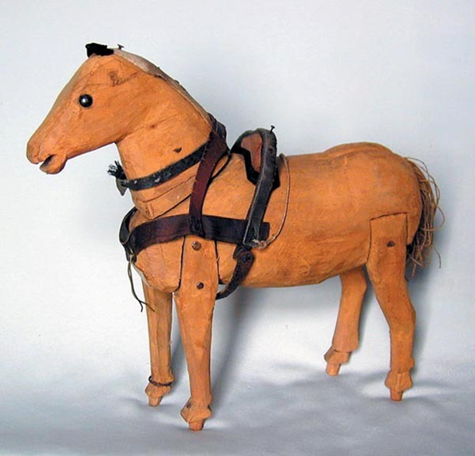
About the poem
In his most famous poem, in the Children’s Game we can experience how bemused he was. His rhymes are exact and clear. His poems show calmness, peace, love and sensibility.

Slide 8
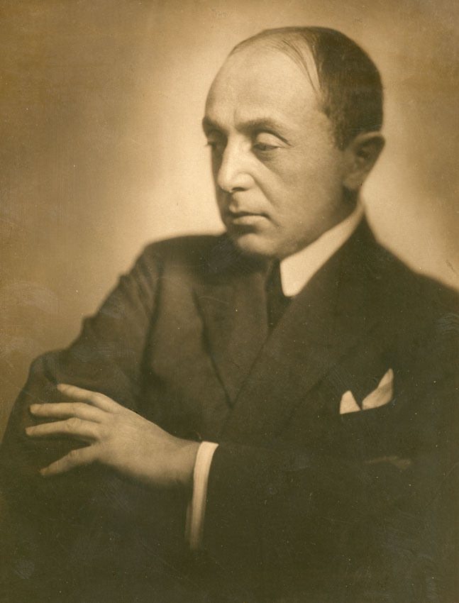
About the poet I.
Szép Ernő (1884-1953)
He was born in 1884 in Huszt as son of a poor country teacher. In his childhood he moved to Debrecen with his parents. After his studies, Szép moved to Budapest at nineteen where he soon became a popular journalist, writer of lyrics and erotic prose. His poetry had two inspirations: the clearly recalled experiences of his childhood and sentimentality.

Slide 9
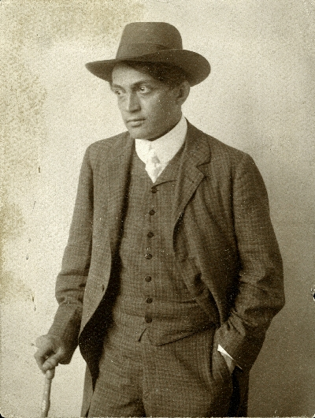
About the poet II.
He published his first collection of poems in 1902.
In 1908 he worked for the newspaper Nyugat, then in 1910 for the Est. In the 1st world war, he worked as a volunteer. He had a good contact with the other poet Endre Ady.
He died in 1953. He was burried in the jewish cemetery of Kozma street.

Slide 10
Thank you for your kind attention!

