Slide 1
Zoltán Zelk
In the evening it is good
Készítette:
Bettina Debreceni
Emese Nedró
Alma Arany
Panka Kiss

Slide 2
Content
„In the evening it is good”
About the writer
About the poem
Other poems

Slide 3
Zoltán Zelk In the evening it is good
In the evening it is good,
After all it is good.
Dad is bathing, Mom is cooking,
It is good to be together.
Slow dance, slow dance,
dances the ceiling,
I may even touch it now,
so shallow it is.
Their dance is round
like a wreath,
a small one even dies,
yet it is not sad.
Slow dance, slow dance,
dances the ceiling,
I may even touch it now,
so shallow it is.
Who is, who is lifting,
cradling me?
Still I would open my eyes,
but it couldn't be.
The world is melted,
but at the center
Mom is sitting, and
on her lap that's me.
But the bed with the chair
is running far away,
like the smoke, all the
black walls fly away.
I'm not afraid, although
would like to cry,
since I'm easy
like the smoke I fly.

Slide 4
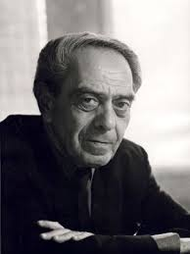
About Zoltán Zelk
He was born in 1906 18 December. Soon, he lost his father. First book of poems was published in 1930. Children's Day also launched Little Drummer title (1952-1956), in which their children's poems have appeared.

Slide 5
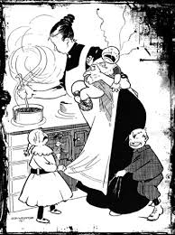
About the poem
He wanted to show the kids what is the literature, the arts , what is the world. His poems were beautiful. He used and concentrated the mother tongue with poetically arranged terms.

Slide 6
Other poems
This poem is that as song, too. Ildikó Vitai is singing it.
His other poems in books: The most famous is : The three rabbit

Slide 7
Thank you for your attention!☺
☺

