Slide 1
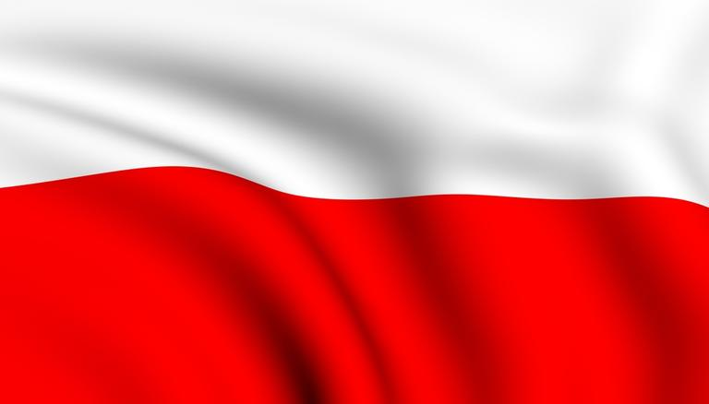
GET TO KNOW POLAND
Aleksandra Michajlow, Maria Rząd, Karolina Wójtowicz & Olga Drwal

Slide 2
INTERESTING FACTS ABOUT POLAND

Slide 3
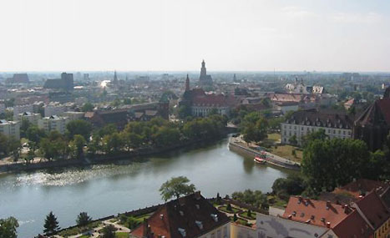
The longest river in Poland is called Vistula.
It’s over 1000 kilometers long.

Slide 4
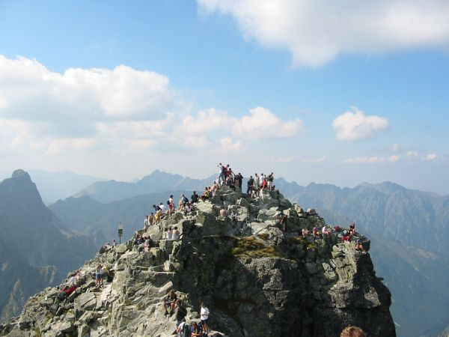
There are two mountain ranges in Poland.
The highest peek (2499m) is called Rysy
and is located in High Tatras.

Slide 5
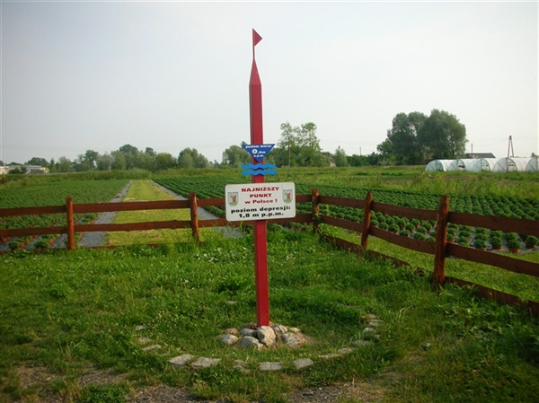
The lowest point in Poland is Raczki Elbląskie
at 1.8m.

Slide 6
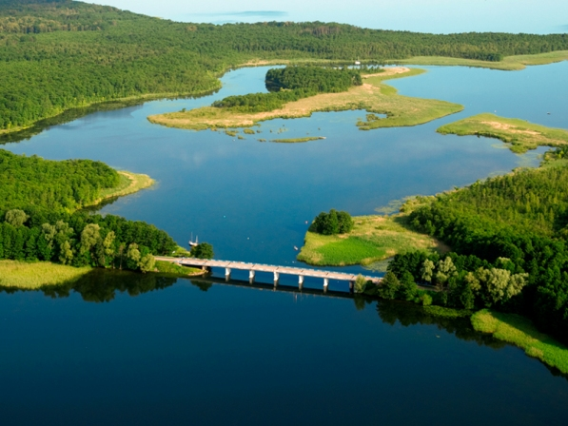
Poland is famous for 2,000 lakes in the region
of Masuria.

Slide 7
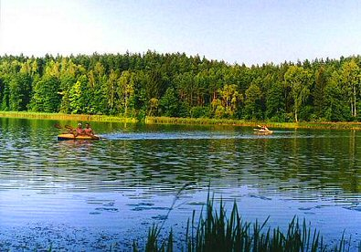
Lake Hańcza is the deepest lake in Poland
with the maximum depth of 108.5m

Slide 8
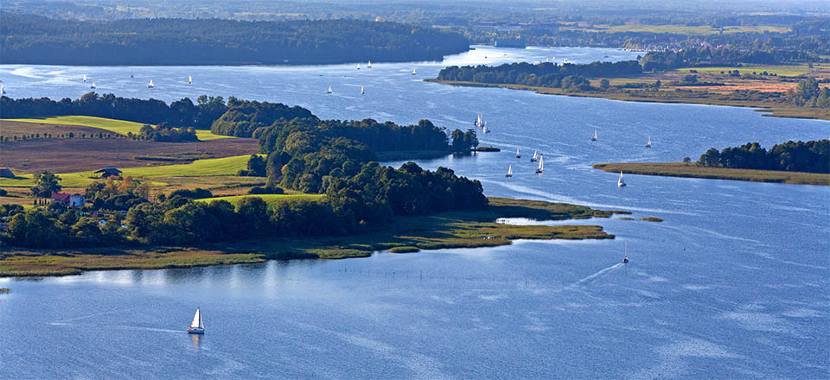
The largest Polish lake is Śniardwy with an area
of 114 square kilometers.

Slide 9
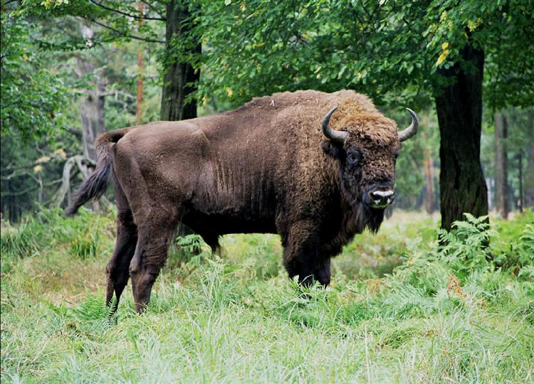
Białowieski National Park is the oldest one
in Poland. European bison is the symbol of it.

Slide 10
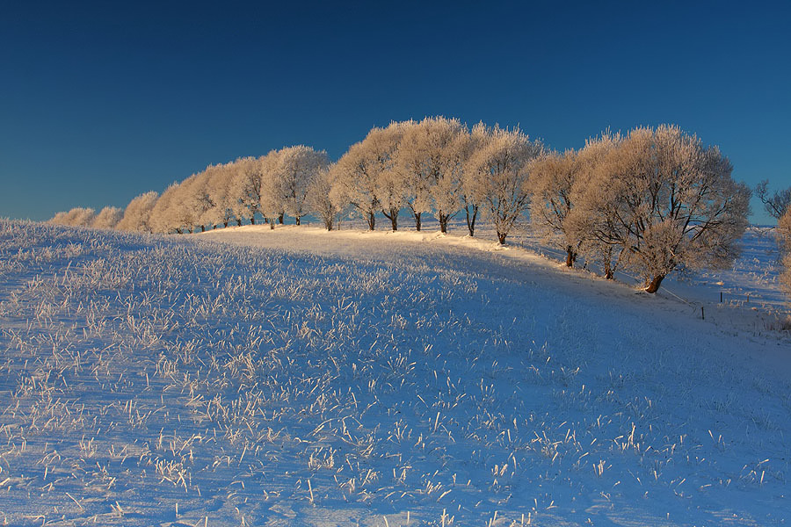
The coldest place in Poland is the town Suwalki in the north-east of the country.

Slide 11
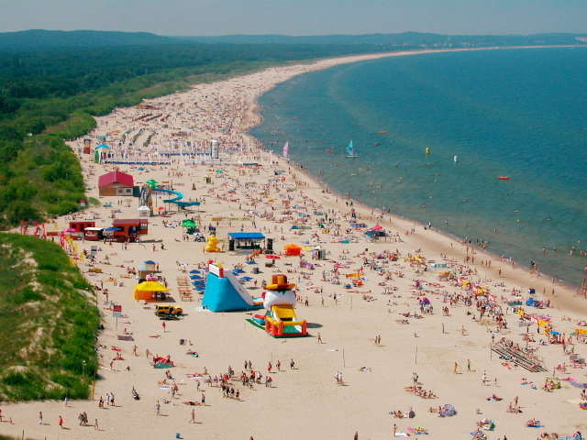
The Polish Baltic Coast is approximately 530km
long. The widest beach is located in Swinoujscie
that is 130m wide.

Slide 12
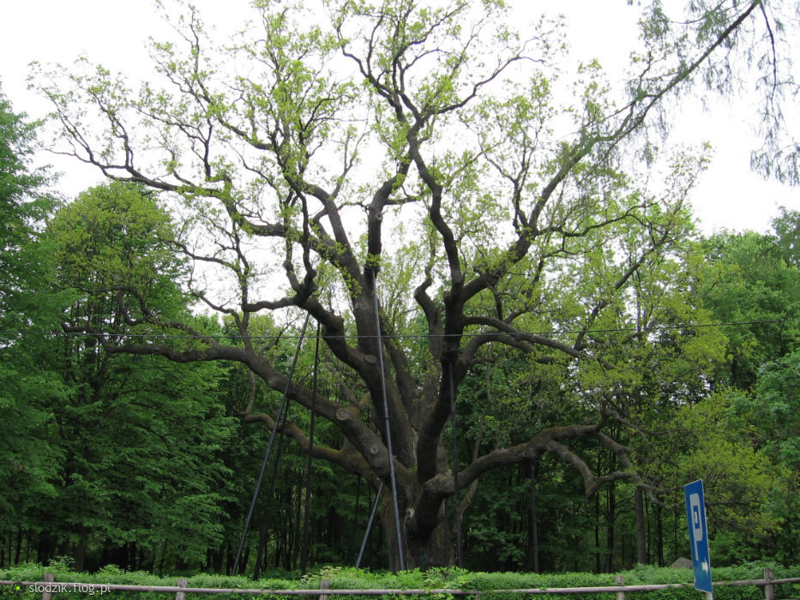
Bartek Oak is the most popular tree in Poland.
It’s over 600 years old.

Slide 13
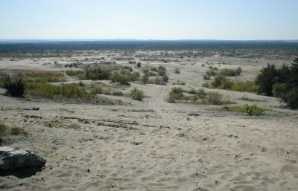
Błędów Desert is the only desert in Poland and is thought to be the only natural one in Europe.

Slide 14
DO POLAND AND HUNGARY HAVE SOMETHING IN COMMON?

Slide 15
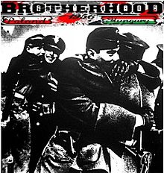
On March 12 in 2007, Hungary’s parliament
declared March 23
the „Day of Polish-Hungarian Friendship”

Slide 16
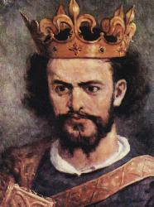
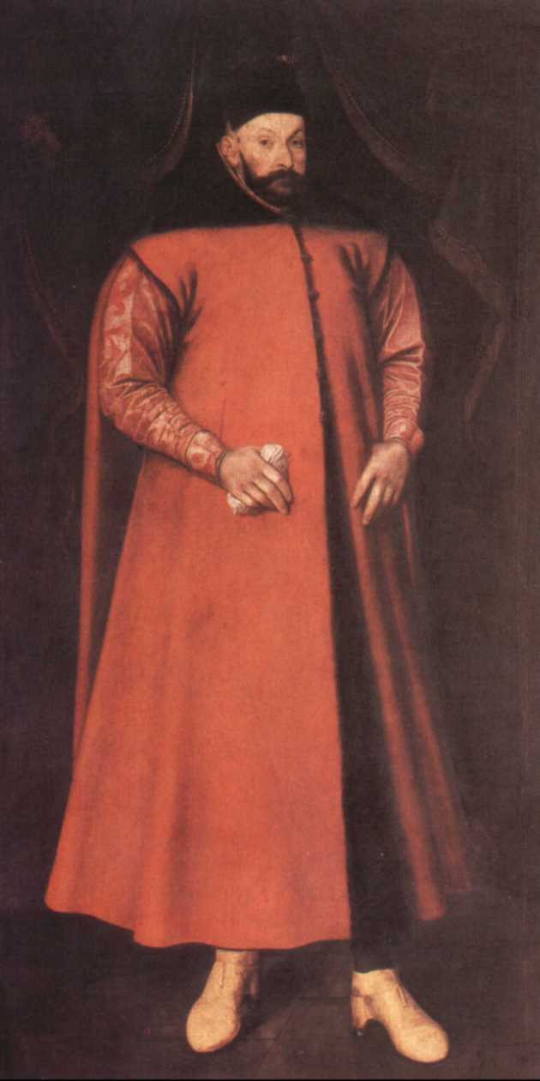
Louis the Great King of Hungary became the king of Poland in 1342.
In the 16th century Poland elected Hungarian nobleman as the king.

Slide 17
SPORT IN POLAND

Slide 18
FOOTBALL
Football is the national Polish sport. Our first, the most significant win was in 1972, when we got a gold medal in Olimpic Football Tournament. In this competition Hungarians were on the second place. Afterwards we got silver medal in the same competiton, two bronze medals in the World Cup and silver medal in Olimpic Football Tournament. Nowadays Polish national football isn’t successful at all.
A few players of our national team play in one of the best clubs in the world, for example, Robert Lewandowski, Wojciech Szczęsny, Jakub Błaszczykowski, Łukasz Piszczek.

Slide 19
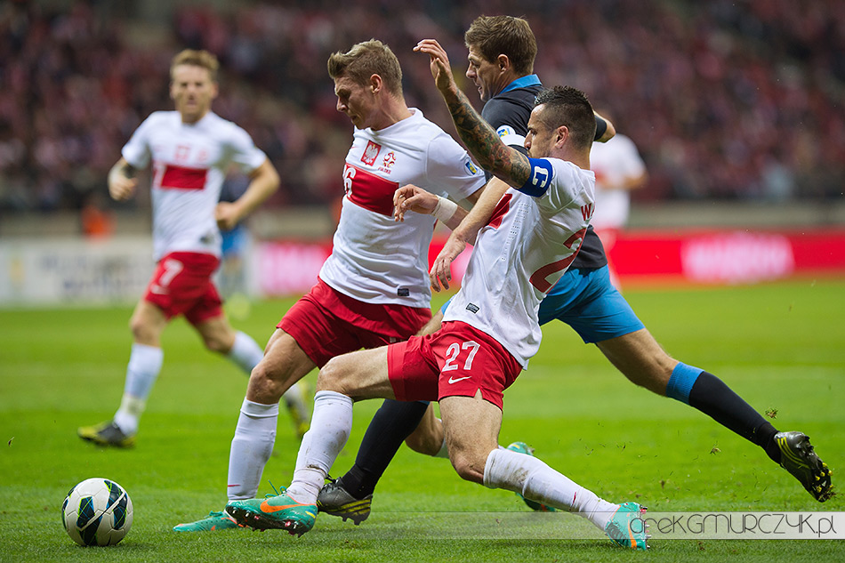

Slide 20
VOLLEYBALL
Volleyball is one of the most popular sports in Poland. We are well-known because of our volleyball players, who have got many successes in that discipline. In this year, we had organised the world championship, which we we won. Until now we had received 5 gold, 8 silver and 3 brozne medals in different tournament. Our national team have worked with the French couch, Stéphane Antiga, for only one year.

Slide 21
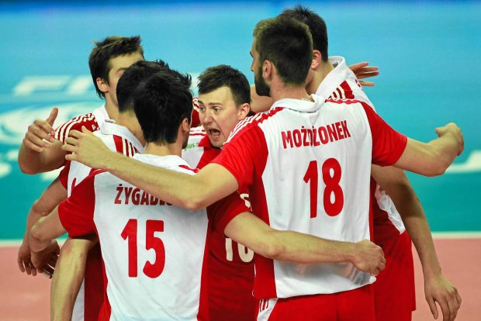
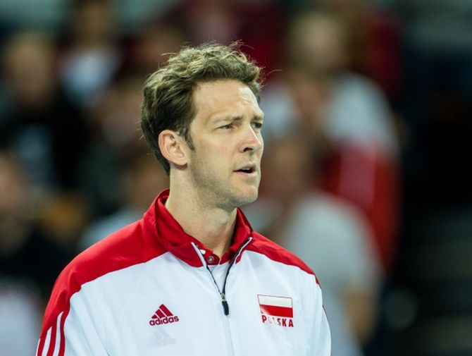

Slide 22
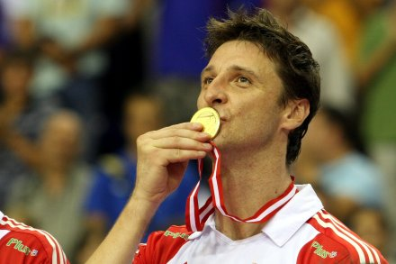
Piotr Gruszka is the player who takes parts the most frequently in matches.
He participated in 450 matches and also in dance competition 'Dancing with the stars”.

Slide 23
Poles are really keen on watching winter sports in TV. Especially ski jumping and cross-country.
Adam Małysz used to be a brilliant ski jumper, but now he doesn't jump and his follower is Kamil Stoch, who is the current world champion and the double Olympic champion.
Justyna Kowalczyk is a only cross country skier, who won the Tour de Ski four times without any break. She has got 7 gold, 5 silver and 4 bronze medals mainly in olimpic games and world championships.

Slide 24
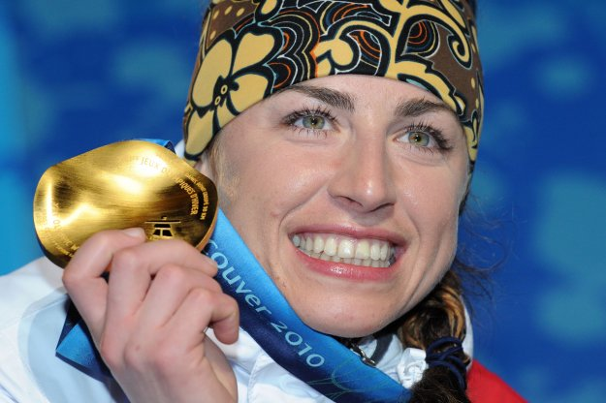
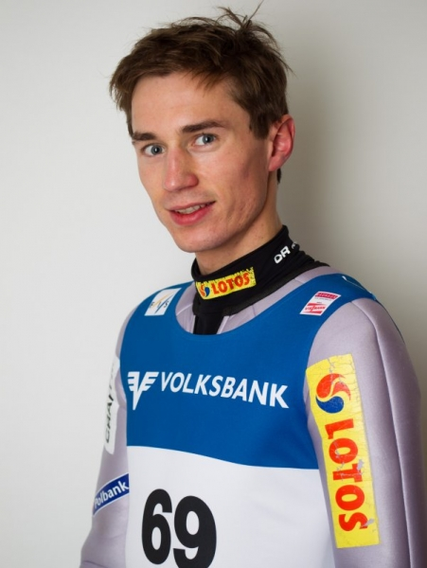
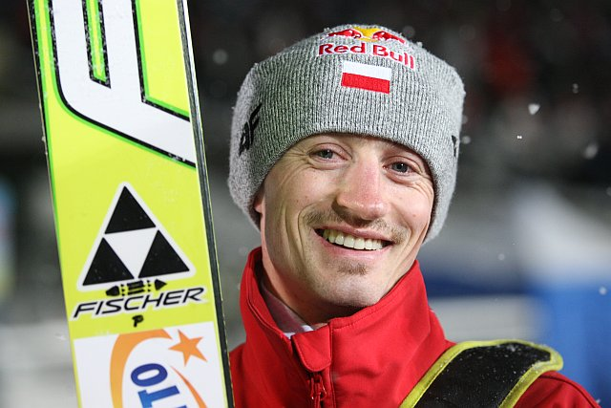

Slide 25
famous monuments

Slide 26
St. Mary's Basilica, Krakow
Roman Catholic
Gothic-style
completed in 1347
a trumpet signal—called the Hejnał mariacki

Slide 27
Palace of Culture and Science
tallest building in Poland (237 m)
completed in 1955

Slide 28
Royal Baths Park in Warsaw
76 hectares
Palace on the Water
Roman theater
White House
Myślewicki Palace

Slide 29
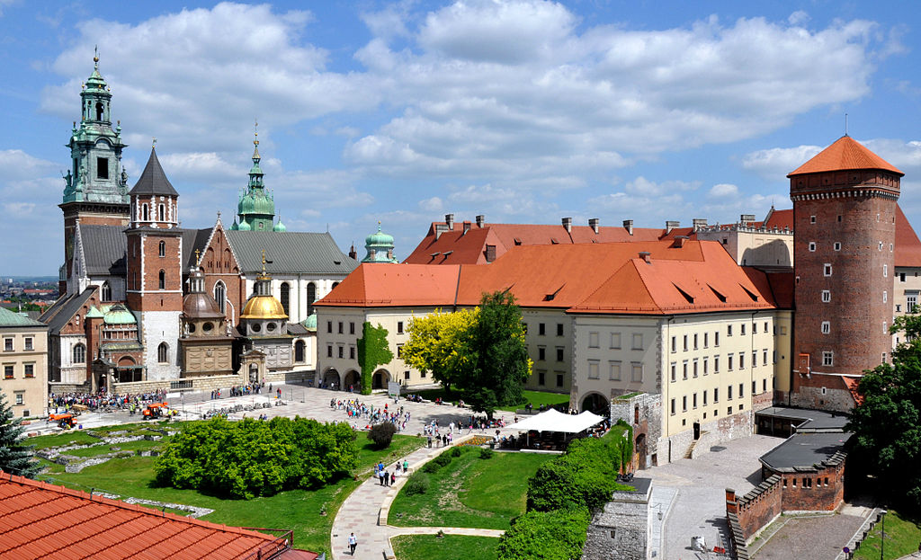
Wawel Castle
Situated in Wawel Hill
royal residence
Historical museum
Renaissance style

Slide 30
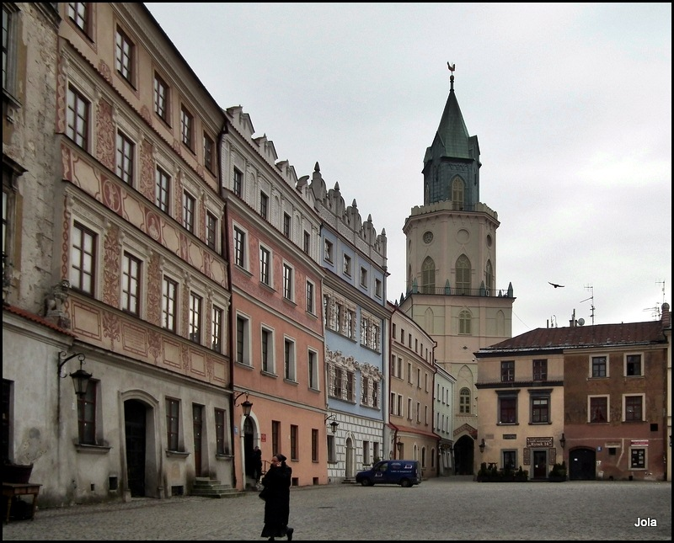
Lublin Old Town
Krakowska Gate
Grodzka Gate
Trinitarian Tower
Castle square
Townhouses

Slide 31
Famous people from
POLAND

Slide 32
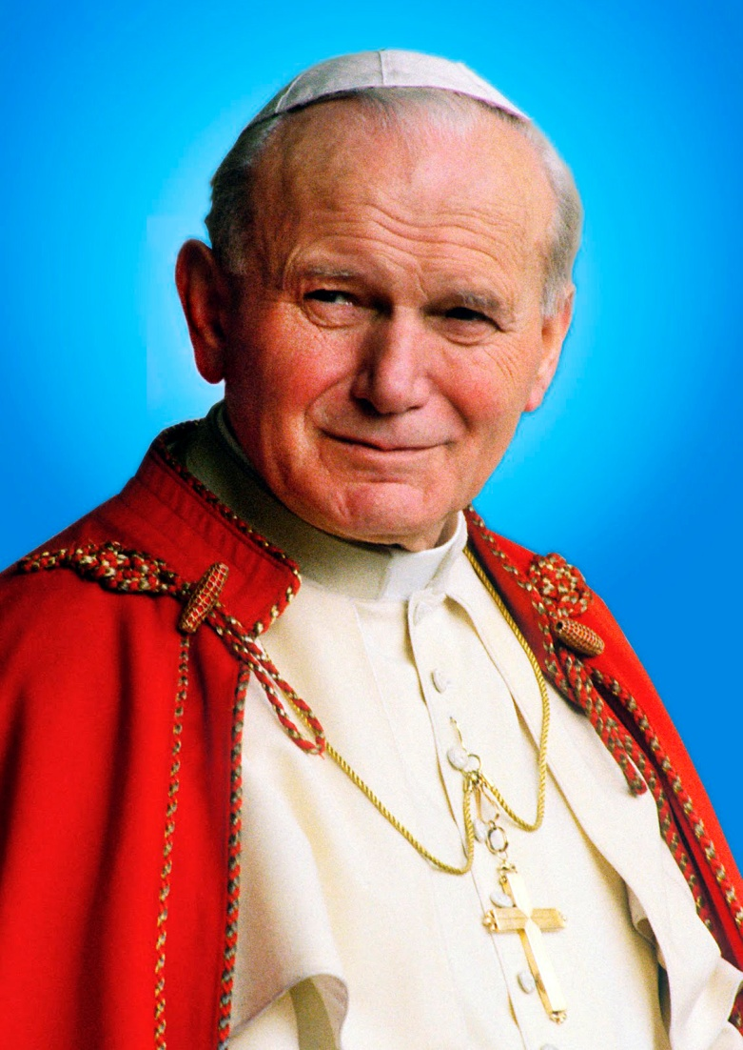
Jan Paweł II (Karol Wojtyła)
born in 1920, died in 2005
the Pope of Catholic Church

Slide 33
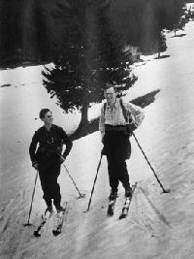

Slide 34
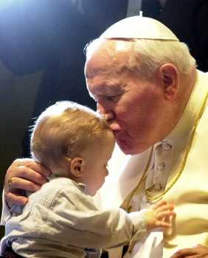

Slide 35
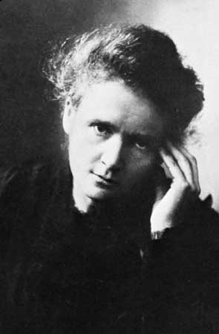
Maria Skłodowska - Curie
1867 – 1934
lived in Paris with her husband
discovered two chemical elements
won a Nobel Prize twice

Slide 36
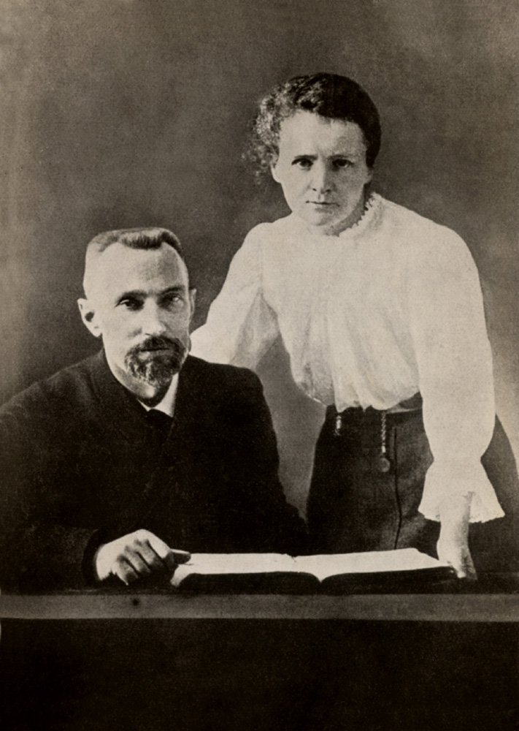

Slide 37
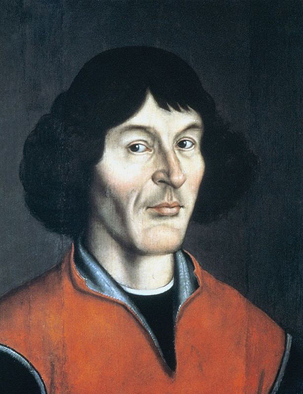
Mikołaj Kopernik
born in 1473 in Toruń
heliocentric theory

Slide 38
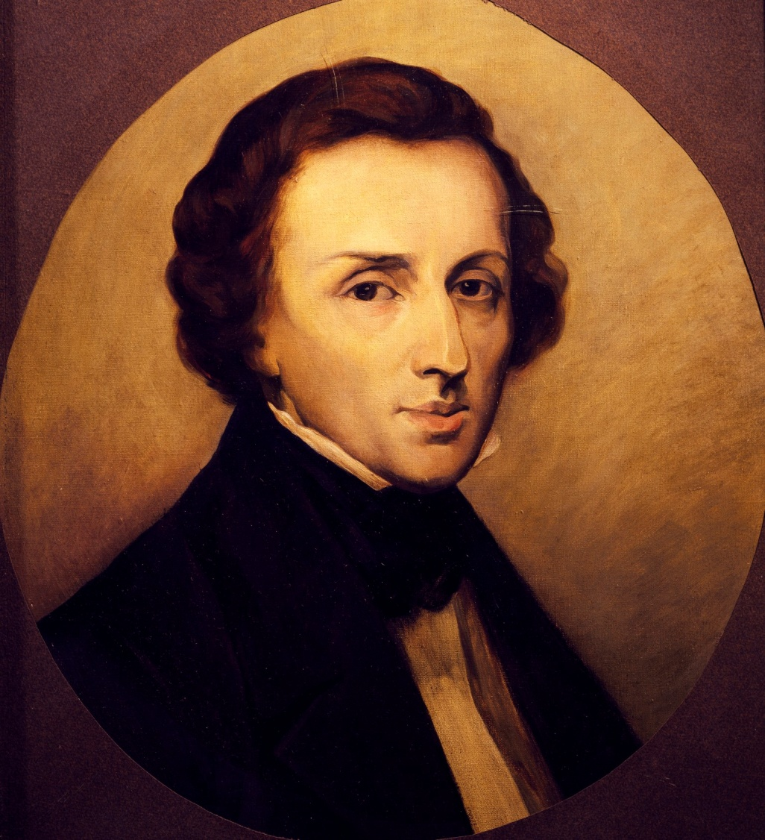
Fryderyk Chopin
1810 (Żelazowa Wola) – 1849 (Paris)
great composer and pianist

Slide 39
